Slide 1
AIT Lighting Spectra
Chris Elvidge
AIT Nighttime Remote Sensing
Lecture 6 a
January 18, 2024

Slide 2
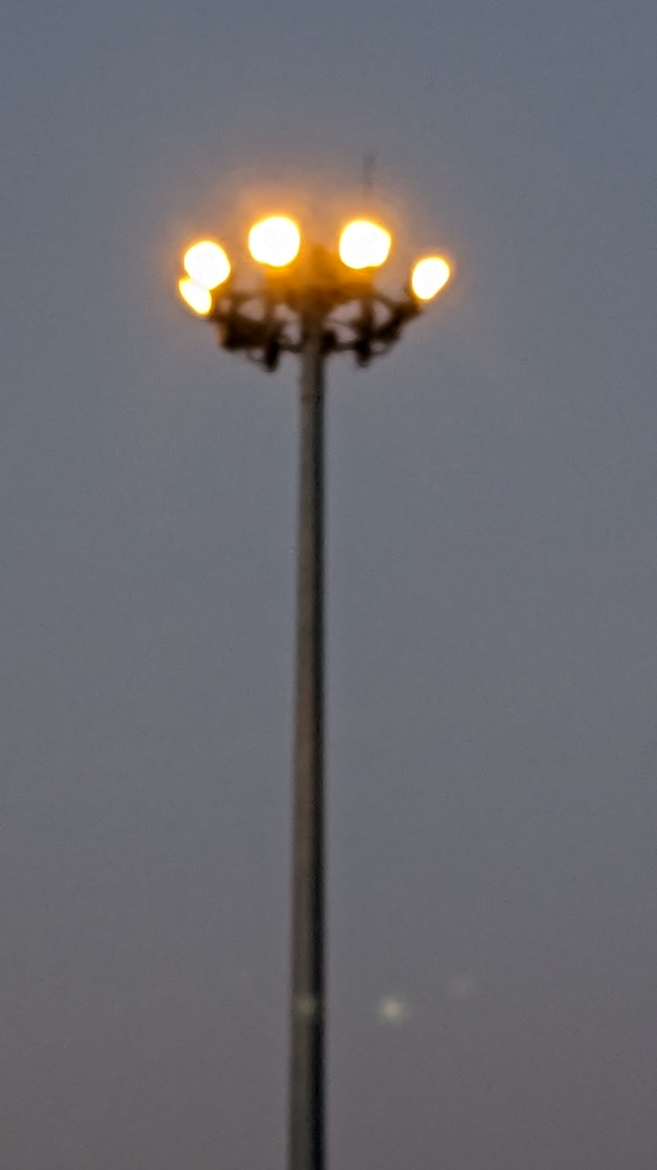
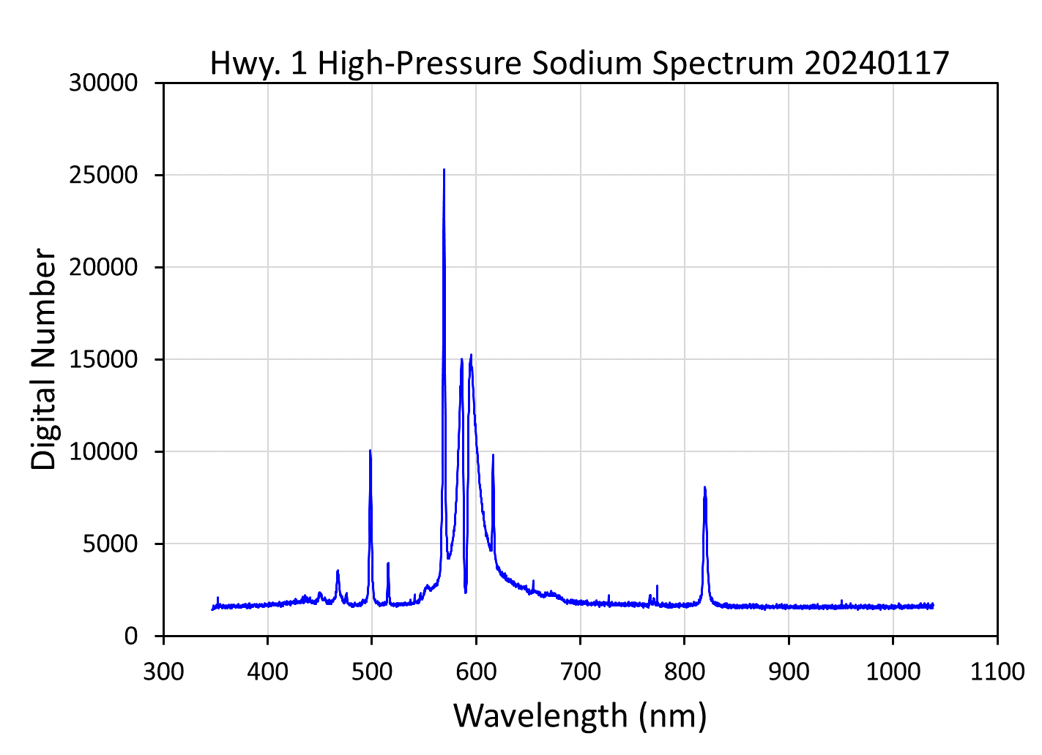

Slide 3
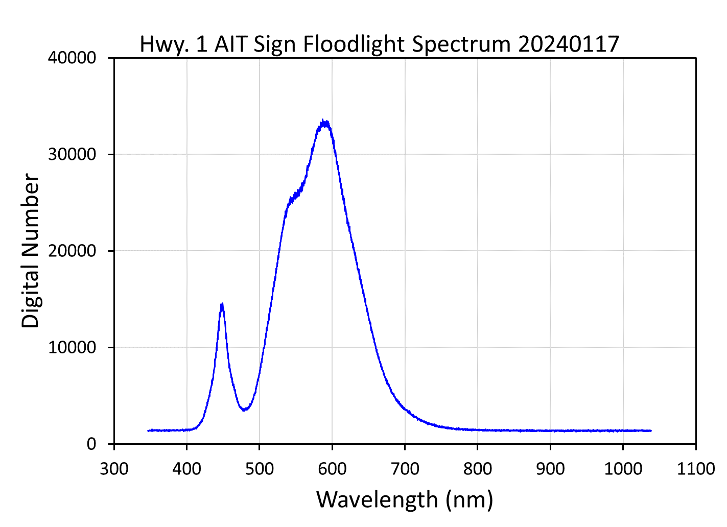
Hwy. 1
AIT Sign Floodlight

Slide 4
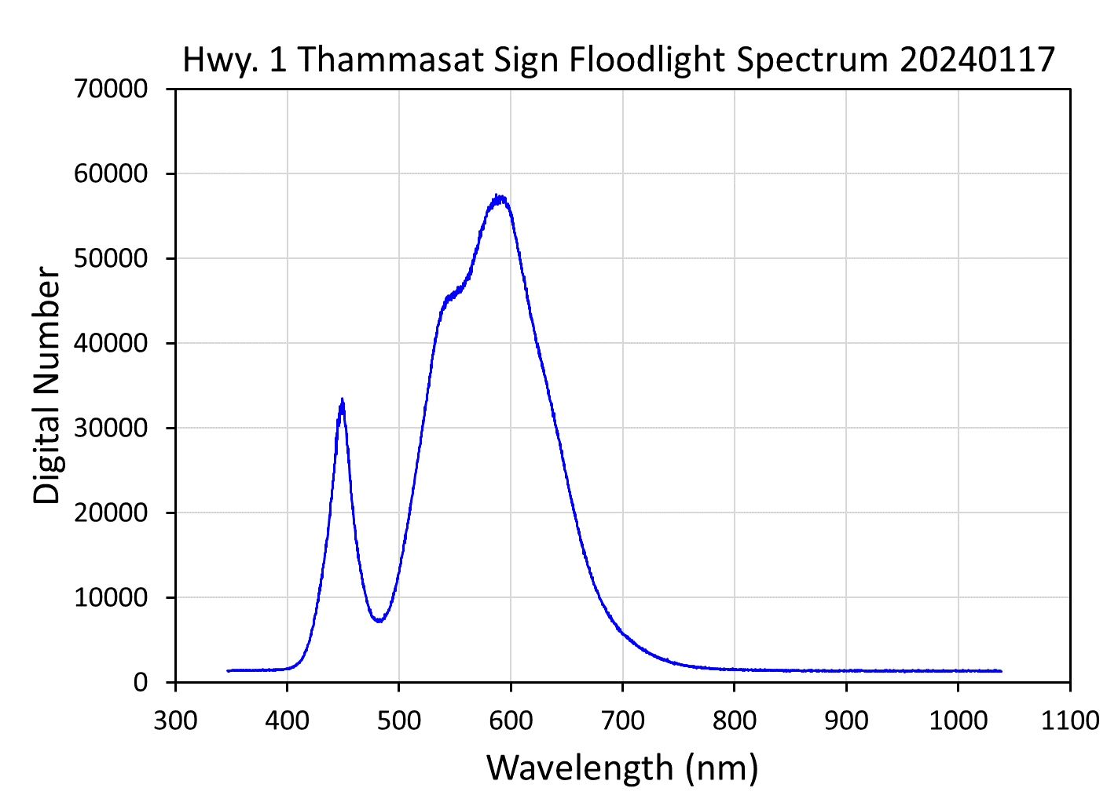
Hwy. 1 Thammasat Sign Floodlight

Slide 5
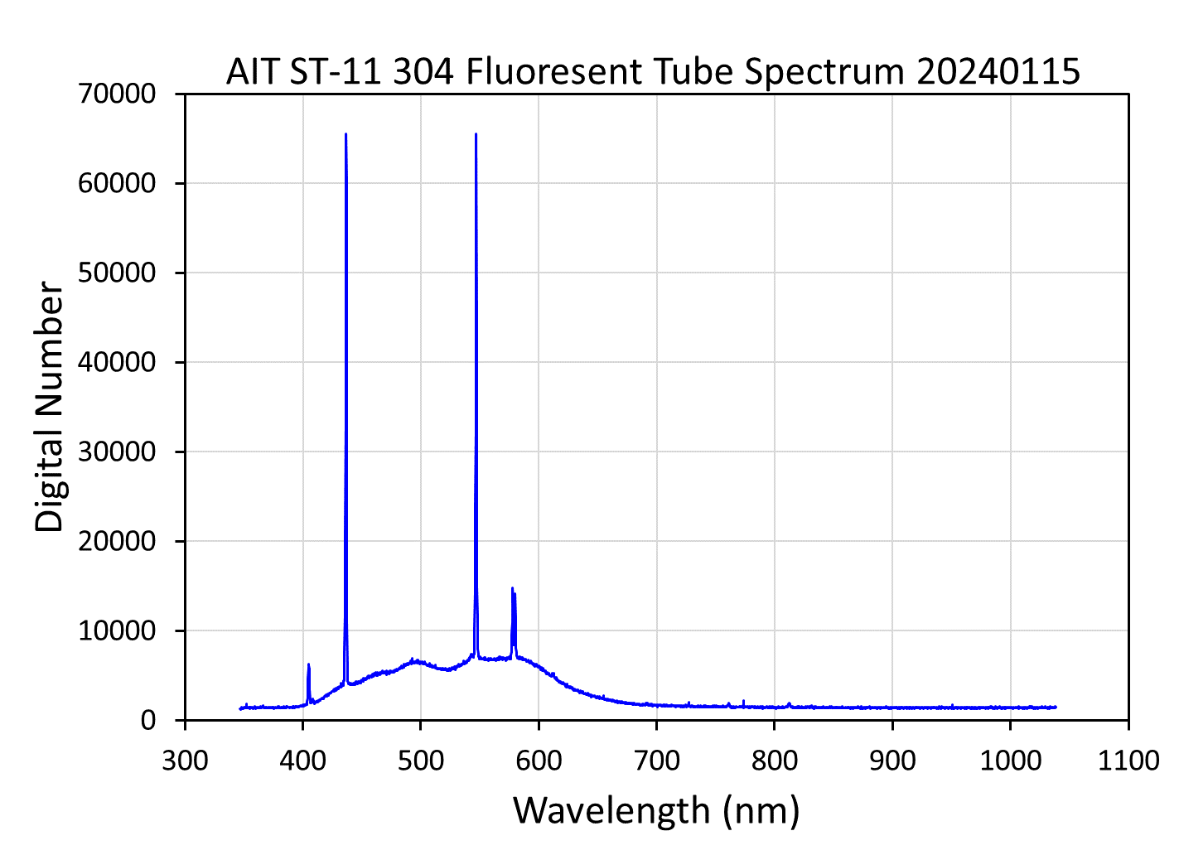
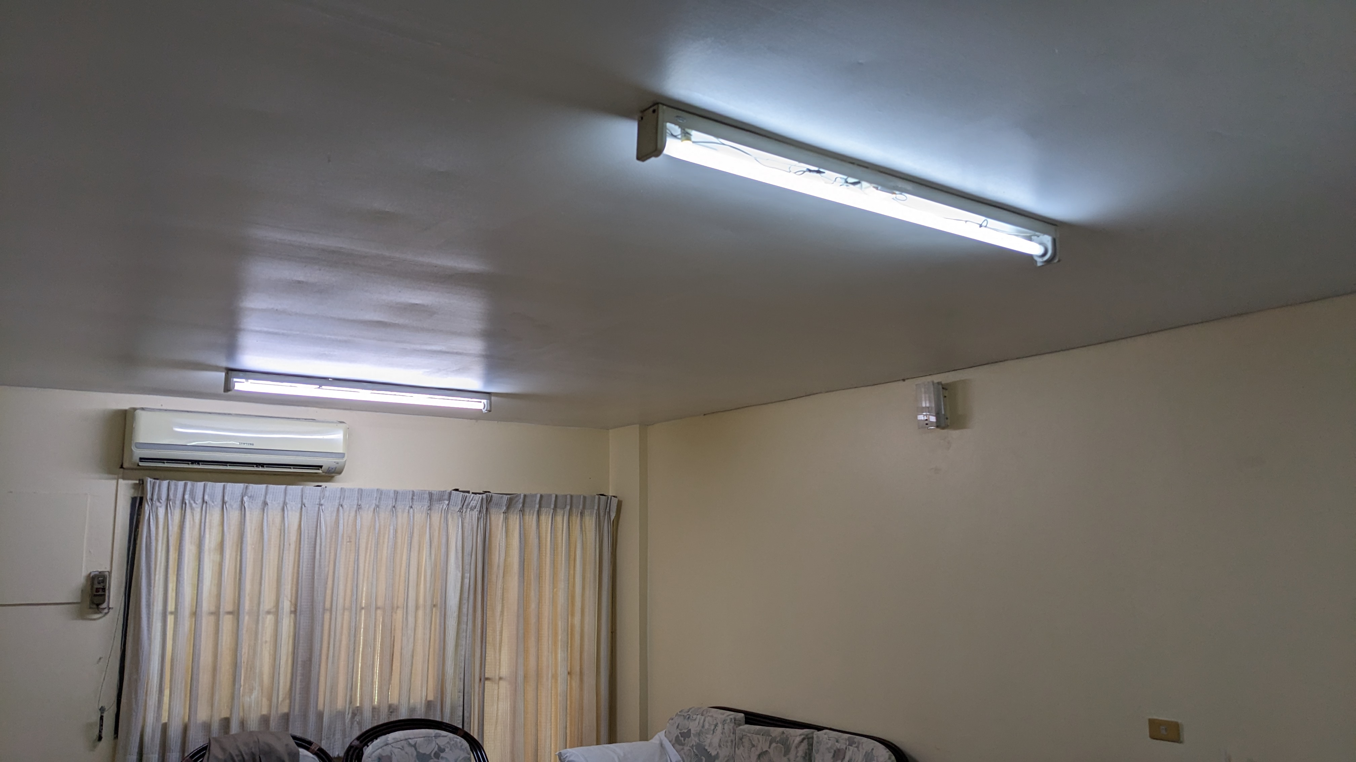
AIT ST-11 304 Fluorescent Tube Lights

Slide 6
