Slide 1
VIIRS MODTRAN Atmospheric Corrections
Mikhail Zhizhin and Christopher D. Elvidge (celvidge@mines.edu)
Earth Observation Group
Payne Institute for Public Policy
Colorado School of Mines
January 23, 2024

Slide 2
Outline
Rationale for atmospheric correction
MODTRAN inputs
VIIRS band transmissivity from a single day
Atmospheric effects on VNF calculations

Slide 3
Rationale for an Atmospheric Correction
While the VIIRS bands are placed in relatively clear atmospheric windows – some portion of the radiance emitted by a flare is absorbed and scattered by the atmosphere.
There is a wavelength dependency that is based on the composition of the atmosphere and the path length.
The MODTRAN model calculates the transmissivity of the atmosphere at fine spectral resolution.
The transmissivity for well mixed gases, such as nitrogen, oxygen and carbon dioxide can be modeled either with single standard atmosphere or a small set of latitudinal / seasonal atmospheres.
External sources are required to parameterize MODTRAN for the calculation of transmissivity effects of atmospheric constituents with high spatial and temporal variability – such as water, ozone, and aerosols.
From the MODTRAN transmissivity spectra – the percent transmissivity for individual VIIRS spectral bands are calculated.
An atmospheric correction is performed by dividing the “top-of-atmosphere” radiance by the band specific transmissivity.
This adjustment affects the temperature, source area and radiant heat calculations from VIIRS nightfire (VNF).
An atmospheric correction is crucial to the triple curve Planck curve fitting performed by VNF version 4 – which identifies pixels having two major infrared emitters along with the background. The primary emitter is hotter and is typically the flare. The source of the lower temperature secondary emitters found at flaring sites is to-be-determined.

Slide 4
Key total atmospheriec column inputs to MODTRAN
Precipitable water – from the NOAA National Center for Environmental Prediction (0.25 degree on 6 hour increments) or the Advanced Technology Microwave Sounder (ATMS) flying with VIIRS
Ozone – from NOAA’s Global Forecast System (GFS) or the Ozone Mapping and Profiler Suite (OMPS) flying with VIIRS
Aerosol Optical Depth – from the U.S. Navy

Slide 5
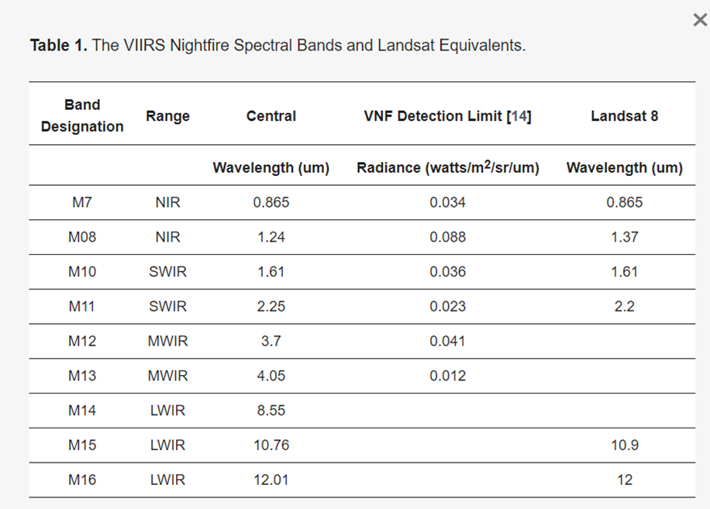
VIIRS M-bands collecting at night

Slide 6
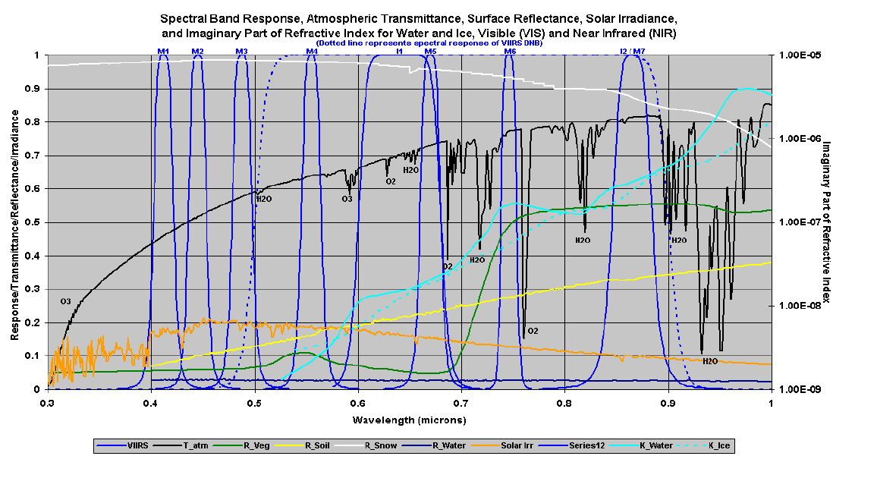
VIIRS Bands M1-M7 and DNB Placed in Clear Atmospheric Windows

Slide 7
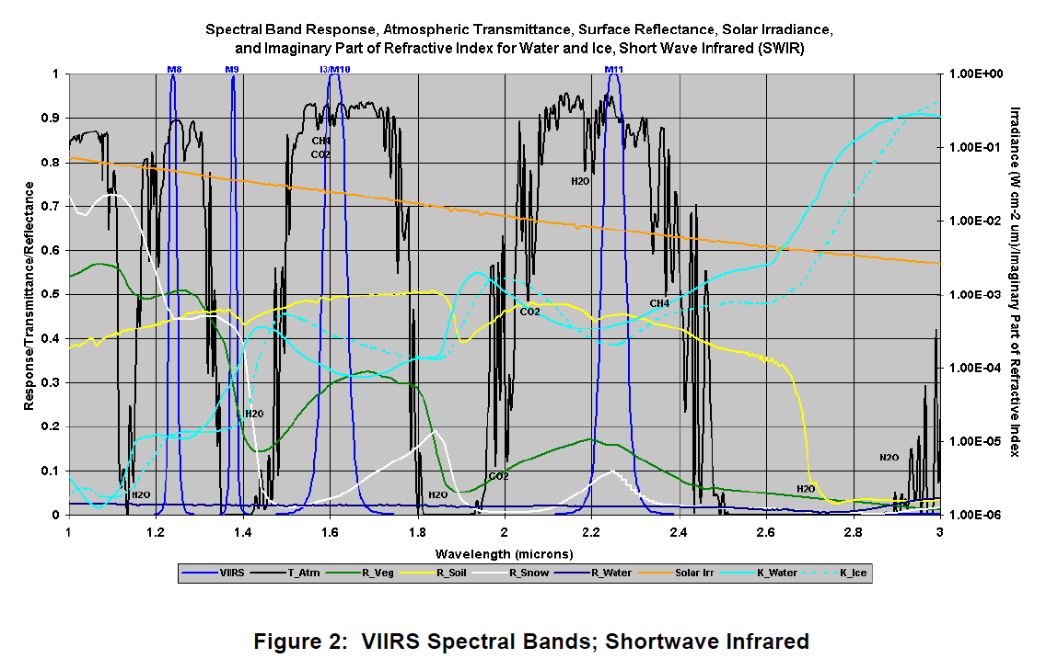
VIIRS Bands M8-M11 Placed in Clear Atmospheric Windows

Slide 8
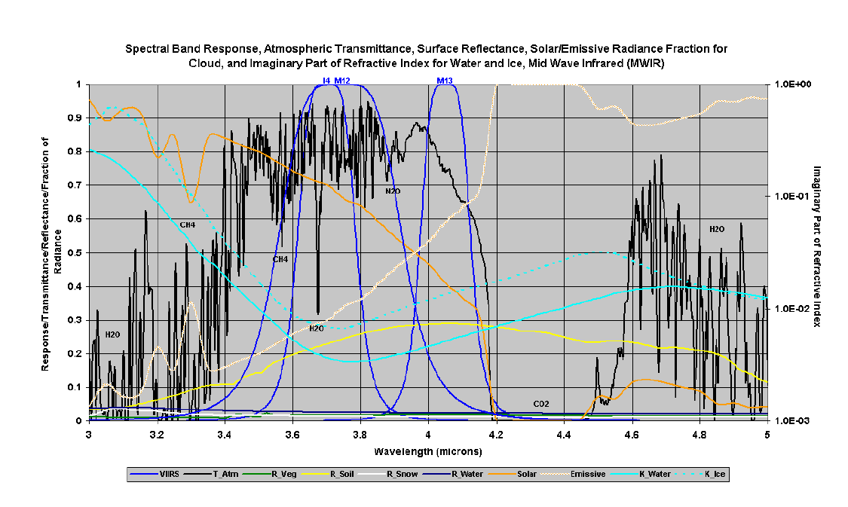
VIIRS MWIR Bands Placed in Not-so Clear Atmospheric Windows

Slide 9
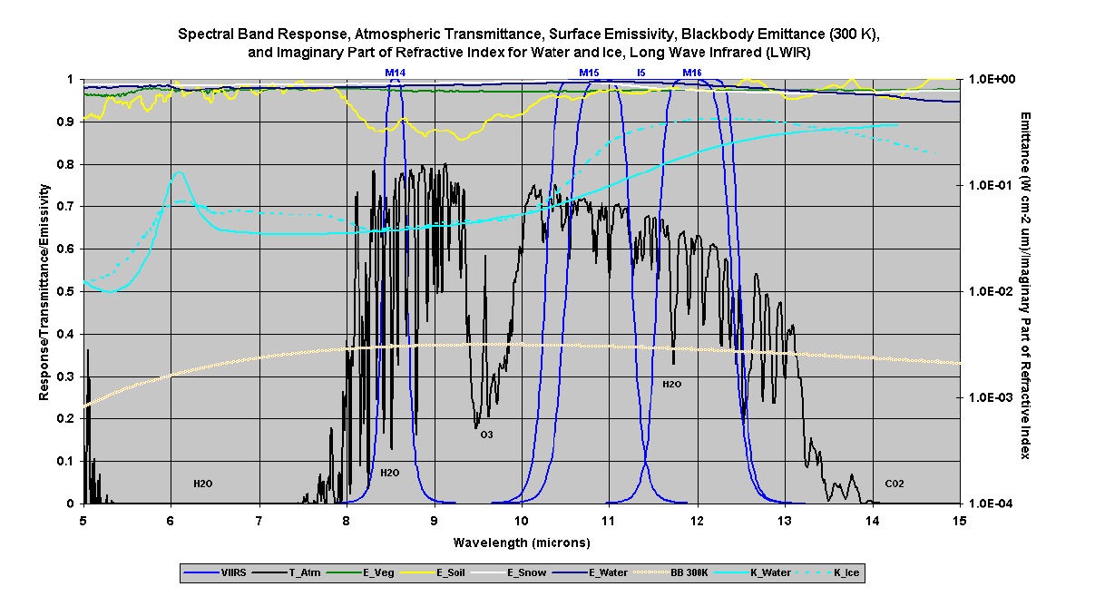
VIIRS LWIR Bands Placed in Not-so Clear Atmospheric Windows

Slide 10
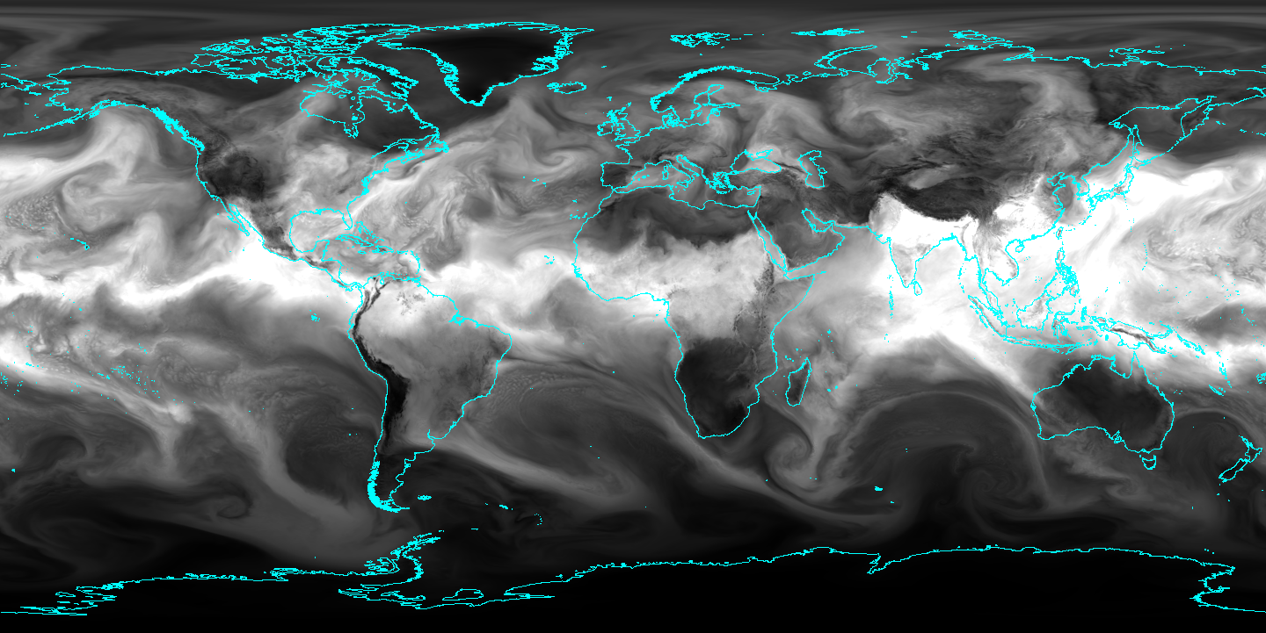
Precipitable Water

Slide 11
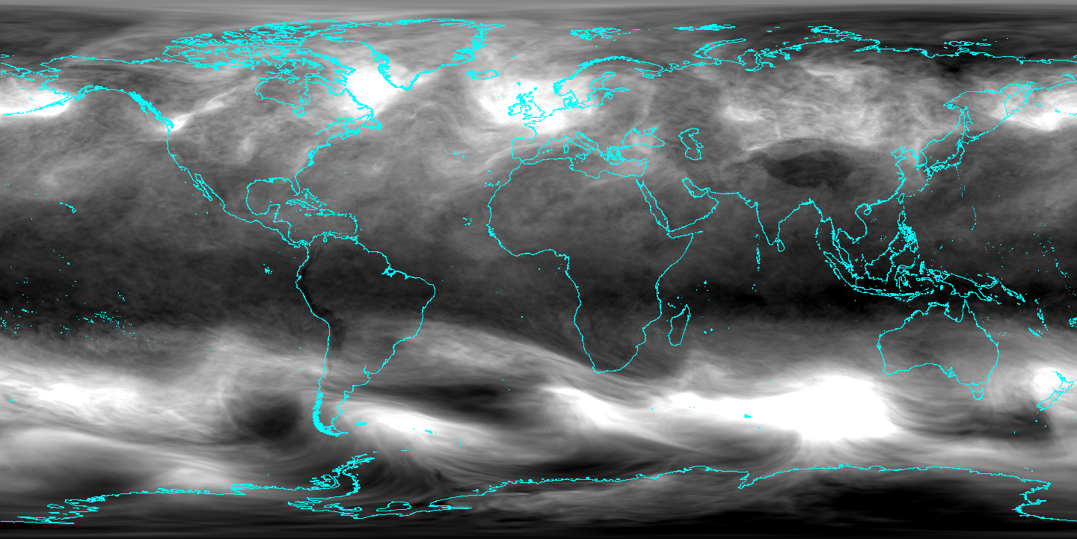
Ozone

Slide 12
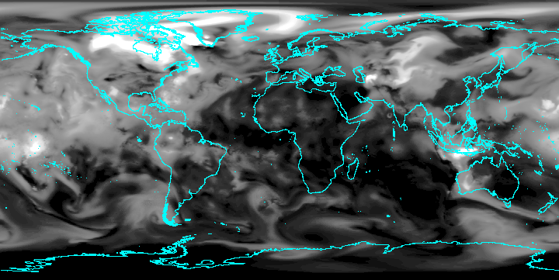
Aerosol Optical Depth

Slide 13
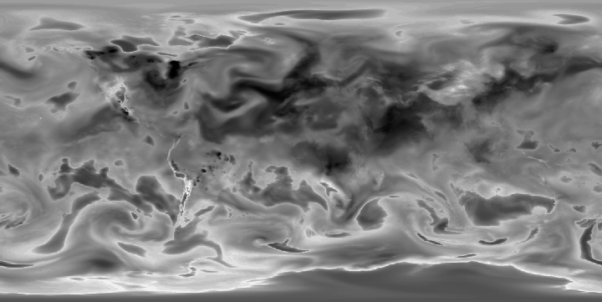
DNB single day transmissivity October 31, 2022

Slide 14
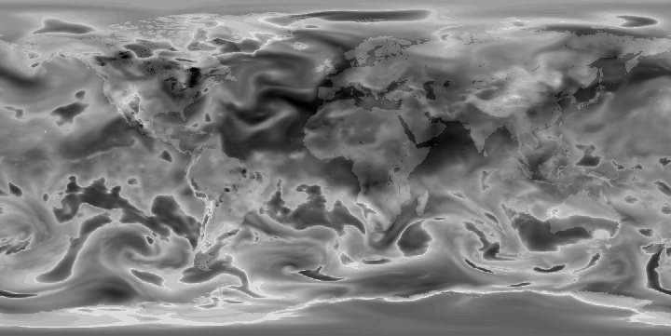
M10 single day transmissivity October 31, 2022

Slide 15
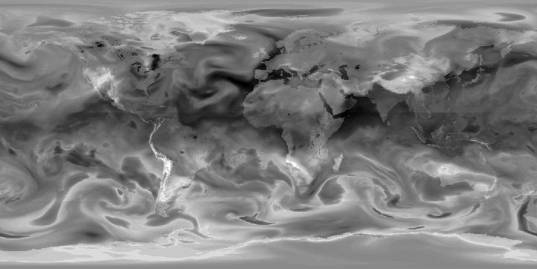
M13 single day transmissivity October 31, 2022

Slide 16
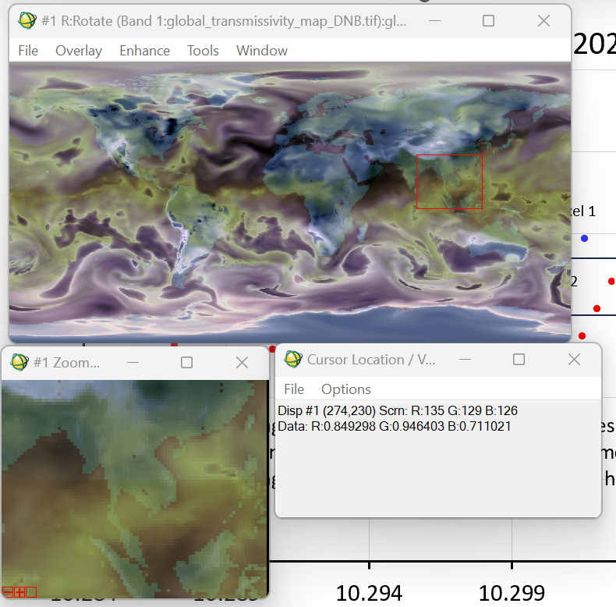
In Bangkok on October 28, 2022 DNB transmissivity = 84% M10 = 95 % M13 = 71 %

Slide 17
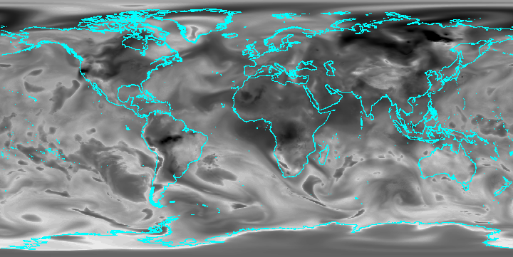
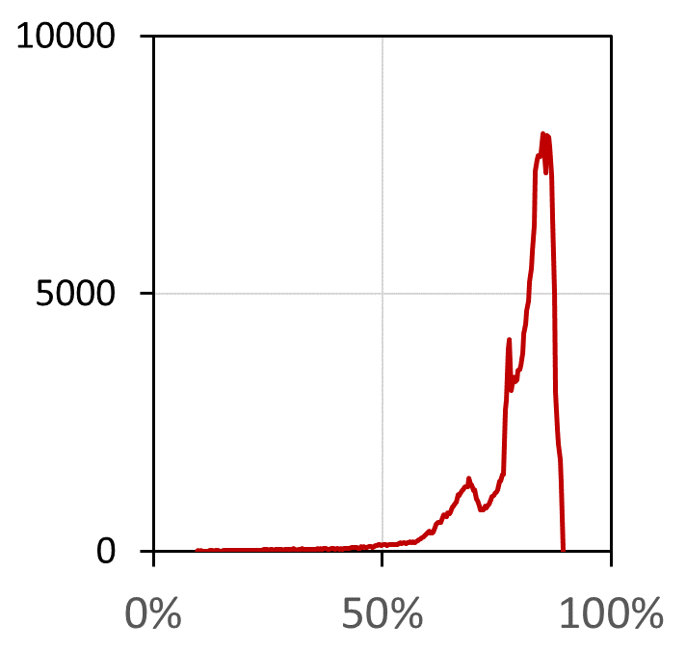
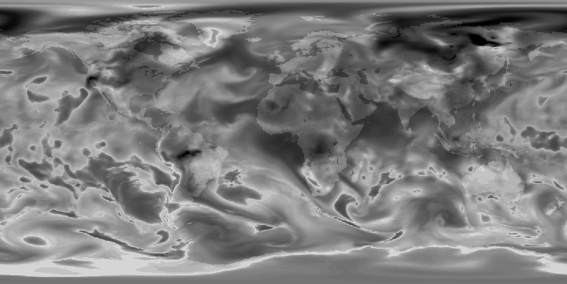
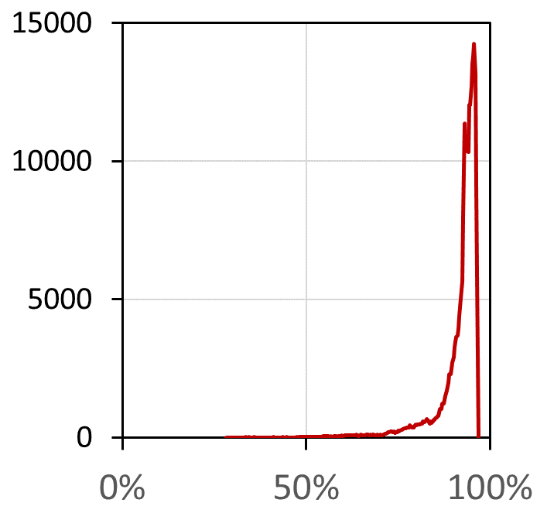
Atmospheric Transmissivity in short wavelength VIIRS bands Nadir view October 31, 2022
DNB 0.7 um
M10 1.65 um

Slide 18
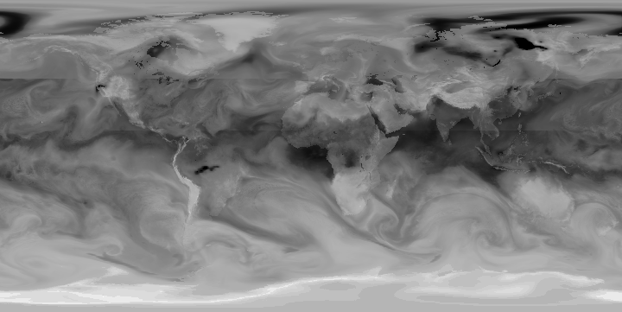
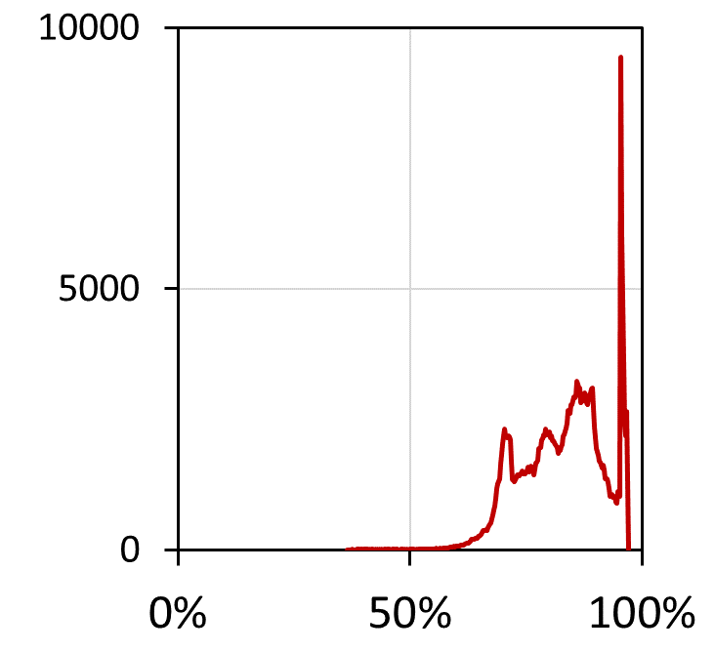
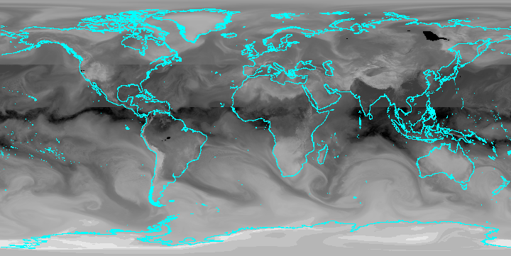
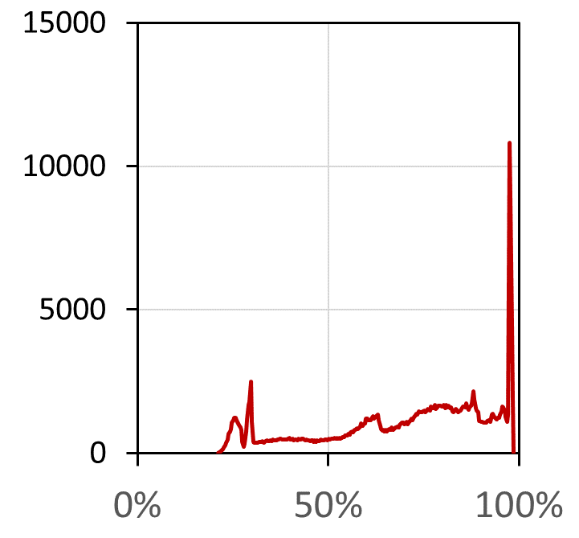
Atmospheric Transmissivity in thermal wavelength VIIRS bands Nadir view October 31, 2022
M12 3.7 um
M16 12 um

Slide 19
Transmissivity spectra calculated for top 30 flares for August 8, 2021
Nigeria
Algeria

Slide 20
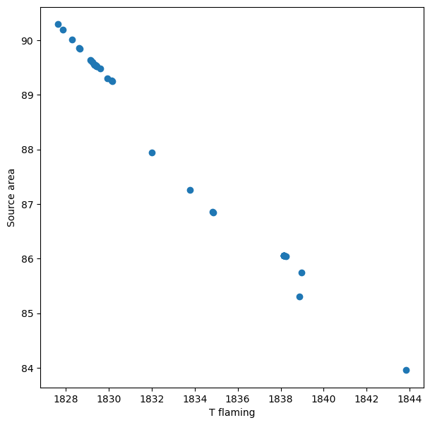
Simulation of Atmospheric Effects On 100 m² flare at 1810 K Temperature increases – source area decreases – radiant heat decreases
Russia
Algeria
Iraq
Iran
Venezuela
Mexico
Nigeria

