Slide 1
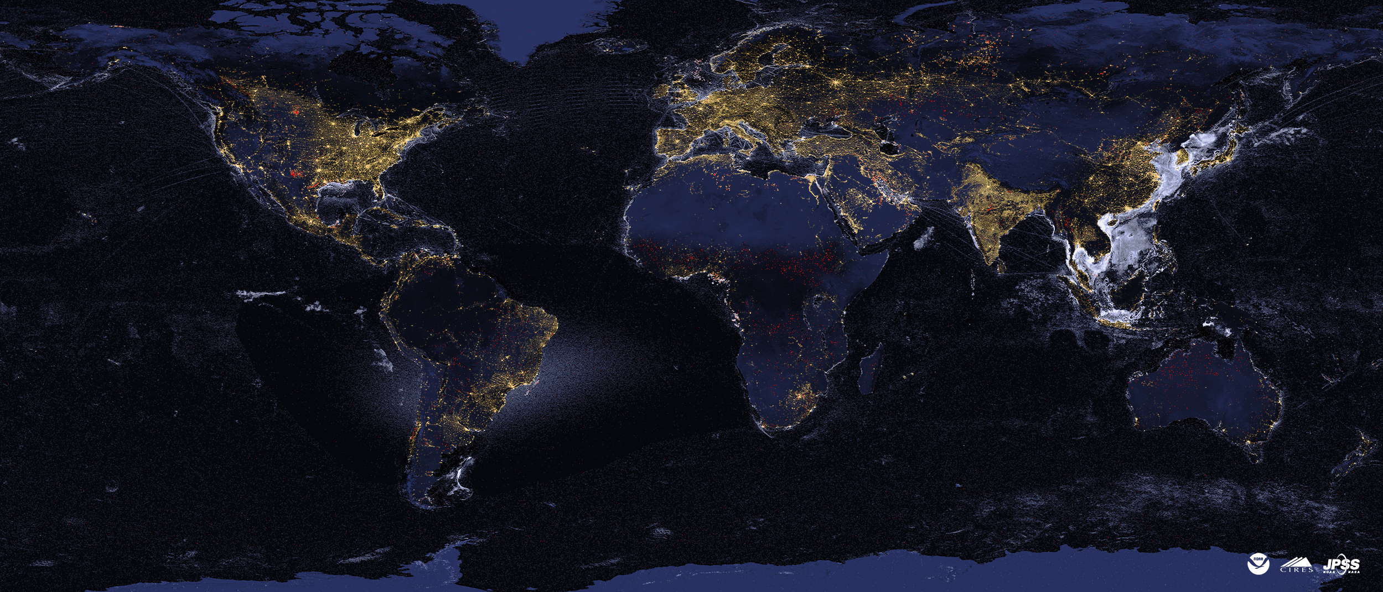
Satellite tracking of industrial activity worldwide with nighttime VIIRS data
Christopher Elvidge
AIT Nighttime Remote Sensing
Lecture 3-c
celvidge@mines.edu
January 11, 2024

Slide 2
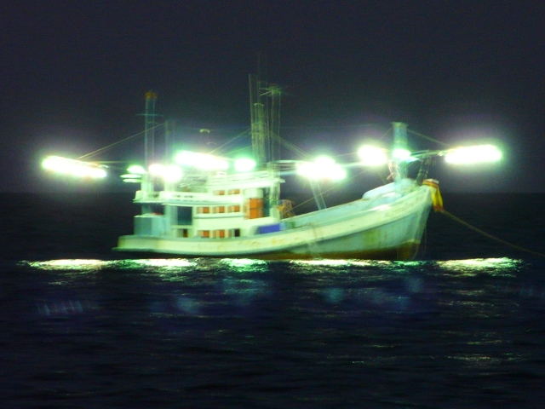
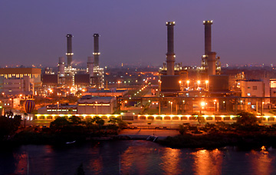
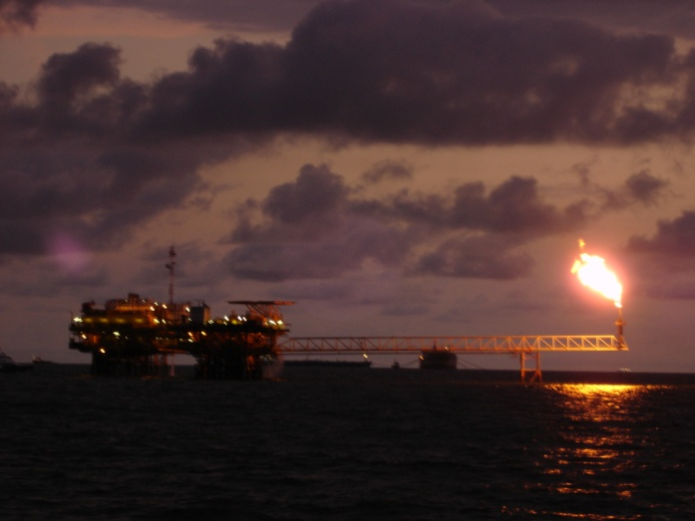
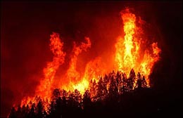
Lights
At
Night!
Boats
Cities and human
settlements
Industrial Sites
Gas Flares
Fires

Slide 3
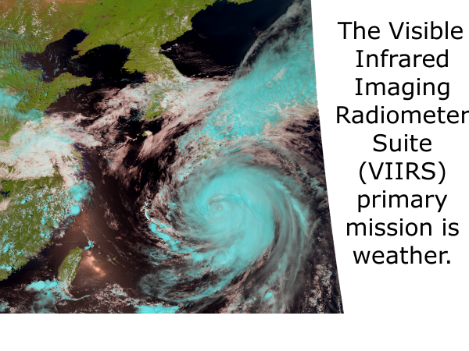

Slide 4
The VIIRS day/night band (DNB) collects low light imaging data in the visible at night to enable detection of moonlit clouds. Electric lighting, fires and flares are also detected.
Thank you, meteorologists!
Manila, March 23, 2016

Slide 5
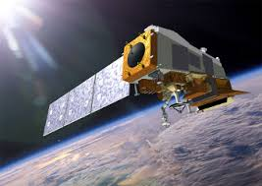
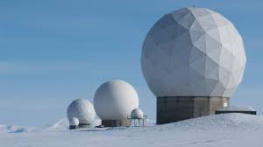
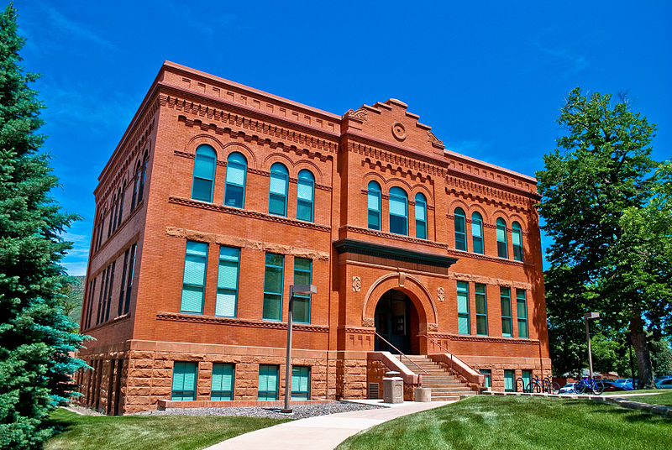
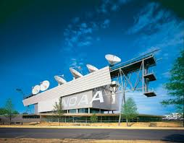
EOG ingest VIIRS data about two hours after the collection
VIIRS in 101 minute long orbit
Download once per orbit at
Svalbard ground station
Data arrive at Mines about 2 hours after the collection
Via undersea data cables
GRAVITE
Data Pool
NOAA’s National Satellite Operations Facility (NSOF), Suitland, Maryland
VNF email alerts sent about four hours after the collection
Primary customer is NOAA’s
National Weather Service

Slide 6
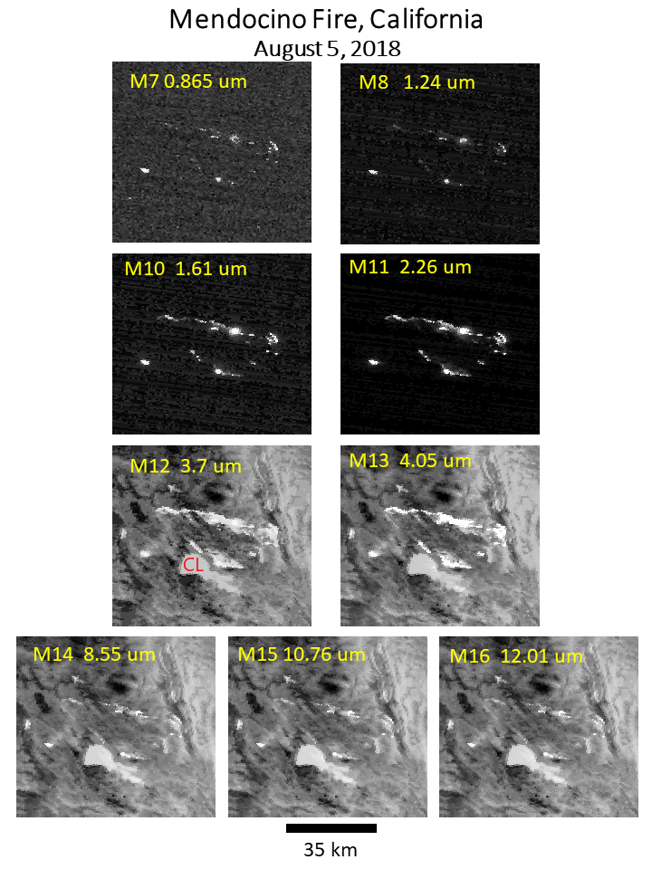
VIIRS is unique in collecting data in four near and shortwave infrared channels at night. These channels are designed for daytime imaging. At night – they serve as super-detectors for infrared emitters!

Slide 7
If an object fills the field of view – its temperature can be calculated from the radiance in a single spectral band
Plank curve lines for full pixel objects do not cross each other. Thus, the objects temperature can be calculated with the observed radiance in a single spectral band. The situation is more complicated for subpixel IR emitters.

Slide 8
VIIRS Nightfire (VNF): A global multispectral fire product
Derived from nine channels of data collected at night

Slide 9
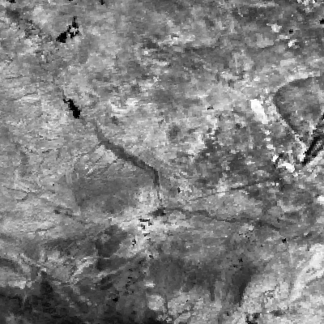
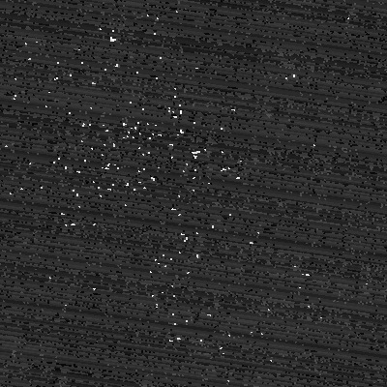
For gas flares – the nighttime is the right time! Bakken Oil Field, North Dakota
Shortwave infrared (1.63 um) day
Same band, same area, next night
Gas flare peak radiant emissions are near 1.63 micrometers.
The flare radiance is lost during the day due to sunlight.

Slide 10
Why Multispectral?
To get at the Planck curves!
Background
Gas
Flare
Daily files are in csv and kmz formats

Slide 11
Typical Biomass Burning Detection
Lower temperature than gas flaring.
Often these have larger source size than gas flares.
North Dakota

Slide 12
Physical laws used by VIIRS Nightfire
Temperature is calculated based on the wavelength of peak radiant emissions using Wien’s Displacement Law.
Source area is calculated based on the ratio of the observed Planck curve amplitude versus the Planck for an object at that temperature filling the field of view (Planck’s Law).
Heat output (radiant heat) is calculated with temperature and source area via the Stefan-Boltzmann Law.

Slide 13
VNF v. 4 will split combustion into flaming and non-flaming phases
Smoldering is a cool temperature non-flaming form of combustion producing abundant smoke and gases harmful to respiration aviation, and commerce. Smoldering peat fires in Sumatra and Kalimantan are a chronic regional source of air quality problems. EOG has developed the only satellite data product capable of unambiguous identification of smoldering peat fires.

Slide 14
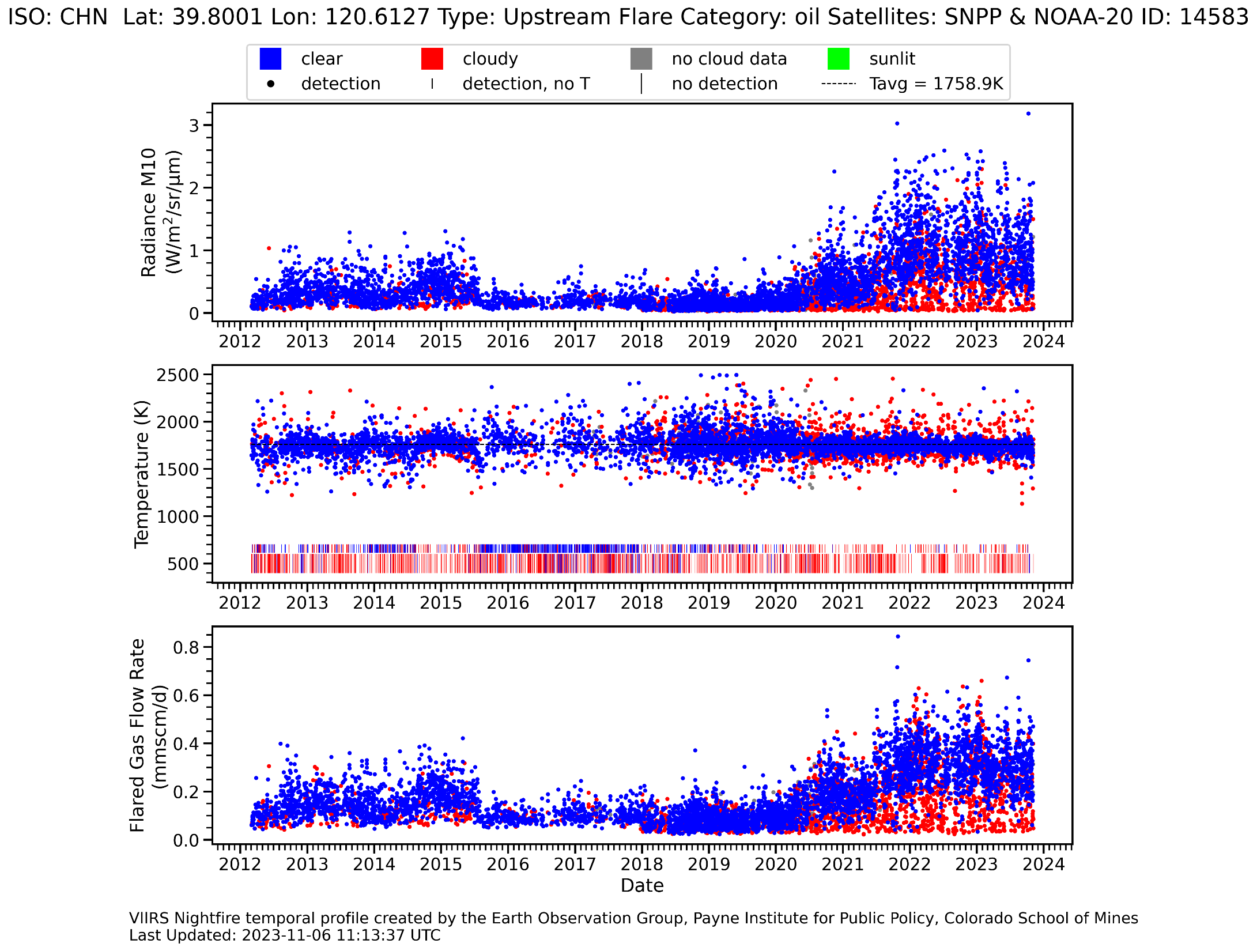
Using ten years of VNF data EOG identified ~20,000 industrial infrared emitters. Each has a nightly temporal profile that is updated once per week. These are available in a web-map service: https://eogmap.mines.edu/giree.

Slide 15
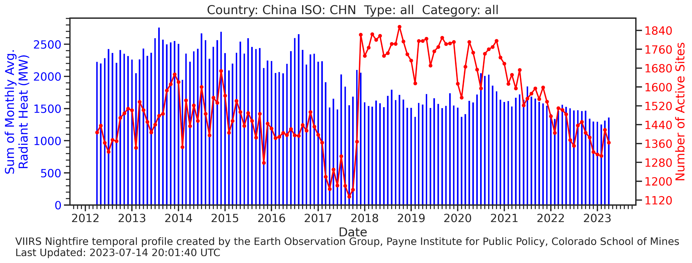
EOG also produces monthly temporal profiles of all industrial emitters by country

Slide 16
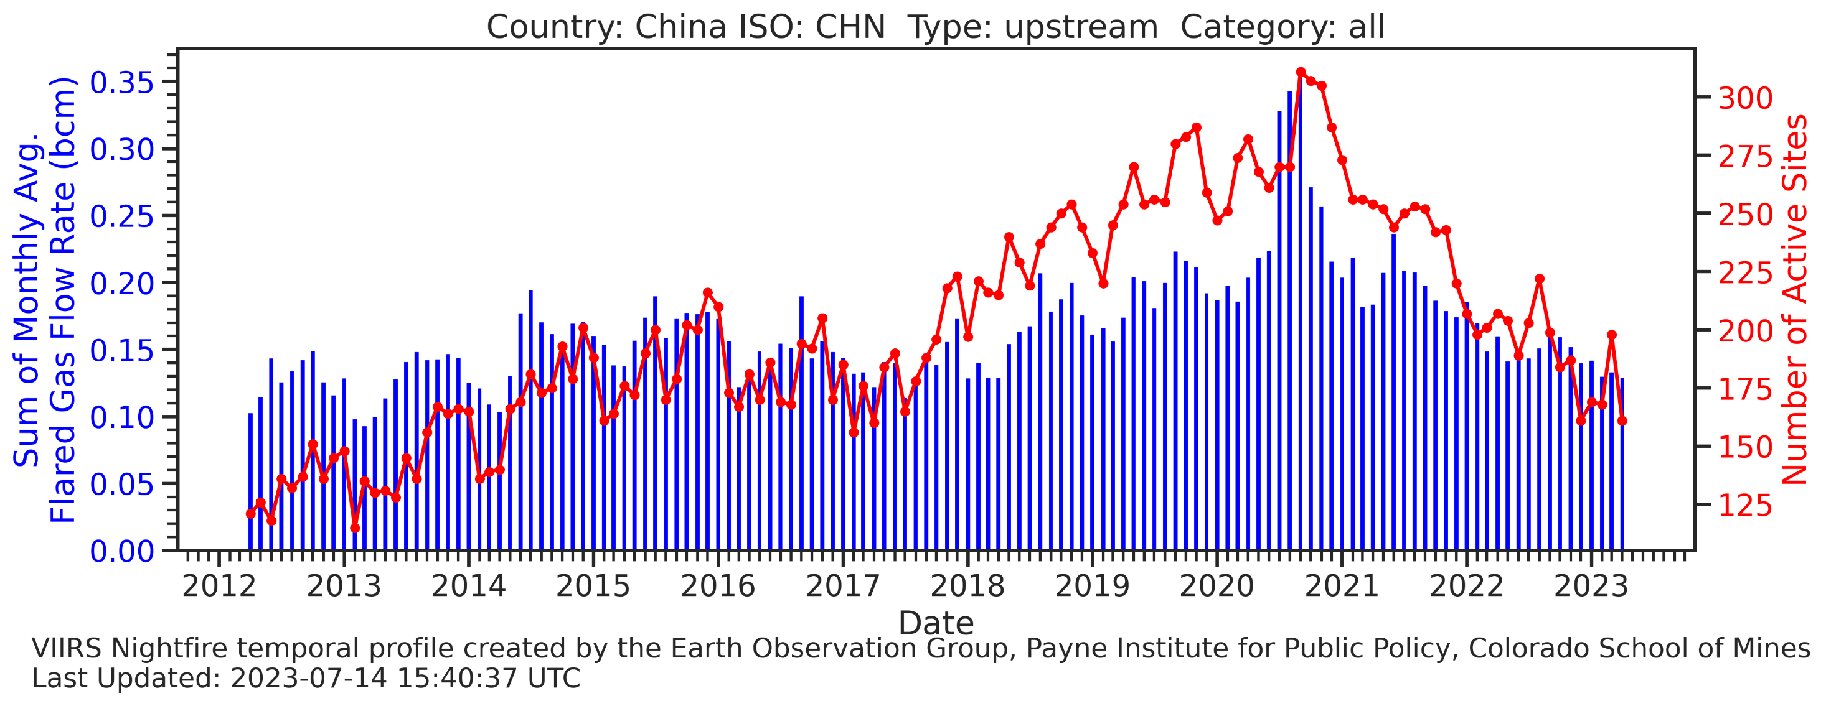
And profiles by country for individual emitter types

Slide 17
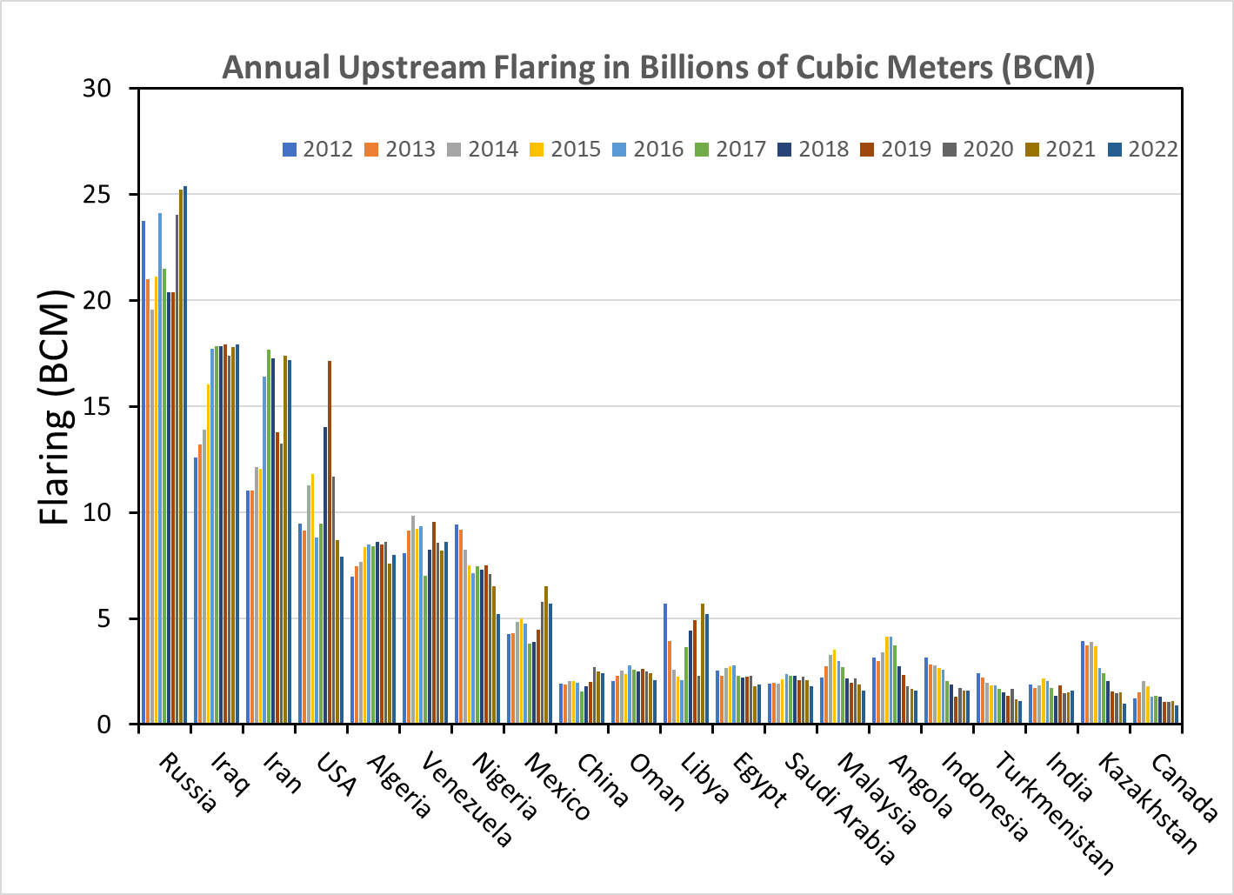
Estimated annual flared gas volumes for the top 20 flaring countries

Slide 18
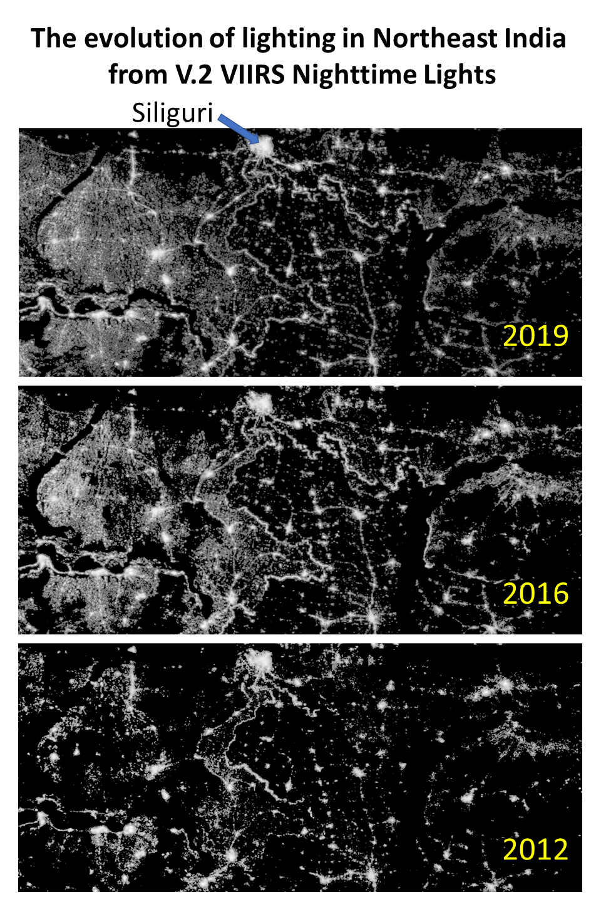
EOG’s Flagship Product is Nighttime Lights
EOG’s most popular dataset
~560TB downloaded in 2021
~42K files downloaded in 2021
DMSP-OLS (1992-2020)
Annual
Monthly
VIIRS (2012-2021)
Annual
Monthly
Nightly profiles in select areas

Slide 19
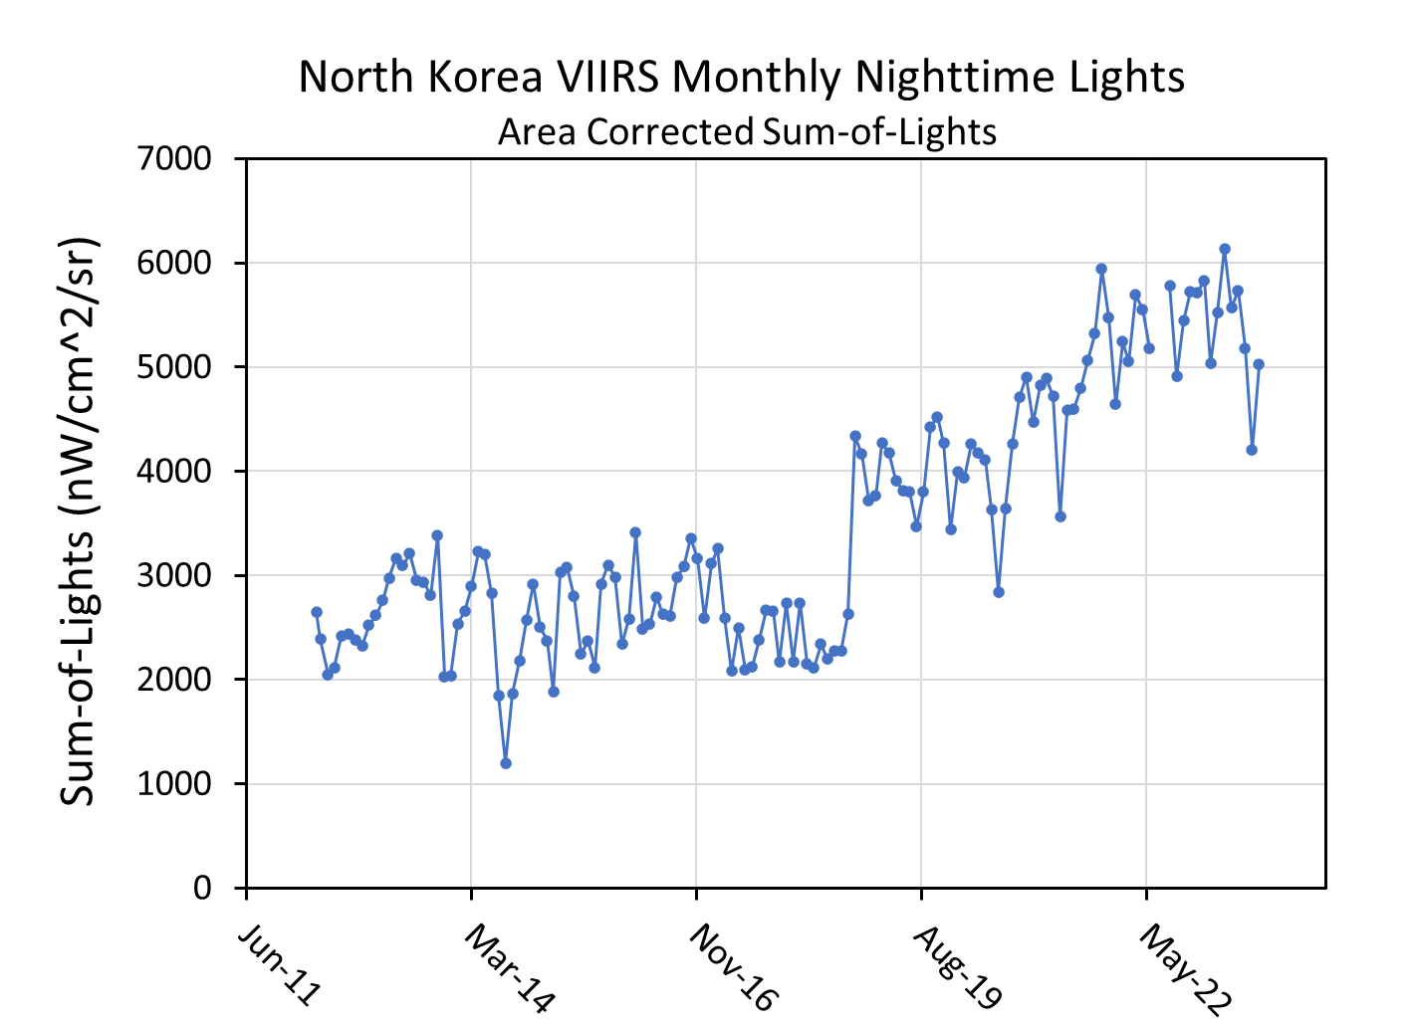
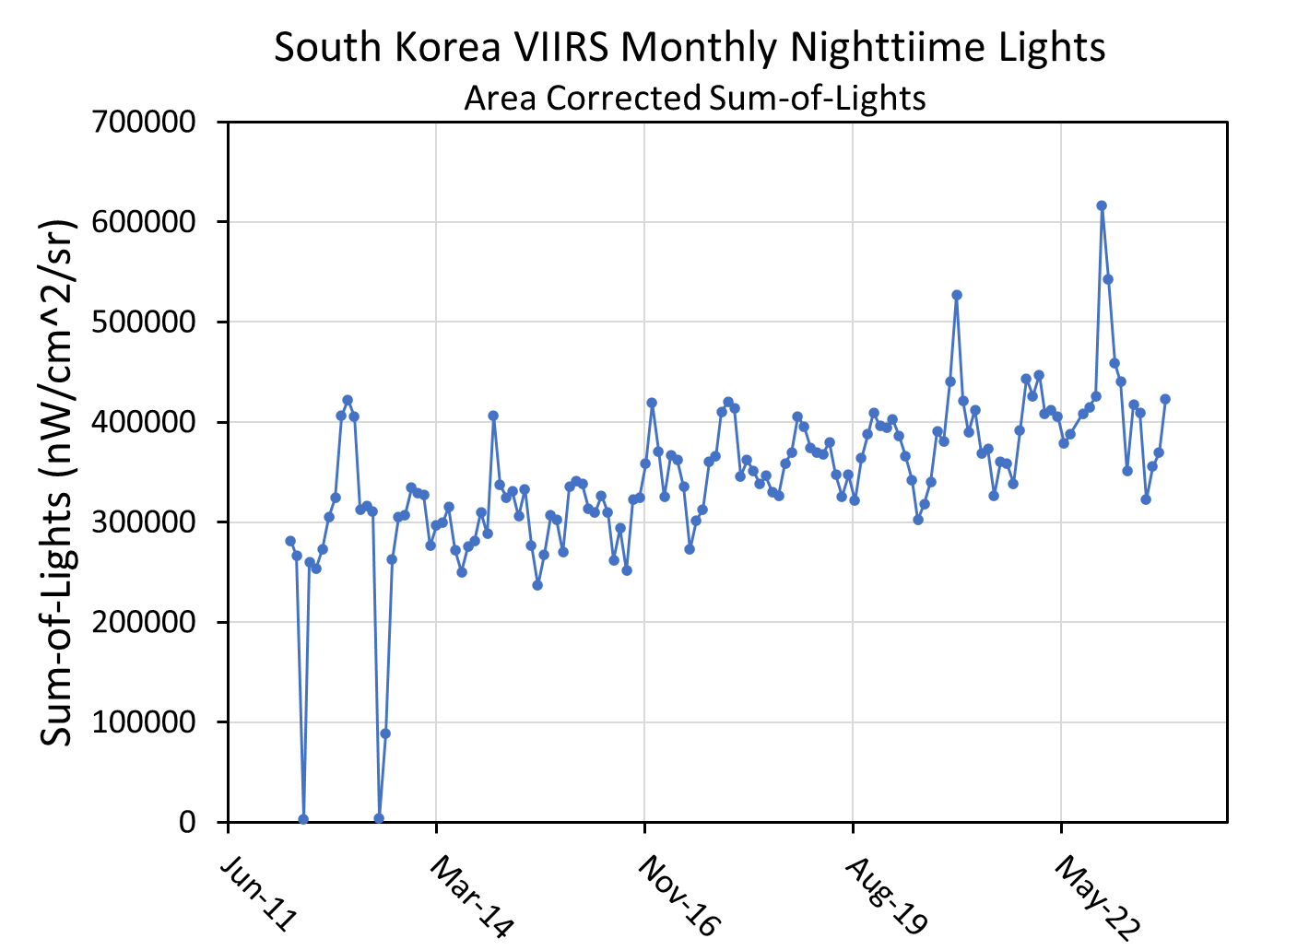
VNL Monthly Temporal Profiles by Country
Stray light dropouts. NOAA implemented
a stray light correction in 2014.

Slide 20
VIIRS boat detection (VBD) – the only daily global survey of vessel detections based on light.
Boats in
Java Sea
Jakarta

Slide 21
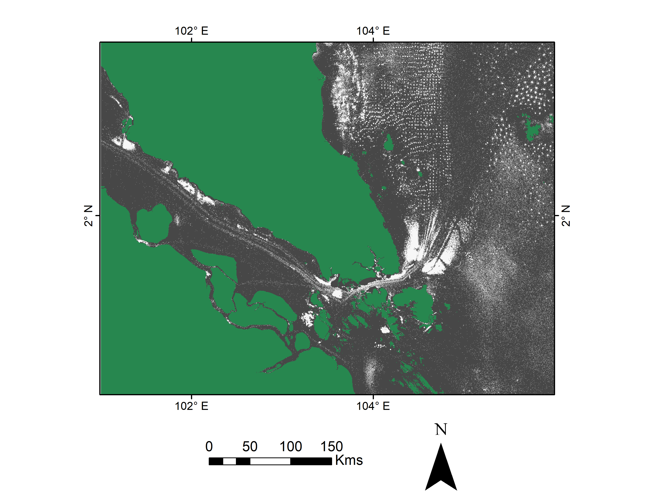
Singapore Cumulative VBD Detections 2012-2023

Slide 22
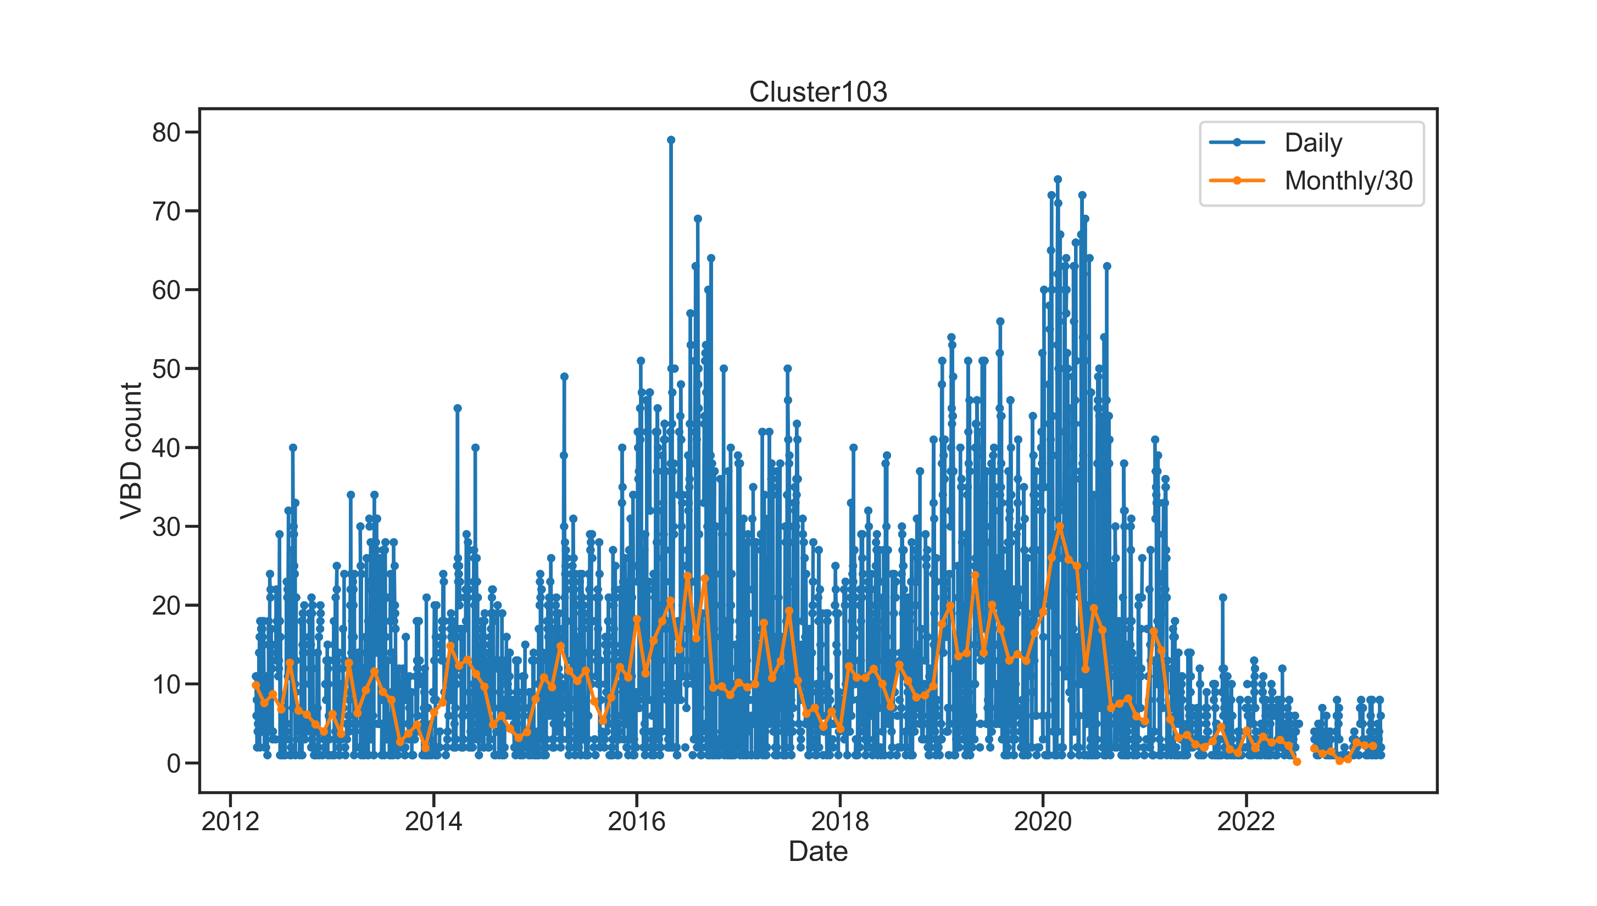
Temporal Profiles of Singapore Anchorages
Nightly VBD Temporal Profile From Singapore Anchorage

Slide 23
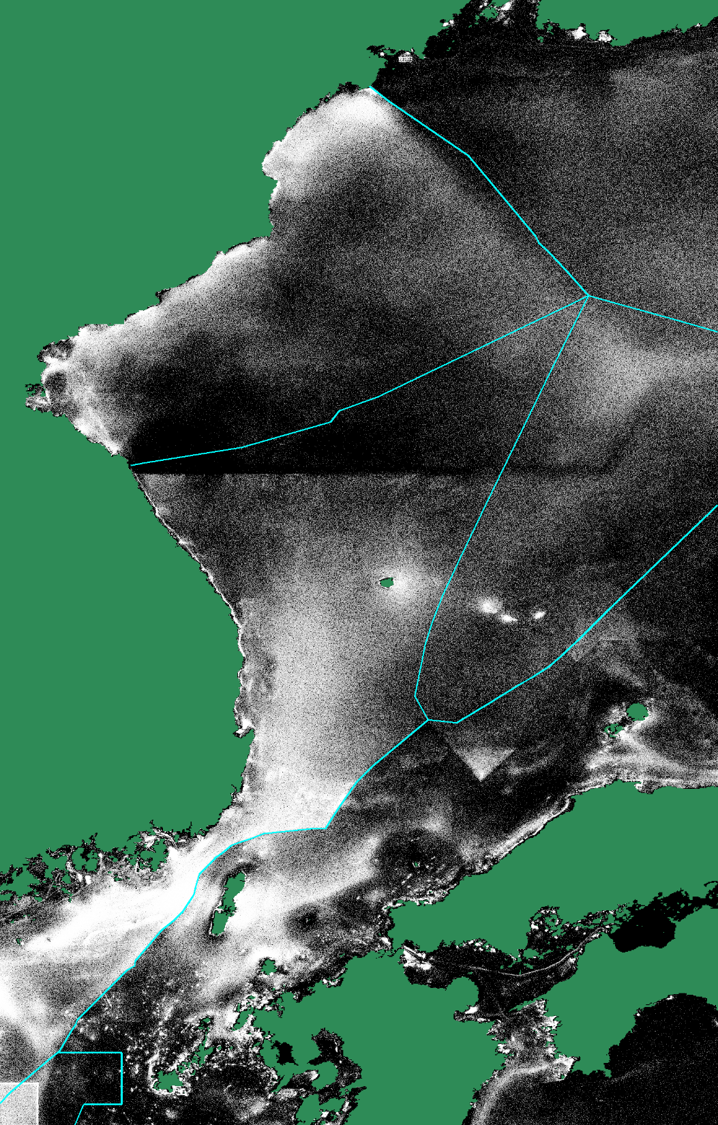
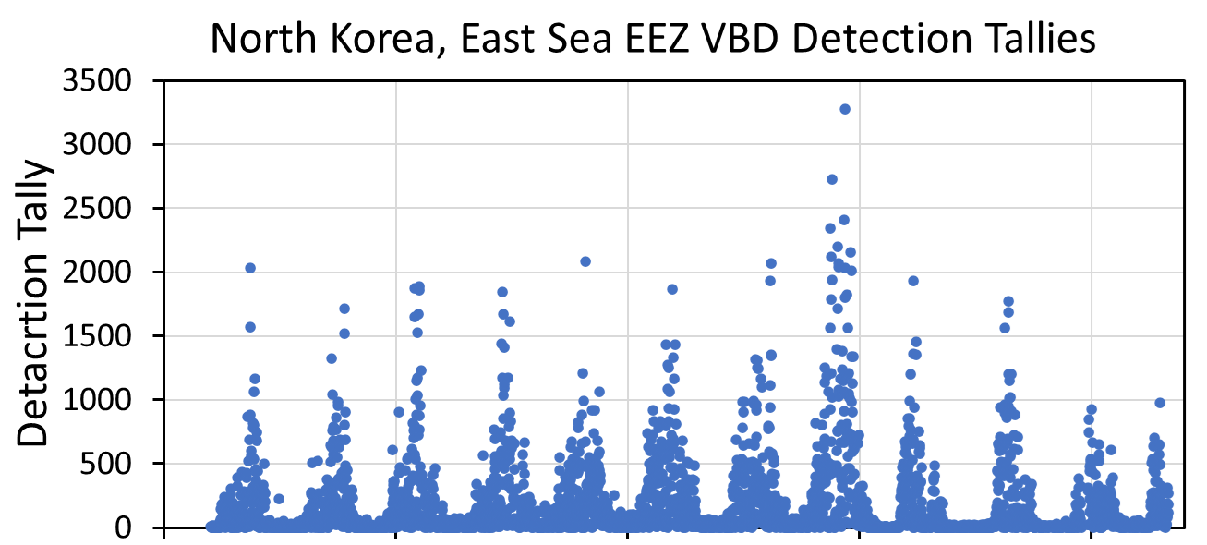
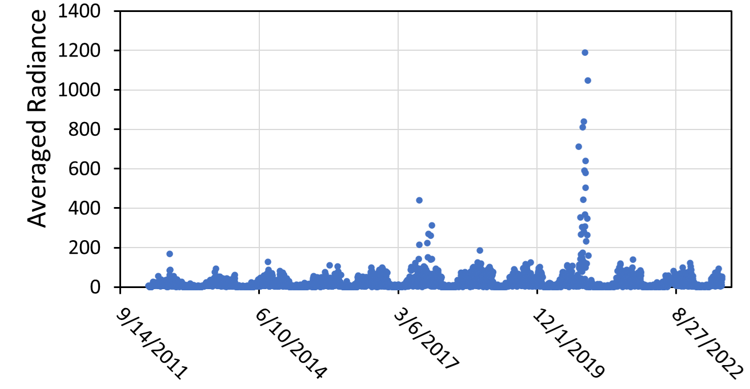
Cumulative VBD in the East Sea

Slide 24
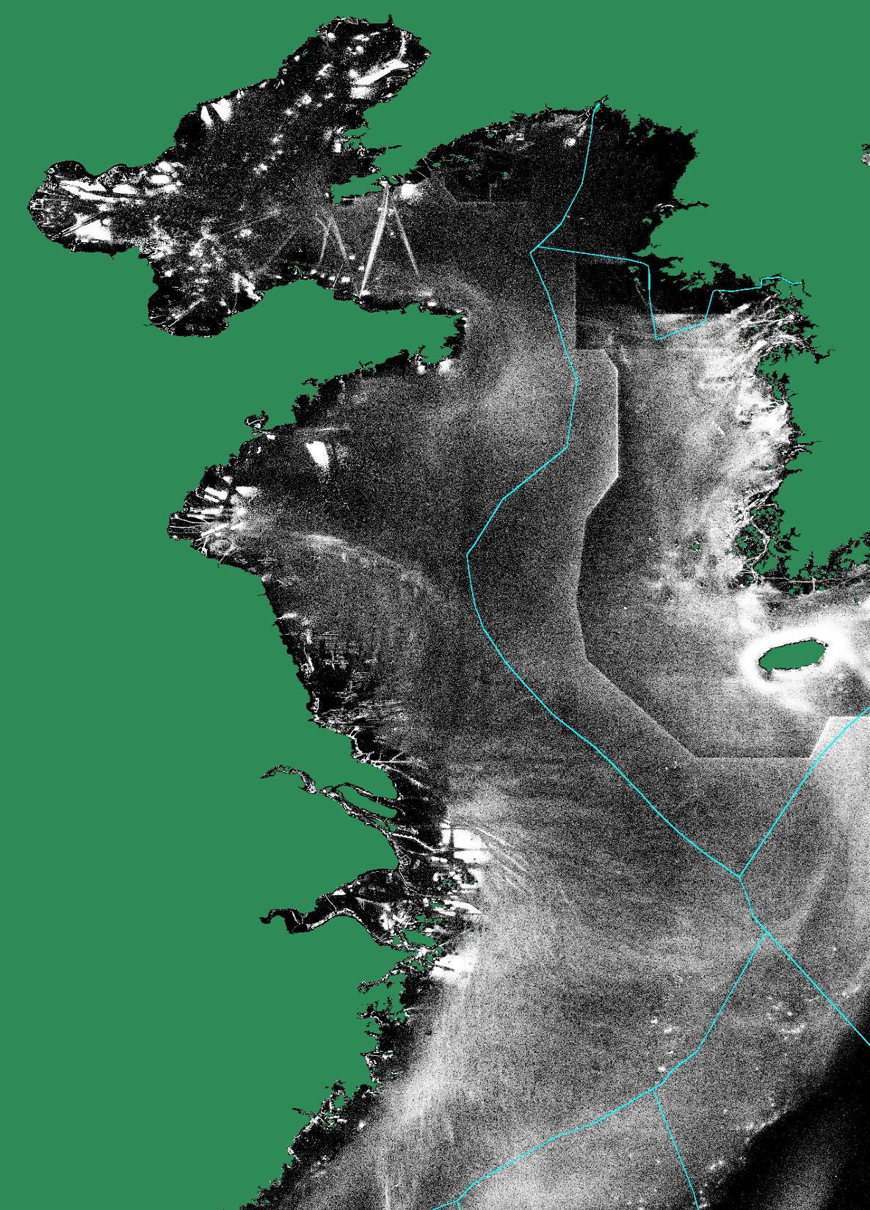
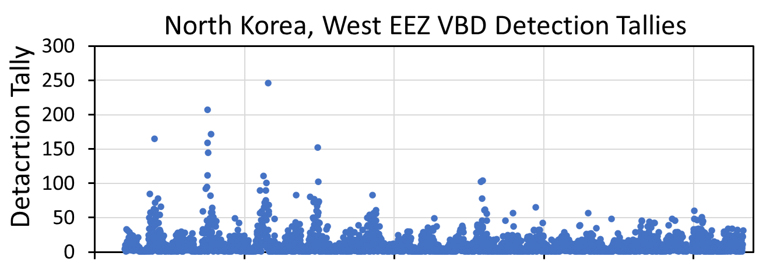
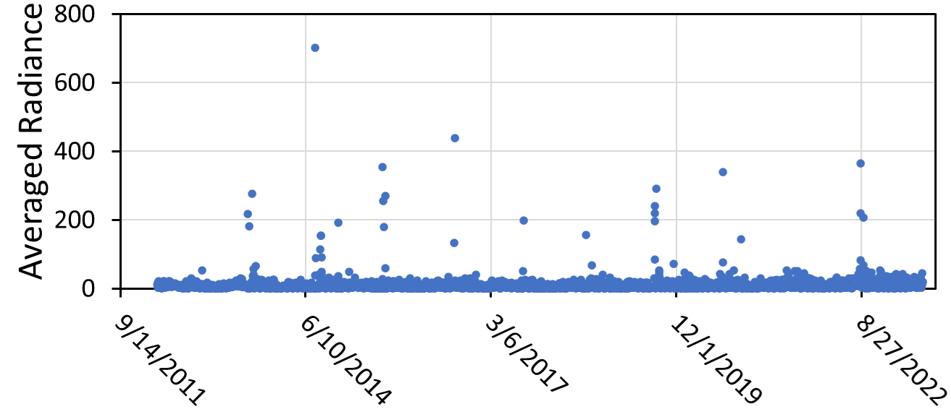
Cumulative VBD Yellow and East China Sea

Slide 25
Summary
EOG processes all nighttime VIIRS data (150 GB per satellite per day) in near-real time with the VIIRS nightfire and boat detection algorithms.
EOG produces monthly, annual and multiyear summary grids for VNF, VNL, and VBD.
The most detailed information comes from nightly temporal profiles.
EOG has defined 20,000+ industrial infrared emitters and tracks these with weekly updates to the nightly temporal profiles.
EOG has developed – but not yet implemented an atmospheric correction for all three product lines.
EOG plans to develop an improved cloud detection algorithm tuned for light sources and industrial infrared emitters.
The entire cloud record will need to be reprocessed back to 2012.
EOG is a soft money operation, relying on sponsors and data subscription fees to cover staff salaries and other expenses.

Slide 26
VIIRS Nightfire Publications
Elvidge, Christopher D., Mikhail Zhizhin, Feng-Chi Hsu, and Kimberly E. Baugh. "VIIRS nightfire: Satellite pyrometry at night." Remote Sensing 5, no. 9 (2013): 4423-4449.
Elvidge, Christopher D., Mikhail Zhizhin, Kimberly Baugh, Feng-Chi Hsu, and Tilottama Ghosh. "Methods for global survey of natural gas flaring from visible infrared imaging radiometer suite data." Energies 9, no. 1 (2015): 14.
Elvidge, Christopher D., Mikhail Zhizhin, Kimberly Baugh, Feng Chi Hsu, and Tilottama Ghosh. "Extending nighttime combustion source detection limits with short wavelength VIIRS data." Remote Sensing 11, no. 4 (2019): 395.
Elvidge, Christopher D., Mikhail Zhizhin, Feng Chi Hsu, Tamara Sparks, and Tilottama Ghosh. "Subpixel Analysis of Primary and Secondary Infrared Emitters with Nighttime VIIRS Data." Fire 4, no. 4 (2021): 83.
Zhizhin, Mikhail, Christopher Elvidge, and Alexey Poyda. "Night-Time Detection of Subpixel Emitters with VIIRS Mid-Wave Infrared Bands M12–M13." Remote Sensing 15, no. 5 (2023): 1189.

Slide 27
VIIRS Nighttime Lights Publications
Elvidge, Christopher D., Kimberly Baugh, Mikhail Zhizhin, Feng Chi Hsu, and Tilottama Ghosh. "VIIRS night-time lights." International Journal of Remote Sensing 38, no. 21 (2017): 5860-5879.
Elvidge, Christopher D., Feng-Chi Hsu, Mikhail Zhizhin, Tilottama Ghosh, Jay Taneja, and Morgan Bazilian. "Indicators of electric power instability from satellite observed nighttime lights." Remote Sensing 12, no. 19 (2020): 3194.
Elvidge, Christopher D., Mikhail Zhizhin, Tilottama Ghosh, Feng-Chi Hsu, and Jay Taneja. "Annual time series of global VIIRS nighttime lights derived from monthly averages: 2012 to 2019." Remote Sensing 13, no. 5 (2021): 922.
Elvidge, Christopher D., Mikhail Zhizhin, David Keith, Steven D. Miller, Feng Chi Hsu, Tilottama Ghosh, Sharolyn J. Anderson et al. "The VIIRS Day/Night Band: A Flicker Meter in Space?." Remote Sensing 14, no. 6 (2022): 1316.
Elvidge, Christopher D., Kimberly Baugh, Tilottama Ghosh, Mikhail Zhizhin, Feng Chi Hsu, Tamara Sparks, Morgan Bazilian, Paul C. Sutton, Kenneth Houngbedji, and Ran Goldblatt. "Fifty years of nightly global low-light imaging satellite observations." Frontiers in Remote Sensing (2022): 79.

Slide 28
VIIRS Boat Detection Publications
Elvidge, Christopher D., Mikhail Zhizhin, Kimberly Baugh, and Feng-Chi Hsu. "Automatic boat identification system for VIIRS low light imaging data." Remote sensing 7, no. 3 (2015): 3020-3036.
Elvidge, Christopher D., Tilottama Ghosh, Kimberly Baugh, Mikhail Zhizhin, Feng-Chi Hsu, Nilo Selim Katada, Wilmon Penalosa, and Bui Quang Hung. "Rating the effectiveness of fishery closures with visible infrared imaging radiometer suite boat detection data." Frontiers in Marine Science 5 (2018): 132.
Hsu, Feng-Chi, Christopher D. Elvidge, Kimberly Baugh, Mikhail Zhizhin, Tilottama Ghosh, David Kroodsma, Adi Susanto et al. "Cross-matching VIIRS boat detections with vessel monitoring system tracks in Indonesia." Remote Sensing 11, no. 9 (2019): 995.

Slide 29
For more information, visit https://payneinstitute.mines.edu/eog/ or email celvidge@mines.edu

