Slide 1
Development of a nighttime VIIRS cloud detection algorithm optimized for the analysis of lights and flares from space
Chris Elvidge (celvidge@mines.edu)
AIT Nighttime Remote Sensing
Lecture 3-b
January 11, 2024

Slide 2
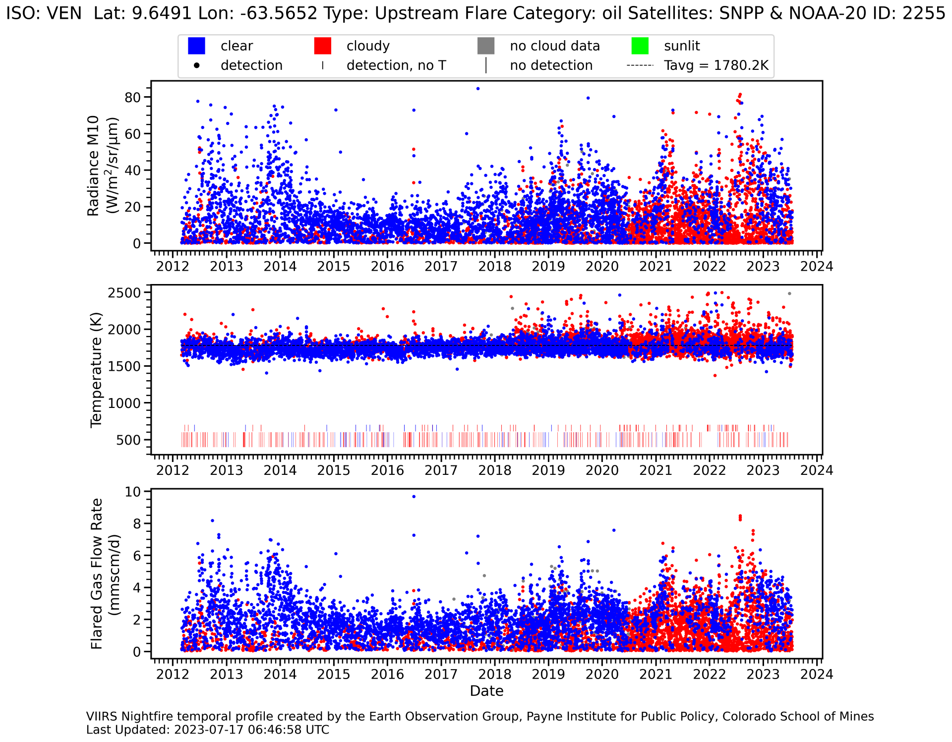
Pixels color doded as blue clear and red cloudy. Note the increase in cloud pixels starting in mid-2020. Prior to June 24, 2020 EOG used the original NOAA cloud-mask with cloud-clearing for low cloud optical thickness pixels. After that date NOAA switched to a new cloud probability product. EOG made it’s own cloud mask from the new cloud probability grids, labeling pixels with 25% or more cloud probability as cloudy. Even with a 100% cloud probability threshold, the new cloud product over-detects clouds in many cloud-prone areas.

Slide 3
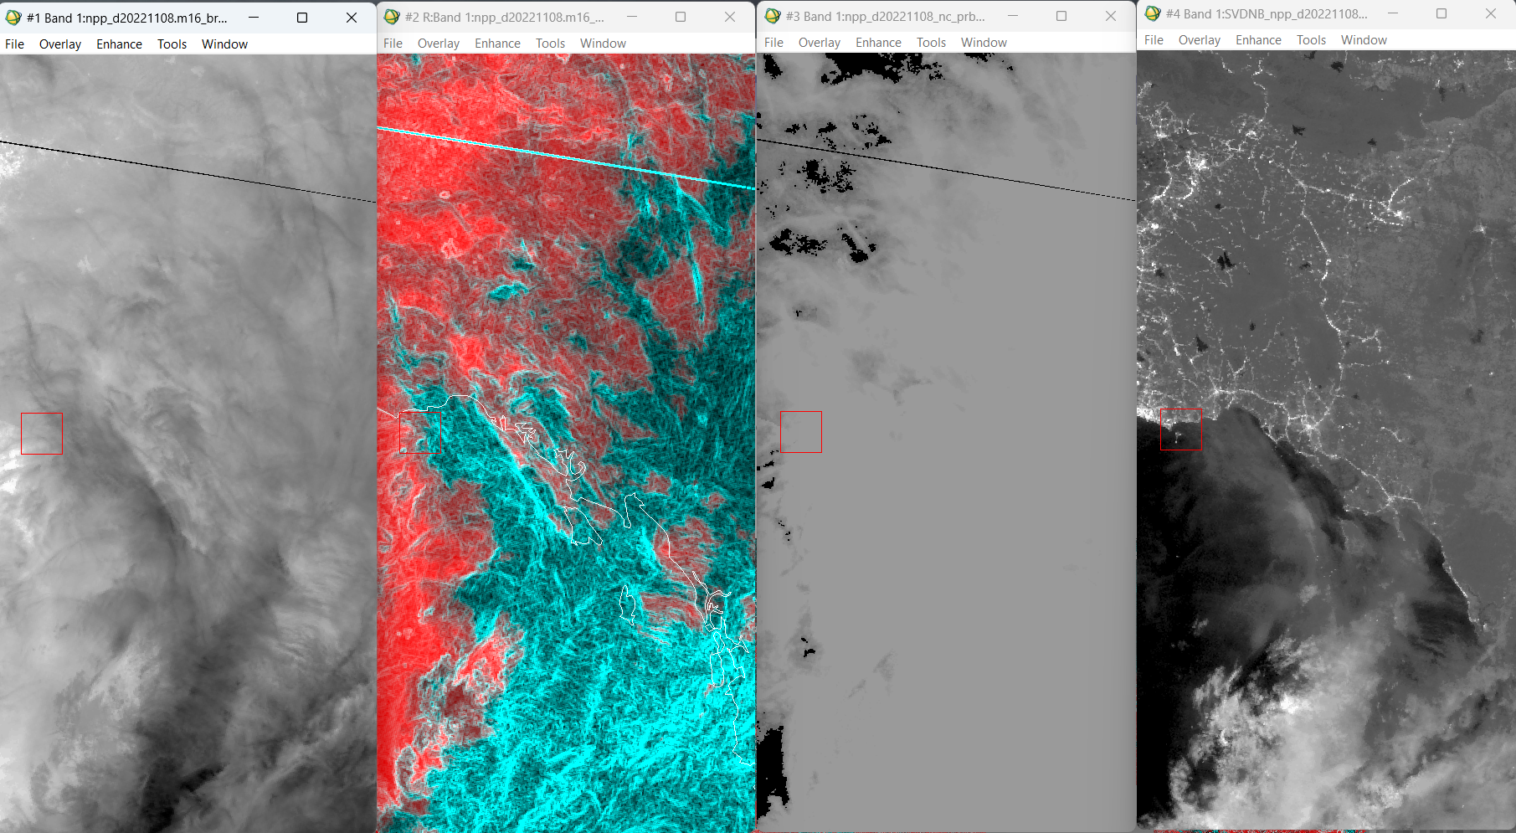
LWIR, LWIR 3x3 data range, NOAA cloud probability and DNB
M16 Brighness Temperature November 8, 2022 Global Mosaic
M16 BT Red M16 3x3 Data Range Cyan
Clear Lights = Cloud-Free
Over-detection of Clouds (100% Cloud Probability)
Moonlit DNB

Slide 4
We propose to develop a new cloud product that is informed by the appearance of surface features in the LWIR and moonlit DNB
Visibility of shorelines, drainage patterns, topography, lakes and reservoirs are indicators of clear sky conditions.
Fuzzy or blurry lights = cloudy.
Sharp lights – clear.

Slide 5
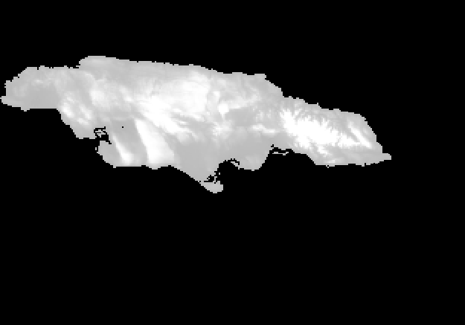
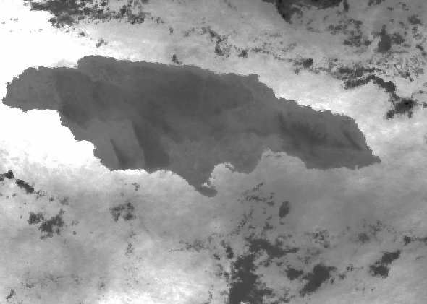
Cloud-free coastlines stand out in 3x3 data range images in geolocated VIIRS LWIR or moonlit DNB imagery
Jamaica 20221108
USGS GTOPO 30
M16 Brightness Temperature

Slide 6
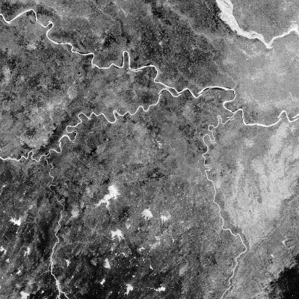
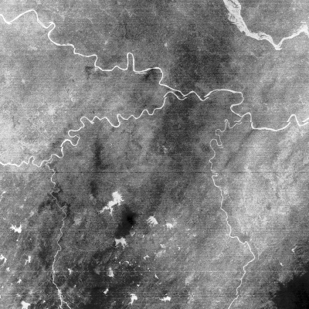
Visibility of Rivers, Lakes, Reservoirs in Geolocated VIIRS I4 and I5 Imagery
Northern India 20230828
I4
I5
Inland water bodies are typically warmer than their surroundings at night in the LWIR.
Reference data options include global river, lake and reservoir vectors or recent daytime cloud-free composites?

Slide 7
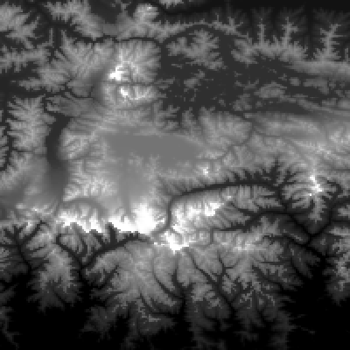
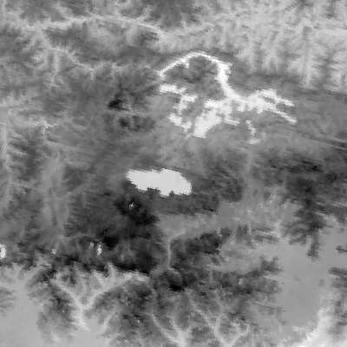
Cloud-free mountains can be identified through comparison with digital topography data
Northern India 20221108
Clouds are often over-detected in alpine areas because of the snow and cold temperatures.
USGS GTOPO 30
I5

Slide 8
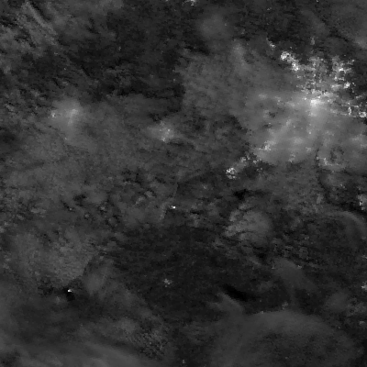
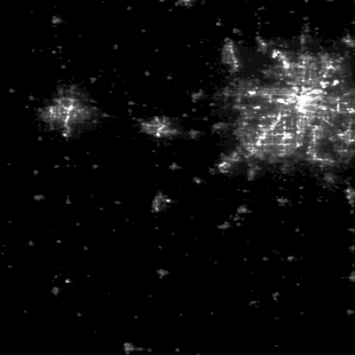
Clear Versus Blurry Lights in VIIRS Day/Night (DNB) Band Imagery
Kansas City 20221108
Use the DNB blur index from the VIIRS boat detection product to identify blurry lights relative to the corresponding annual nighttime lights.
DNB Mosaic 20221108
VNL 2022 Reference

Slide 9
Summary
Cold clouds can be labeled in the longwave infrared based on their low brightness temperature (or radiance), edges with high 3x3 data ranges, and lack of visibility of shorelines, terrain features and lights.
Warm clouds (fog) generally appear as smooth sheets in the LWIR, with no shorelines or terrain features
Similar results are possible in moonlit DNB data.
The DNB may also provide clues that clouds are or are not present:
Blurry lights indicate clouds
Sharp lights indicate clear.

Slide 10
Possible modules for identifying clear versus cloudy areas within moonlit DNB and LWIR granules or aggregates
A) Shoreline detector – could be performed by extracting matches between 3x3 data range and vector shorelines.
B) Drainage pattern detector.
C) Steep topography detector.
D) Lake and reservoir detector.
E) Fuzzy lights – could reference most recent annual nighttime lights.
F) Sharp lights – could reference most recent annual nighttime lights.
G) High data-range extractor (excluding shorelines).
H) Set clear versus cloud threshold on the LWIR histogram by marking pixels from A-G as guides.

