Slide 1
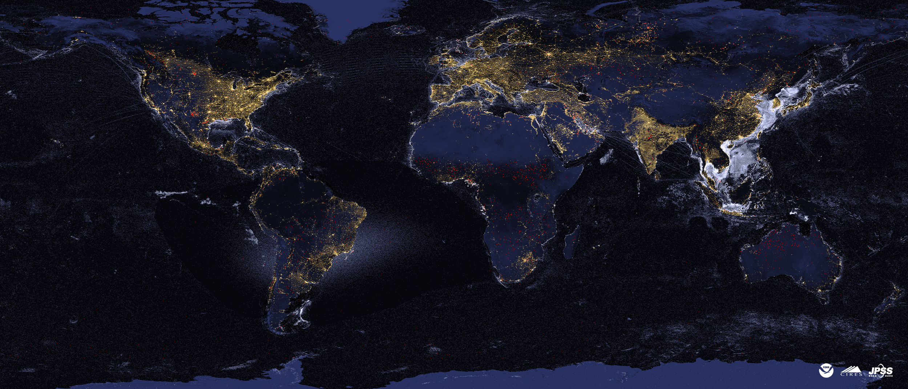





Satellite Animation of Ukraine War Events and Recovery
Christopher D. Elvidge, Mikhail Zhizhin, Tilottama Ghosh, Tamara Sparks & Stephen Pon
Earth Observation Group
Payne Institute for Public Policy
Colorado School of Mines
Golden, Colorado
celvidge@mines.edu
December 18, 2023

Slide 2
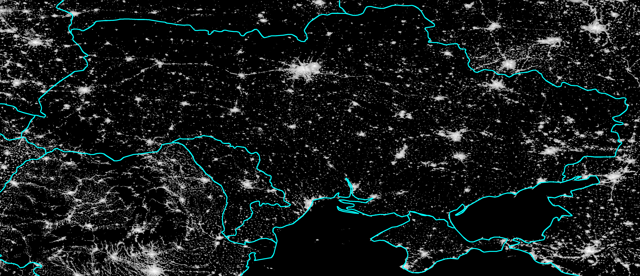
EOG’s Multiyear Map of Lighting in Ukraine and surroundings

Slide 3
EOG’s Three Nightly Global Products Have Recorded War Damage Events in Ukraine
VIIRS Nighttime Lights (VNL) temporal profiles indicate lights went out in most parts of the Ukraine on February 24, 2022. Lighting recovery has been variable.
VIIRS Nightfire (VNF) temporal profiles from flares and industrial sites show outages and reductions in infrared emissions – with some sites recovering and others not. In many sites, first evidence of decline was in December 2021, prior to the start of the 2022 invasion.
VNF also detected many ephemeral IR emitters associated with specific attacks and battles.
VIIRS Boat Detections (VBD) reveal the decline in grain shipment activity in waters offshore from Odessa.

Slide 4
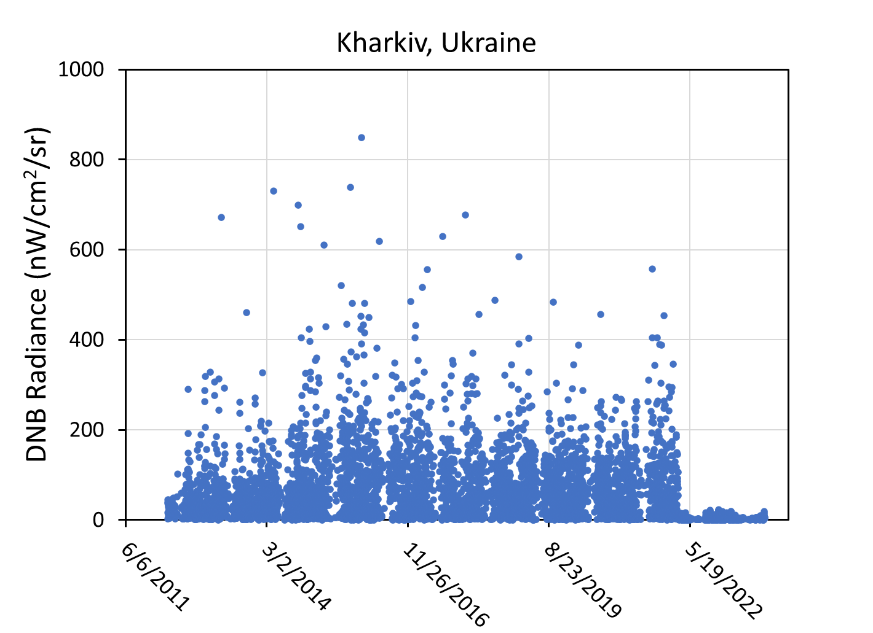
Kharkiv’s DNB temporal profile shows lights dimmed to near the DNB’s detection limit on February 24, 2024 with minor recovery from October 2022 to April 2023, followed by a second round of dimming during the summer of 2023.

Slide 5
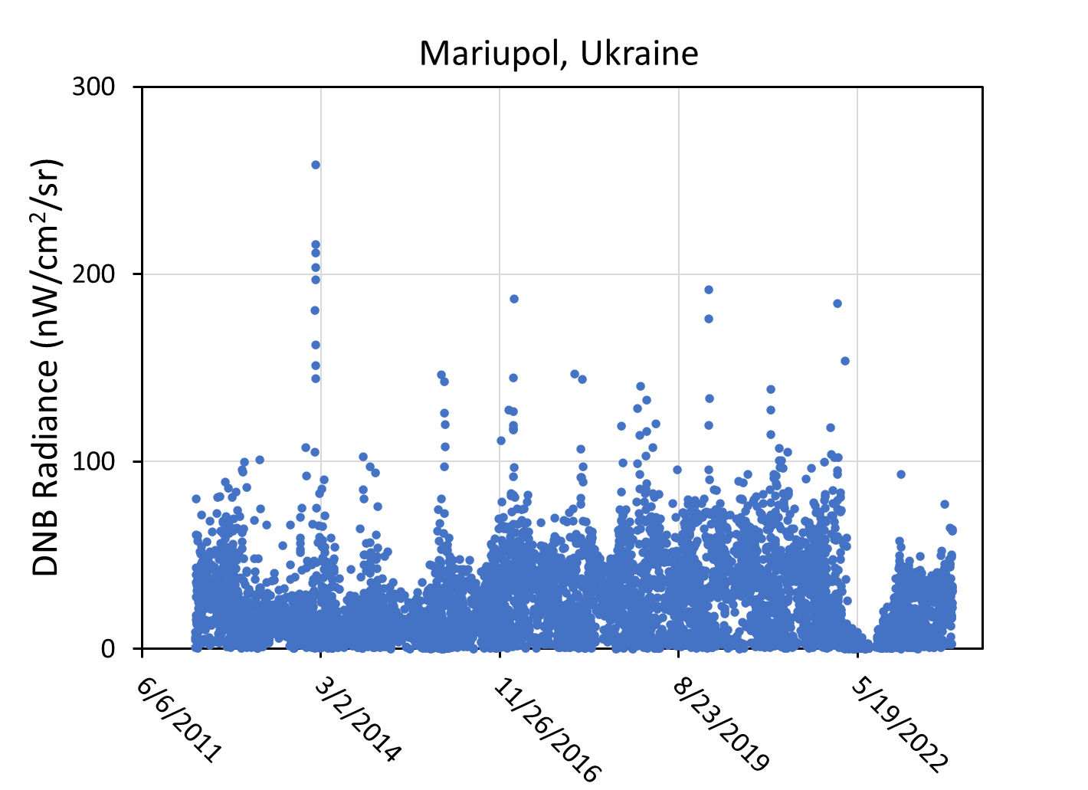
Mariupol’s DNB temporal profile shows lights dimmed on February 24, 2024and hiot a low point in July 2022. Lighting shows substantial recovery in 2023.

Slide 6
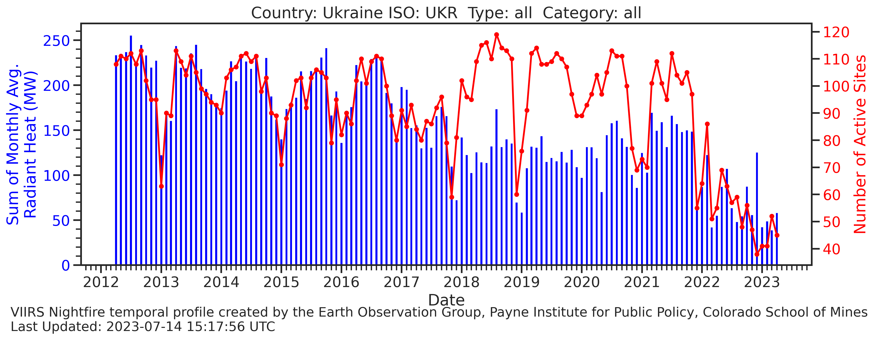
Ukraine’s industrial IR emitters (of all types) declined in number of active sites and total radiant heat beginning in December 2021, prior to the start of the 2022 invasion.

Slide 7
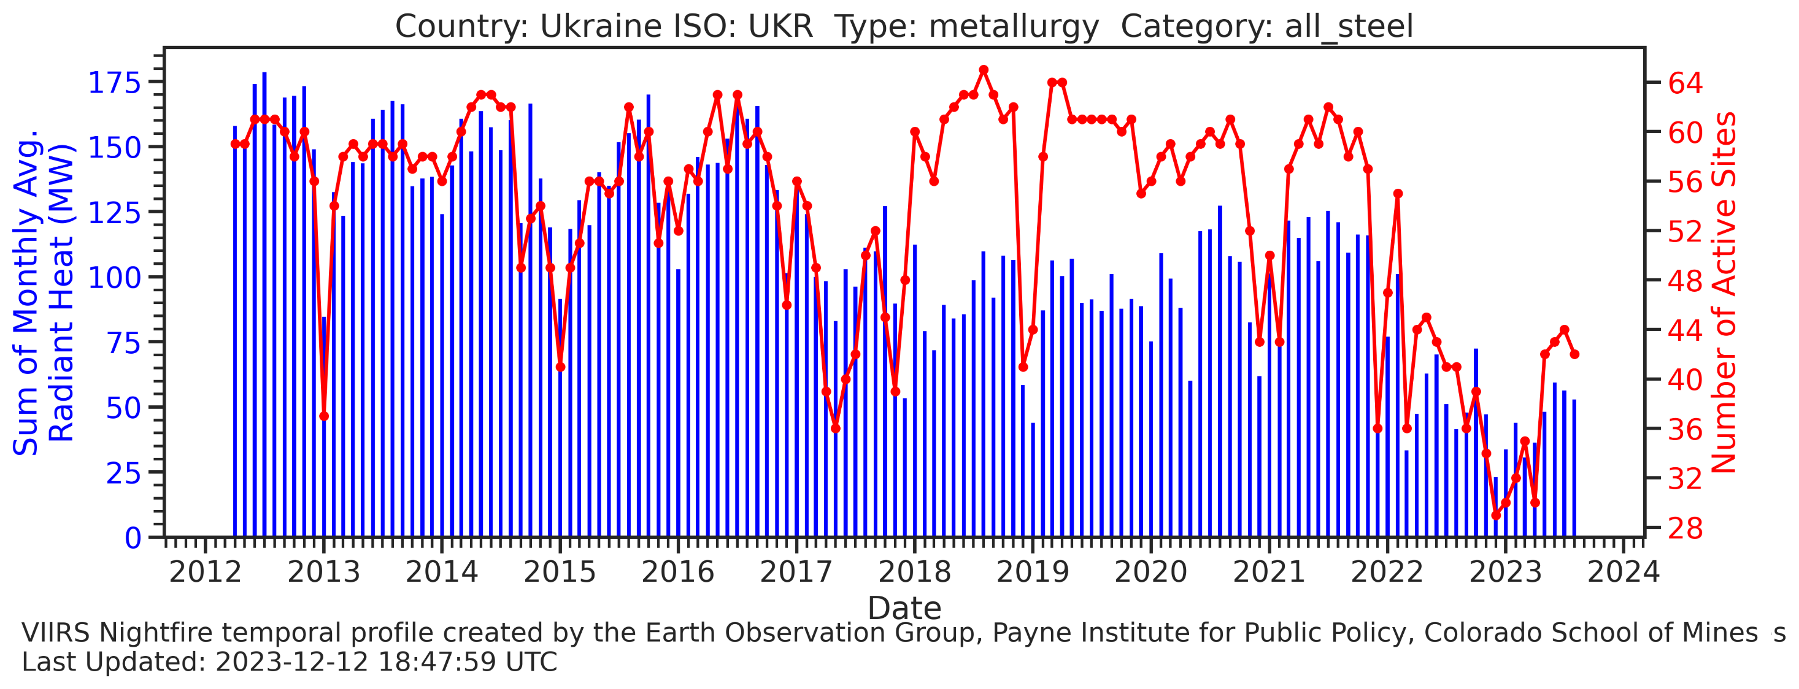
Ukraine’s steel mills declined in number of active sites and total radiant heat beginning in December 2021, prior to the start of the 2022 invasion.

Slide 8
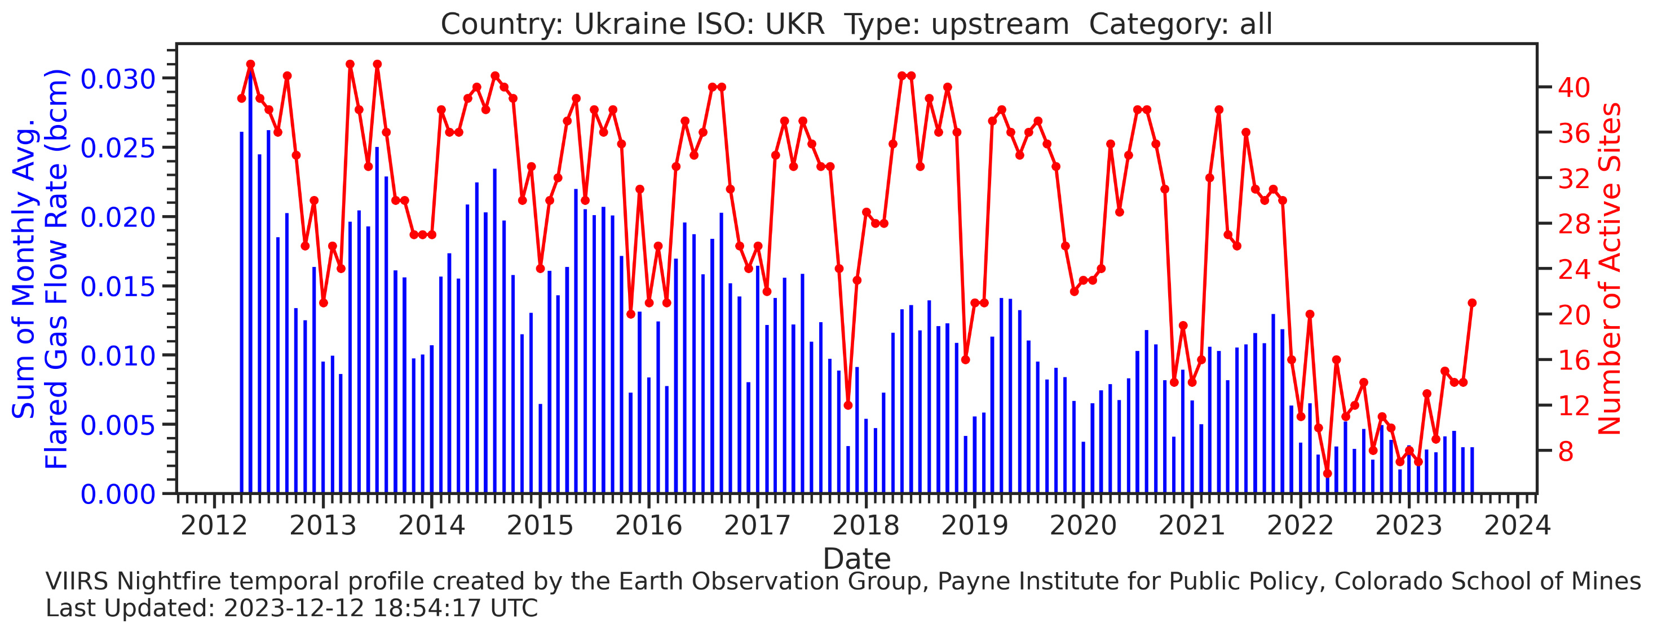
Ukraine’s upstream gas flaring declined in number of active sites and total radiant heat at the end of 2021 – prior to the 2022 invasion.

Slide 9
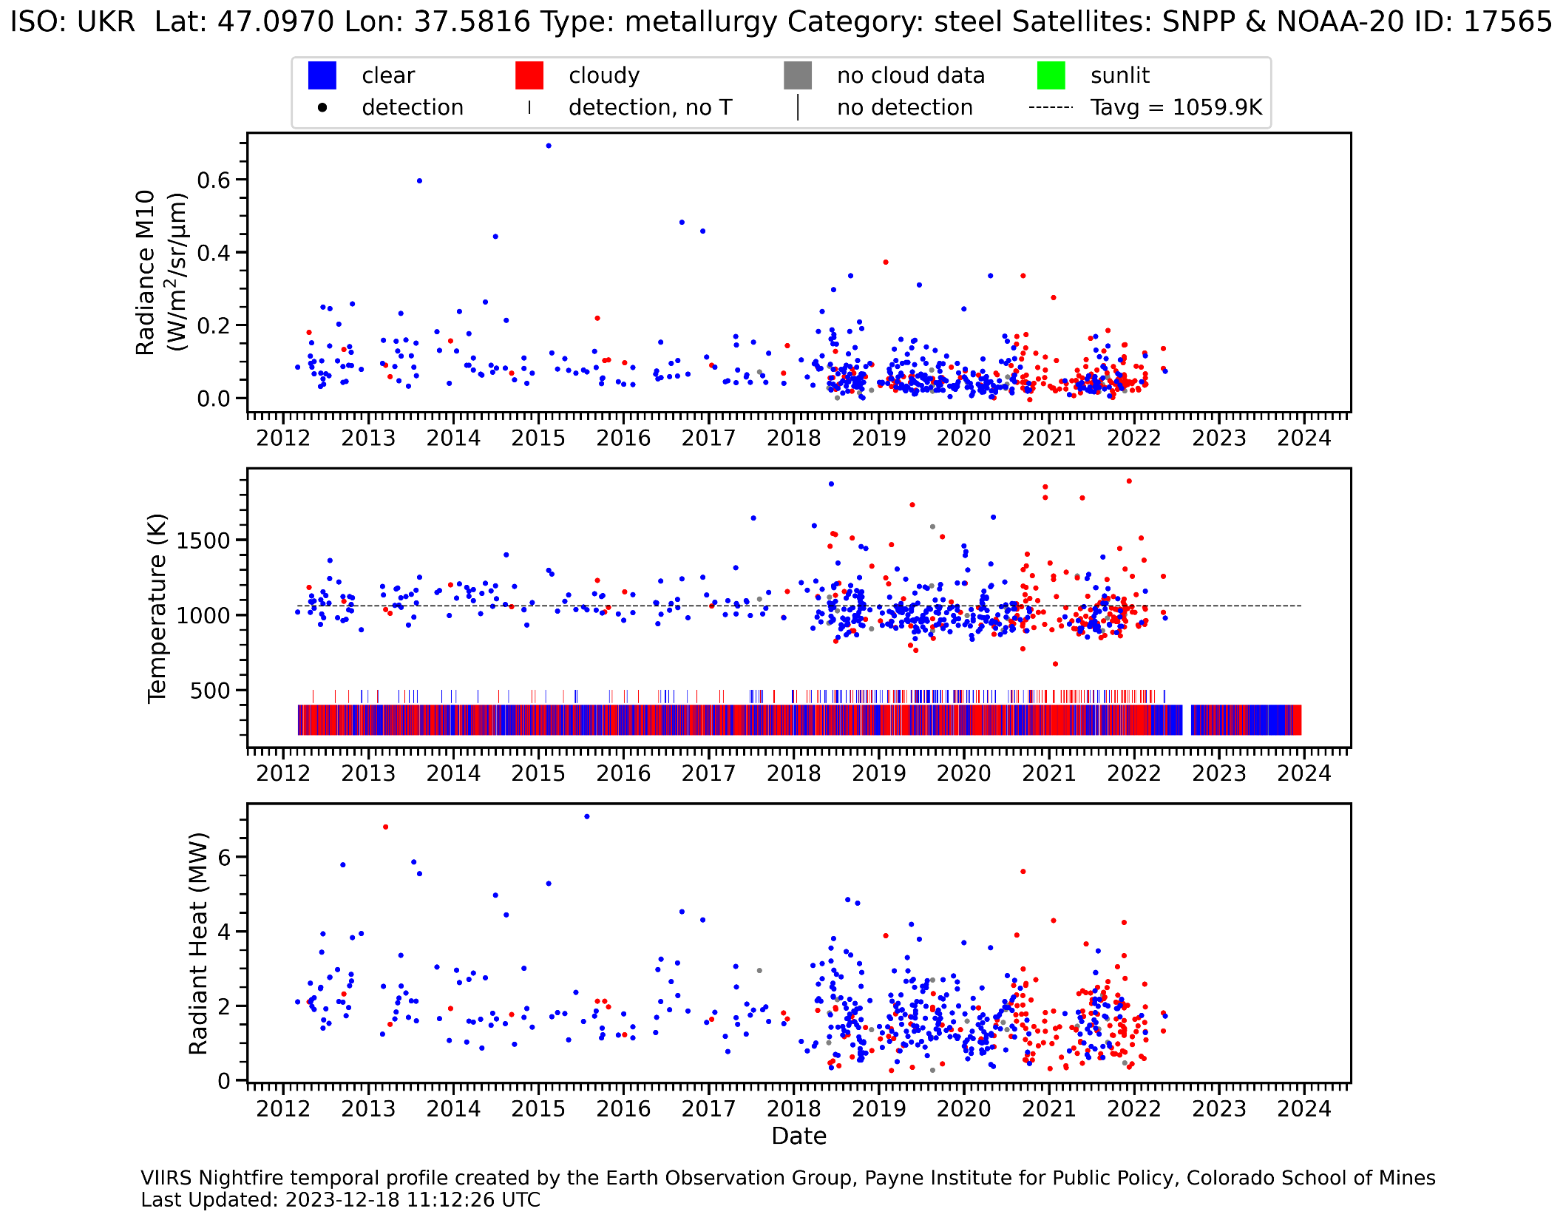
NightlyVNF temporal profile of a Mariupol steel mill shows activity ended on at the start of the conflict in 2022 and has not returned.

Slide 10
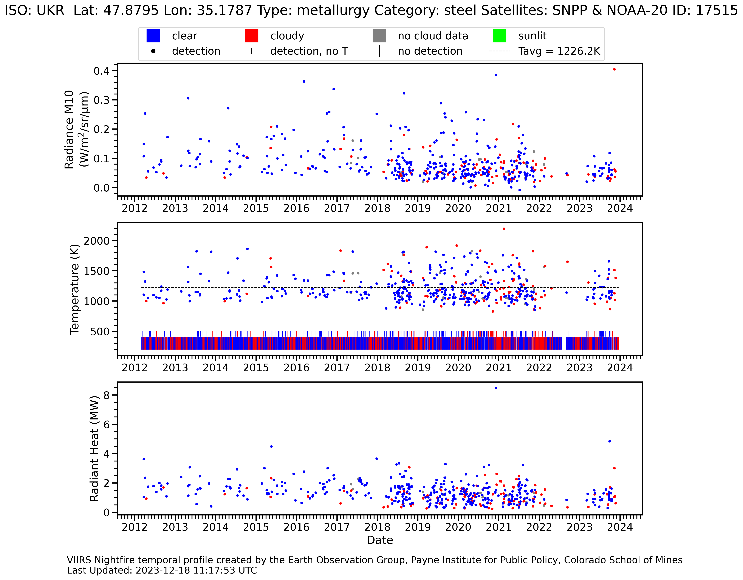
VNF temporal profile of a Zaporizhzhia steel mill shows activity largely halted from the invasion start – but had recovery starting in February 2023.

Slide 11
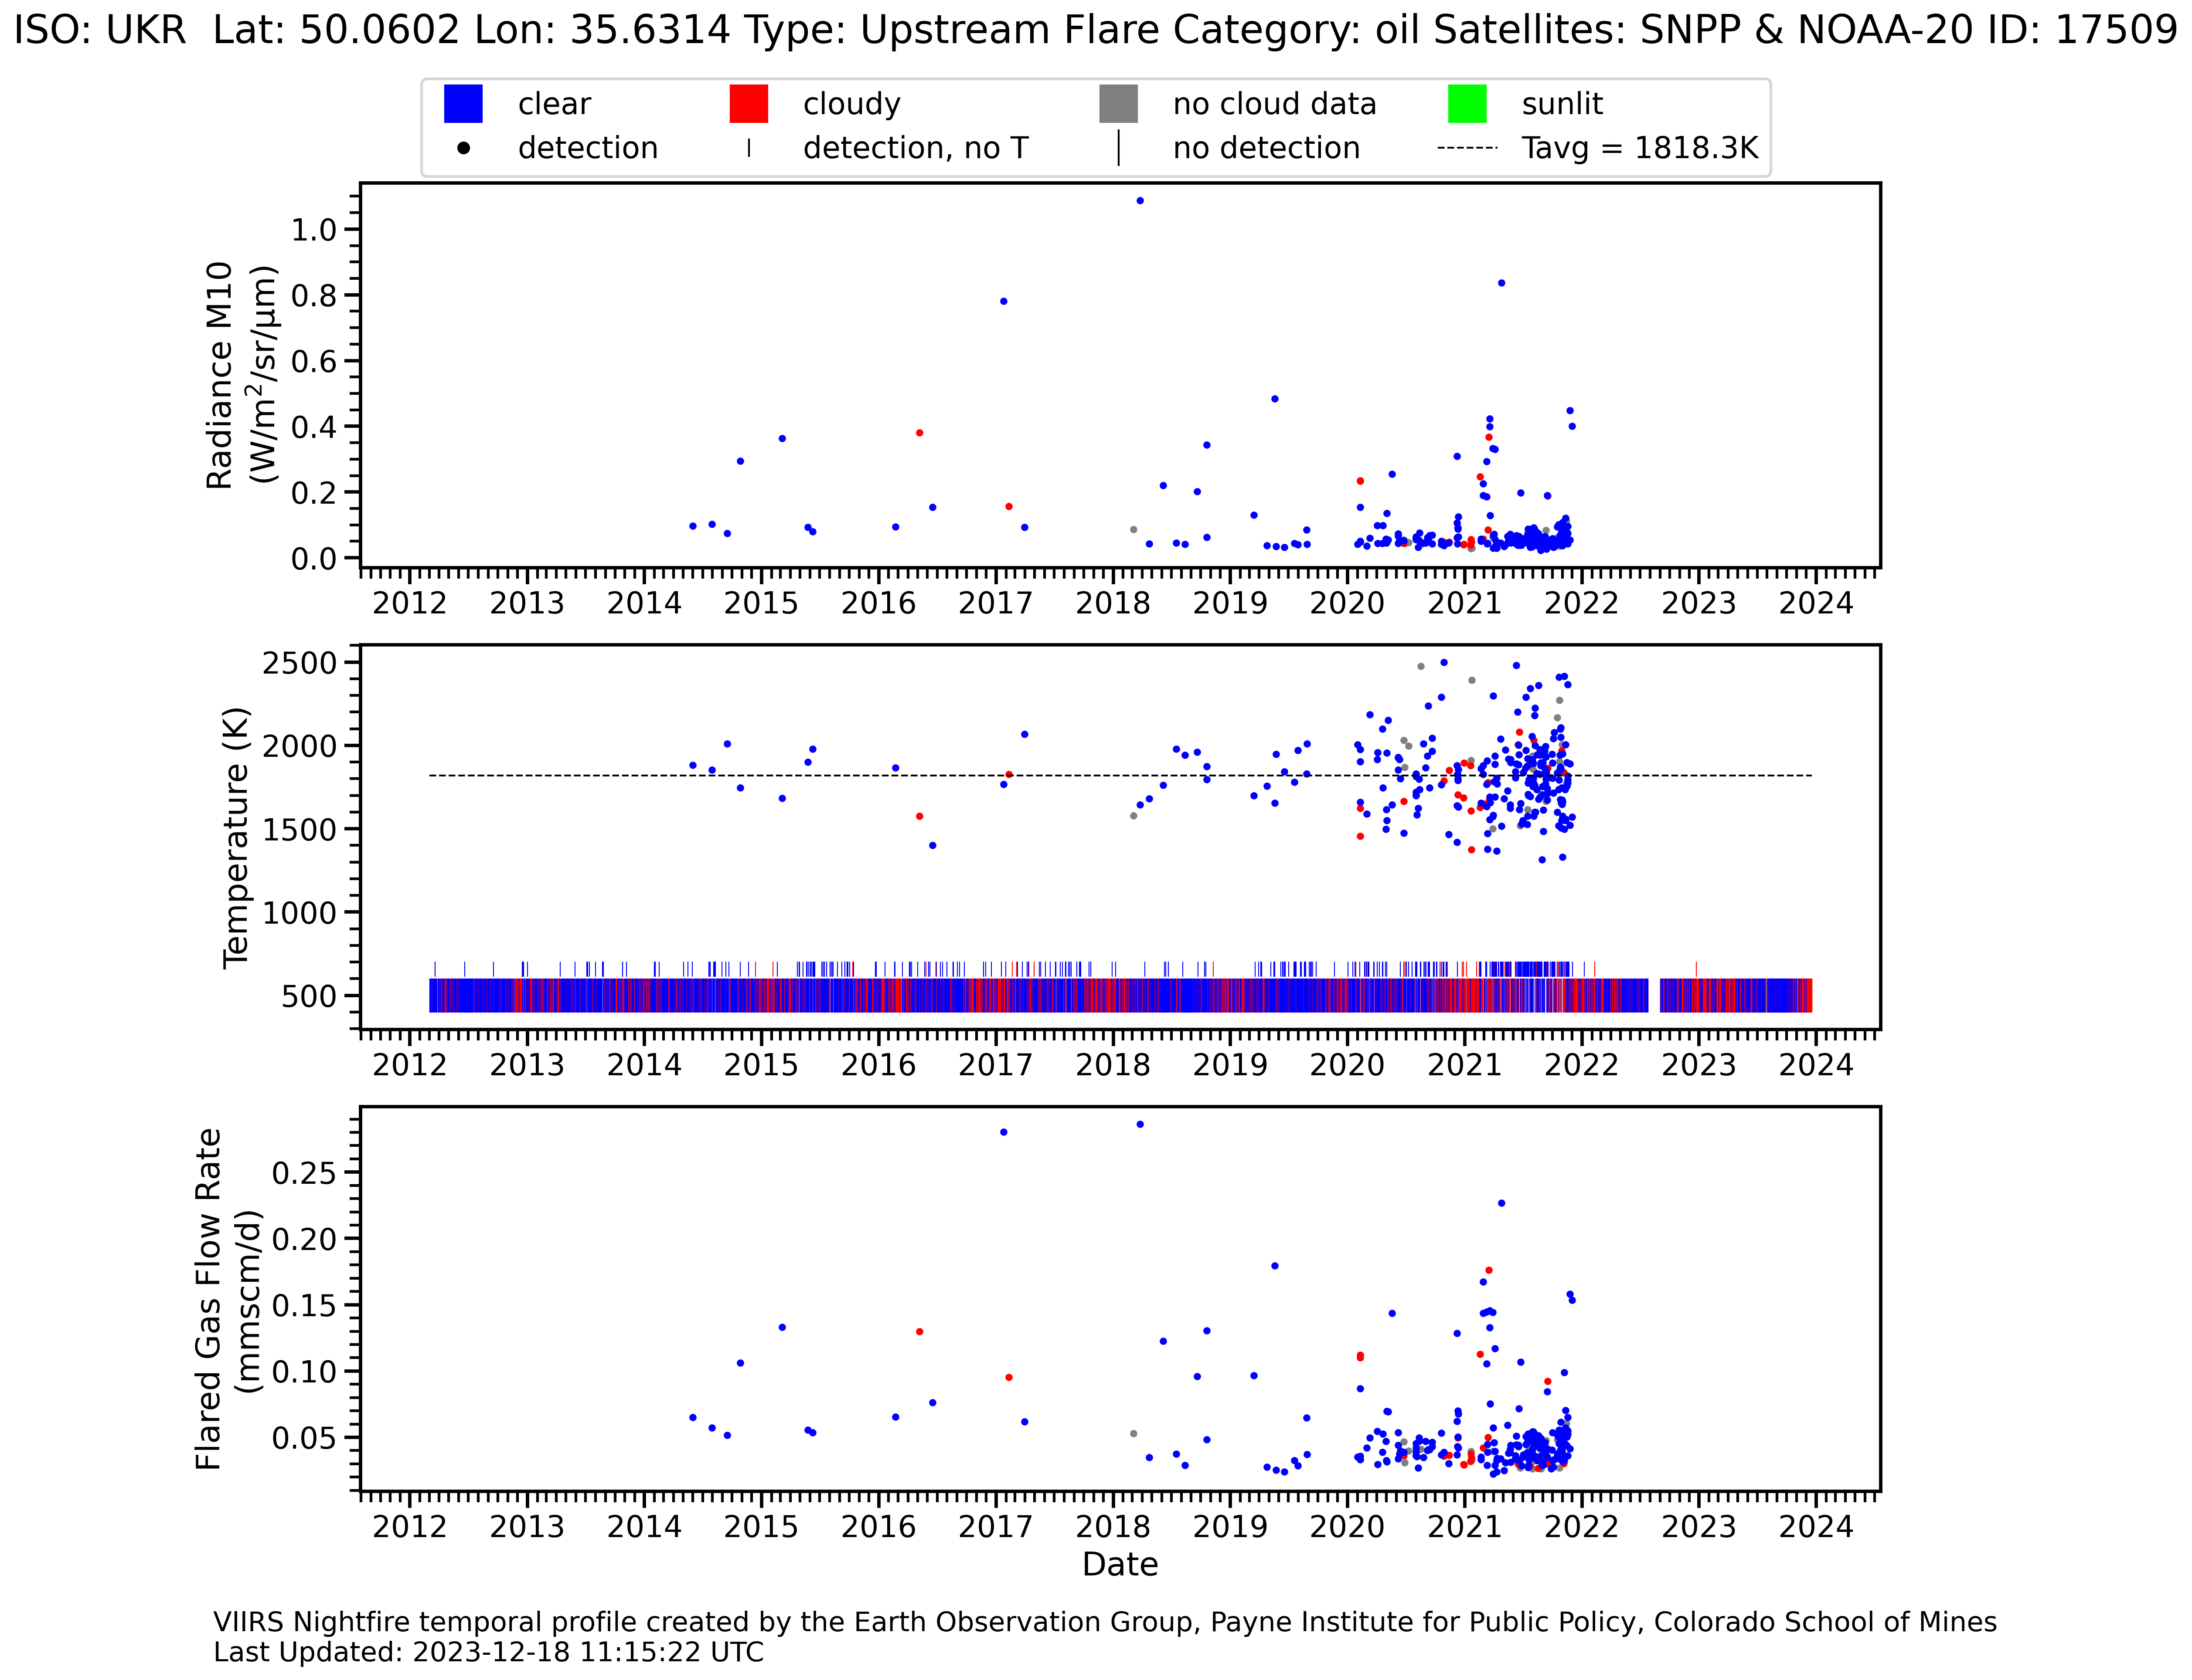
VNF temporal profile of an upstream gas flare west of Kharkiv shows no activity detected from December 2021 to present.

Slide 12
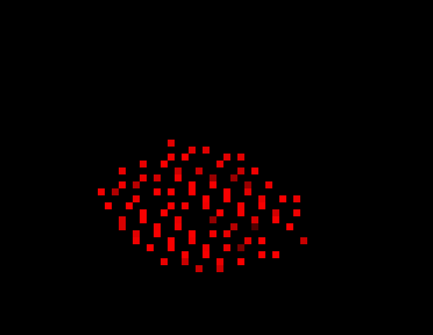
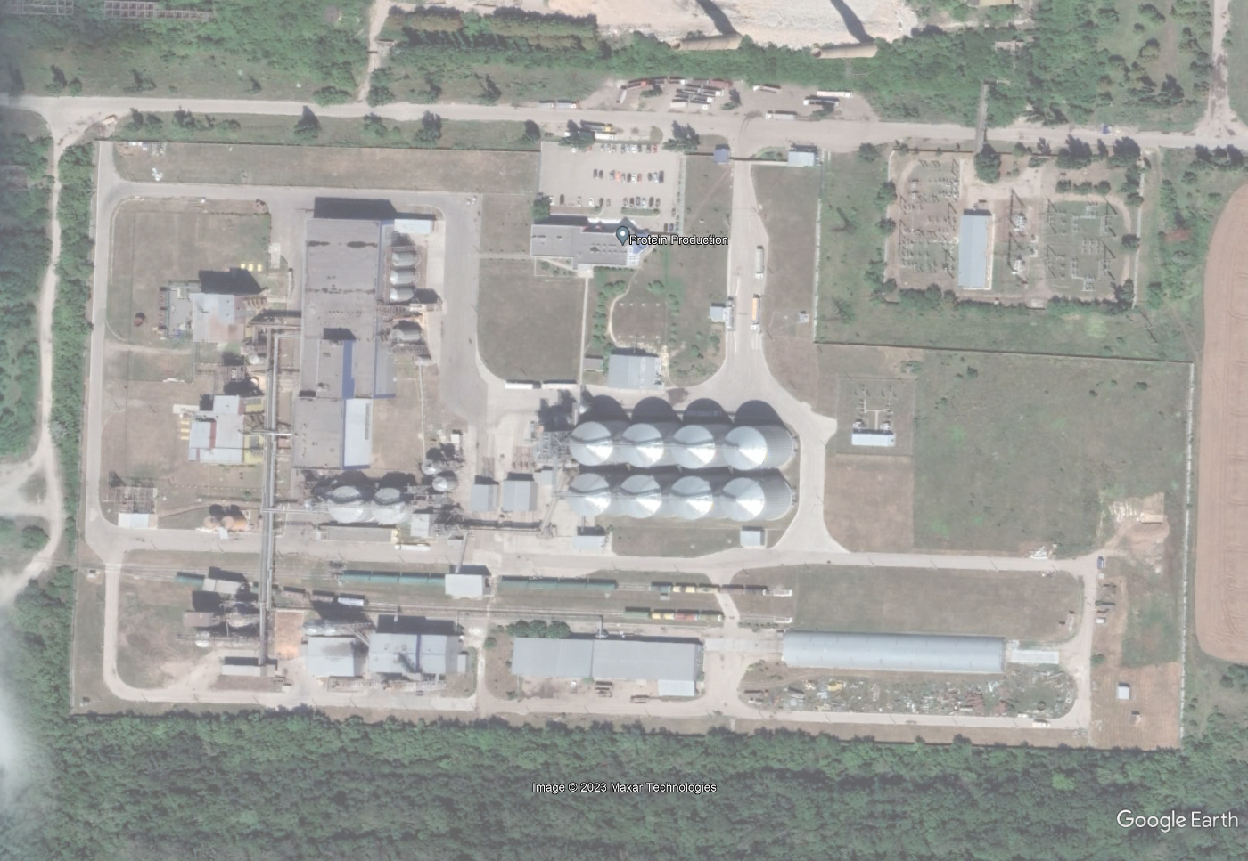
Carpet bombing of numerous grain storage silos near Solodka Balka, Ukraine
VNF detection cluster
Google Earth image of one set of silos
Cumulative VNF detections from March 2022 to October 2023 reveal and unusual cluster extremely
hot (~1600 K) IR emitter detections covering numerous grain storage silos.

Slide 13
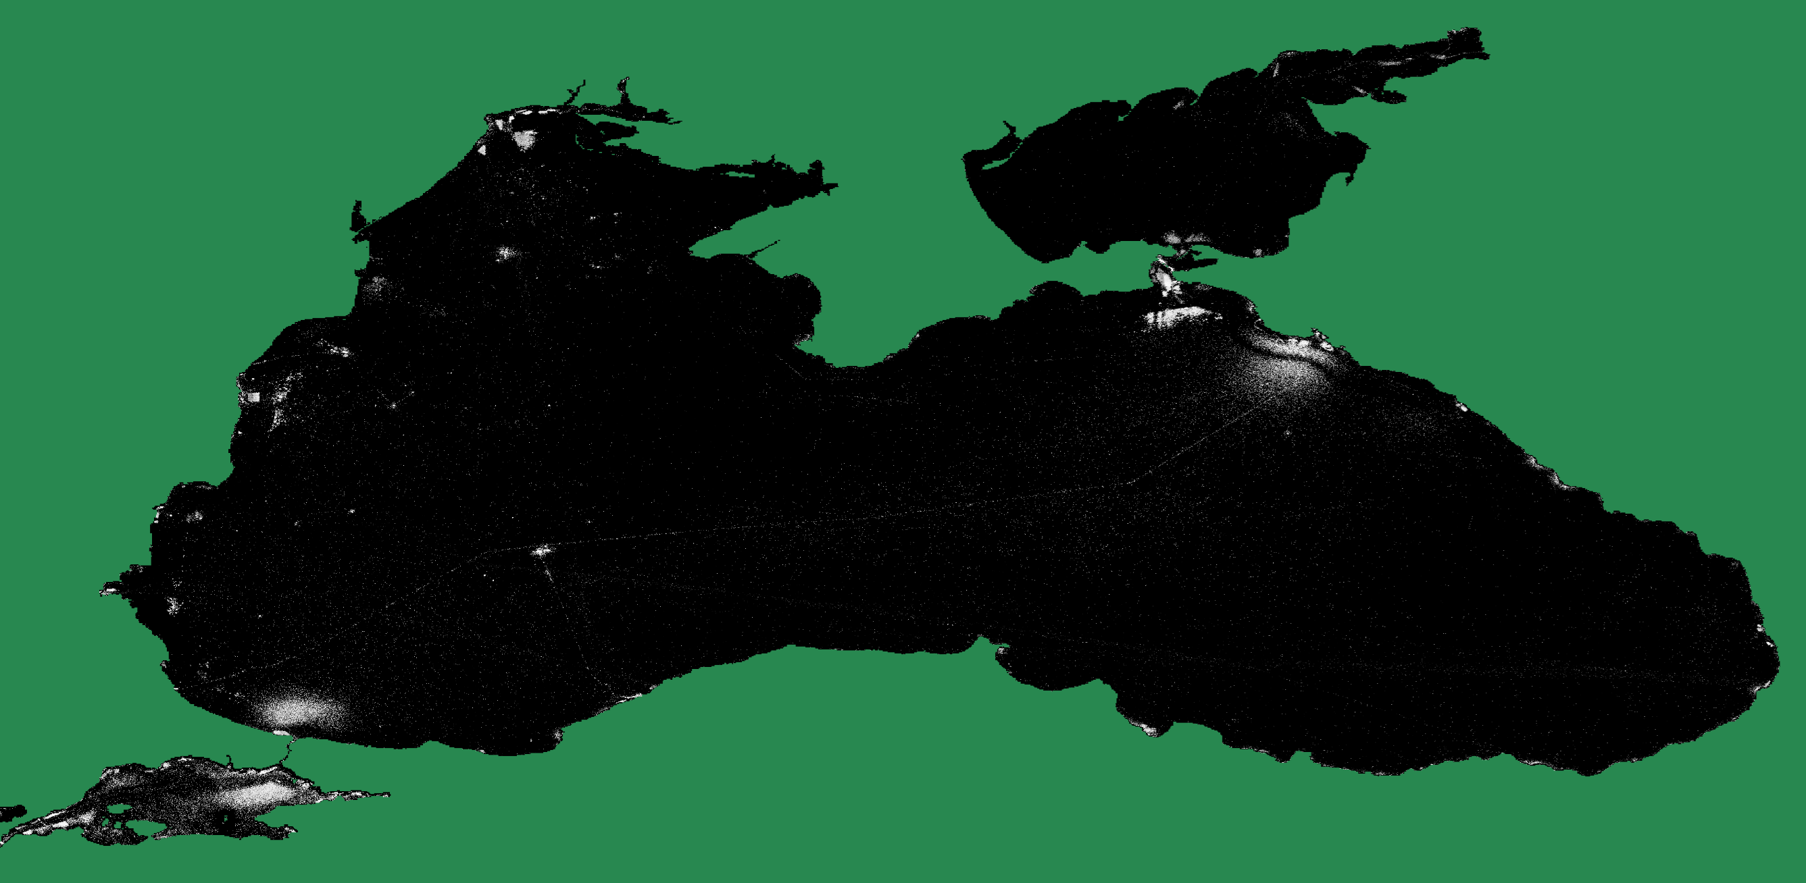
Cumulative VIIRS boat detections (VBD) in the Black Sea – 201701 through 202212

Slide 14
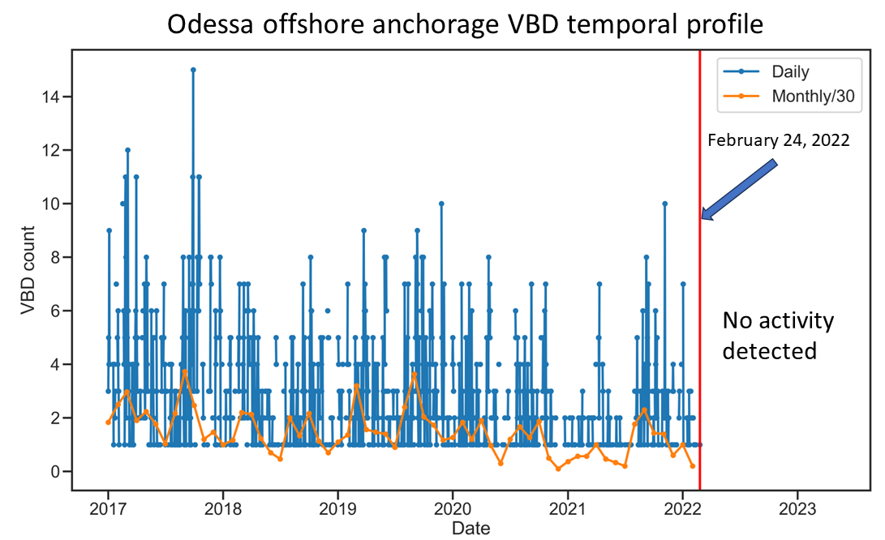
Example of Odessa VBD anchorage temporal profile shows detection ceased when the war began in February 2022.

Slide 15
EOG’s Proposal
Build nightly full country and surroundings temporal animations from 2020 to near-present.
  VIIRS nighttime lights (VNL)
  VIIRS nightfire (VNF) persistent IR emitting industrial sites
  VIIRS nightfire outside of industrial sites
  VIIRS boat detections (VBD)
Provide open access to the VIIRS record and technical support to sponsor.
Merge with war maps from the Institute for the Study of War and other sources.
Prepare and submit a report summarizing the findings.

Slide 16
VIIRS Nighttime Lights Publications
Elvidge, Christopher D., Kimberly Baugh, Mikhail Zhizhin, Feng Chi Hsu, and Tilottama Ghosh. "VIIRS night-time lights." International Journal of Remote Sensing 38, no. 21 (2017): 5860-5879.
Elvidge, Christopher D., Feng-Chi Hsu, Mikhail Zhizhin, Tilottama Ghosh, Jay Taneja, and Morgan Bazilian. "Indicators of electric power instability from satellite observed nighttime lights." Remote Sensing 12, no. 19 (2020): 3194.
Elvidge, Christopher D., Mikhail Zhizhin, Tilottama Ghosh, Feng-Chi Hsu, and Jay Taneja. "Annual time series of global VIIRS nighttime lights derived from monthly averages: 2012 to 2019." Remote Sensing 13, no. 5 (2021): 922.
Elvidge, Christopher D., Mikhail Zhizhin, David Keith, Steven D. Miller, Feng Chi Hsu, Tilottama Ghosh, Sharolyn J. Anderson et al. "The VIIRS Day/Night Band: A Flicker Meter in Space?." Remote Sensing 14, no. 6 (2022): 1316.
Elvidge, Christopher D., Kimberly Baugh, Tilottama Ghosh, Mikhail Zhizhin, Feng Chi Hsu, Tamara Sparks, Morgan Bazilian, Paul C. Sutton, Kenneth Houngbedji, and Ran Goldblatt. "Fifty years of nightly global low-light imaging satellite observations." Frontiers in Remote Sensing (2022): 79.

Slide 17
VIIRS Nightfire Publications
Elvidge, Christopher D., Mikhail Zhizhin, Feng-Chi Hsu, and Kimberly E. Baugh. "VIIRS nightfire: Satellite pyrometry at night." Remote Sensing 5, no. 9 (2013): 4423-4449.
Elvidge, Christopher D., Mikhail Zhizhin, Kimberly Baugh, Feng-Chi Hsu, and Tilottama Ghosh. "Methods for global survey of natural gas flaring from visible infrared imaging radiometer suite data." Energies 9, no. 1 (2015): 14.
Elvidge, Christopher D., Mikhail Zhizhin, Kimberly Baugh, Feng Chi Hsu, and Tilottama Ghosh. "Extending nighttime combustion source detection limits with short wavelength VIIRS data." Remote Sensing 11, no. 4 (2019): 395.
Elvidge, Christopher D., Mikhail Zhizhin, Feng Chi Hsu, Tamara Sparks, and Tilottama Ghosh. "Subpixel Analysis of Primary and Secondary Infrared Emitters with Nighttime VIIRS Data." Fire 4, no. 4 (2021): 83.
Zhizhin, Mikhail, Christopher Elvidge, and Alexey Poyda. "Night-Time Detection of Subpixel Emitters with VIIRS Mid-Wave Infrared Bands M12–M13." Remote Sensing 15, no. 5 (2023): 1189.
Elvidge, Christopher D., Mikhail Zhizhin, Tamara Sparks, Tilottama Ghosh, Stephen Pon, Morgan Bazilian, Paul C. Sutton, and Steven D. Miller. "Global Satellite Monitoring of Exothermic Industrial Activity via Infrared Emissions." Remote Sensing 15, no. 19 (2023): 4760.

Slide 18
VIIRS Boat Detection Publications
Elvidge, Christopher D., Mikhail Zhizhin, Kimberly Baugh, and Feng-Chi Hsu. "Automatic boat identification system for VIIRS low light imaging data." Remote sensing 7, no. 3 (2015): 3020-3036.
Elvidge, Christopher D., Tilottama Ghosh, Kimberly Baugh, Mikhail Zhizhin, Feng-Chi Hsu, Nilo Selim Katada, Wilmon Penalosa, and Bui Quang Hung. "Rating the effectiveness of fishery closures with visible infrared imaging radiometer suite boat detection data." Frontiers in Marine Science 5 (2018): 132.
Hsu, Feng-Chi, Christopher D. Elvidge, Kimberly Baugh, Mikhail Zhizhin, Tilottama Ghosh, David Kroodsma, Adi Susanto et al. "Cross-matching VIIRS boat detections with vessel monitoring system tracks in Indonesia." Remote Sensing 11, no. 9 (2019): 995.
Elvidge, Christopher D., Tilottama Ghosh, Namrata Chatterjee, and Mikhail Zhizhin. "Lights on the Water? Accumulating VIIRS boat detection grids in Southeast Asia spanning 2012–2021." Fish for the People 21, no. 1 (2023): 33-38.

Slide 19
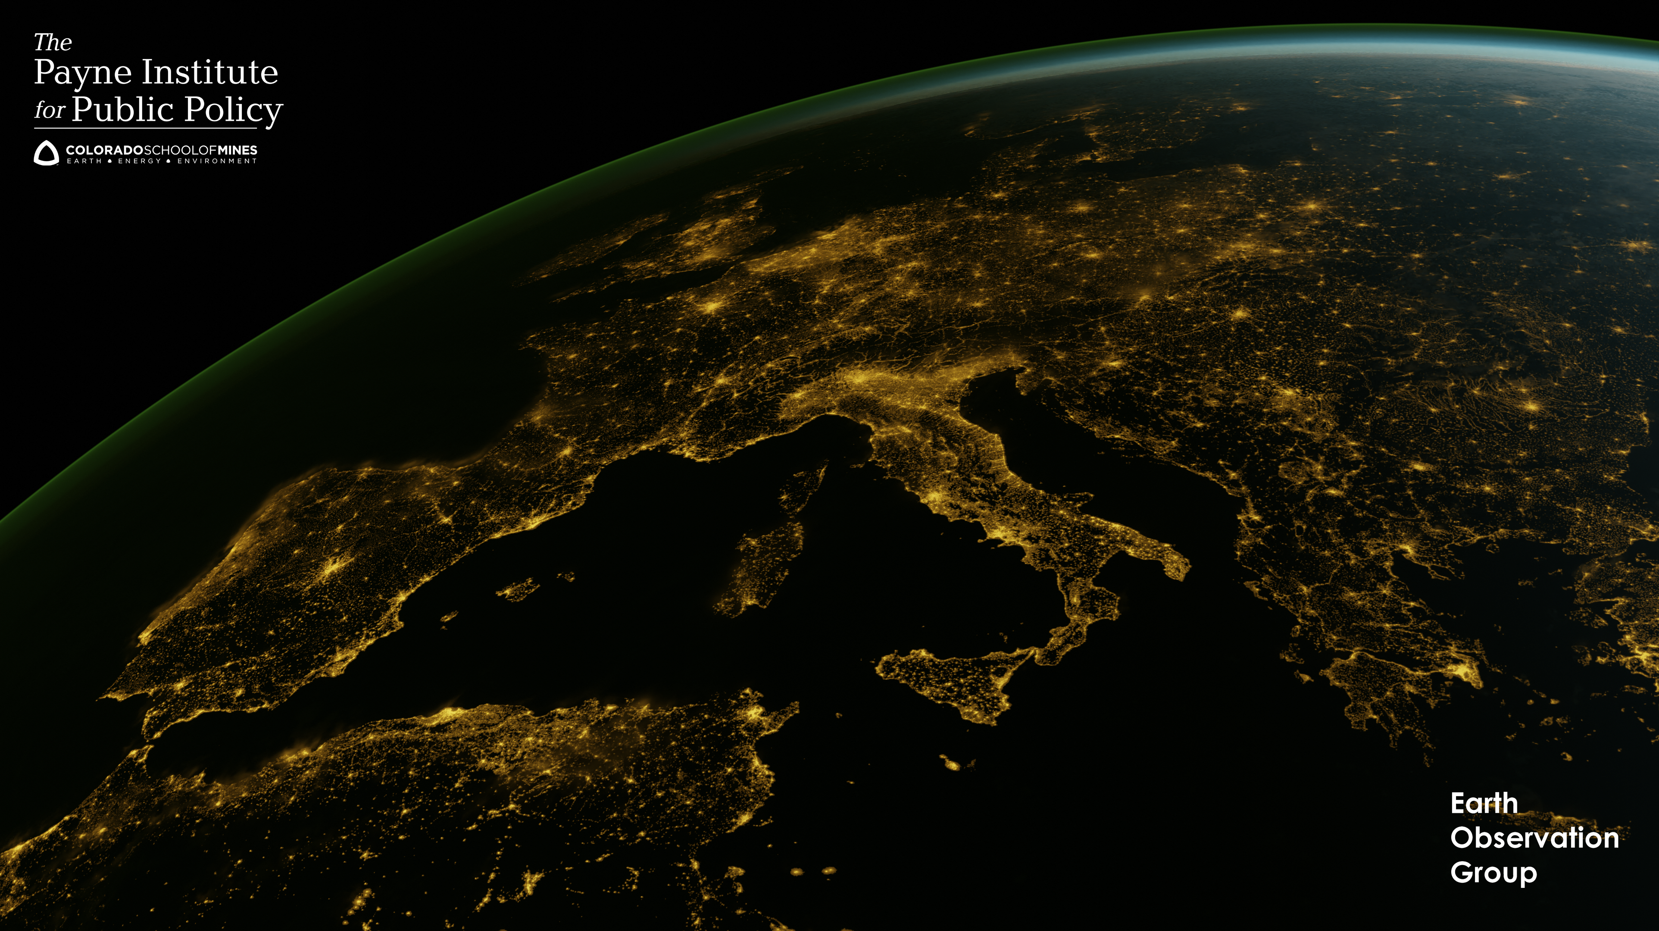
For more information, visit
https://payneinstitute.mines.edu/eog/
or email celvidge@mines.edu

