Slide 1
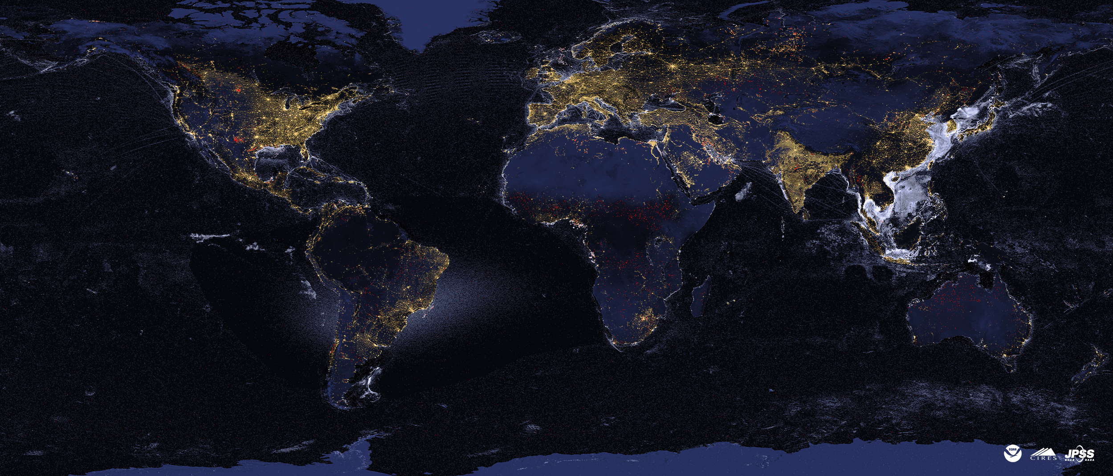
Nighttime Remote Sensing
Chris Elvidge
Earth Observation Group
Payne Institute for Public Policy
Colorado School of Mines
Golden, Colorado
celvidge@mines.edu
Presented at AIT
January 9, 2024

Slide 2
Why observe the Earth at night?
That when the lights are turned on outside
Anthropogenic radiant emissions (lights and infrared emitters) are easier to detect at night.
If the sensor is seeing a noise floor and emitters, the radiance of the emitters pixels can be fully attributed to the emitters inside the pixel footprint.
Detection of IR emitters in the midwave infrared (MWIR) is simplified at night

Slide 3
EOG makes three global data products from VIIRS nighttime data
Temporal increments are nightly, monthly, annual, and multiyear
VNL = VIIRS nighttime lights
VBD = VIIRS boat detections
VNF = VIIRS nightfire
To access the data sign up for an EOG registration via https://eogdata.mines.edu/products/register/
To access VNF data there is a license agreement at https://eogdata.mines.edu/files/vnf_license_agreement_form.pdf

Slide 4
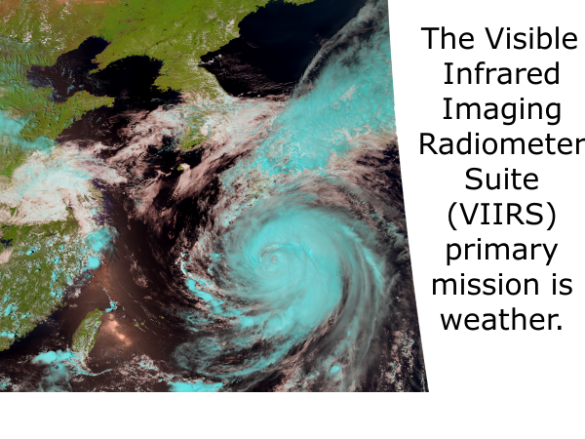

Slide 5
The VIIRS day/night band (DNB) collects low light imaging data in the visible at night to enable detection of moonlit clouds. Electric lighting, fires and flares are also detected.
Thank you meteorologists!
Manila, March 23, 2016

Slide 6
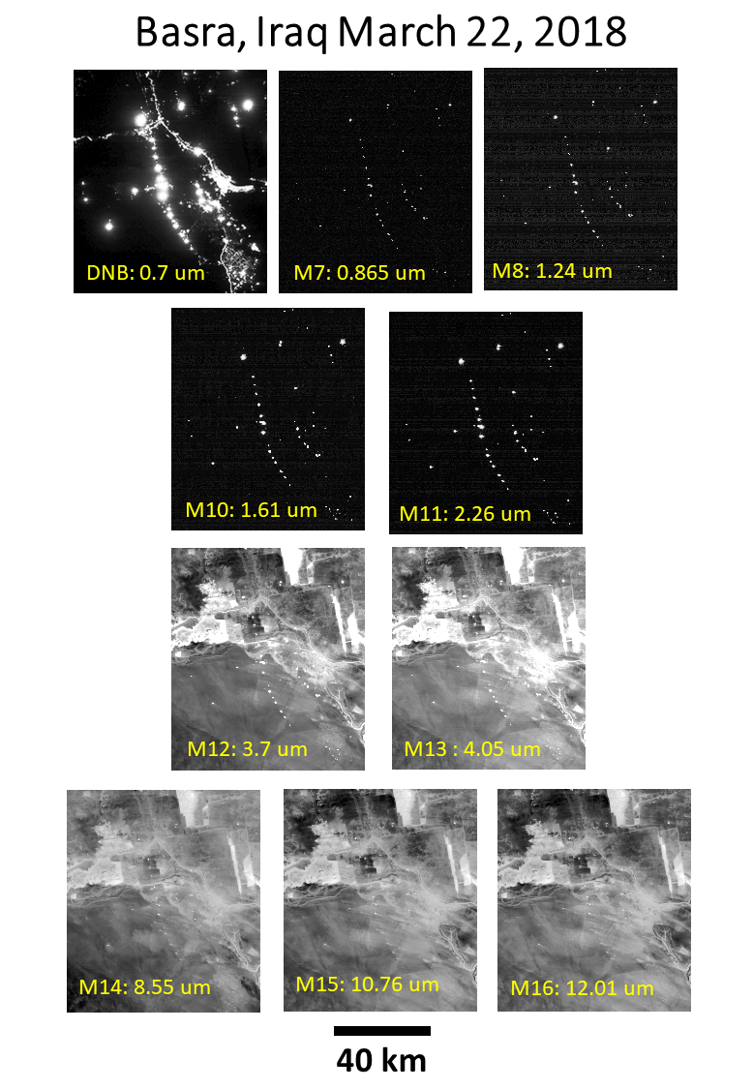
VIIRS collects low light imaging data in five spectral bands at night. The day / night band (DNB) straddles the visible and near infrared and has a million-fold signal amplification. Four daytime channels (two near and shortwave infrared) continue to collect at night. With sunlight eliminated these serve as super-detectors for infrared emitters!

Slide 7
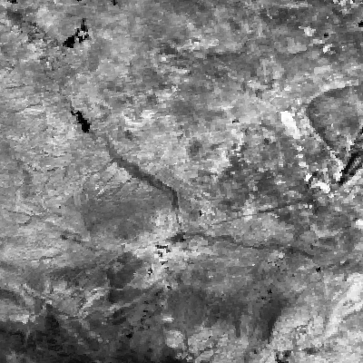
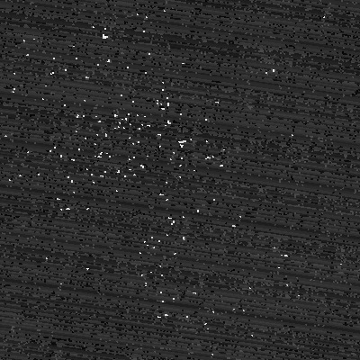
For gas flares – the nighttime is the right time! Bakken Oil Field, North Dakota
Shortwave infrared (1.63 um) day
Same band, same area, next night
Gas flare peak radiant emissions are near 1.63 micrometers.
The flare radiance is lost during the day due to sunlight.

Slide 8
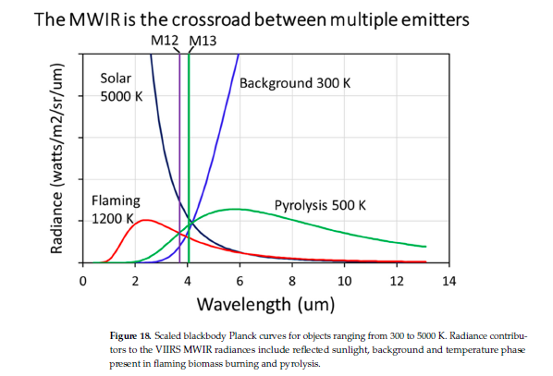
The midwave infrared is complicated

Slide 9
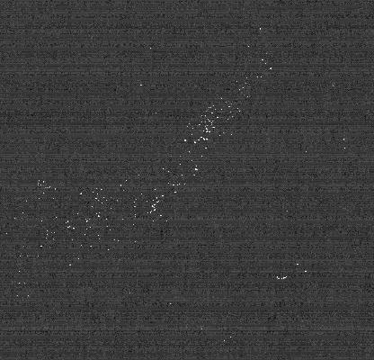
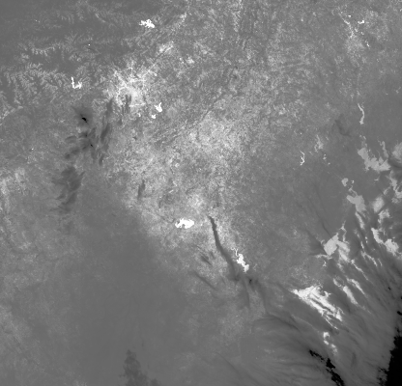
The nighttime SWIR bands are vital for flare detection because they cover the peak in radiant emissions. Here is an example of simultaneously acquired nighttime M10 and M16 collected on the Eagle Ford basin in Texas.
M10
M16

Slide 11
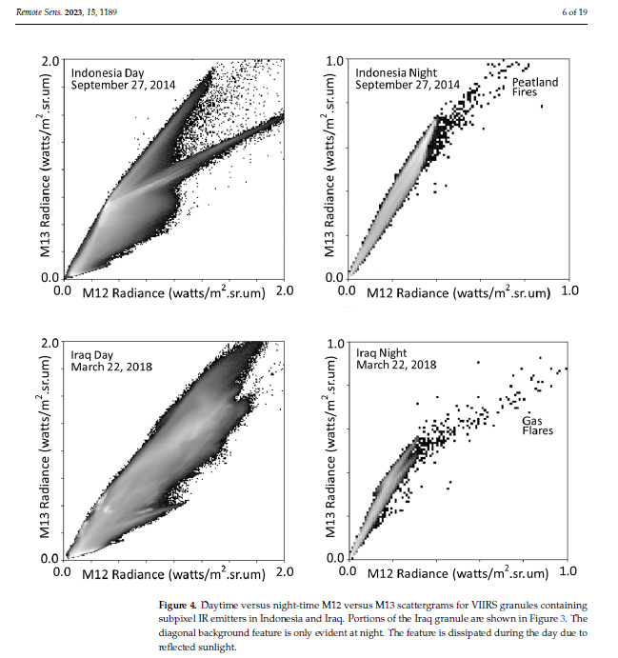
At night the MWIR background collapses to a diagonal – simplifying the detection of IR emitters

Slide 12
Why Multispectral?
To get at the Planck curves!
Background
Gas
Flare
Daily files are in csv and kmz formats

Slide 13
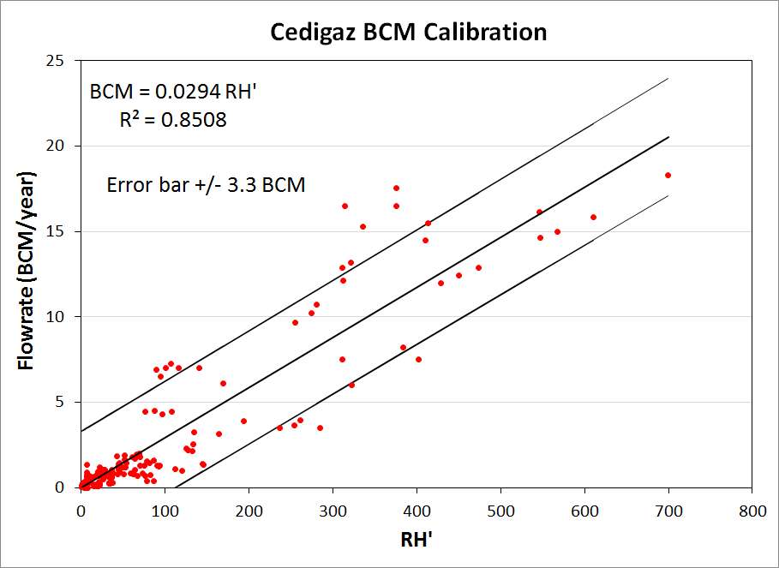
EOG’s original calibration based on national level flared plus vented reported volumes assembled by Cedigaz
Has high error bars due to unresolvable inaccuracies in the reported data.

Slide 14
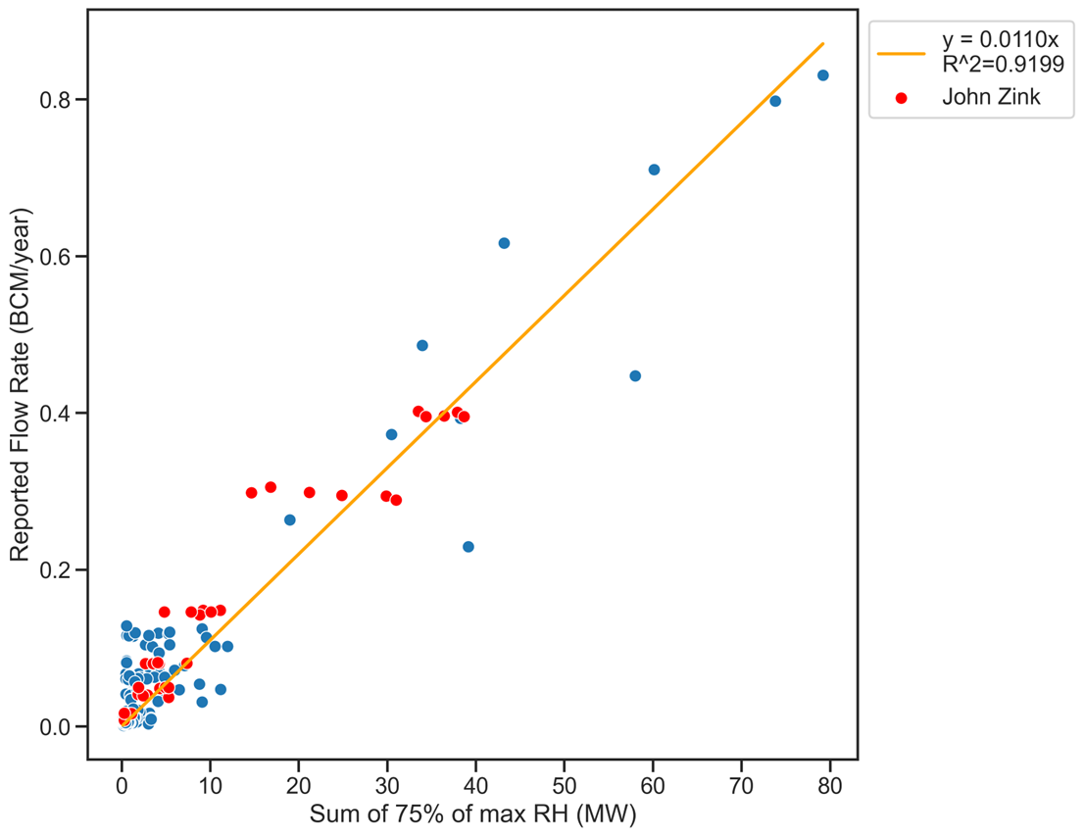
Merged John Zink and OGCI calibration covers flow rates to near one BCM per year

Slide 15
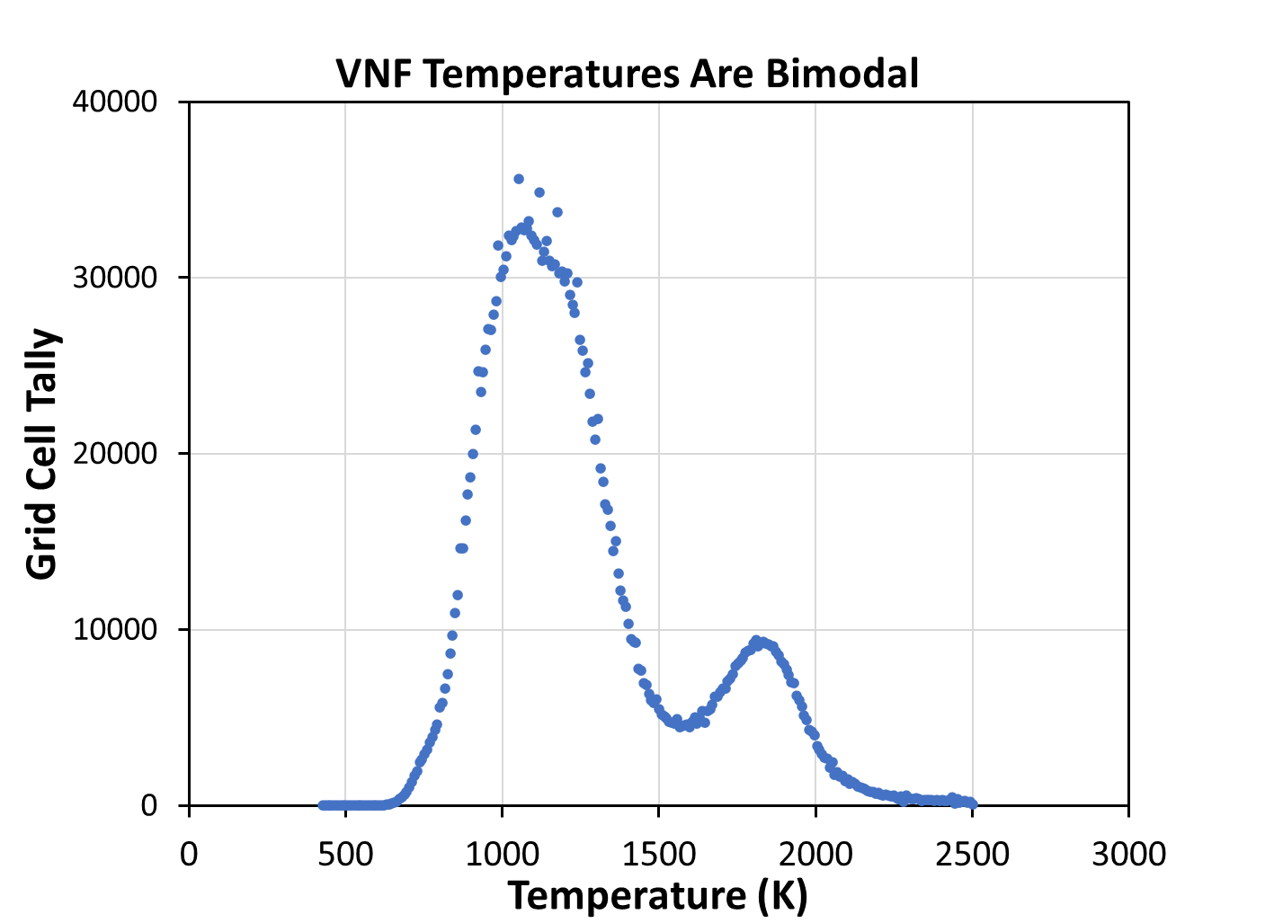
Histogram of Global 2012-2022 VNF Temperatures There is overlap between flaring and biomass burning in the range 1300-1500 K

Slide 16
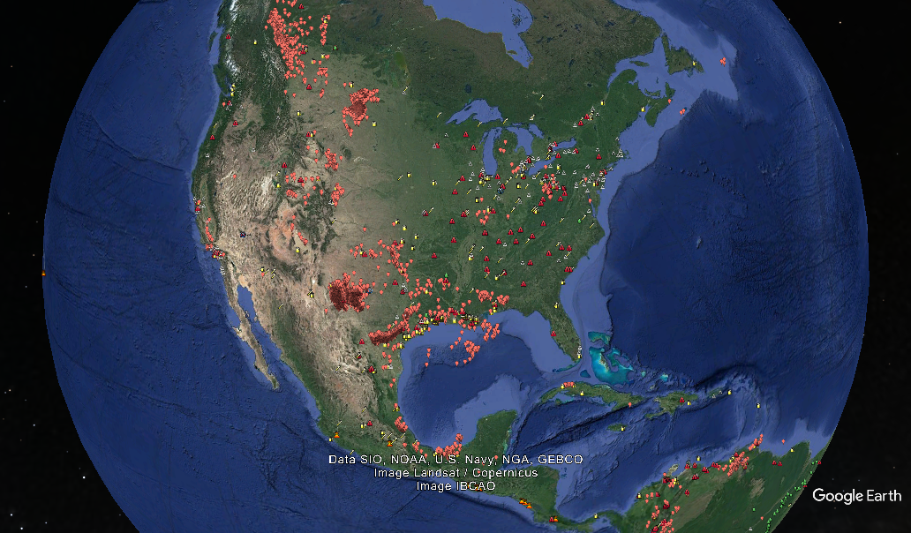
EOG’s Multiyear IR Emitter Catalog With Temporal Profiles (2012-2024) https://eogmap.mines.edu/giree

Slide 17
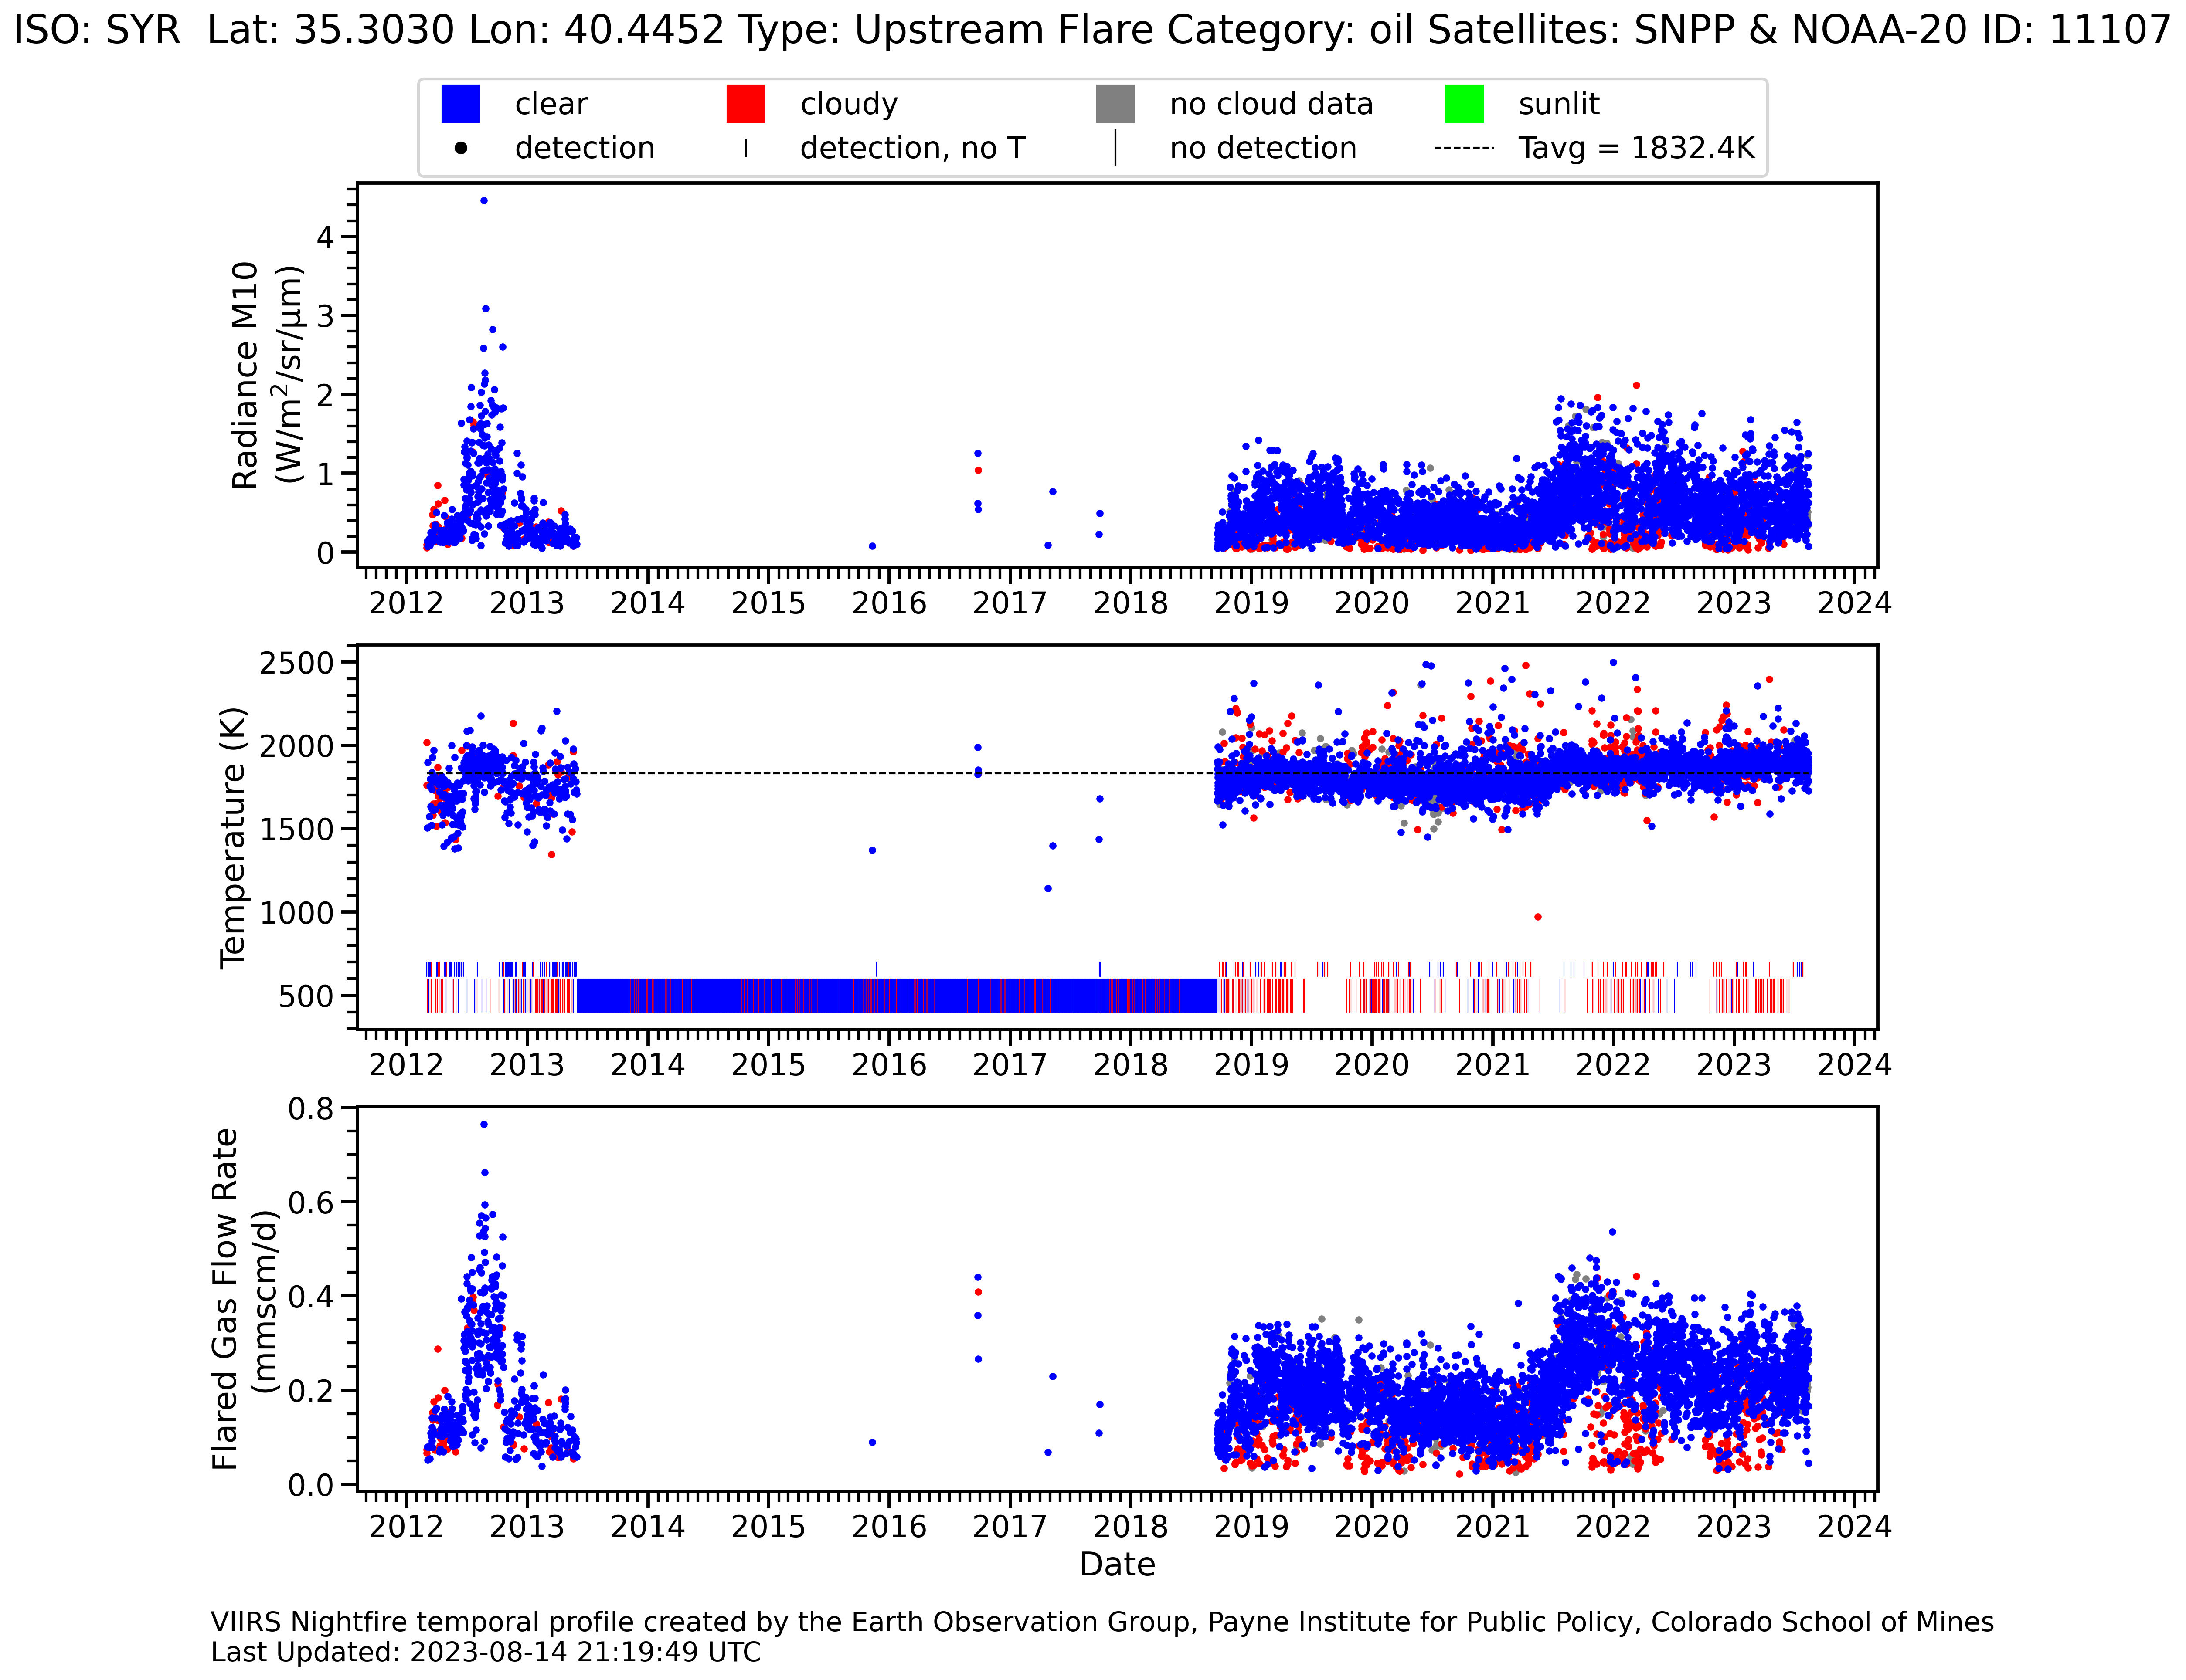
Temporal profile for a flare in Syria has an outage from mid-2013 to later 2018. Profiles are updated once per week.

Slide 18
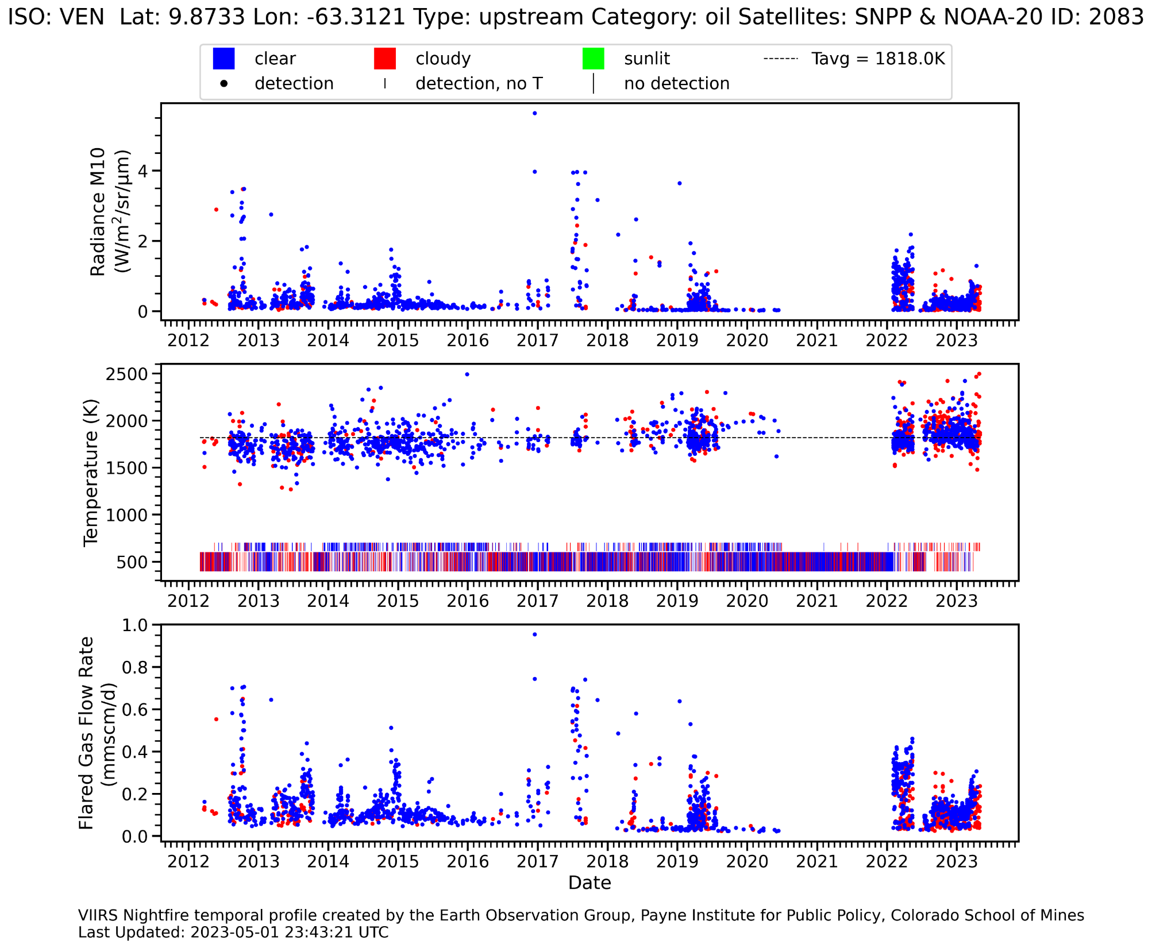
Venezuela “Gappy” Flare

Slide 19
Flare “gappiness” is an indicator of venting – the release of methane to the atmosphere without combustion.

Slide 20
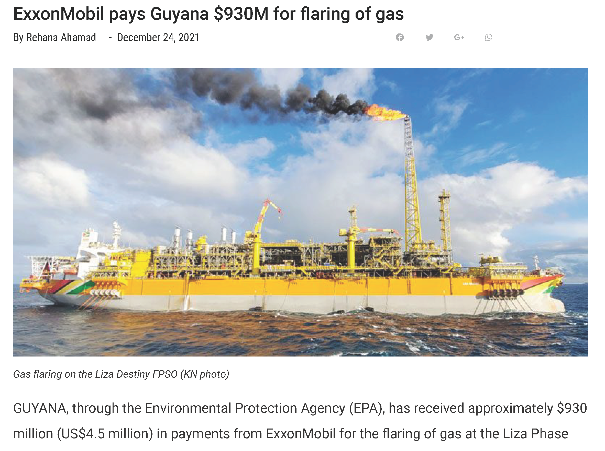
FPSO is a “floating production storage and offloading” facility. Exxon paid $45 GY per ton of gas flared. The fine was $4.5 million USD.
Let’s take a close look at
an interesting flare!

Slide 21
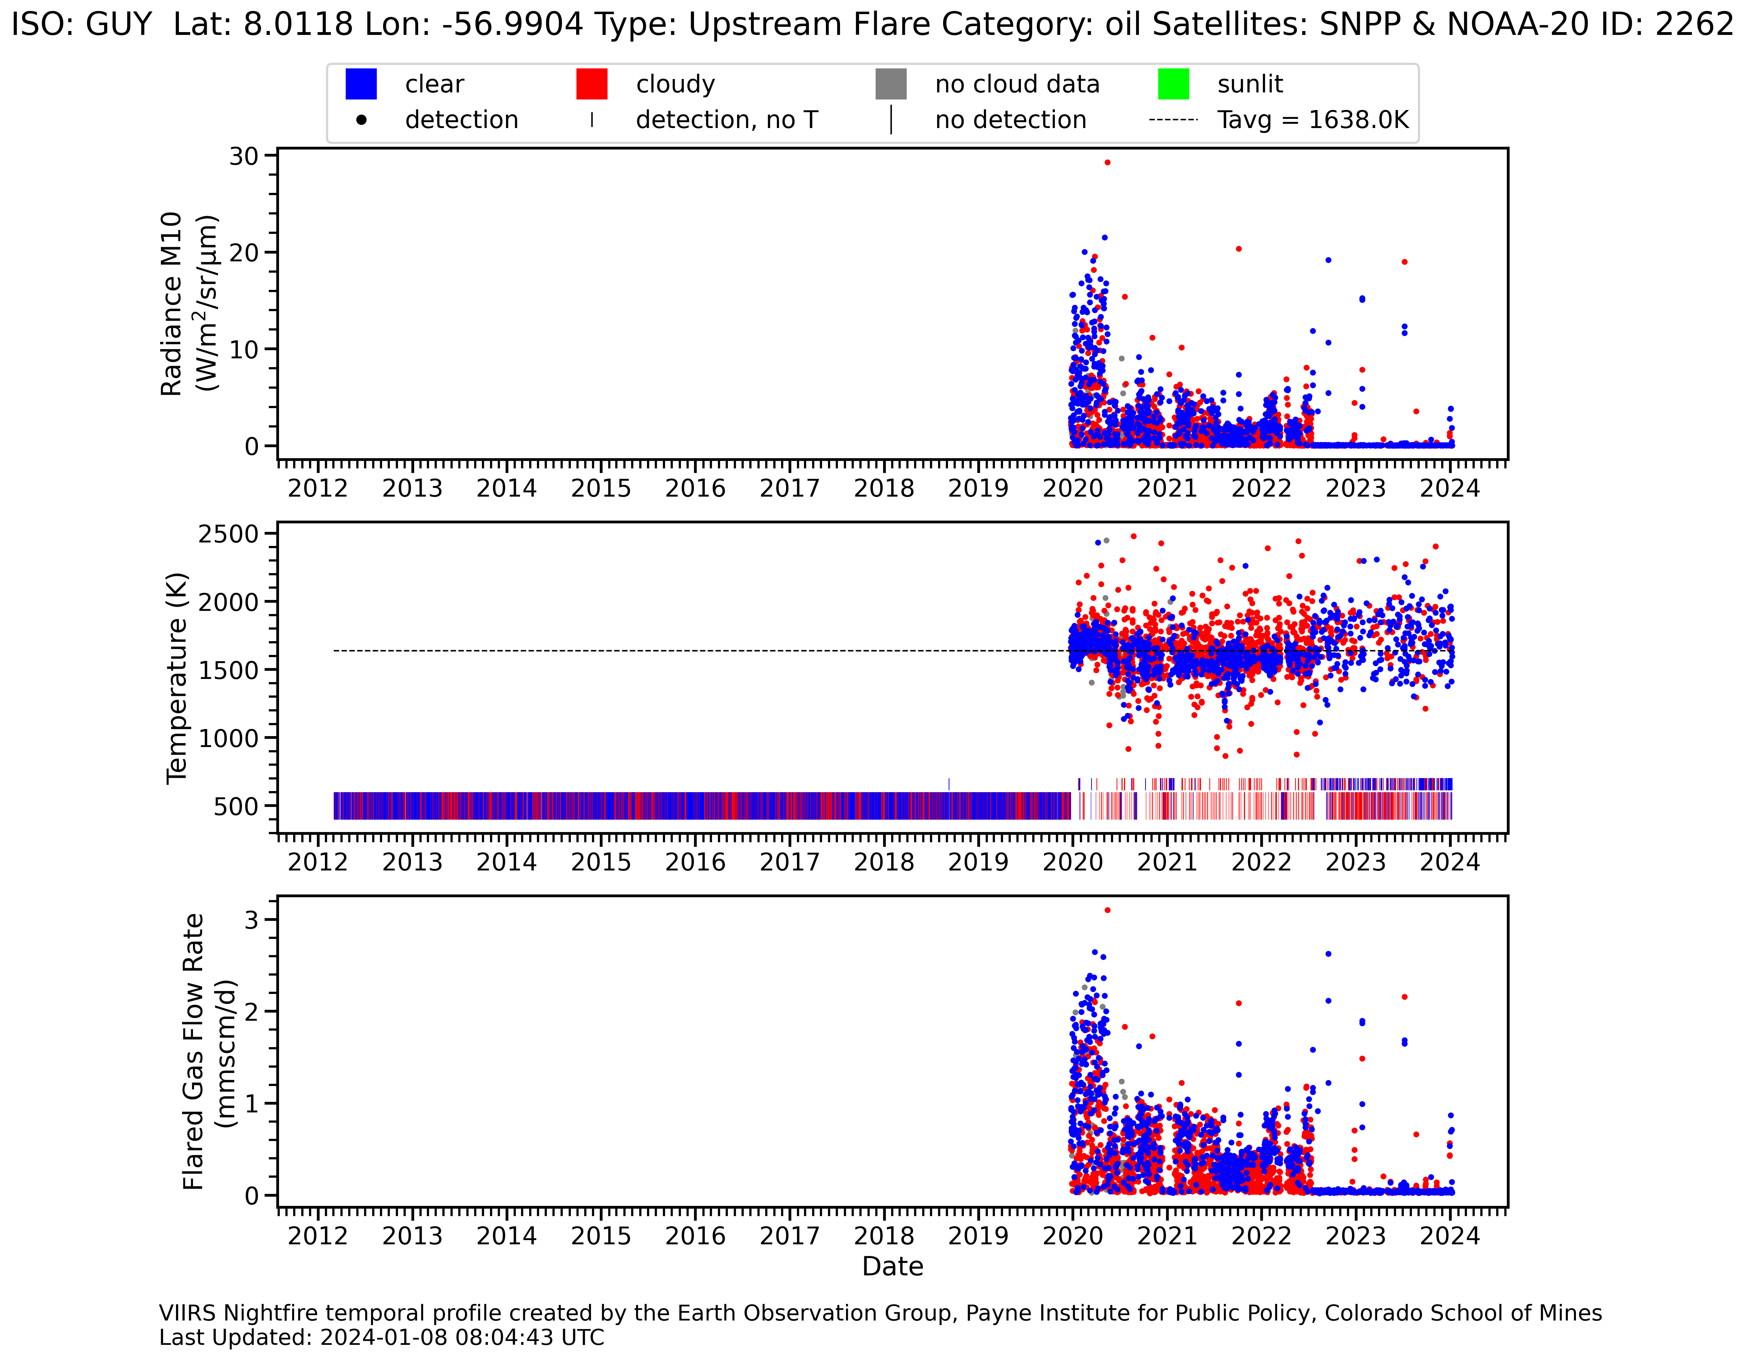
Cessation of routine flaring at Exxon’s “Liza Destiny” FSPO. Pilot light is still detected?

Slide 22
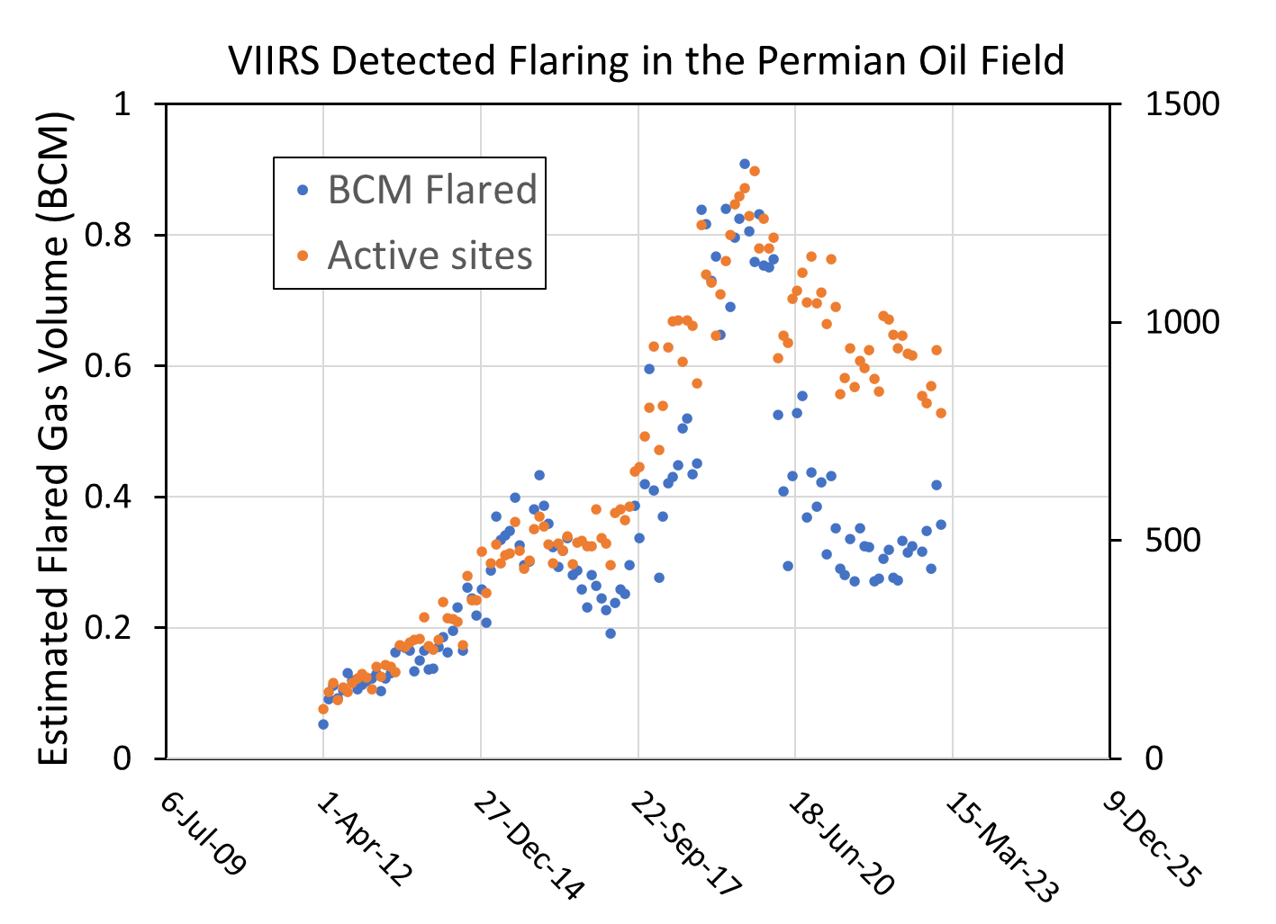
Permian VNF monthly summaries of active sites versus flared gas volume

Slide 23
Summary
EOG processes all nighttime VIIRS data (150 GB per satellite per day) from SNPP, NOAA-20 and NOAA-21 in near-real time with the nightfire algorithm.
By filtering out biomass burning, EOG distilled a decade of nightly VNF data to form a multiyear catalog of industrial infrared emitters, each with a temporal profile. The profiles are updated weekly.
The temporal profiles can be interpreted to identify changes in flare activity, including the cessation of routine flaring.
When routine flaring ceases – a pilot light may remain detectable.
While cities such as Las Vegas are widely regarded as the brightest places on earth at night, gas flares can be ten times brighter.

Slide 24
For more information, visit https://payneinstitute.mines.edu/eog/ or email celvidge@mines.edu

