Slide 1
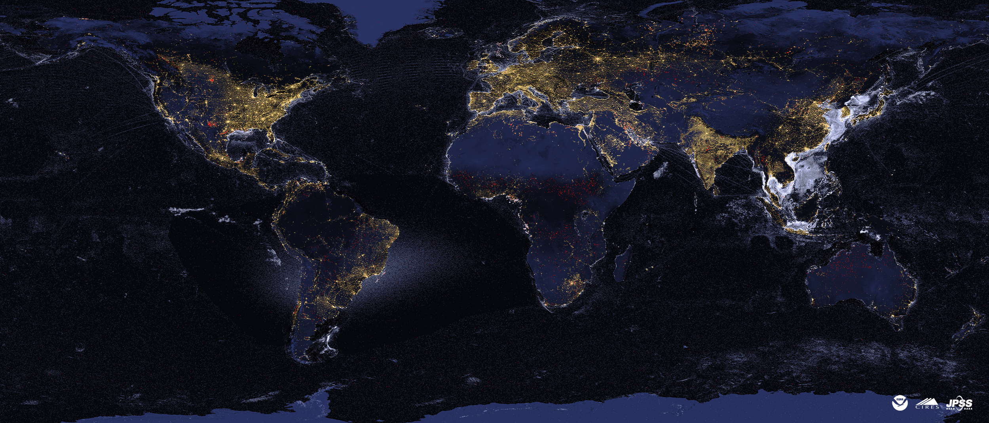
VIIRS Nightfire – Flaming and Non-Flaming Combustion From Space
Christopher D. Elvidge, Mikhail Zhizhin, Tilottama Ghosh, Tamara Sparks, Stephen Pon
Earth Observation Group
Payne Institute for Public Policy
Colorado School of Mines
Golden, Colorado
celvidge@mines.edu
February 2, 2024

Slide 2
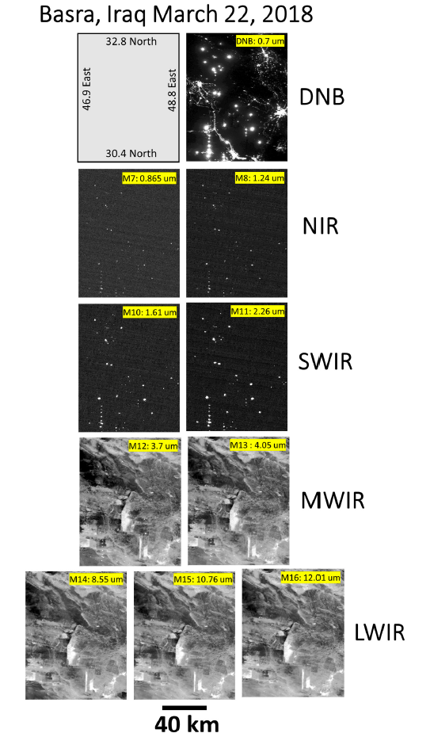
VIIRS is unique in collecting data in four near and shortwave infrared channels at night. These channels are designed for daytime imaging. At night – they serve as super-detectors for infrared emitters!

Slide 3
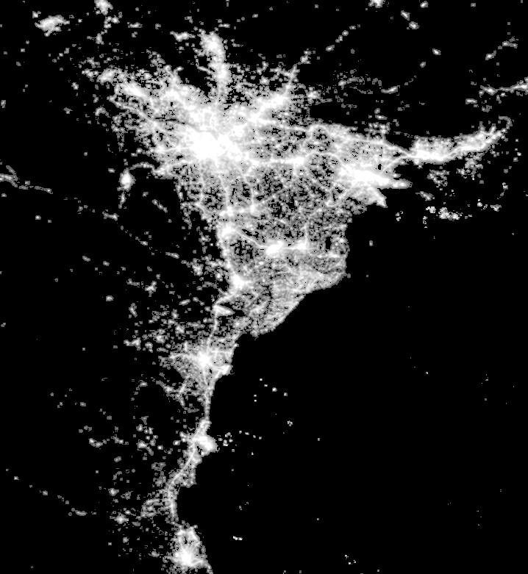
VIIRS Nighttime Lights – Hanoi - 2022

Slide 4
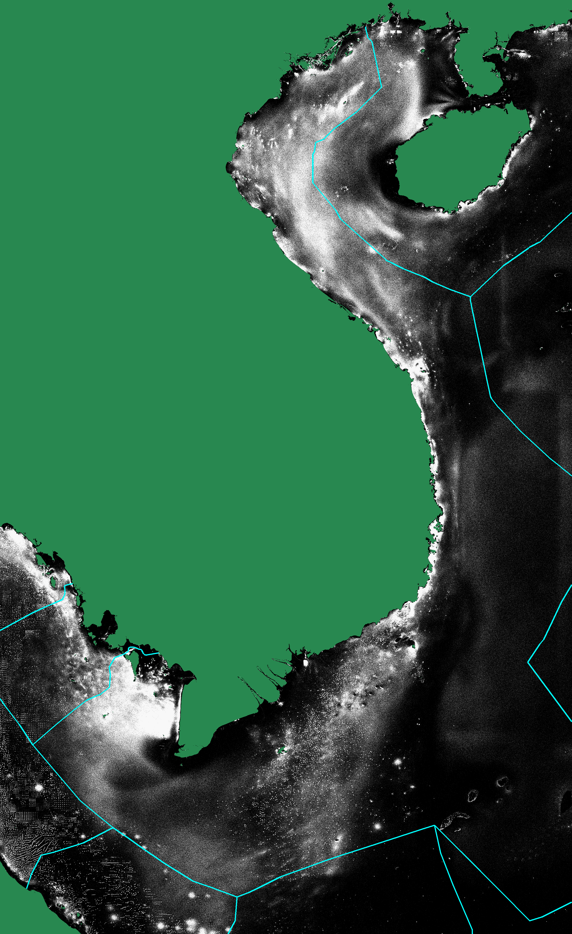
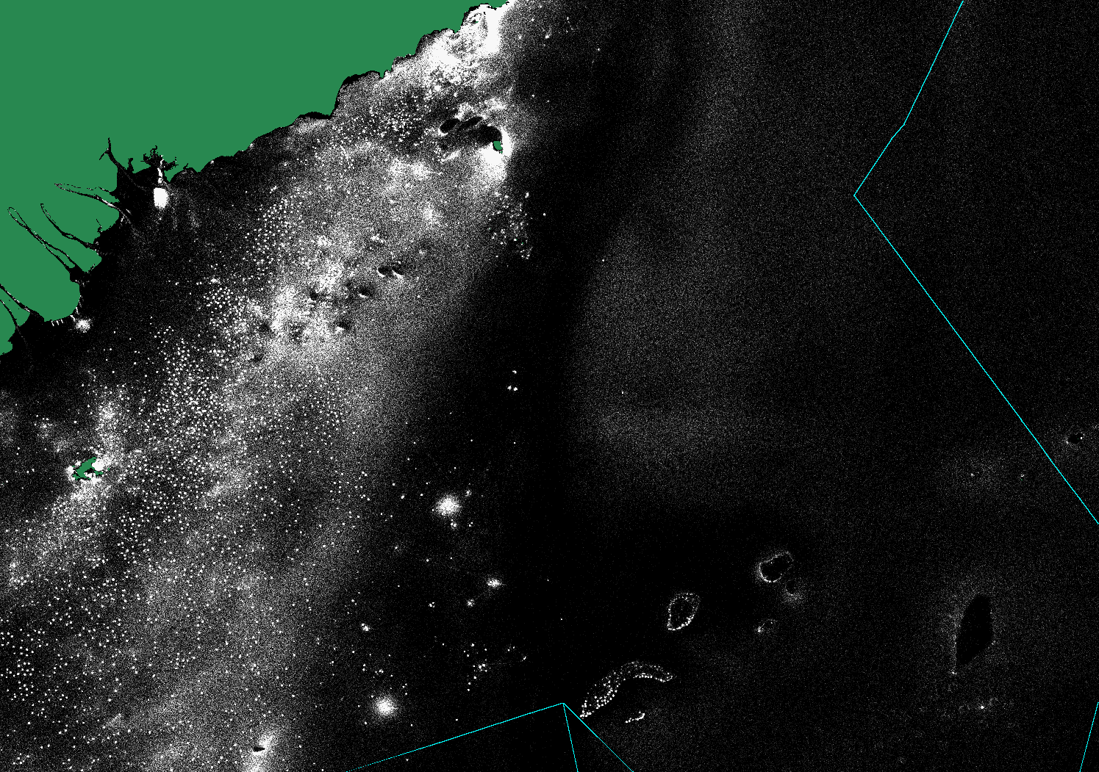
Eleven-year accumulation of nightly VIIRS boat detections

Slide 5
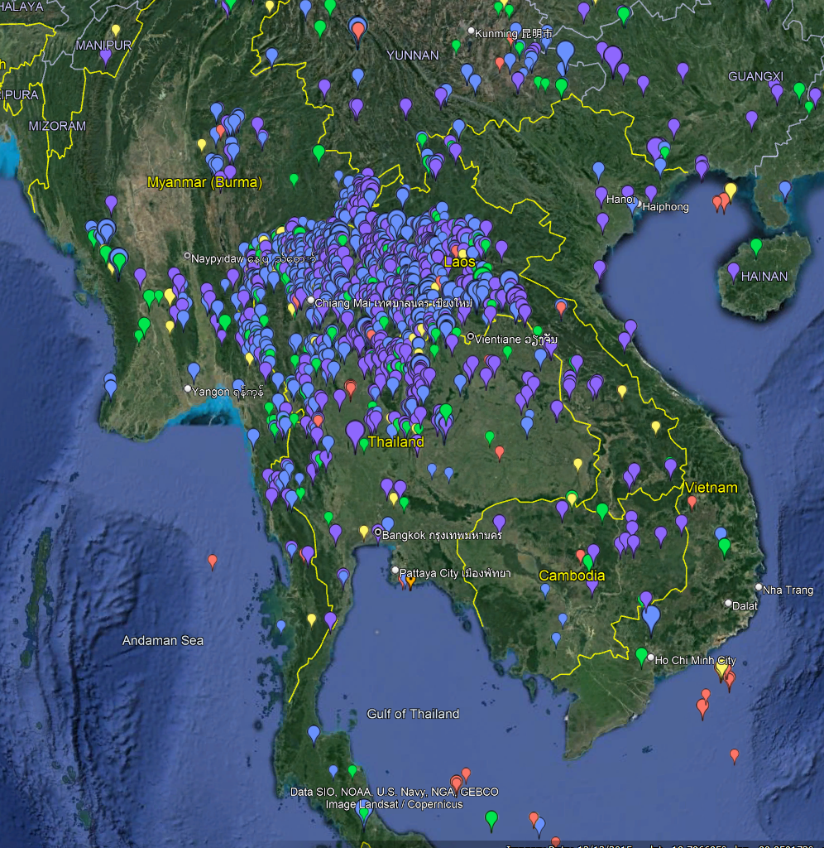
VIIRS Nightfire v.3 April 1, 2023

Slide 6
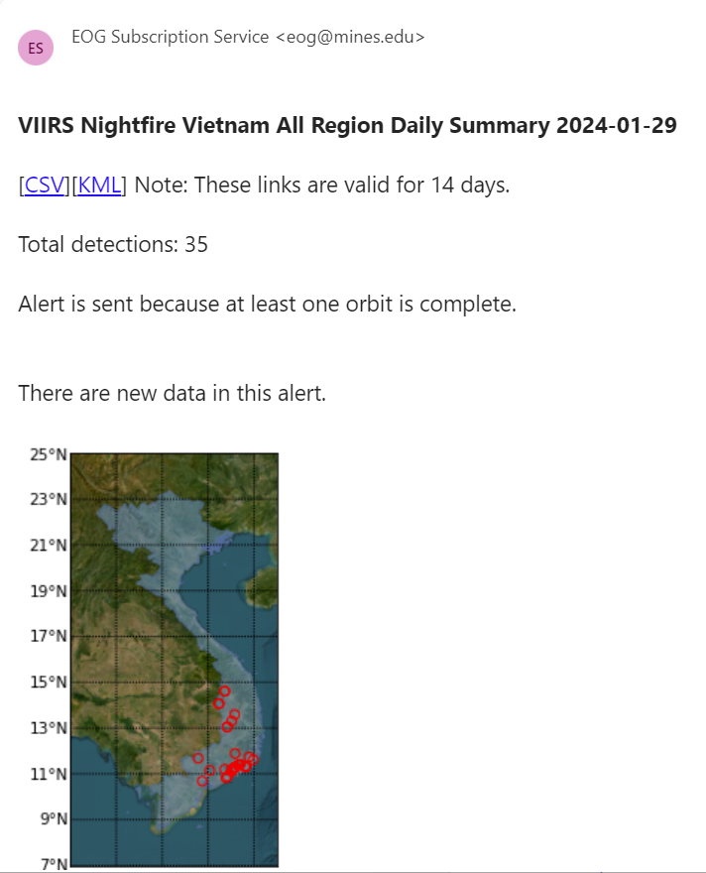
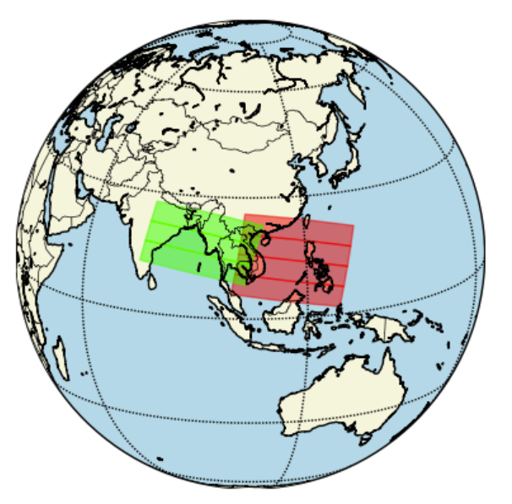
EOG sends VBD and VNF detections at about 06:00 local time. Alerts run for Vietnam, Thailand, Indonesia and S.E. Asia. Let us know if you want alerts!

Slide 7
If an object fills the field of view – its temperature can be calculated from the radiance in a single spectral band
Plank curve lines for full pixel objects do not cross each other. Thus, the objects temperature can be calculated with the observed radiance in a single spectral band. The situation is more complicated for subpixel IR emitters.

Slide 8
Biomass Burning is a Coupled Exothermic / Endothermic System
Flaring, flaming, and smoldering are exothermic – giving off heat. Pyrolysis is driven by the heat emitted by flaming and smoldering. Flaming combustion is fed by volatile gases released by pyrolysis.

Slide 9
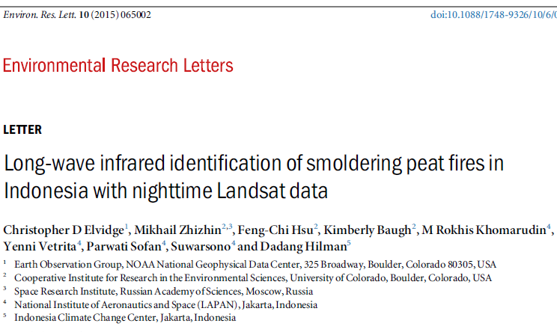
2015 paper on flaming vs non-flaming peatland fires with nighttime Landsat

Slide 10
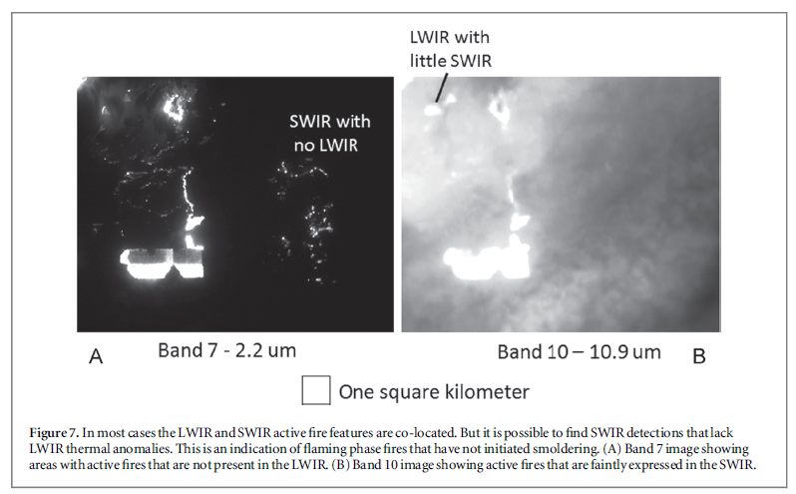
Examples of SWIR only, LWIR only and both, implying two combustion phases.

Slide 11
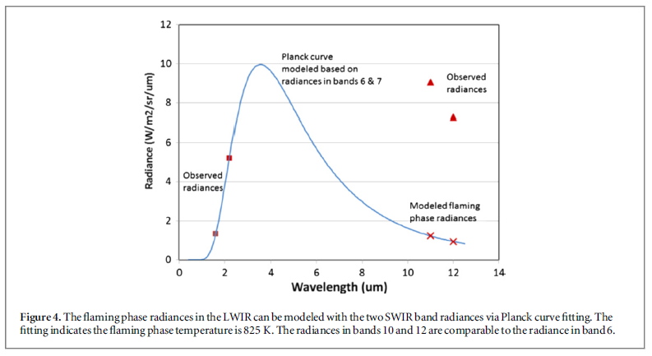
Rudiments of the Flaming-Subtractive Algorithm in 2015

Slide 12
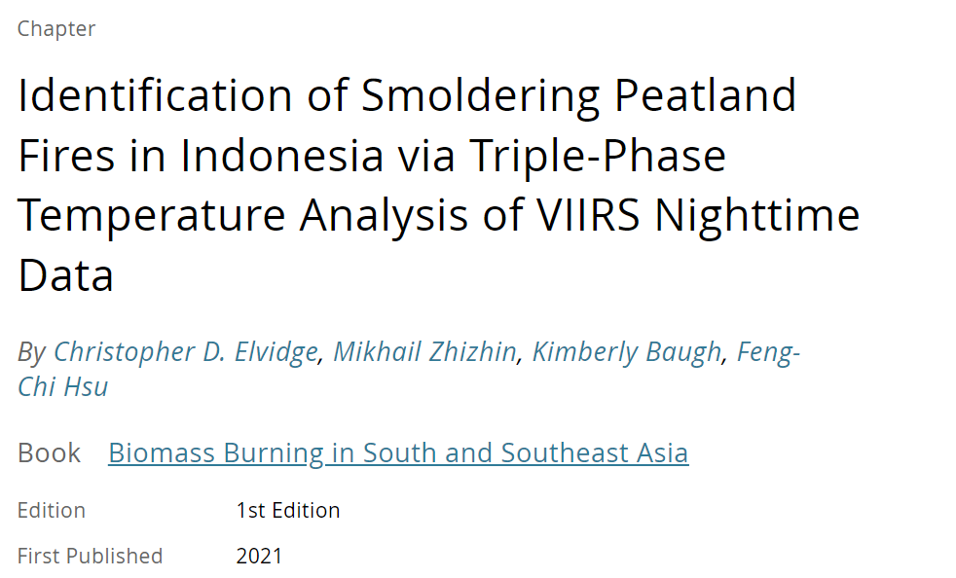
Flaming subtractive method applied to VIIRS. Book editor was Krishna!

Slide 13
Physical laws used by VIIRS Nightfire
Temperature is calculated based on the wavelength of peak radiant emissions using Wien’s Displacement Law.
Source area is calculated based on the ratio of the observed Planck curve amplitude versus the Planck for an object at that temperature filling the field of view (Planck’s Law).
Heat output (radiant heat) is calculated with temperature and source area via the Stefan-Boltzmann Law.

Slide 14
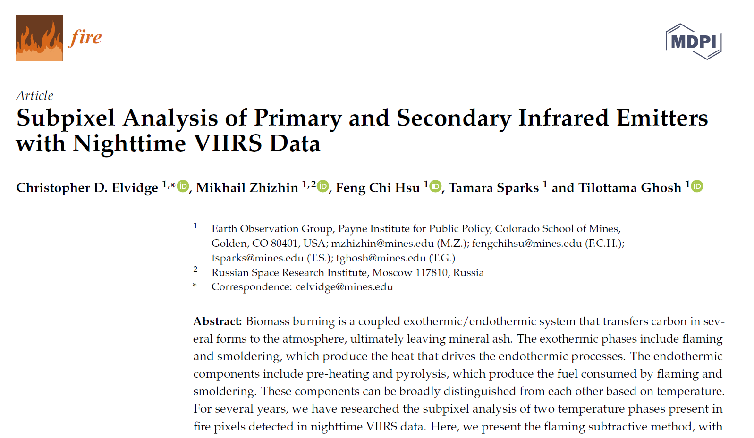
Fire 2021, 4, 83. https://doi.org/10.3390/fire4040083

Slide 15
VNF v.4 nightly global processing started September 1, 2023 – eight years after the nighttime Landsat paper. VNF v.4 has atmospheric correction and tests VNF detections having SWIR and MWIR detection for the presence of secondary emitters. This testing has a ~50% success in identifying secondary emitters.

Slide 16
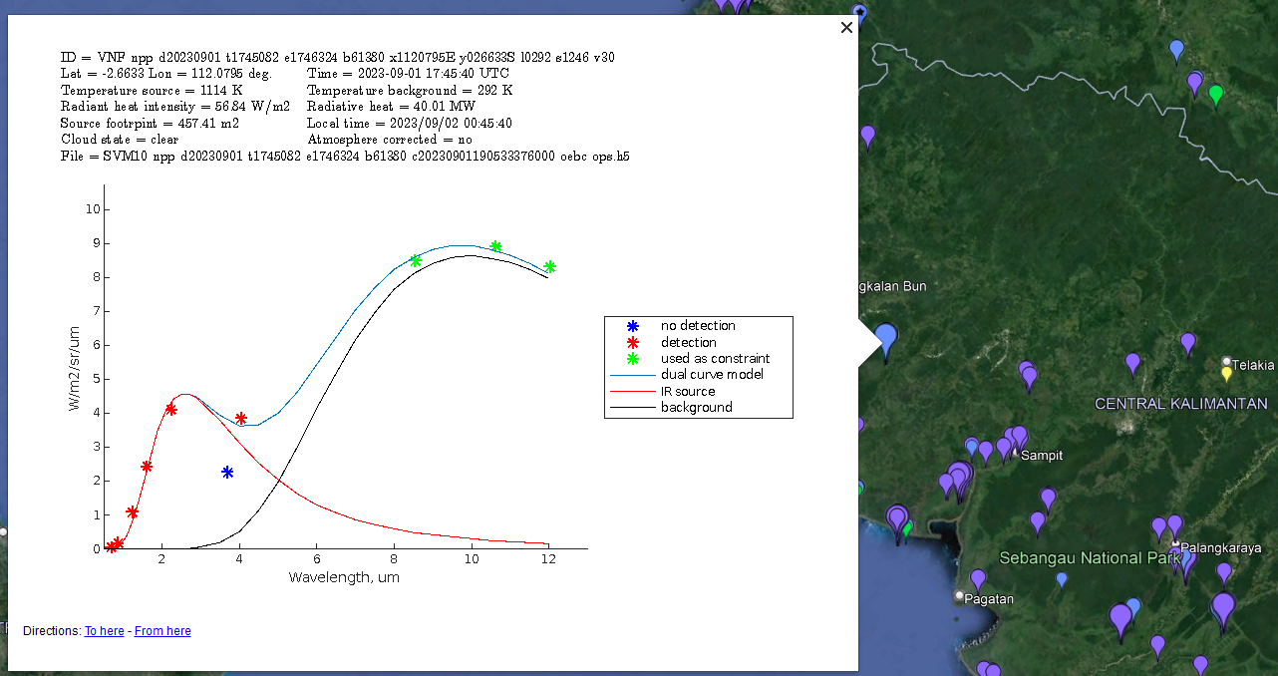
VNF v.3 biomass burning in Kalimantan, Indonesia September 1, 2023

Slide 17
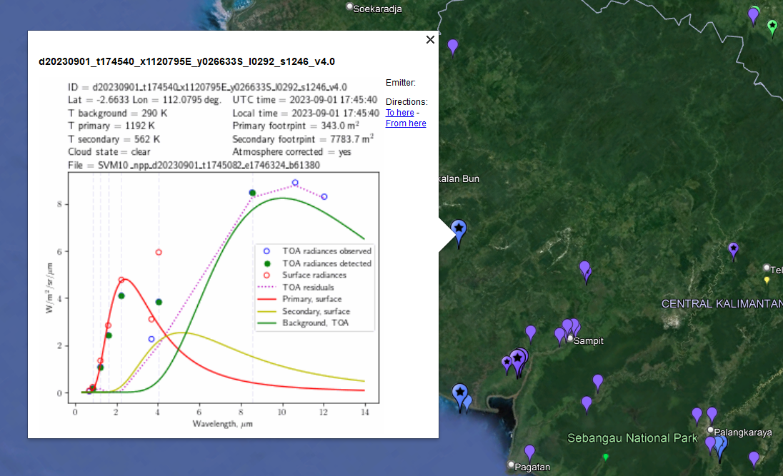
VNF v.4 primary and secondary emitters in Kalimantan, Indonesia 20230901

Slide 18
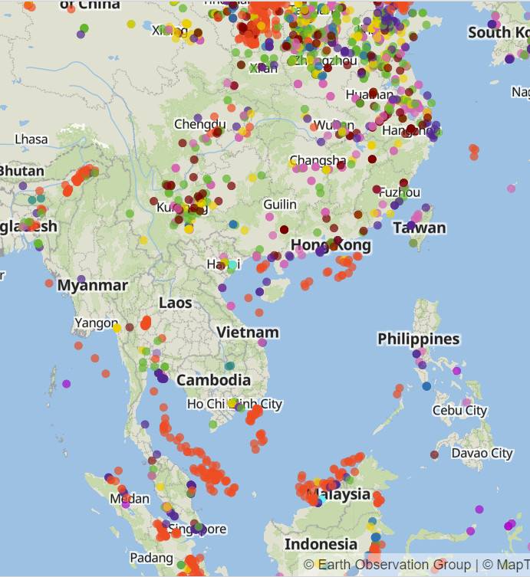
EOG has a web-map service tracking 20,000+ industrial emitters. The Global Infrared Emitter Explorer (https://eogmap.mines.edu/giree)

Slide 19
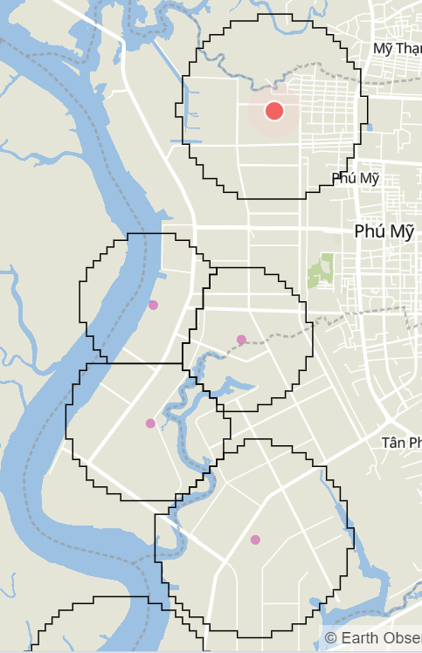
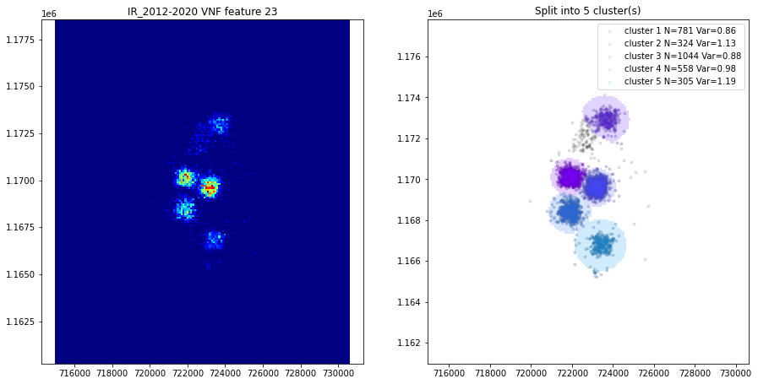
EOG has a multiyear catalog of industrial infrared emitters and a web map service (GIREE)

Slide 20
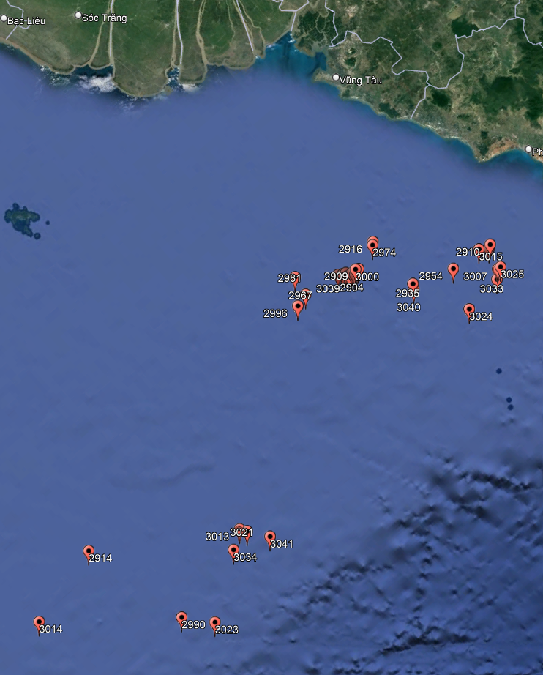
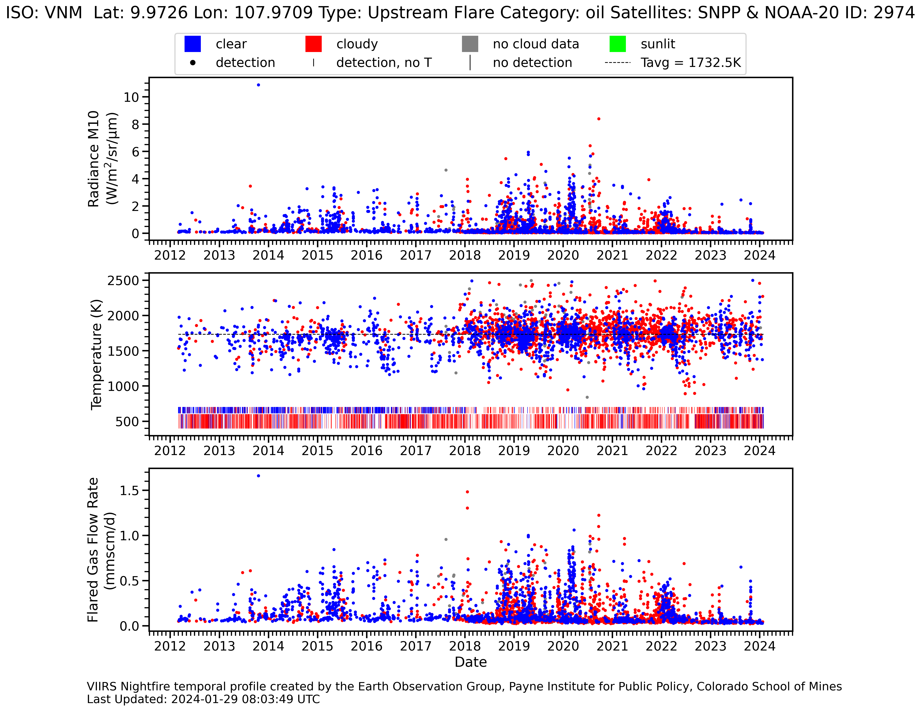
Gas Flare Offshore From Ho Chi Minh City

Slide 21
Summary
EOG produces fire, flare and boat detections in near-real time.
Using spectral bands ranging from near infrared to longwave infrared, EOG derives the IR emitter’s Planck curve – from which temperature, source area and radiant heat are calculated using physical laws.
The quickest way to receive EOG’s nightly data is via email alerts. Let me know if you want VBD or VNF detection alerts for your country.
With VNF data extending back to 2012 – EOG has derived temporal profiles for 20,000+ industrial IR emitters. These are updated once-per-week and are available from the GIREE web-map service.
Three VIIRS sensors operate currently, two others are planned, assuring continuity until ~2040

Slide 22
For more information, visit https://payneinstitute.mines.edu/eog/ or email celvidge@mines.edu

