Slide 1
VNF Super-Resolution
Chris Elvidge
AIT Nighttime Remote Sensing
Lecture 6
January 18, 2024

Slide 2
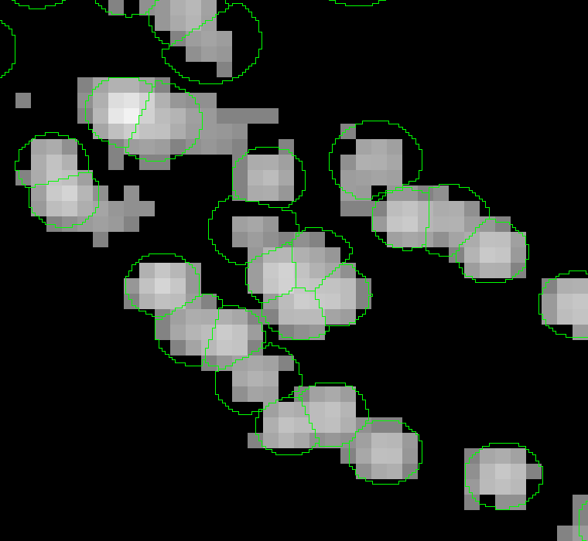
Number of VNF detections from 15 arc second grid 2012-2022 in an oil production area in Iran. Each IR emitter is enclosed in a green “bubble” vector.

Slide 3
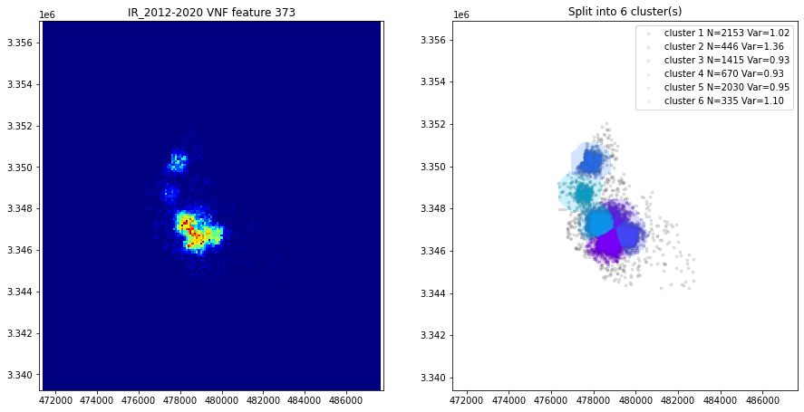
The individual emitters are defined from the data clouds composed of the latitude-longitude pixel canters in UTM projection. Cluster may be single emitters or split apart from conjoined clusters.

Slide 4
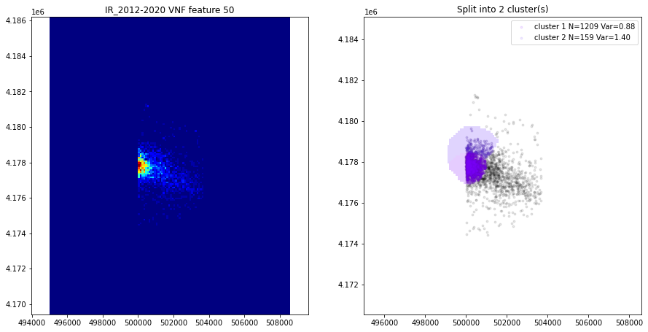
Flawed super-resolution image of an IR emitter

Slide 5
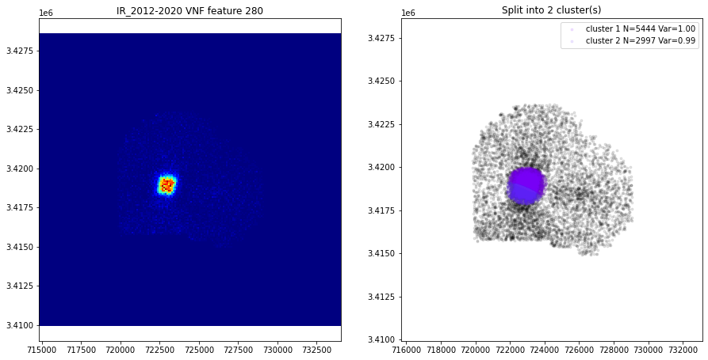
Super-resolution images of sites 11281 and 11291.

Slide 6
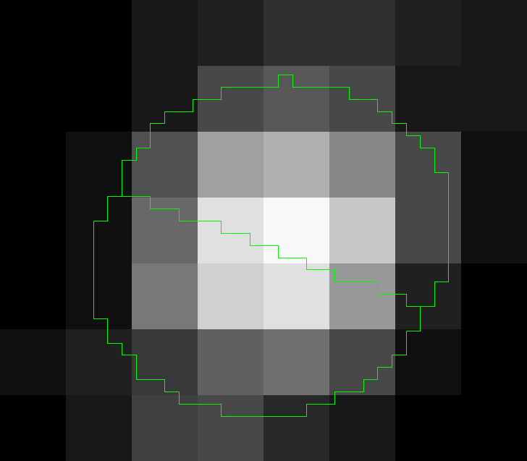
From the 15 arc second N-detect grid with bubble vectors overlain.

Slide 7
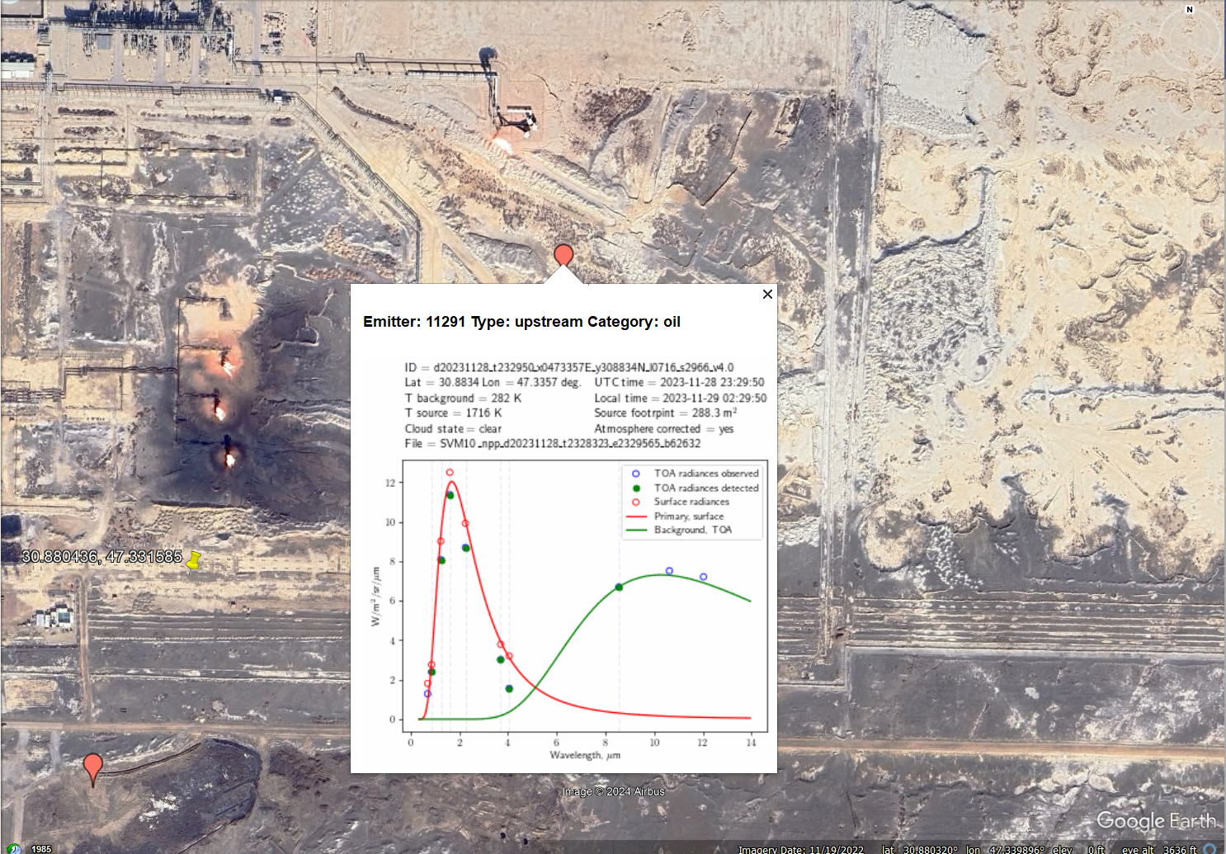
Sites 11281 and 11291 from google earth. Five flare stacks. Two VNF detections from 20231128.
1
2
3
4
5

Slide 8
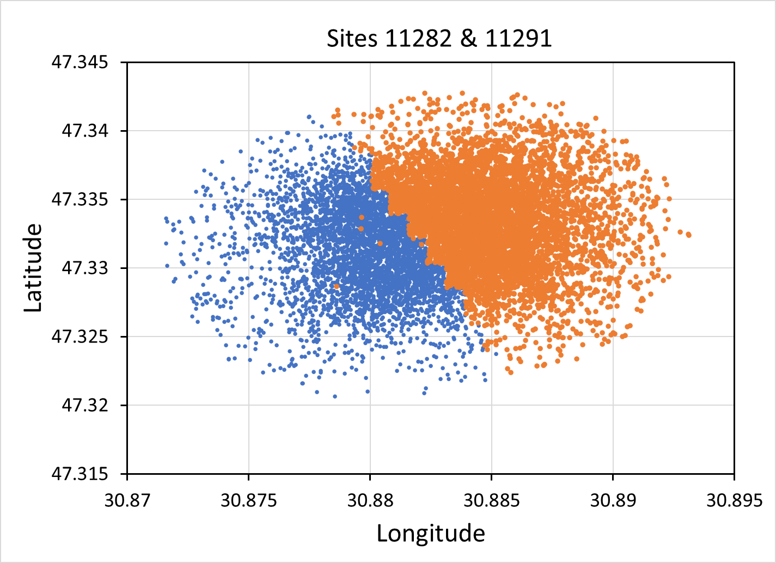
Pixel center locations scattergram. Is this a case of oversplitting?

Slide 9
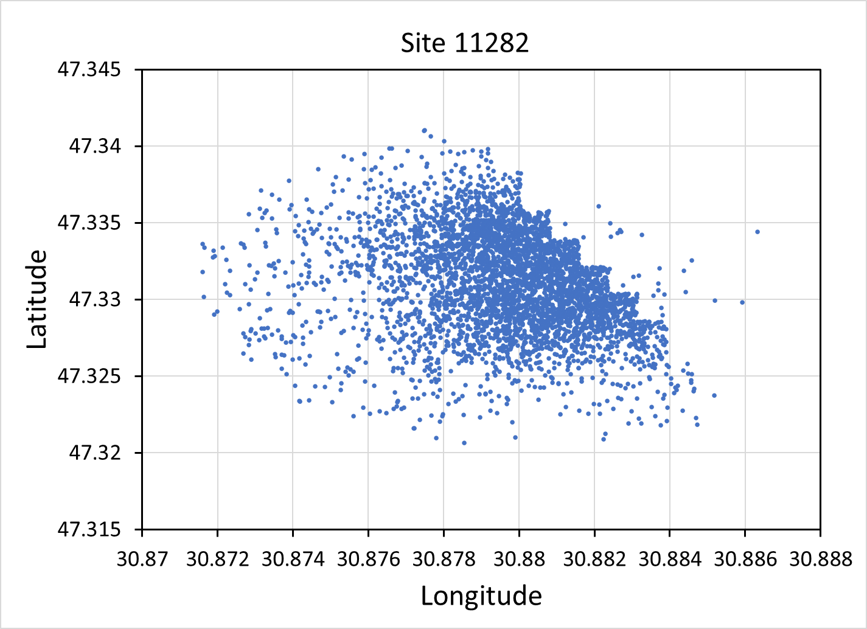
Leakage across the bubble vector boundary?

Slide 10
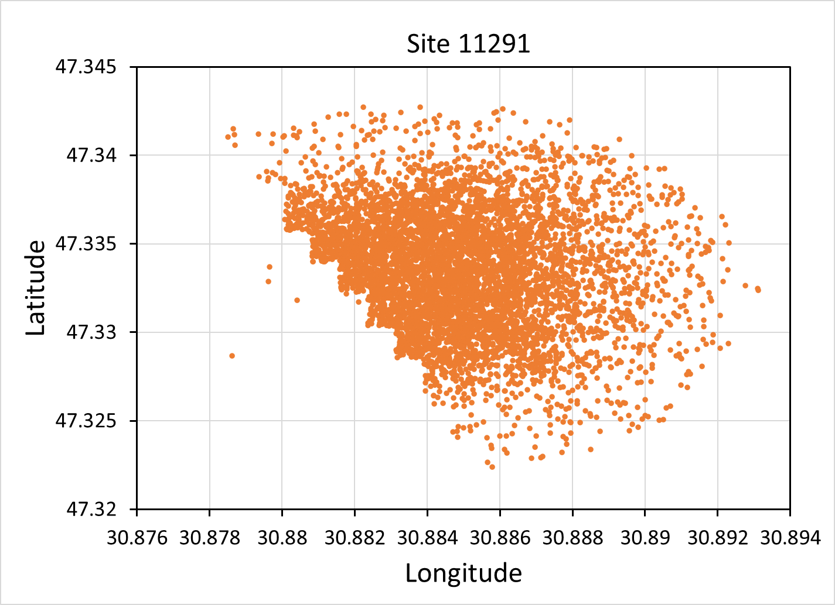
Leakage across the bubble vector boundary?

Slide 11
Is this a case of oversplitting?

