Slide 1
VIIRS Boat Detection (VBD)
Chris Elvidge
AIT Nighttime Remote Sensing
Lecture 9
January 25, 2024

Slide 2
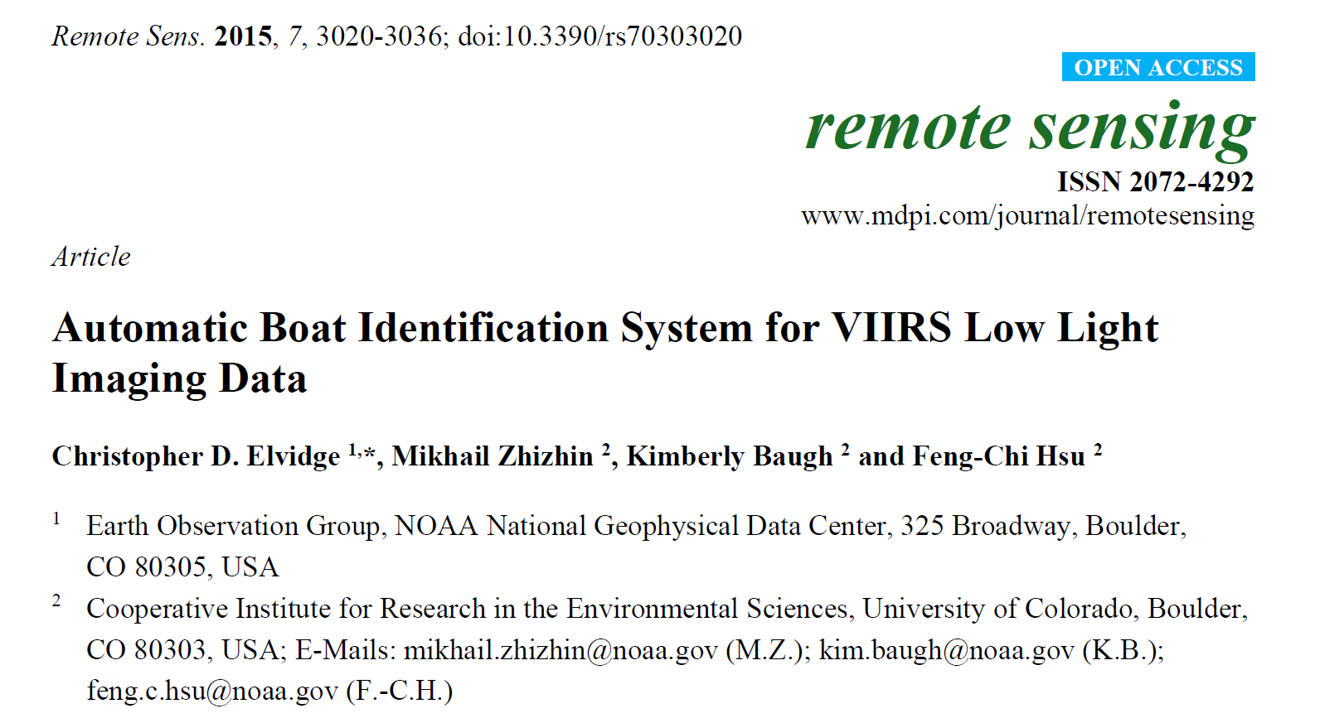

Slide 3
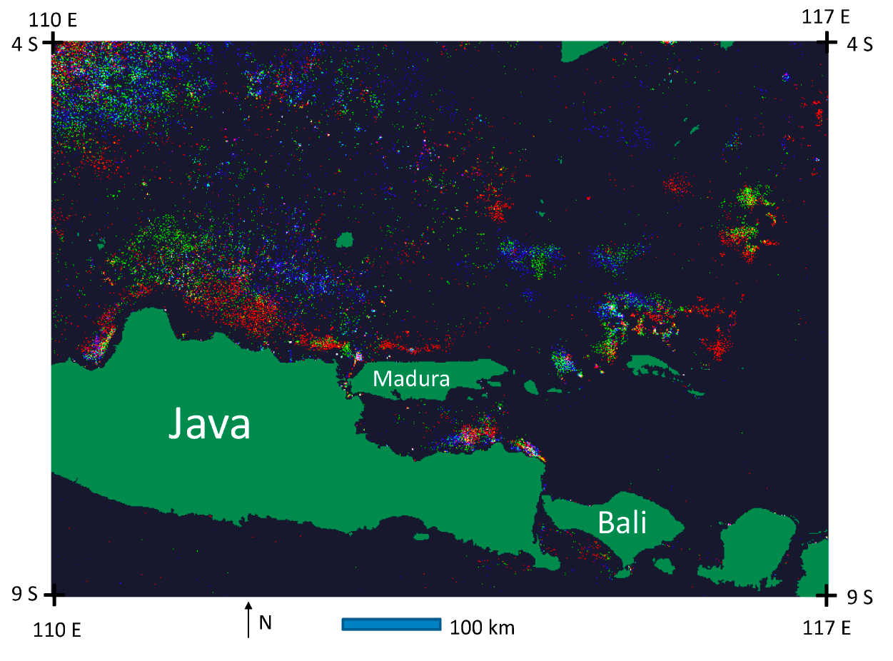
Figure 14. Color composite image of monthly boat detection activity in the Java Sea.
October 2014 boat detections are red. September 2014 boat detections are green, August
2014 boat detections are blue. Other colors are formed when boats were detected in the
same areas for two out of the three months. White indicates that boats (or platforms) were
detected in all three months.

Slide 4
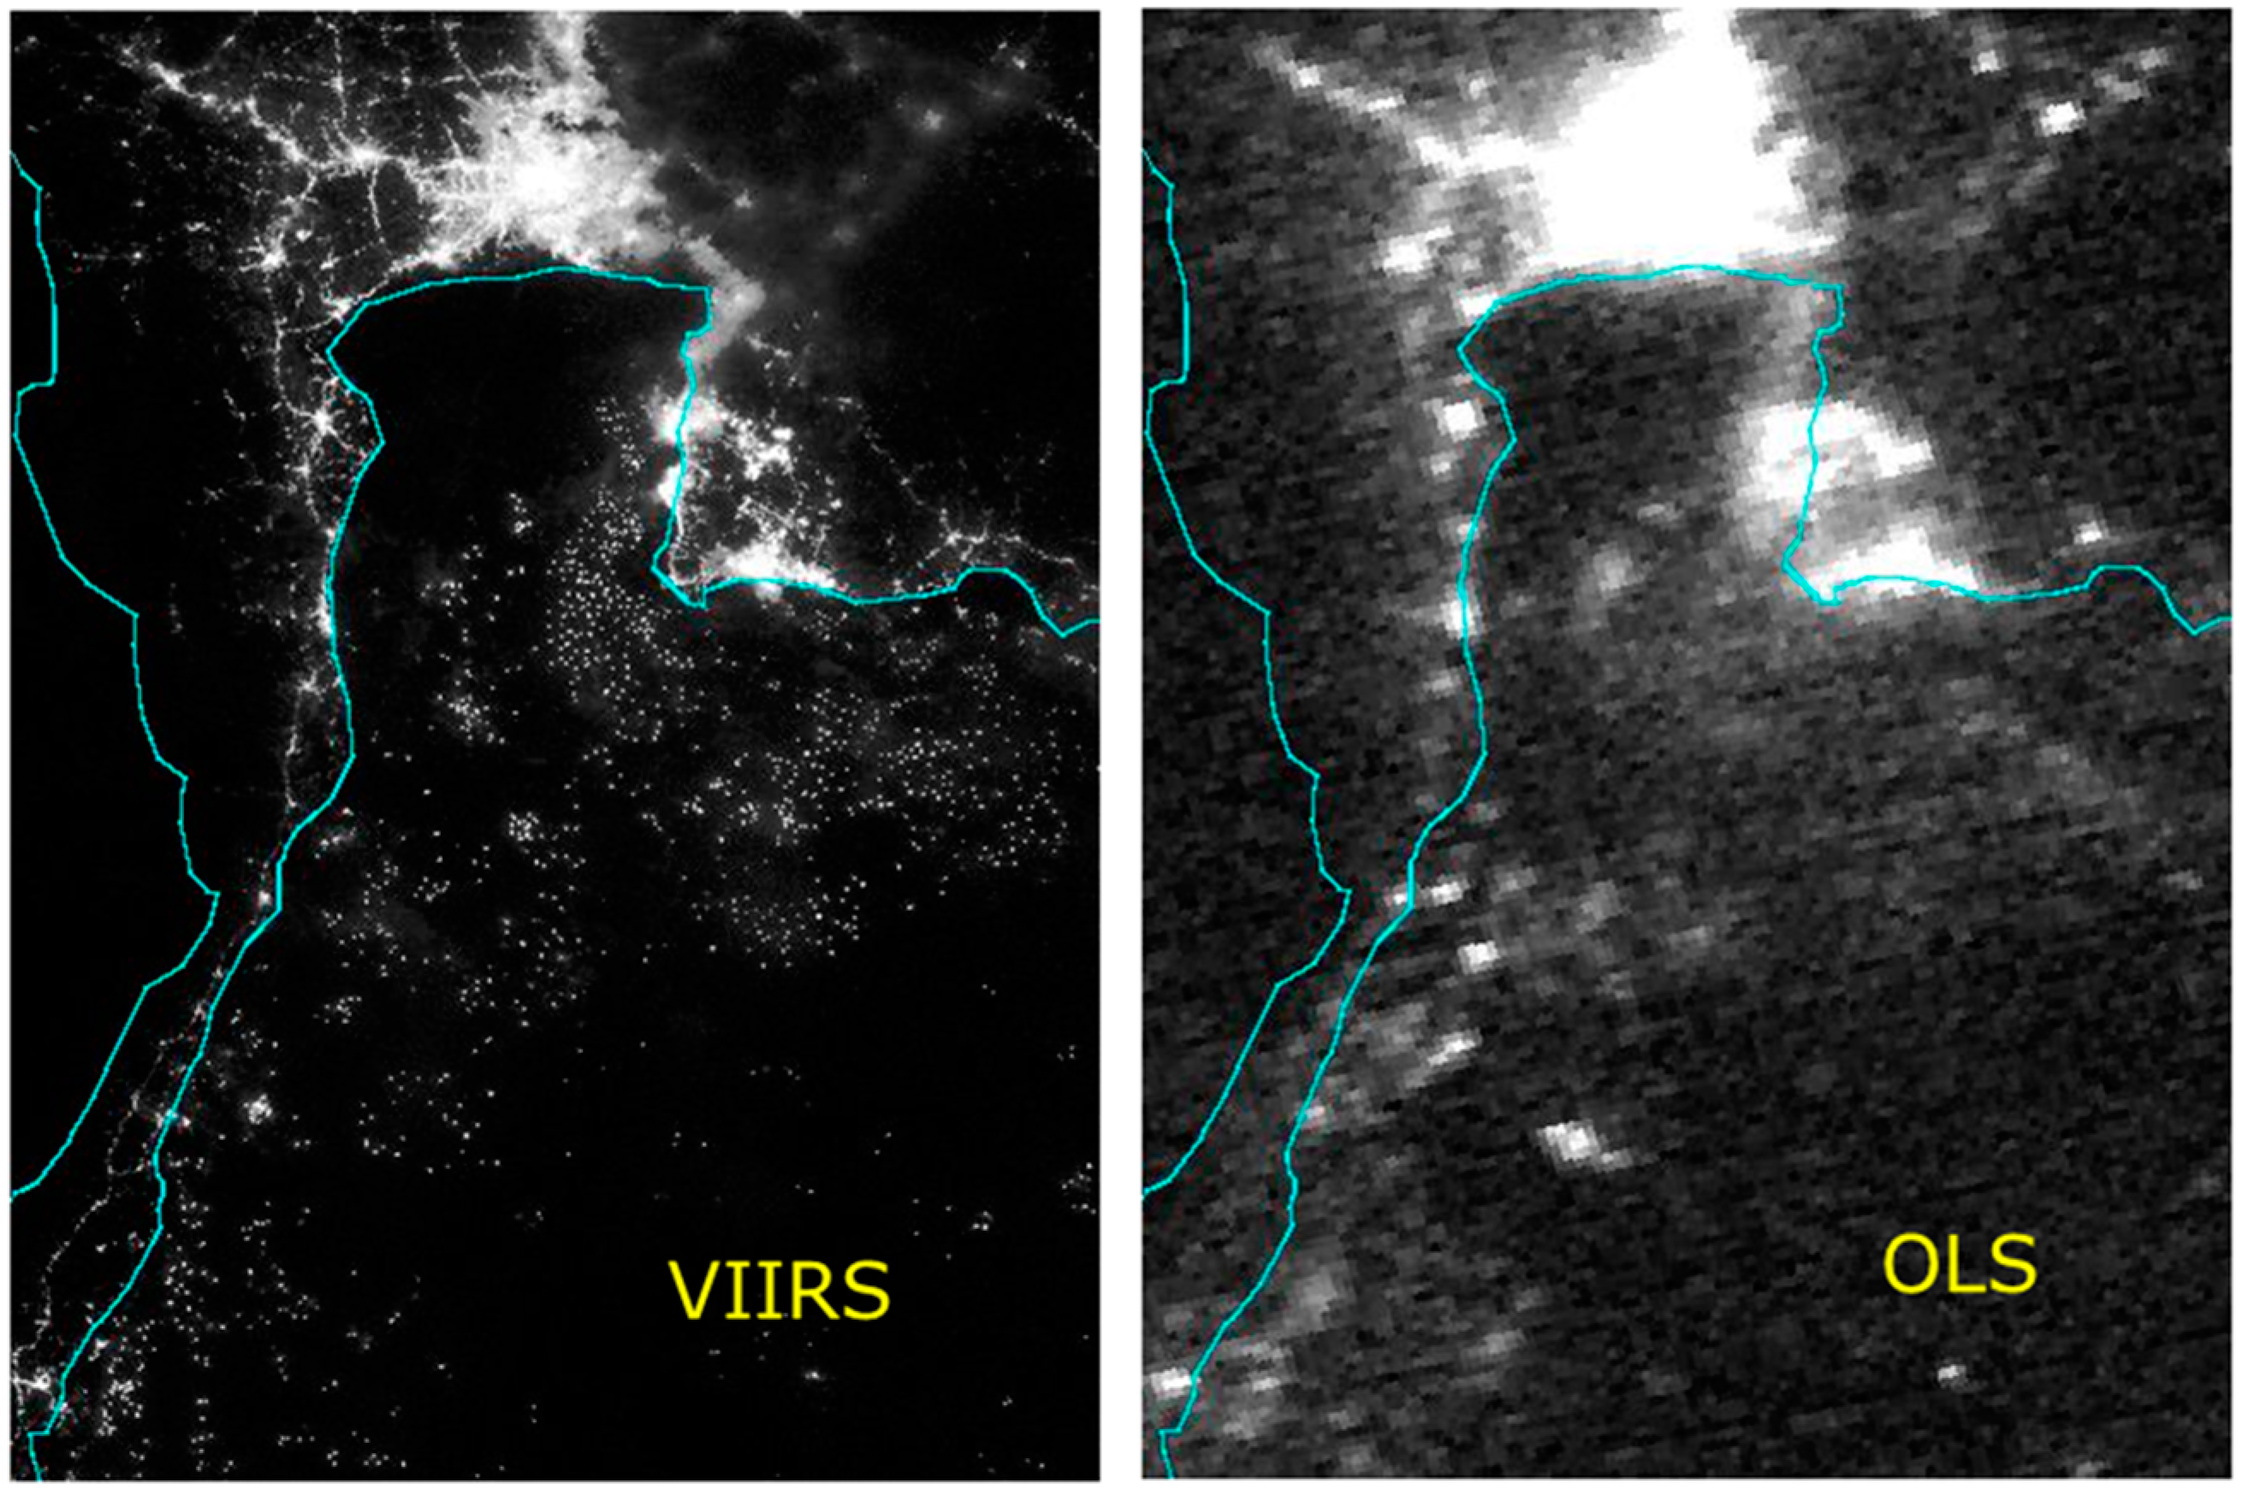
Figure 1
Visible Infrared Imaging Radiometer Suite (VIIRS) vs. Operational Linescan System (OLS) low light imaging data collected over Bangkok and the Gulf of Thailand region approximately five hours apart on the night of 14 October 2012. Note that the higher spatial resolution of the VIIRS data enables the detection of a vastly larger number of individual lighting features offshore.

Slide 5
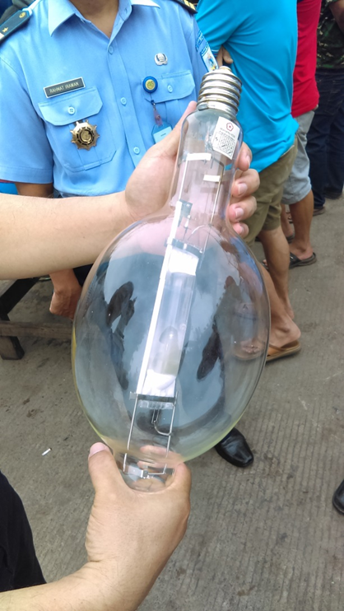
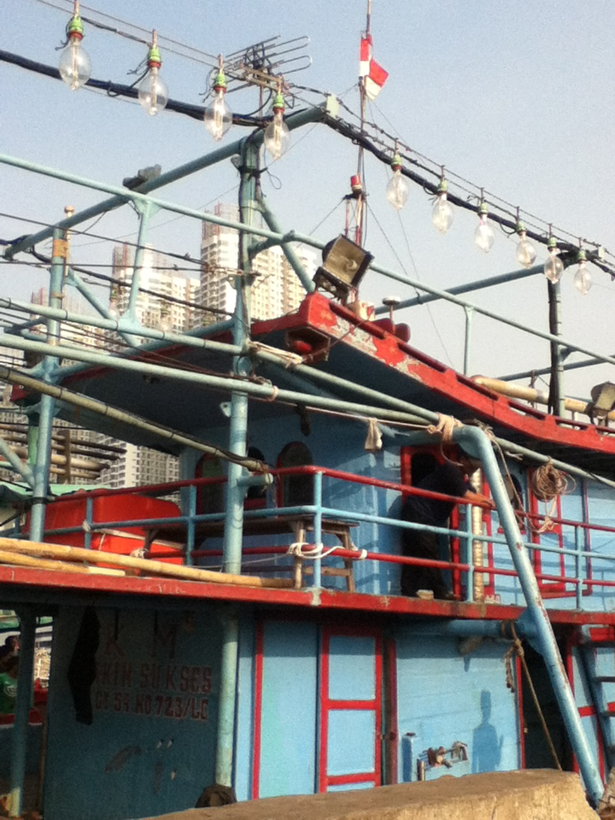
Purse seiner and ring net boats commonly carry strings of bare metal halide bulbs from 1500 to 3000 watts

Slide 6
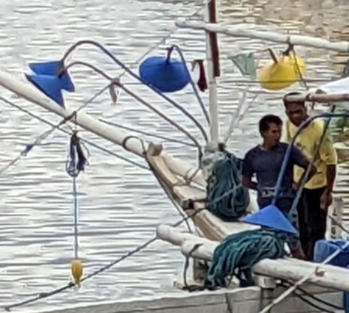
Boats often carry shielded quartz halogen lamps used as spotlights pointed into the water

Slide 7
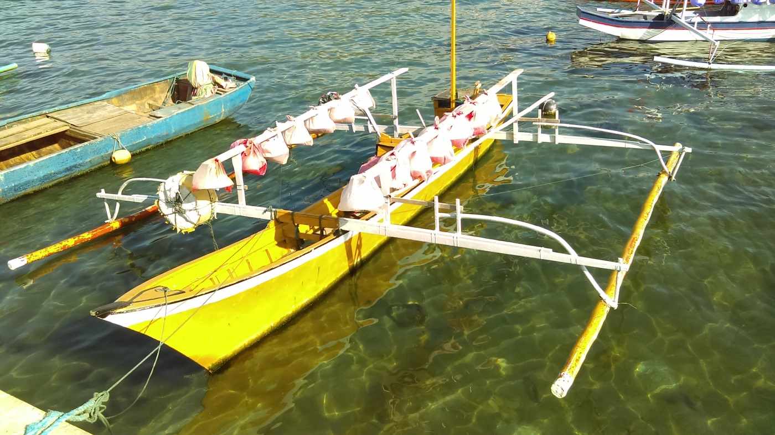
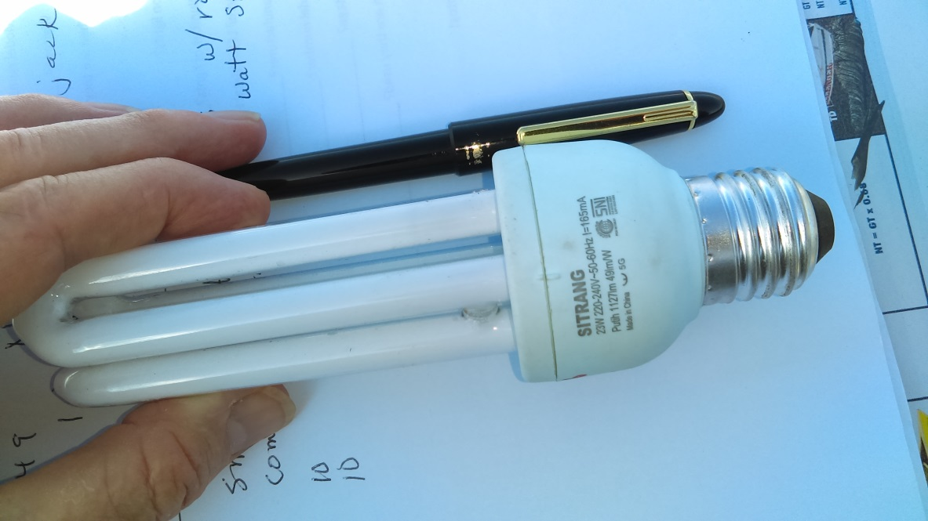
Are small pontoon boats with lights detected? Probably not, but has not been validated
Twelve shielded 24 W compact fluorescent bulbs = 288 watts

Slide 8
Can a calibration be developed between the VIIRS observed radiance and light output into the sky?
We built a 6000 watt metal halide frame with generator. It has been deployed multiple times for VIIRS collections. Preliminary results found strong view angle dependence. The lights have higher DNB radiance when viewed in the outer limbs of VIIRS scans. We estimate the detection limit of 1000 watts, which registers near one nanoWatt in the DNB.

Slide 9
VBD Processing
Flattening the variance, which is higher at the edge of scan.
Detection of DNB spikes with the Spike Median Index (SMI).
Calculation of the Spike Height Index (SHI) and sharpness index (SI).
Label detection types (strong, weak, blurry, weak and blurry, glow.
Filter out moonlit cloud false detections.
Label feature types (platform, gas flares, recurring).
Prepare and send out email alerts.

Slide 10
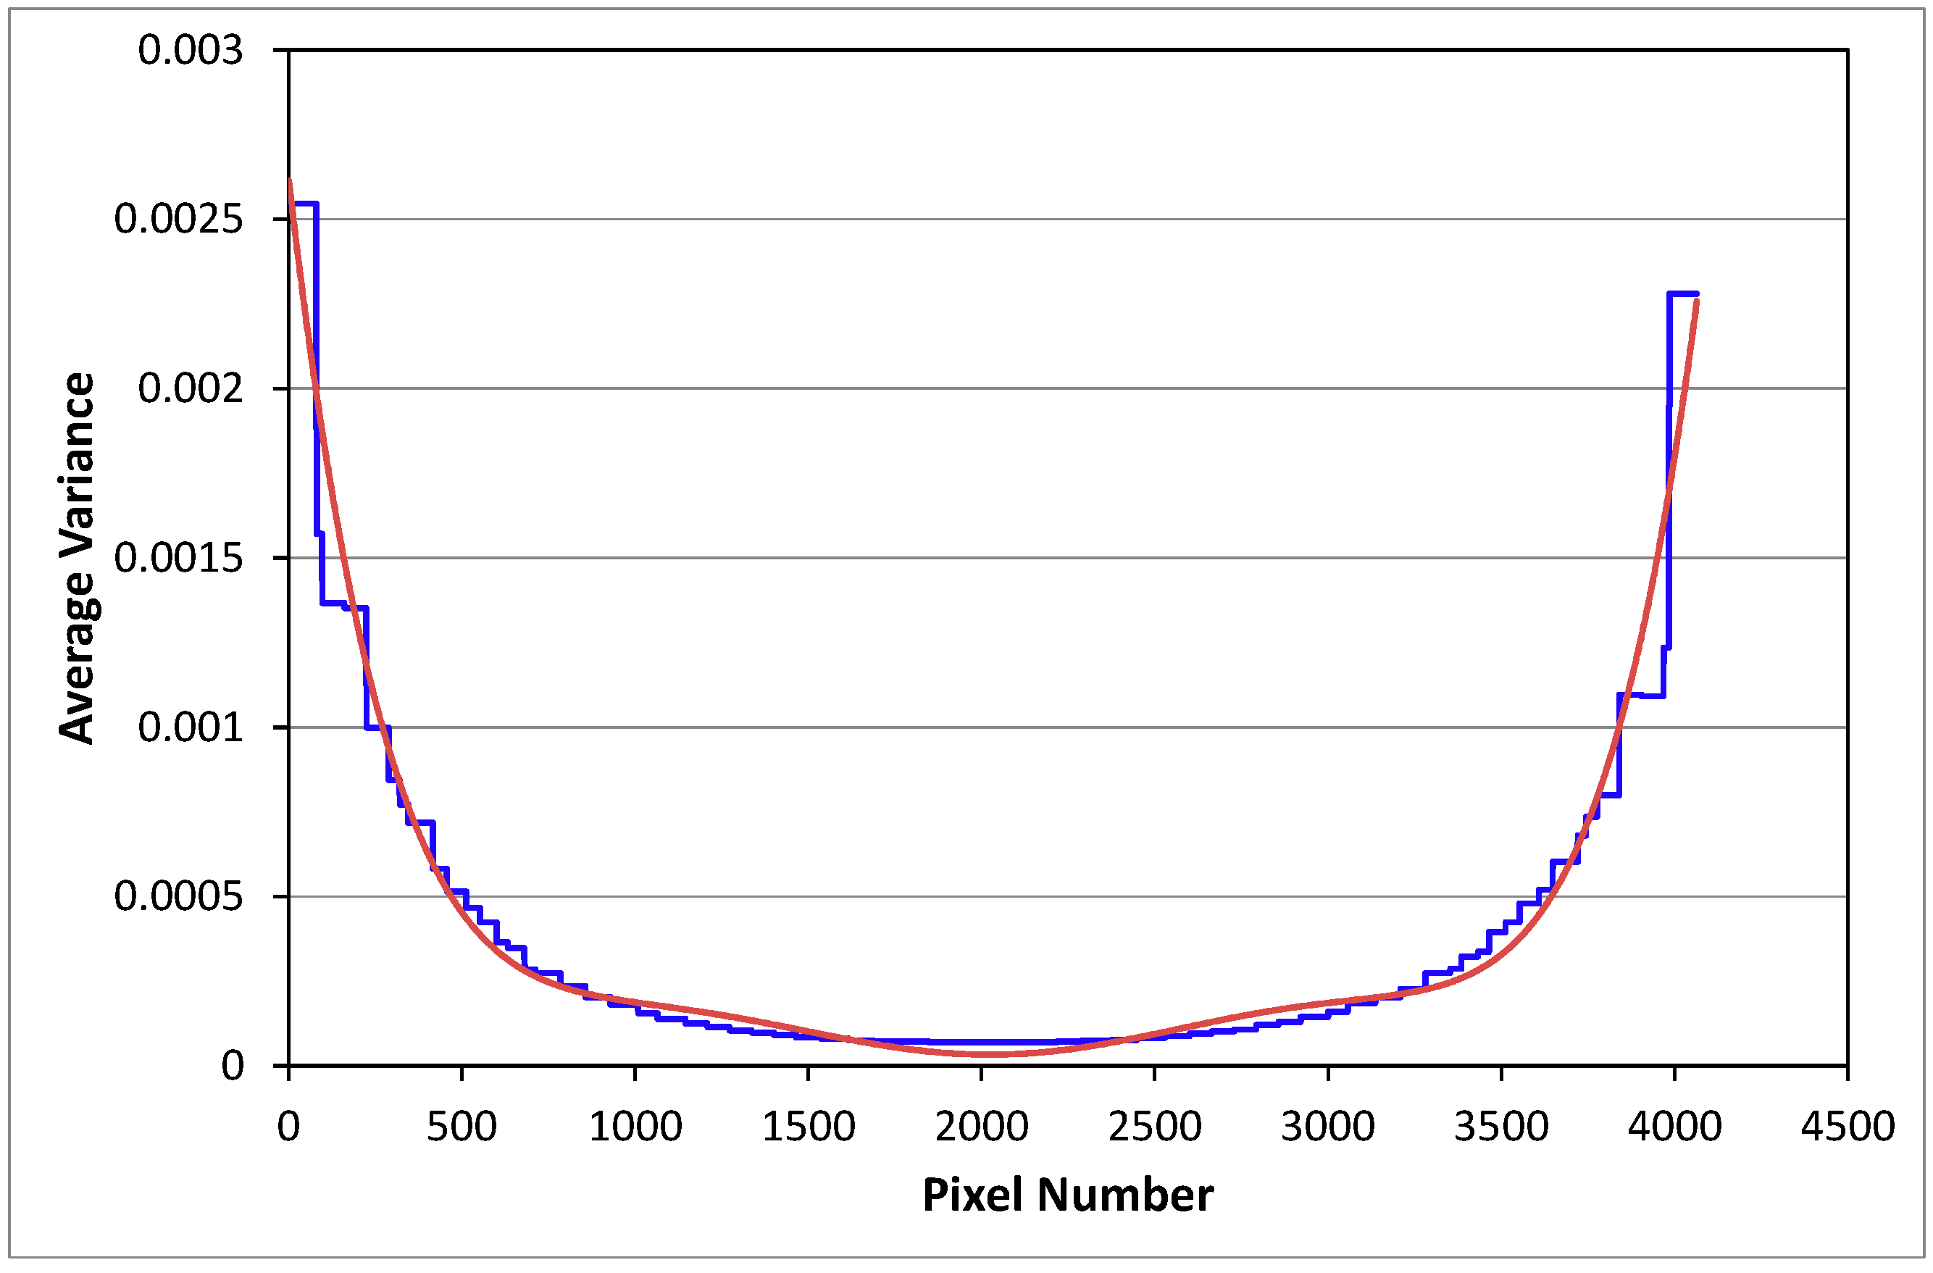
Flattening variance levels at the edge of scan.
Figure 3
The blue line indicates local variance for individual aggregation zones for the log(DNB) data from a reference dark night open ocean aggregate. This metric shows the increase in noise levels as a function of scan angle and aggregation zone and is sometimes referred to as “the smile”. The green line is a sixth order polynomial fit, which is used as input to the Weiner filter to flatten noise levels across the full swath.

Slide 11
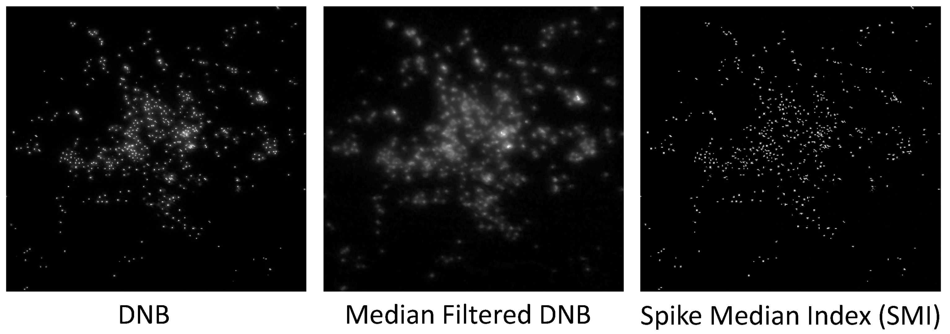
Moonless SMI example
Figure 4
Example of raw DNB data, median filtered version with spike removed, and spike feature image made by subtracting the median filtered image from the original data.

Slide 12
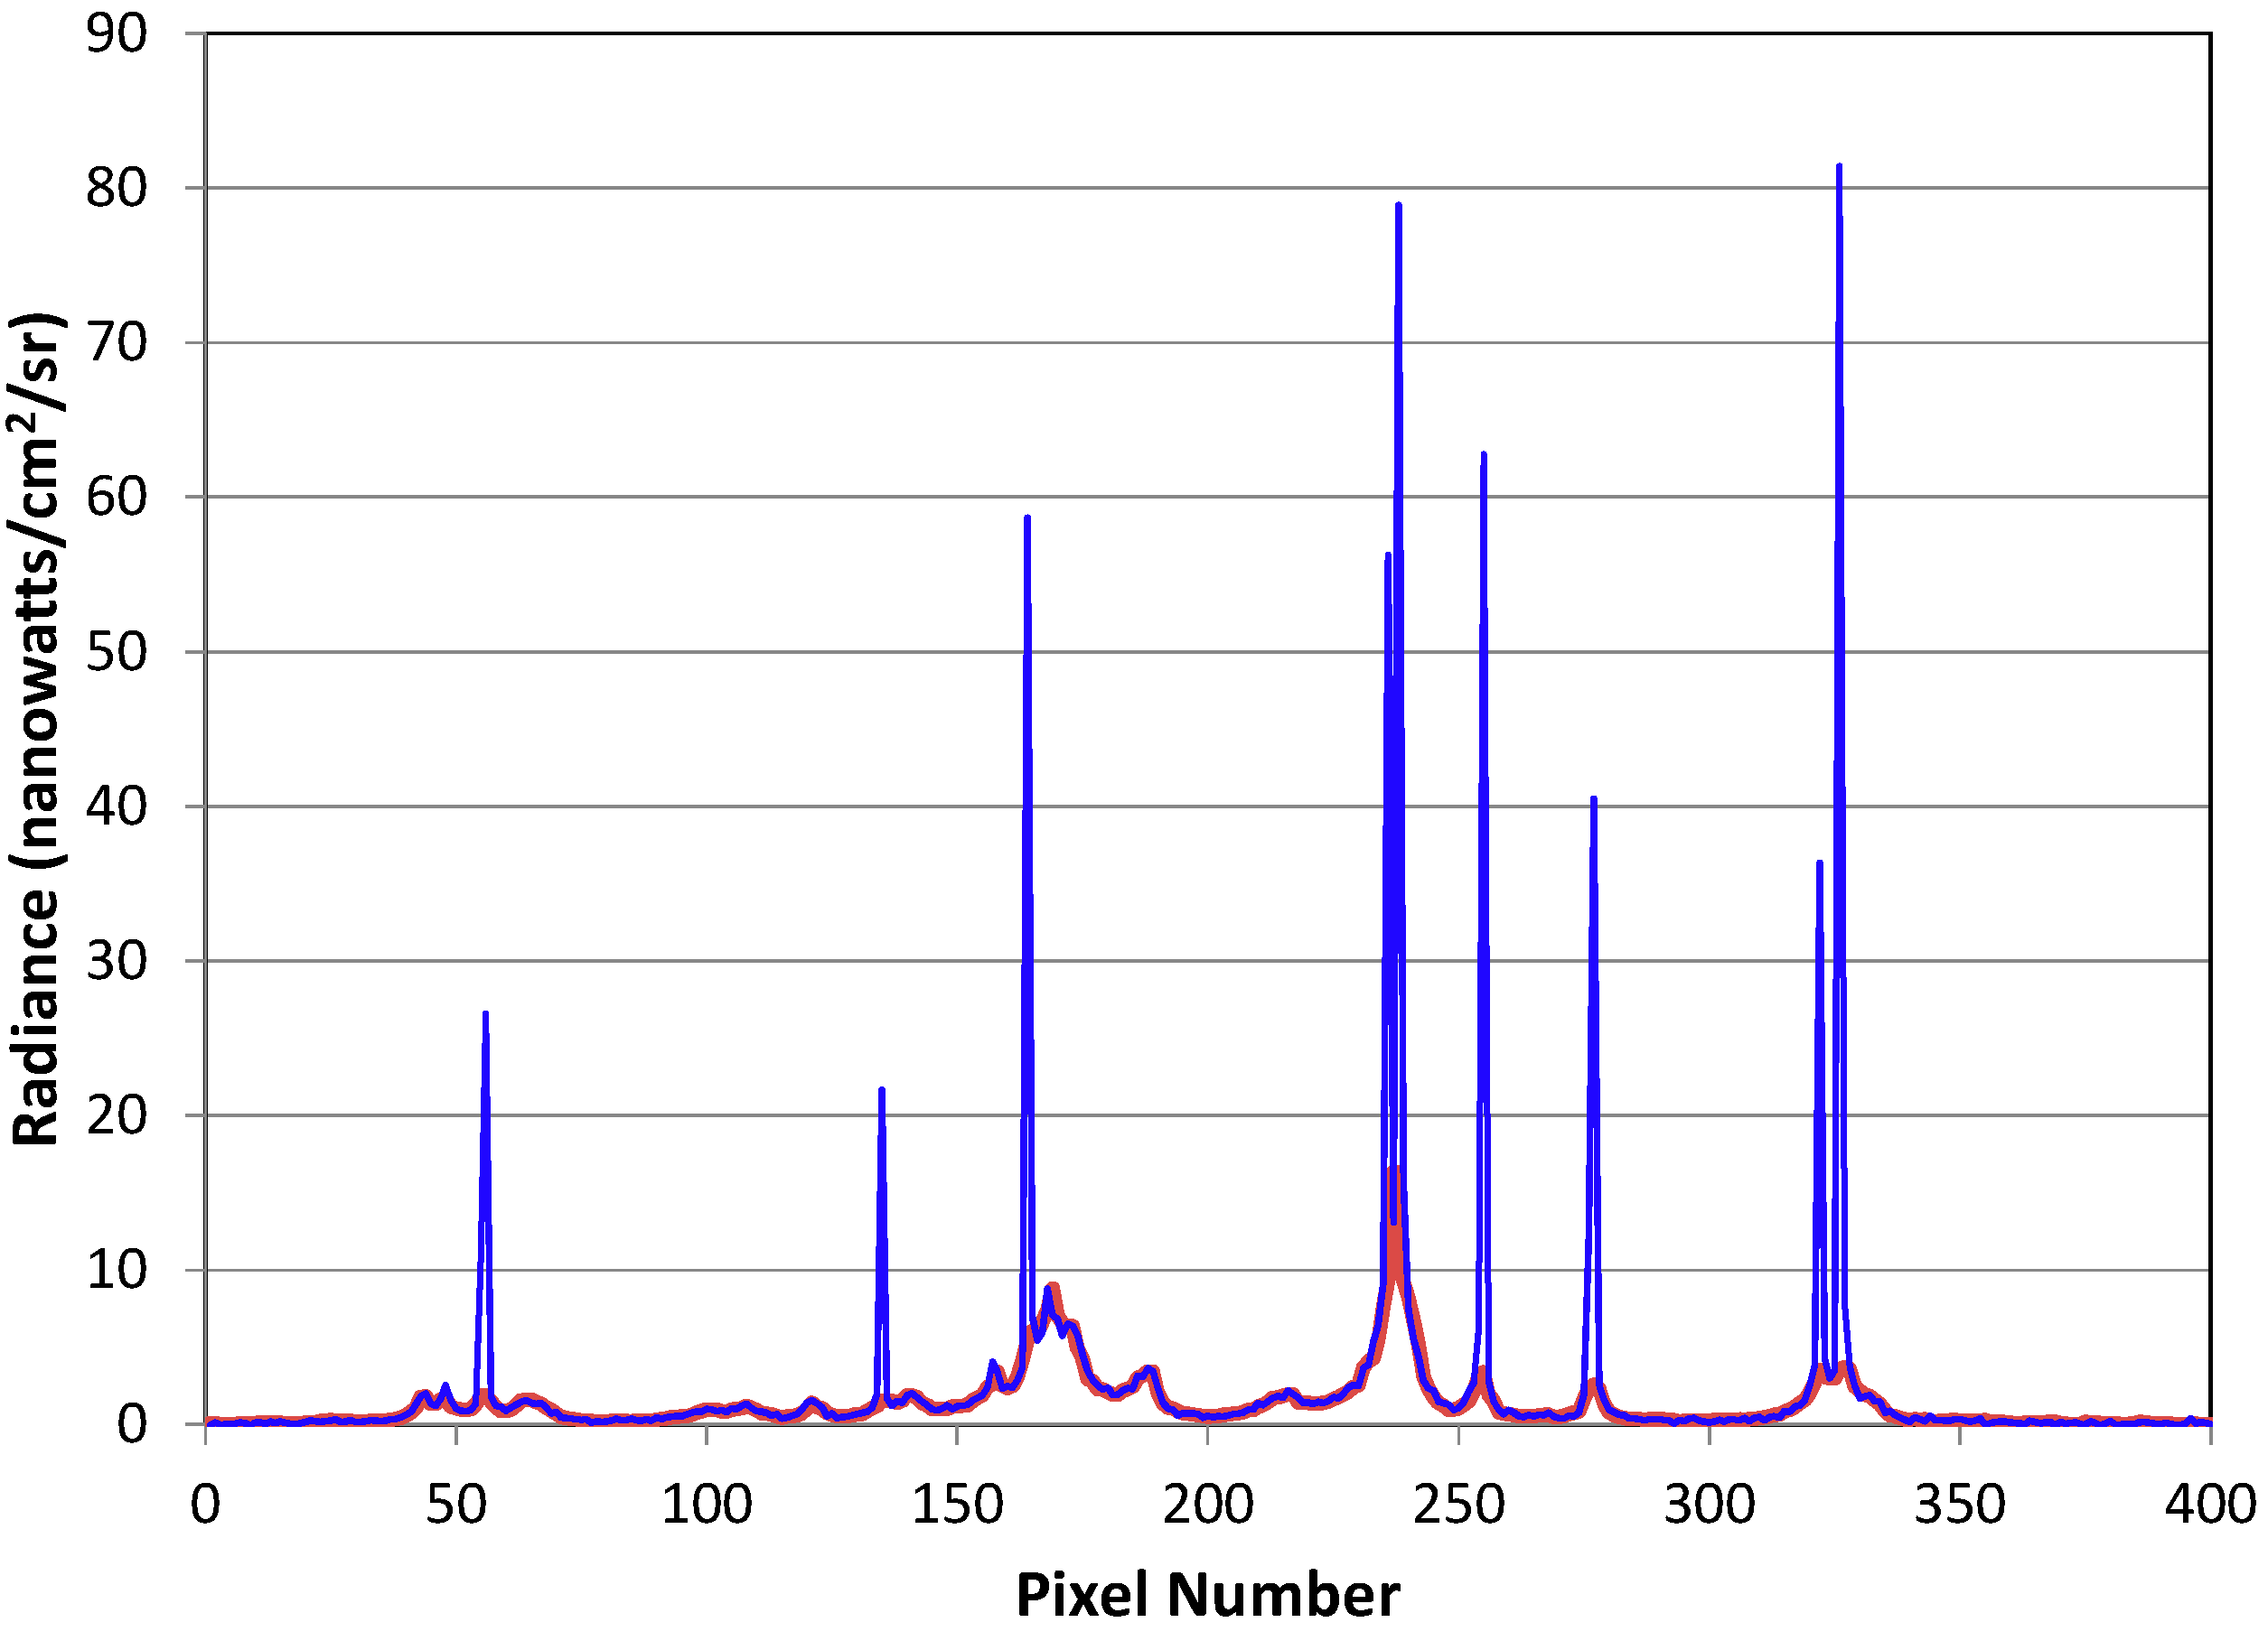
SMI transect
Figure 6
Example transect of DNB data with boat detection spikes (blue) and the median filtered counterpart (red).

Slide 13
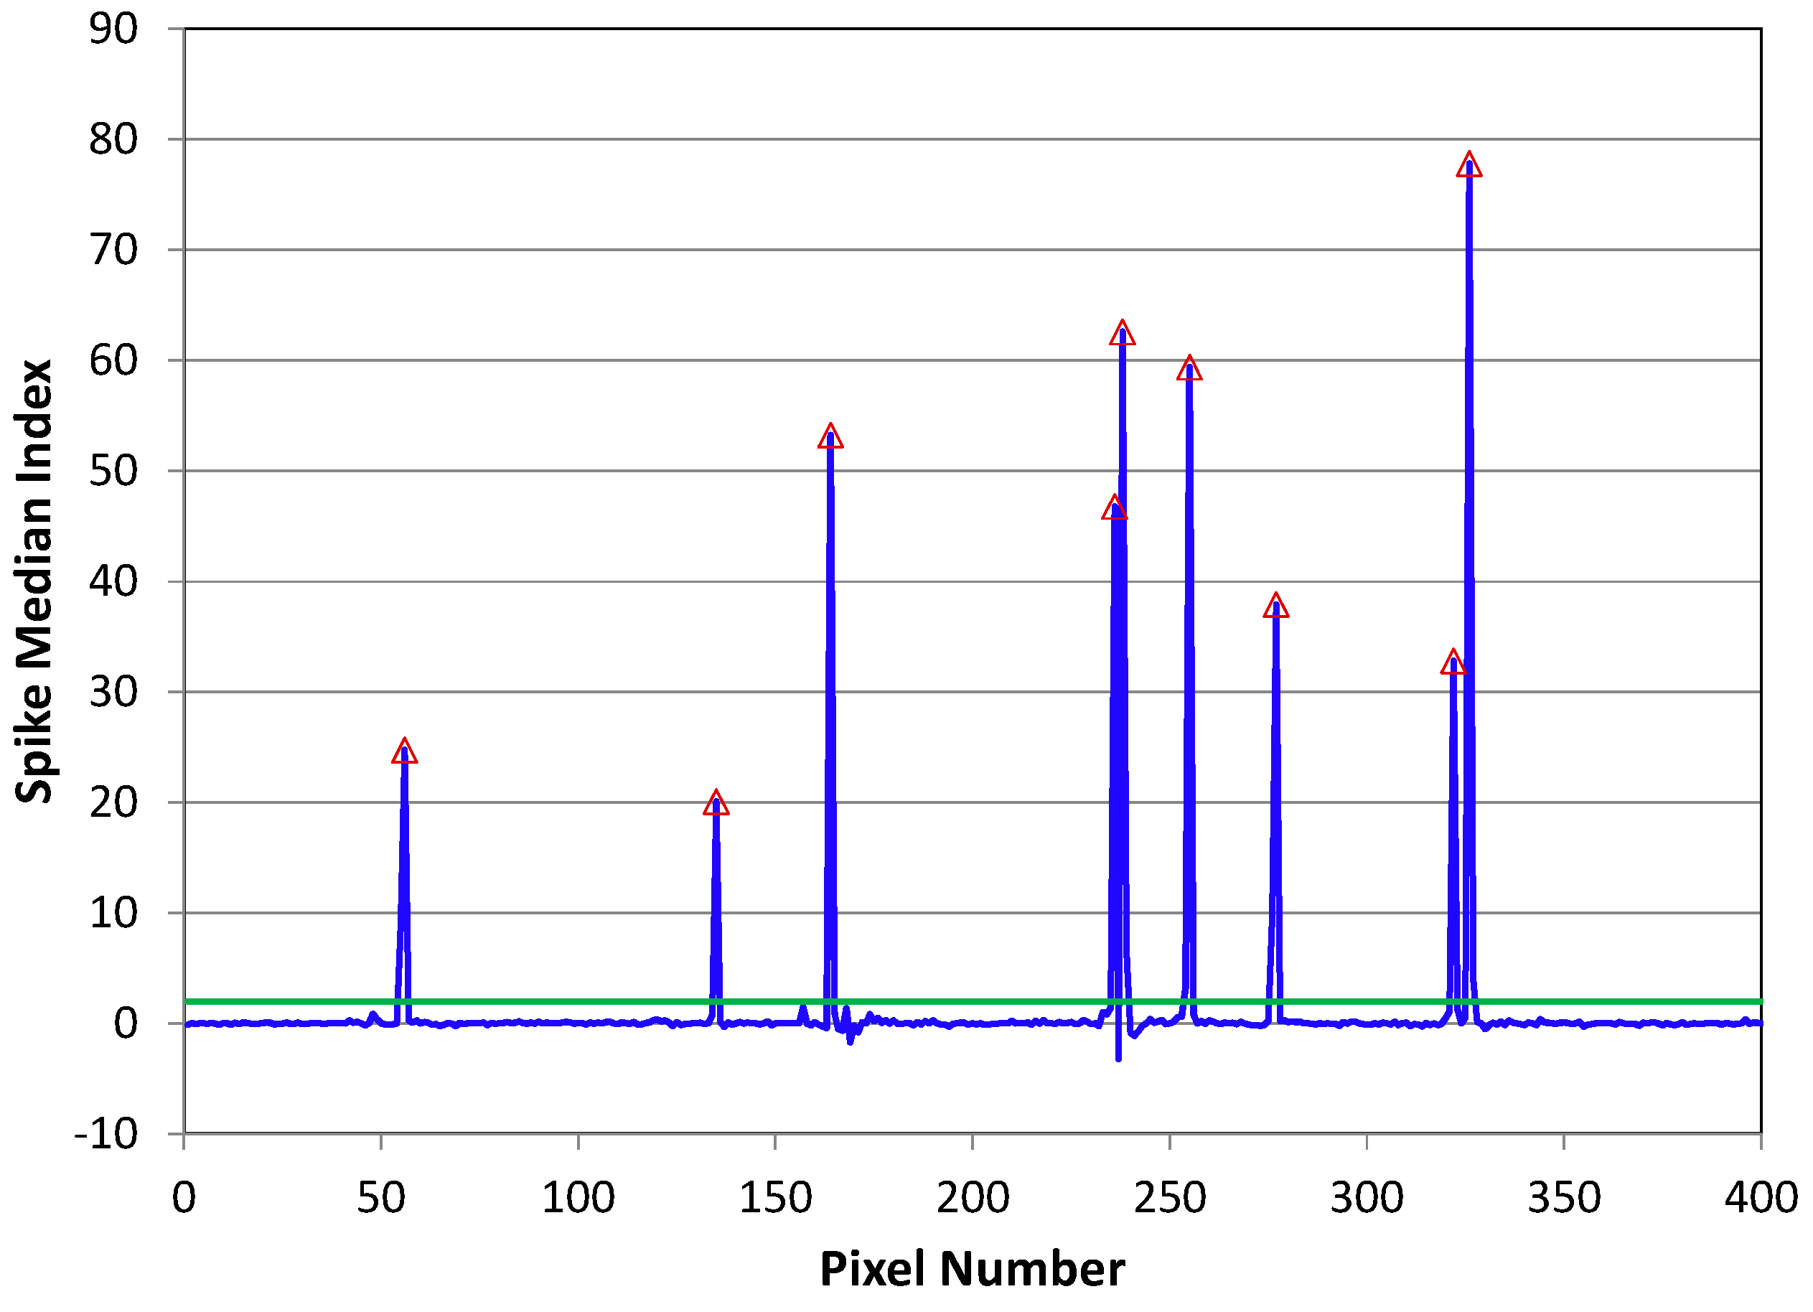
SMI transect
Figure 7
Spike Median Index (SMI) data of the transect from Figure 6. The green line is the detection threshold. The red triangles mark the location of detected spikes.

Slide 14
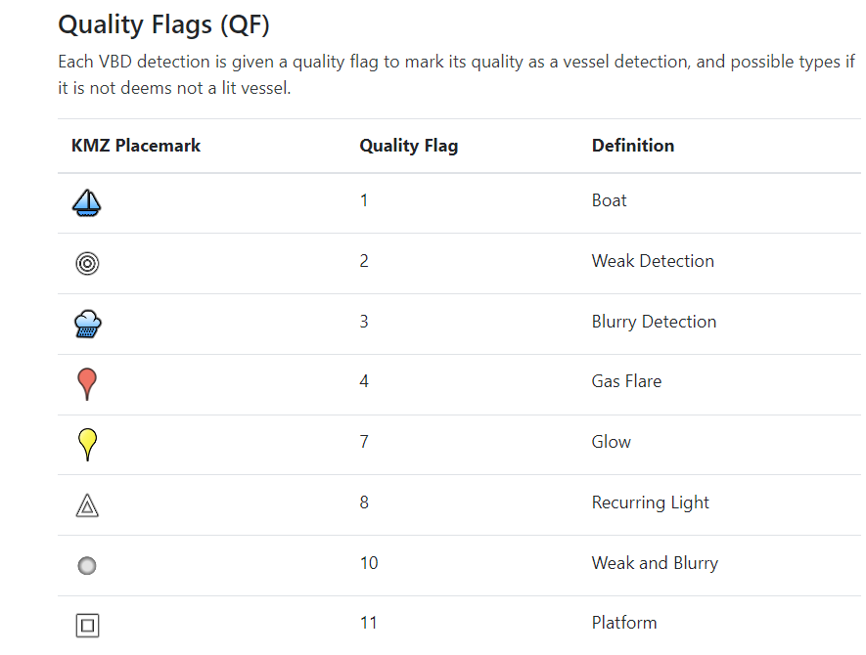
VBD detections are labeled based on the sharpness of the DNB spike, its persistence level, and location.
Three indices are used to label the detection type: SMI, spike height, sharpness and percent frequency of detection. VNF’s gas flares are used to lable the flares.

Slide 15
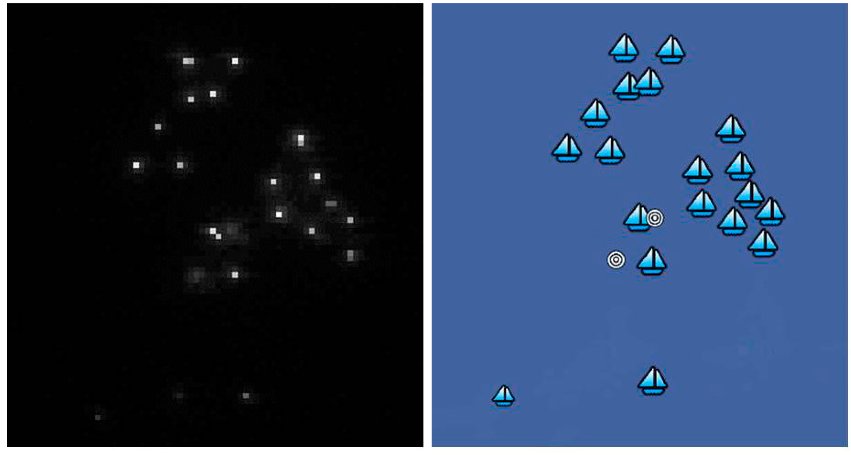
Figure 13
The contrast enhanced DNB image subset on the left showing a cluster of boats. The corresponding boat detections are shown on the right. QF1 strong detections are marked as sailing boats. QF2 weak detections are marked as three concentric circles.

Slide 16
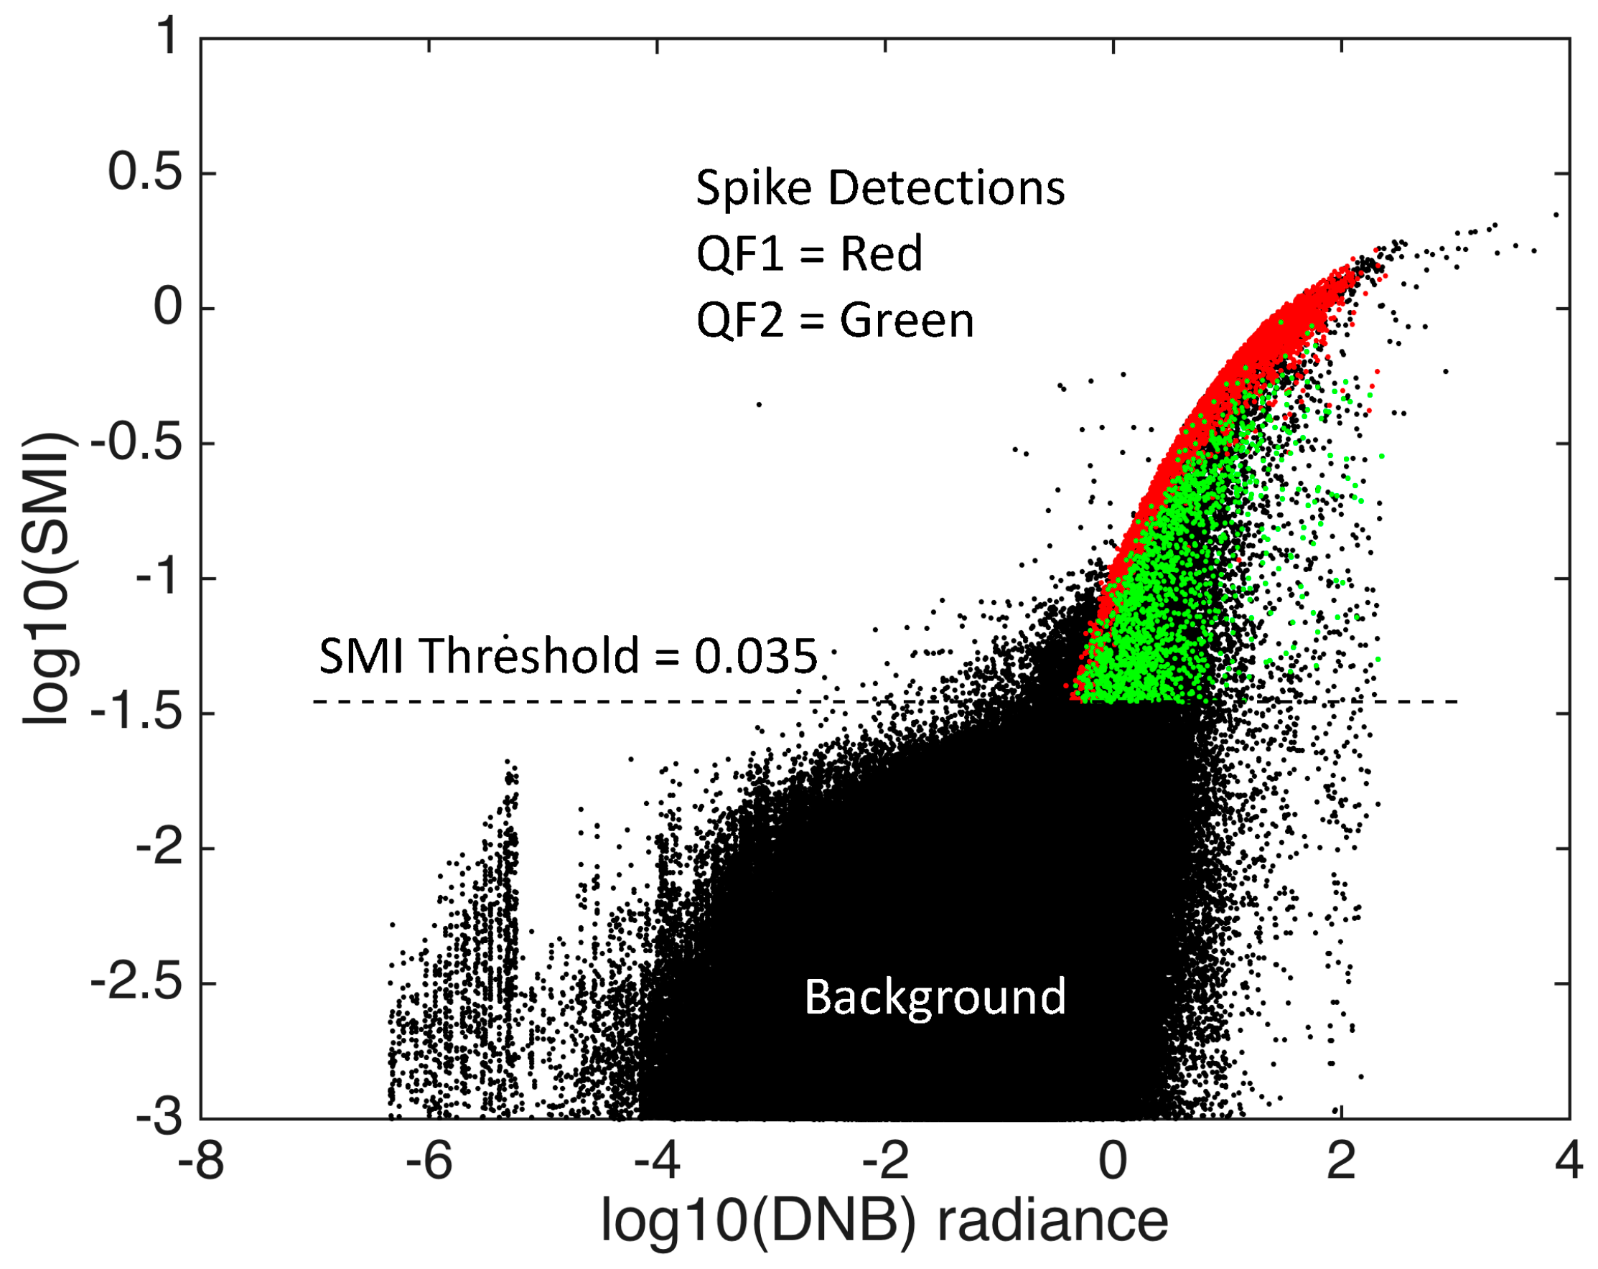
SMI scattergram for moonless night
Figure 5
Scattergram of spike median index (SMI) vs. DNB radiances for a DNB aggregate. There is a dense cloud of background data values in the lower center part of the chart. Spike features are present in the quill-like appendage on the upper right side of the background pixel set. The red and green points are from QF1 (red) and QF2 (green) spike detections.

Slide 17
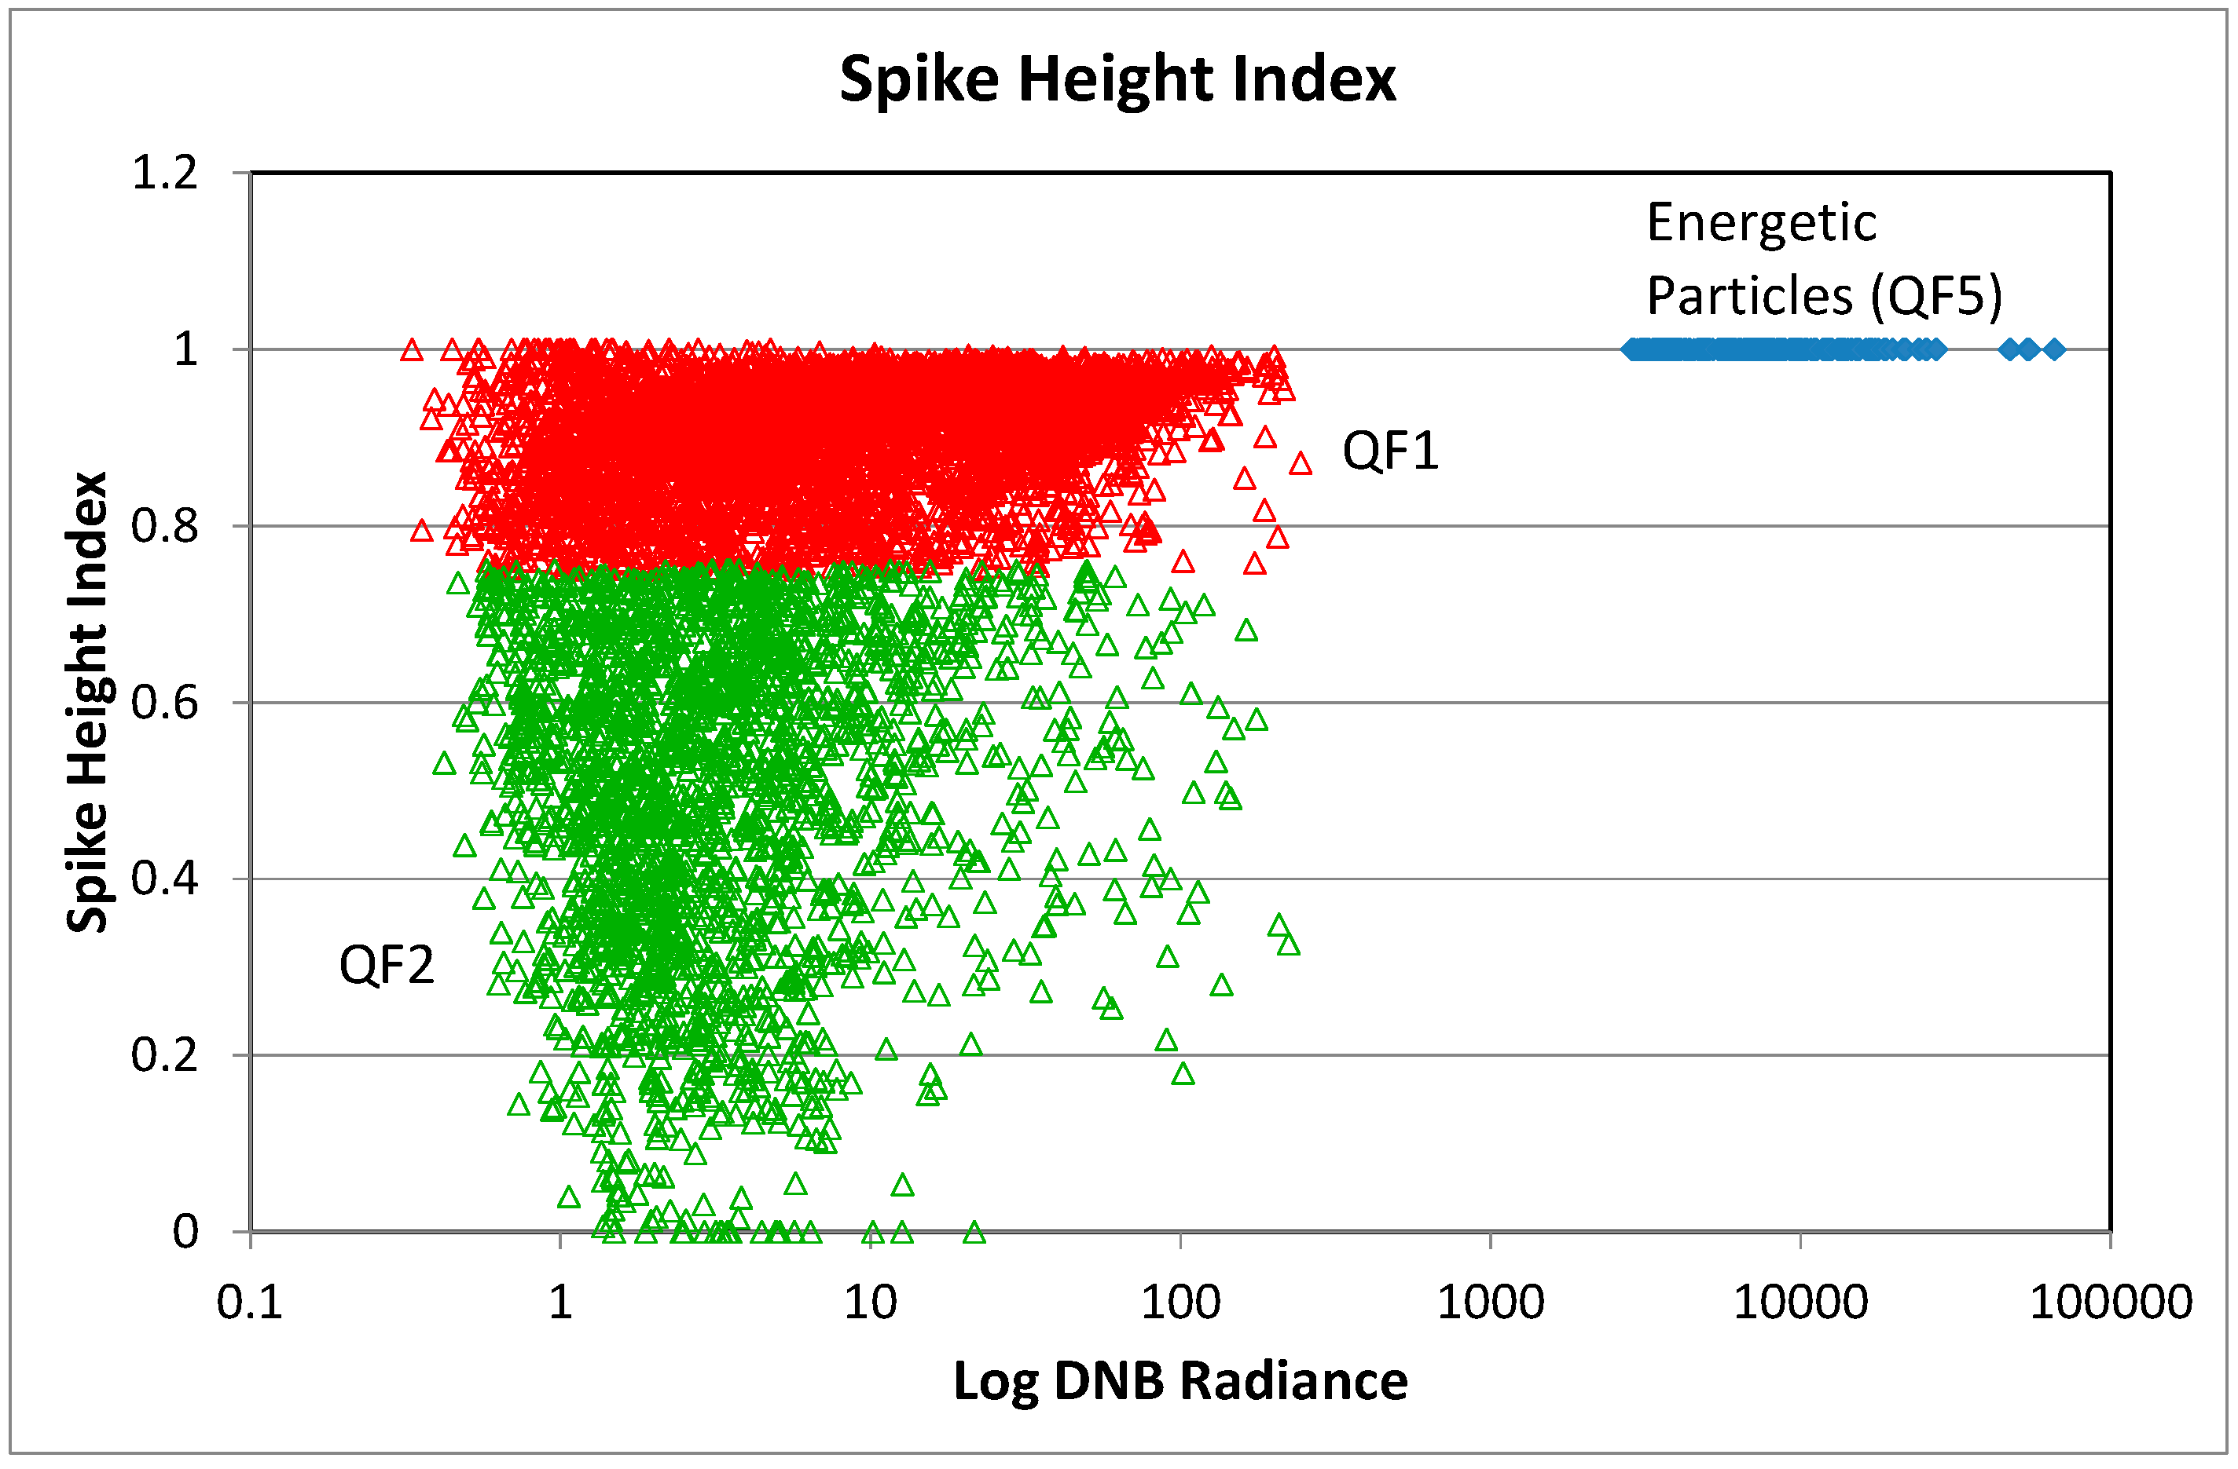
Figure 8
SHI vs. DNB radiances for three categories of pixels. Energetic particle detections have radiances exceeding 1000 nanowatts and SHI values in excess of 0.995. The SHI is used to divide the offshore lights into strong detections (QF1) and weak detections (QF2).

Slide 18
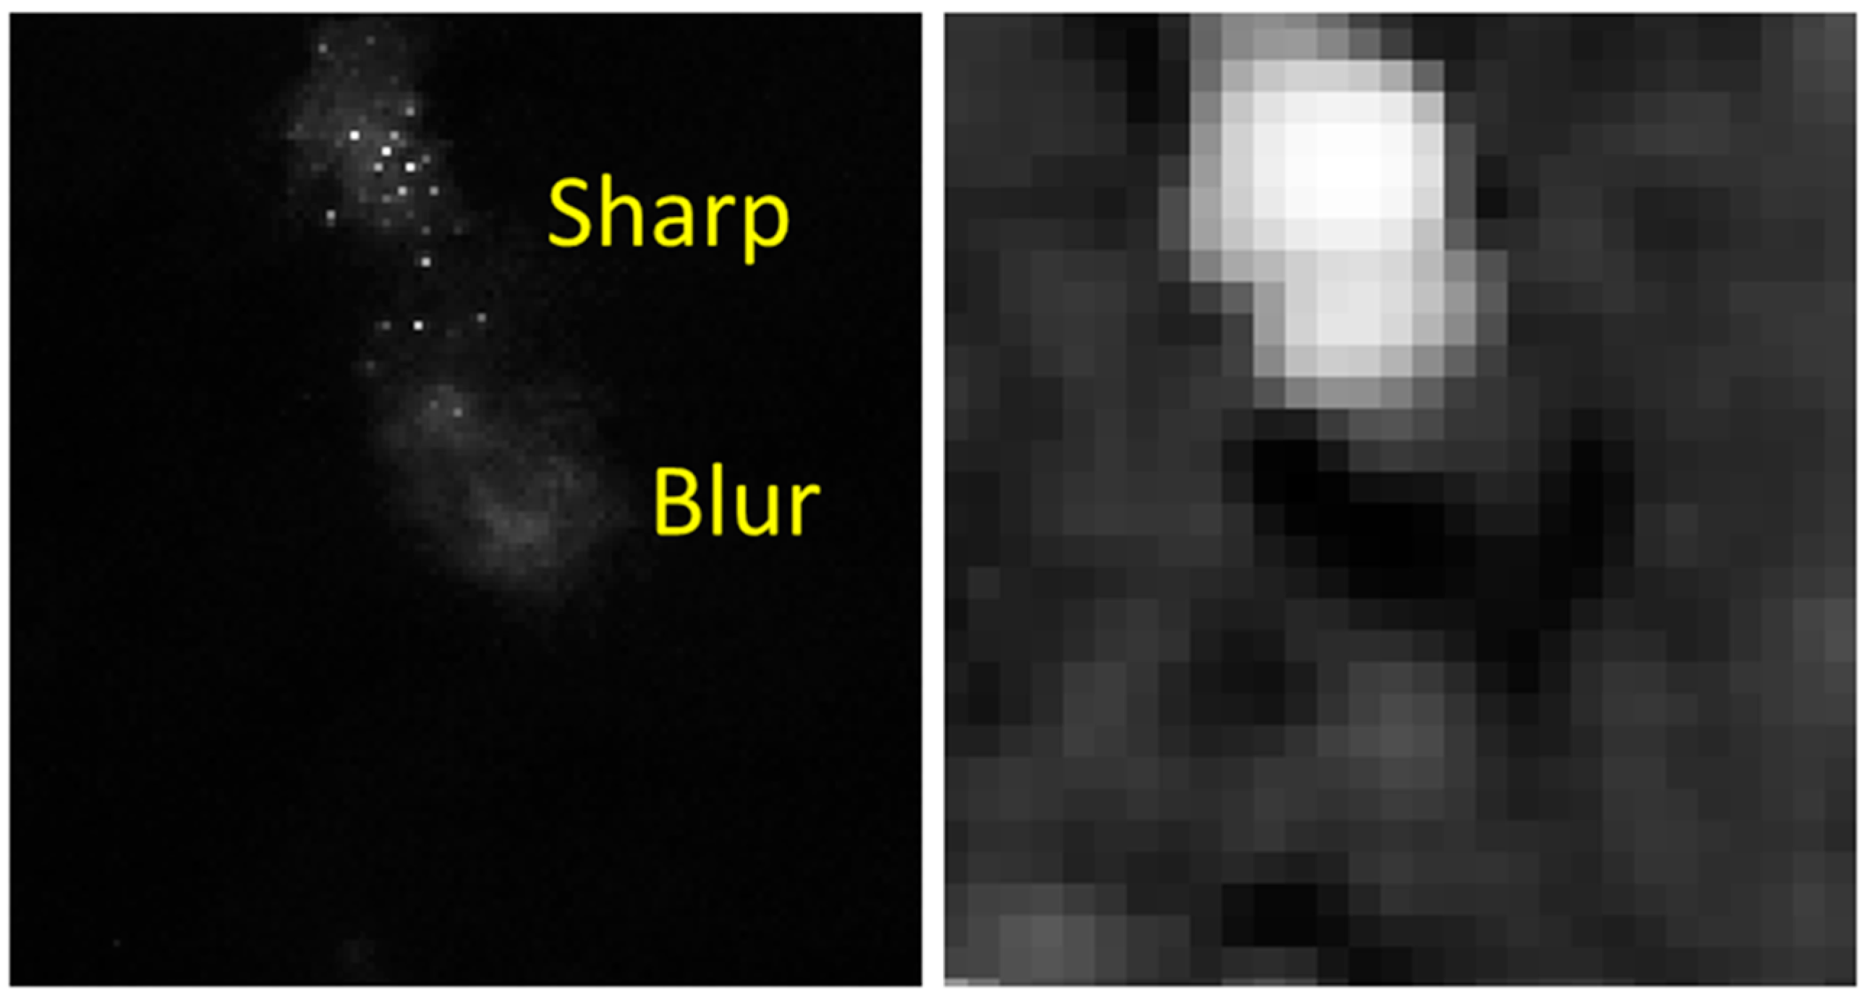
SI – Sharpness Index
Figure 9
DNB for a set of sharp and fuzzy offshore lights vs. the corresponding blur detection output. Blur index values are high for sharp features and low for fuzzy features.
Vu, C.T.; Phan, T.D.; Chandler, D.M. S3: A spectral and spatial measure of local perceived
sharpness in natural images. IEEE Trans. Image Process. 2012, 21, 934–945.

Slide 19
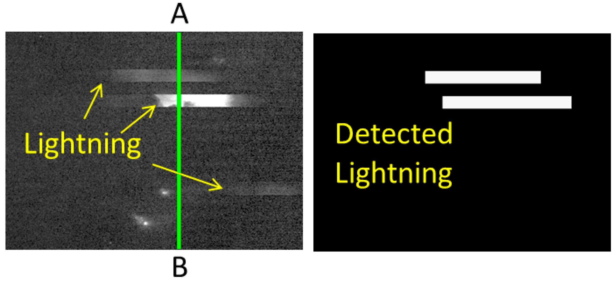
Lightning detection
Figure 10. Illumination detected from lightning forms horizontal ribbons exactly 16 lines wide, corresponding to the number of lines collected in a single sensor scan. The sample images shows three lightning features. The A-B lines shows the position of the along-track transect presented in Figure 11. The algorithm detected two of the three lightning features.

Slide 20
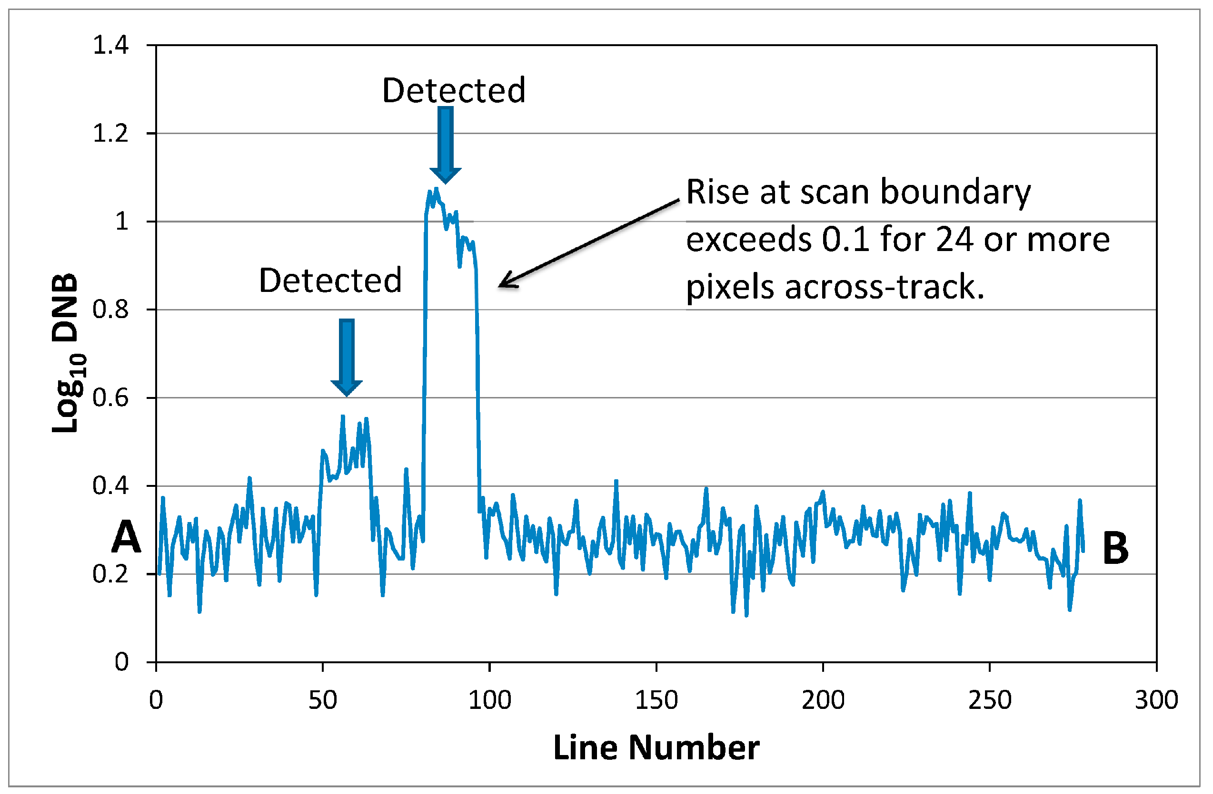
Figure 11
Graphical representation of the lightning algorithm based on the pixels along transect A–B on Figure 10.

Slide 21
Figure 12. The lighting features observed in DNB data collected north of Madura Island, Indonesia contains a combination of boats and gas flares. The two gas flares are identified based on short-wave infrared radiant emissions present in the simultaneously acquired M10 data.

Slide 22
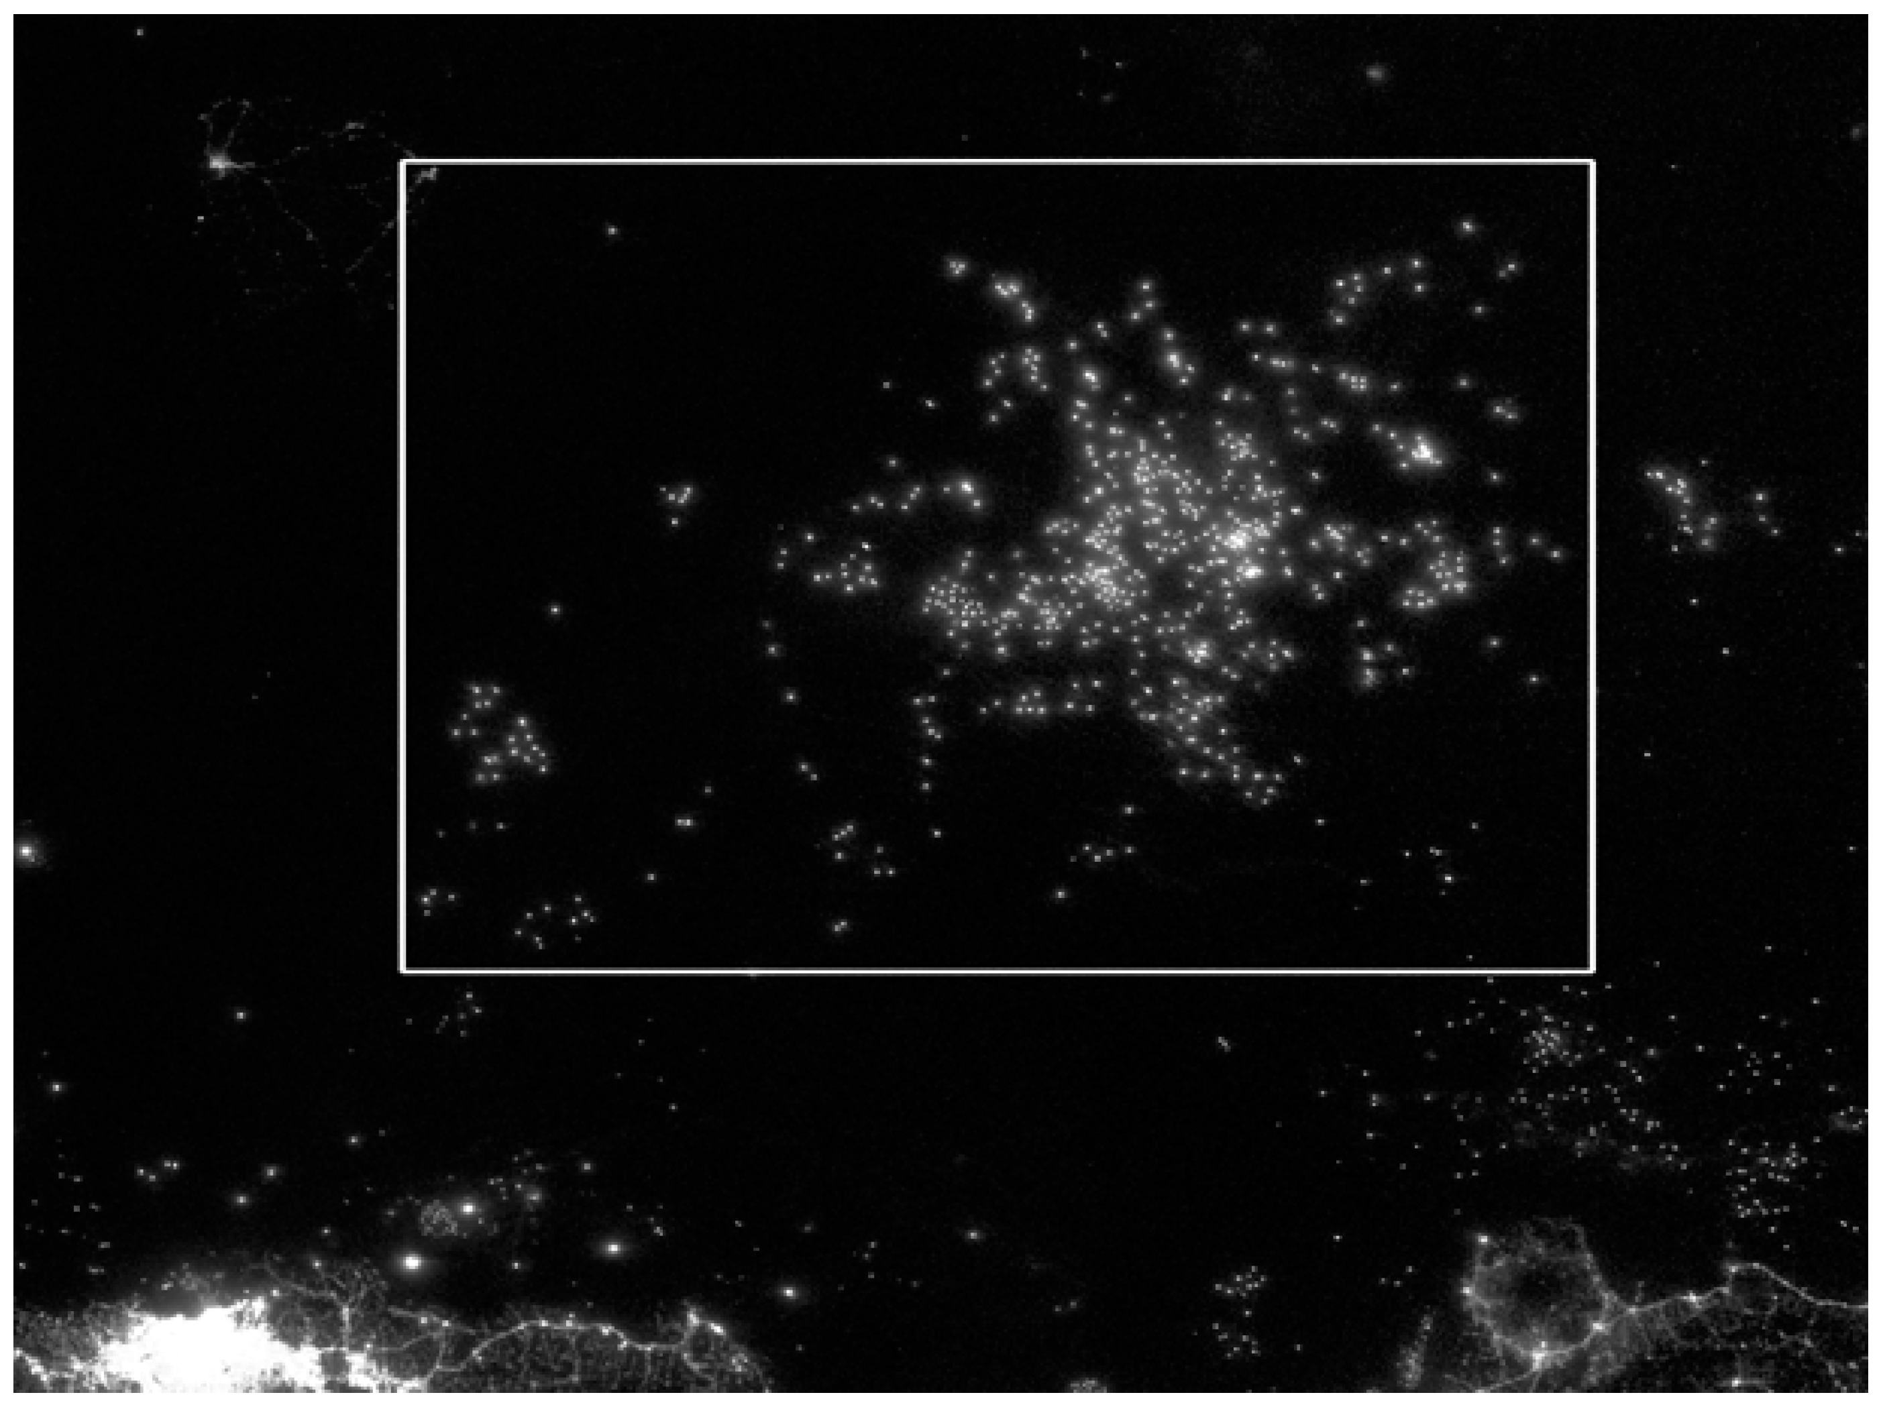
Figure 15
DNB image of the Java Sea from 27 September 2014. The validation study area is marked with a white rectangle.

Slide 23
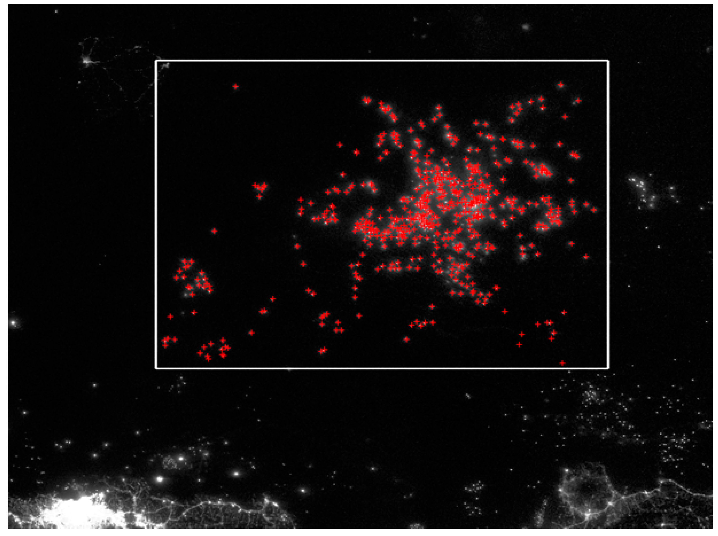
Figure 16
The analysts identified 594 boats in the study area.

Slide 24
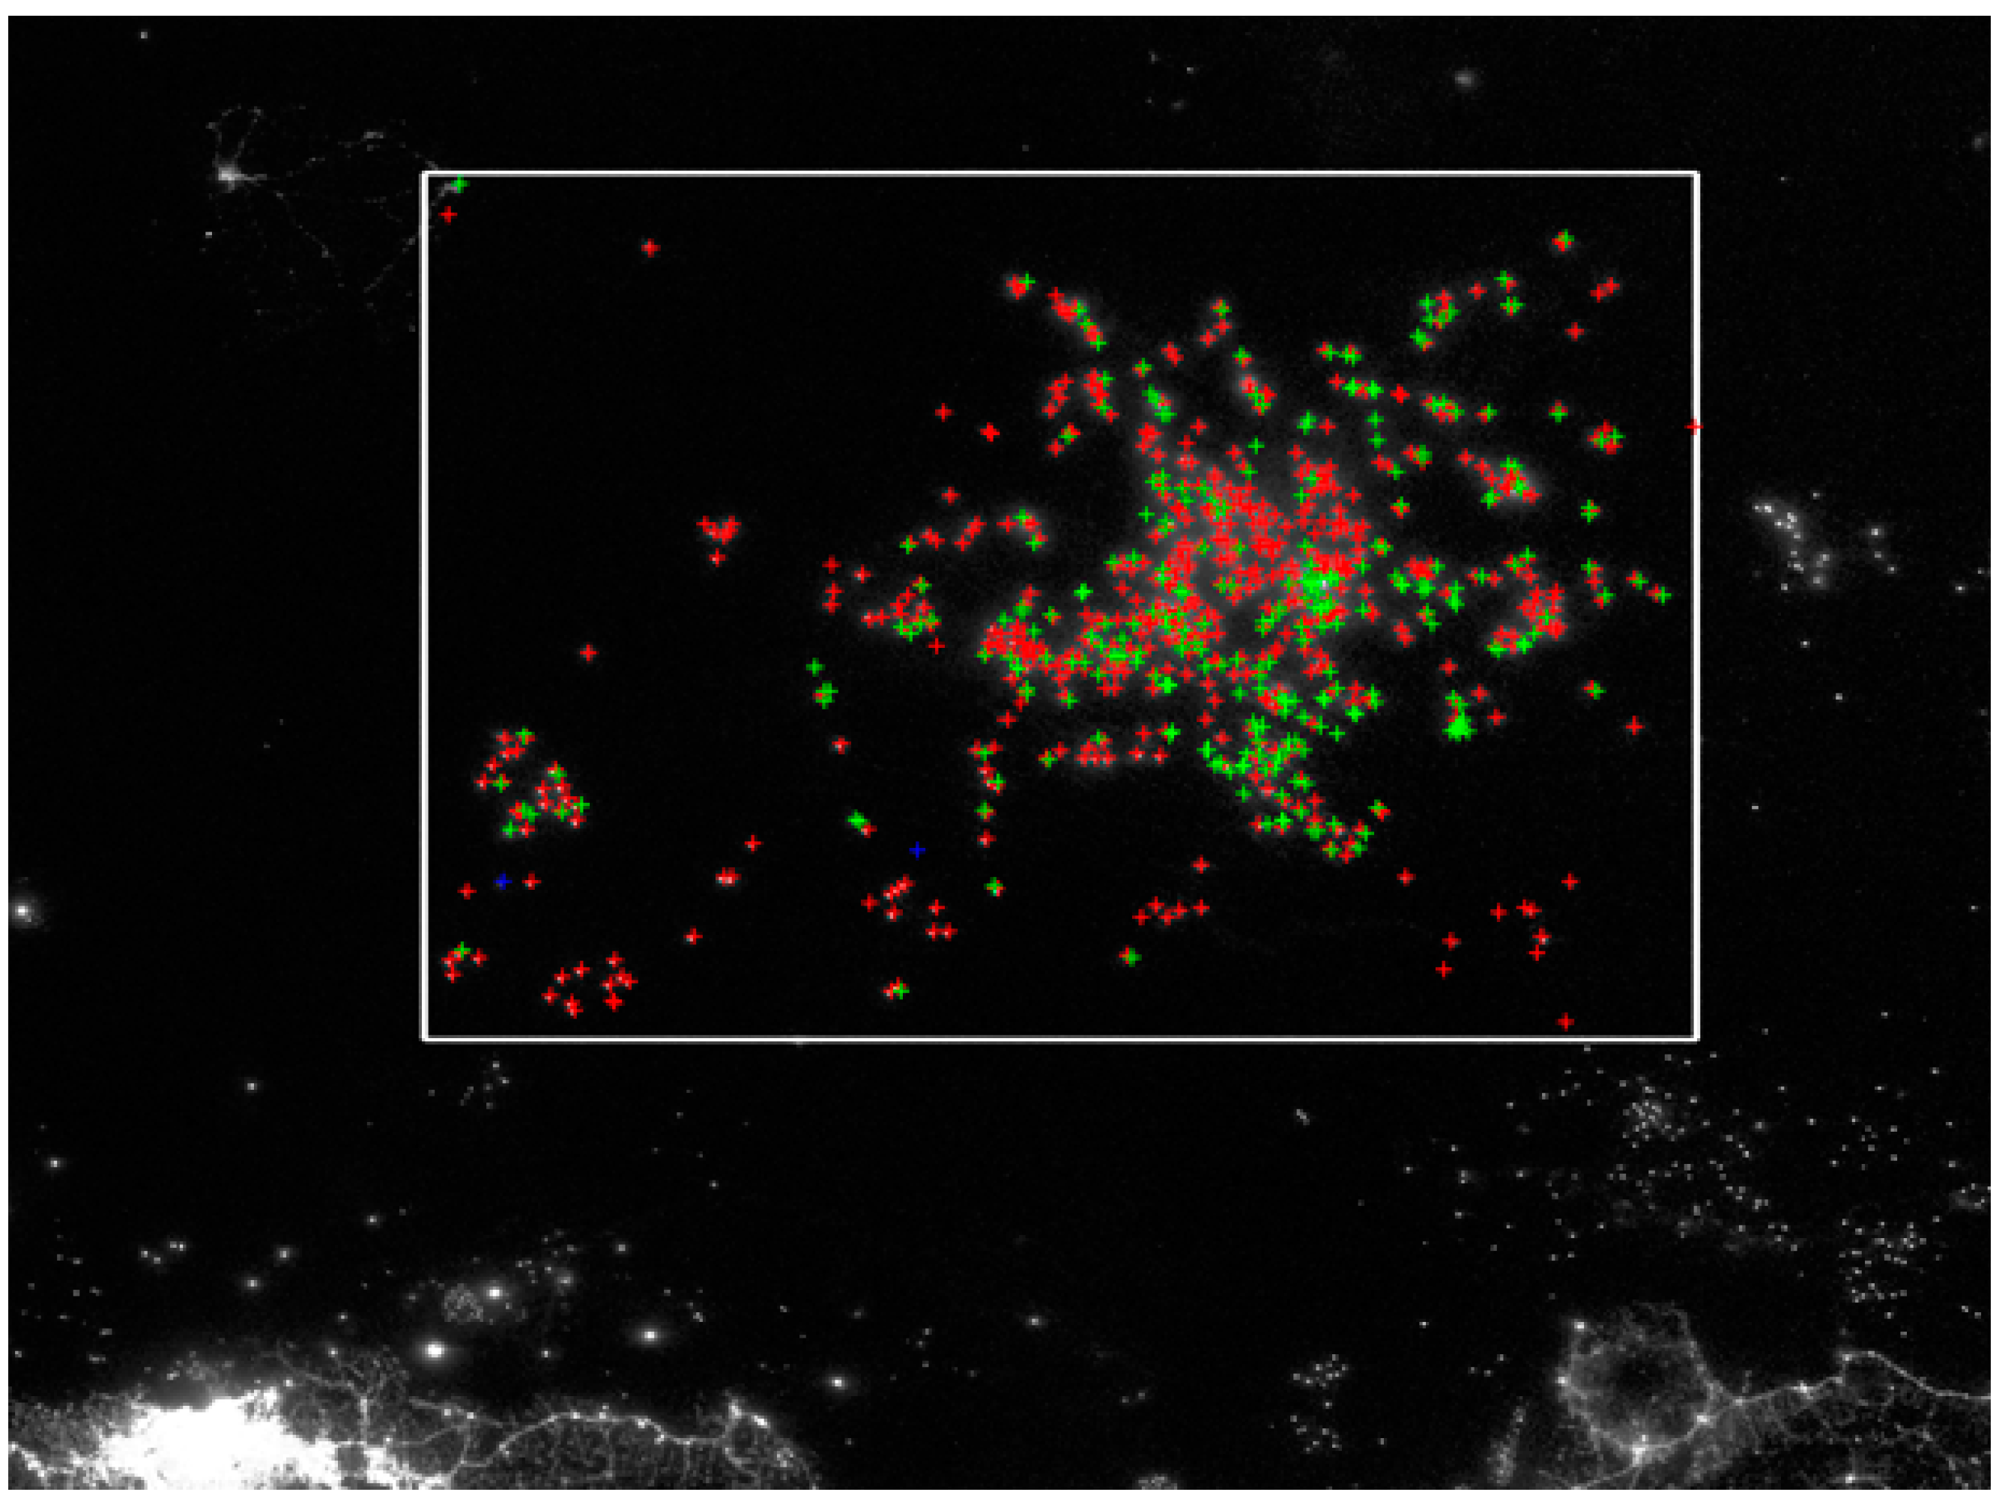
Figure 17
Algorithm identified 835 features. Red = QF1 (458 detections), Green = QF2 (287 detections), Blue = QF3 (2 detections).

Slide 25
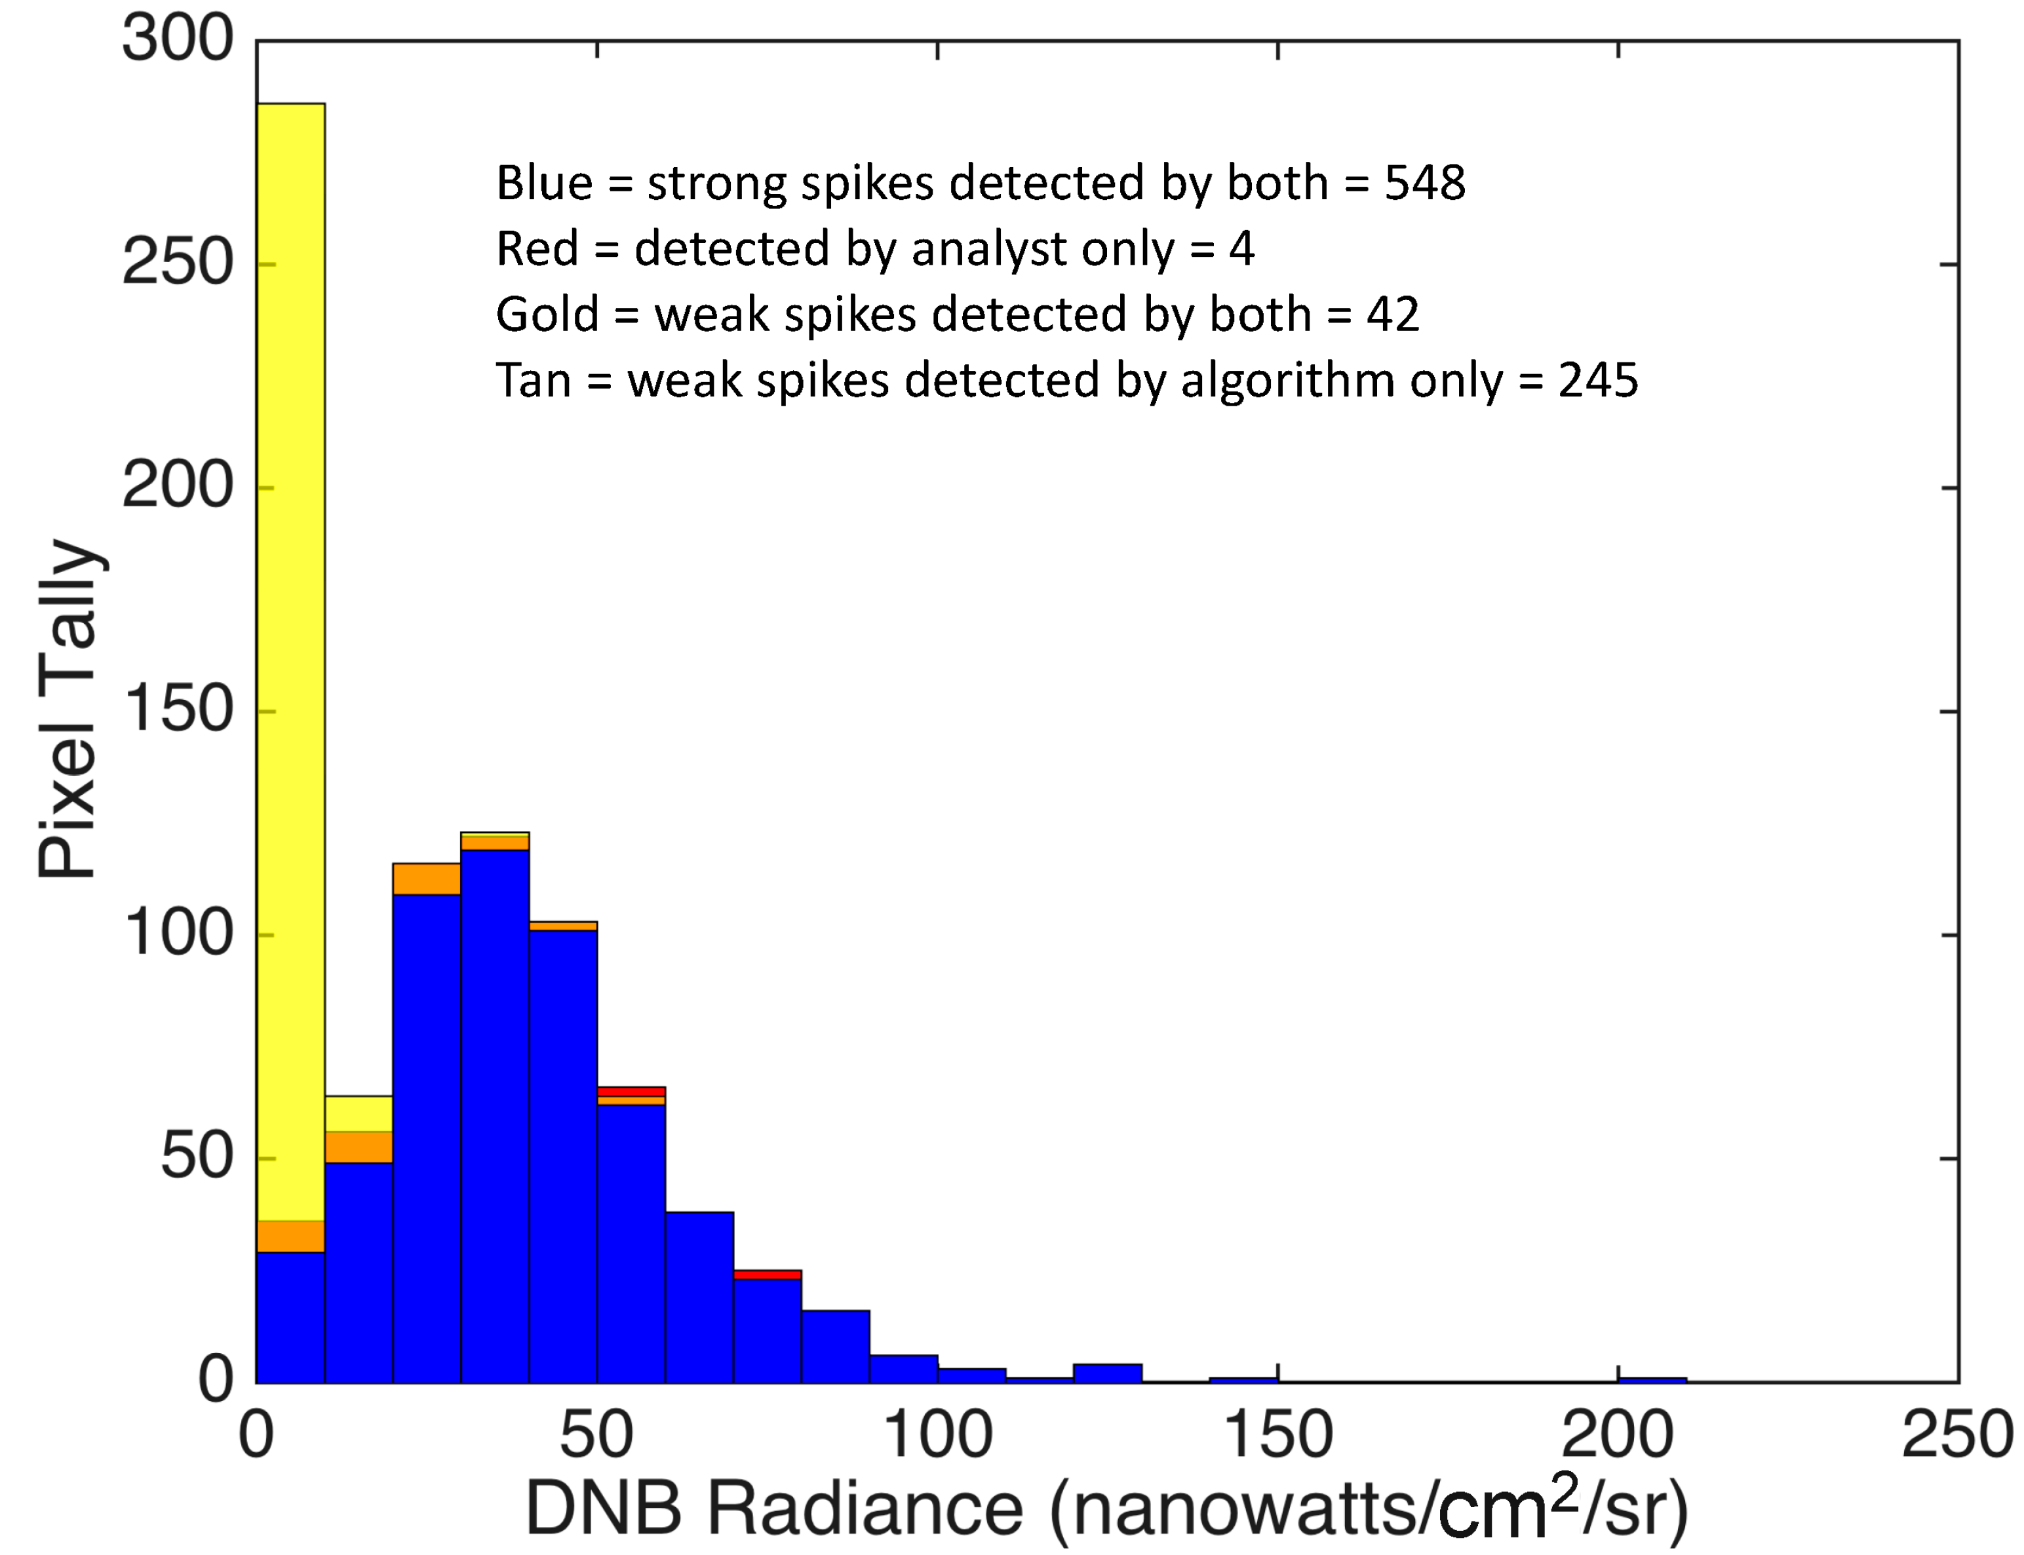
Figure 18
Summary of the
validation results.

Slide 26
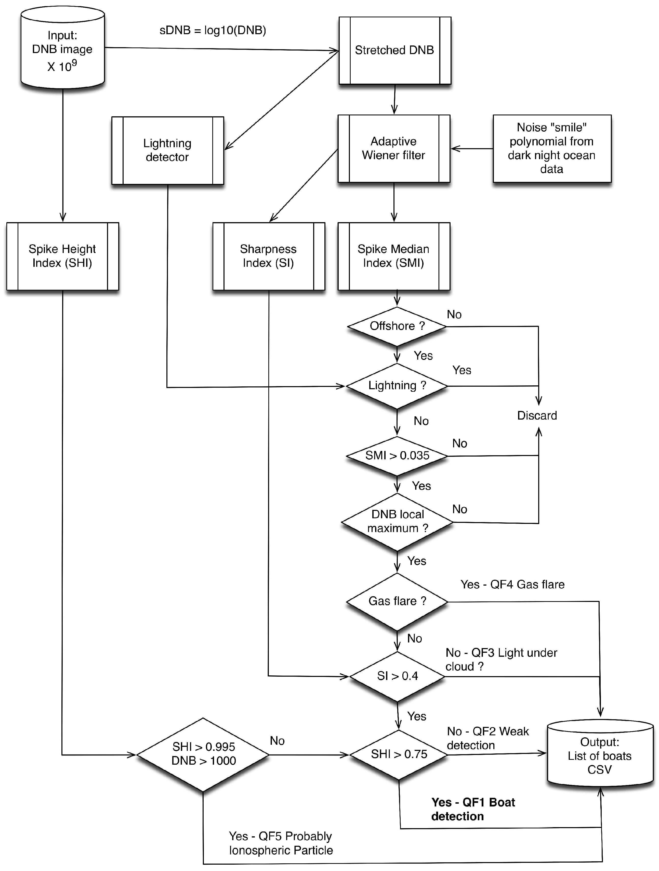
Original VBD processing chain (for dark night data).
Figure 2
Processing flow chart for VIIRS boat detection under low lunar illuminance conditions. The system detects and then assigns them to one of five categories using a quality flag. The highest quality detections are assigned to QF1. QF2 = weaker detections, QF3 = blurry detections, QF4 = gas flares, and QF5 = energetic particle detections.

Slide 27
Problem: High numbers of false detections when moonlight is bright

Slide 28
Moonlit boat detection
Calculate SMI, resample I5 to DNB, calculate SMI vs I5 cross correlation (xcorr).
Create scattergram for SMI vs xcorr.
Set SMI threshold for strong boat detection using pixels in the xcorr range from -0.7 to -1.0. These are “no boat” pixels. Select the SMI threshold from a histogram. Allow for an occasional boat pixel with an extremely high SMI value.
Set threshold for weak boat detections using a diagonal line starting from the intersection of xcorr = -0.6 and the strong SMI threshold and ending at xcorr = 1.0 and SMI = 0.0.
The analysis should be done for ranges of LI. In some cases LI across a full aggregate is stable and a single scattergram will suffice. In other aggregates two or three scattergrams may required.

Slide 29
Day/Night Band (DNB) October 14, 2015

Slide 30
V12 versus v19 red = v12 green = v19

Slide 31
Solution: Use adaptive thresholding to filter out detections on moonlit clouds
“No-boat
Zone”
Strong boat detections
SMI threshold for strong boat detections
Spike Median Index (SMI)
Weak boat detections
Highly
correlated
Poorly correlated
Cross correlation of DNB with simultaneously acquired long wave infrared

Slide 32
I5 Long-wave Infrared

Slide 33
Spike Median Index (SMI)

Slide 34
Example
Strong boat detections
SMI threshold for strong boat detections
Weak boat detections

Slide 35
Discussion with Misha – EOG’s lead programmer – on the Xmas Tree
December 9, 2023: Hi, How did we set the vertical line with the no-detection zone to the left?
Did that no-detection zone remain part of the moonlit VBD to this day?
The horizonal line is set based on the density threshold that Vineet is now using?
Do you have a preferred name for that thresholding method?
Any reference to cite? Thank you.
1. How did we set the vertical line with the no-detection zone to the left?
The vertical line is not a no-detection zone. It marks threshold change from
clouds “for sure” on the left and “weak detections” on the right.
2. Did that no-detection zone remain part of the moonlit VBD to this day?
See answer 1. The vertical line for “for sure” to “weak detections” switch is set adaptively for each granule
3. The horizonal line is set based on the density threshold that Vineet is now using?
Simple answer is yes. In the code we add some epsilon to the density threshold
4. Do you have a preferred name for that thresholding method?
DKNN, density of the K-nearest neighbors
5. Do you have a preferred name for that thresholding method
I did invent the algorithm. There are some reminiscent methods in N-dimensions.
We use it just for 1D “histogram” thresholding

Slide 36
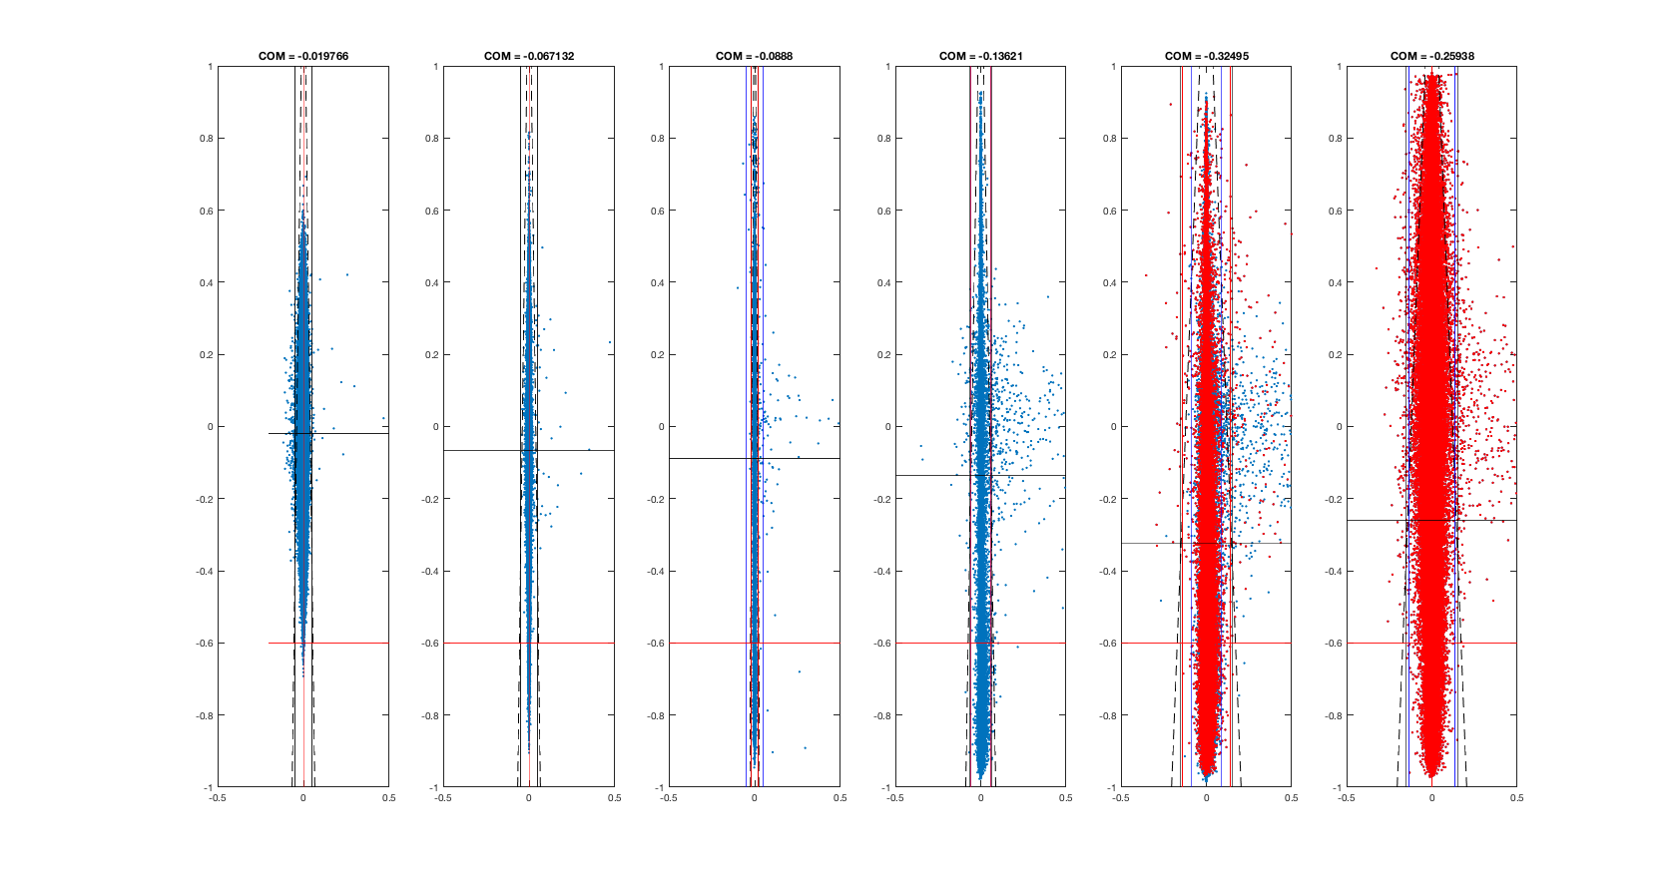
Misha stands the trees up – thus the mismatch in our discussion

Slide 37
Monitoring Compliance For Fishery Closures in the Philippines: 1) National closures 2) 15 km shoreline local government unit closures to large scale commercial fishing.

Slide 38
Palawan Roundscad Closure

Slide 39
Visayan Sardine Closure

Slide 40
Zamboanga Sardine Closure

Slide 41
Davao Gulf Closure

Slide 42
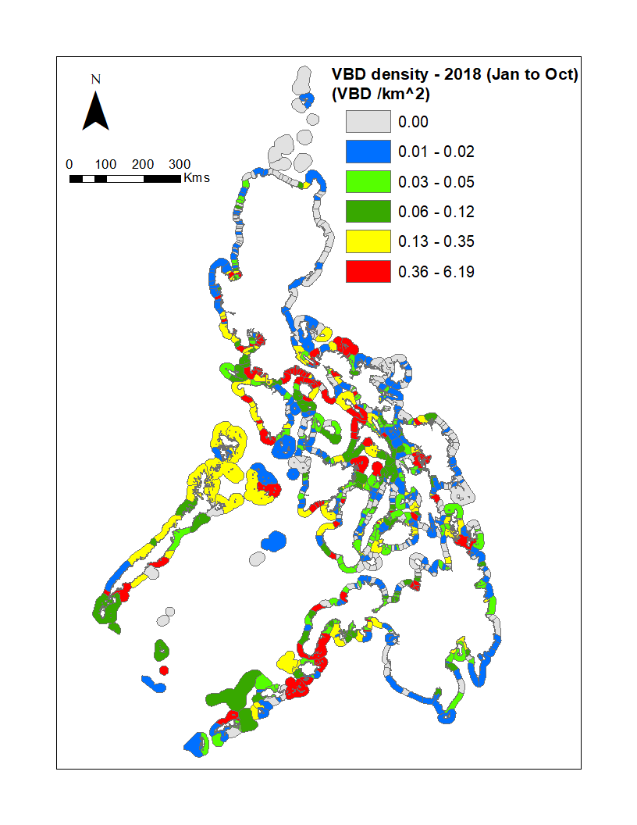
2018 MW VBD through October
VBD Counts
VBD Densities

Slide 43
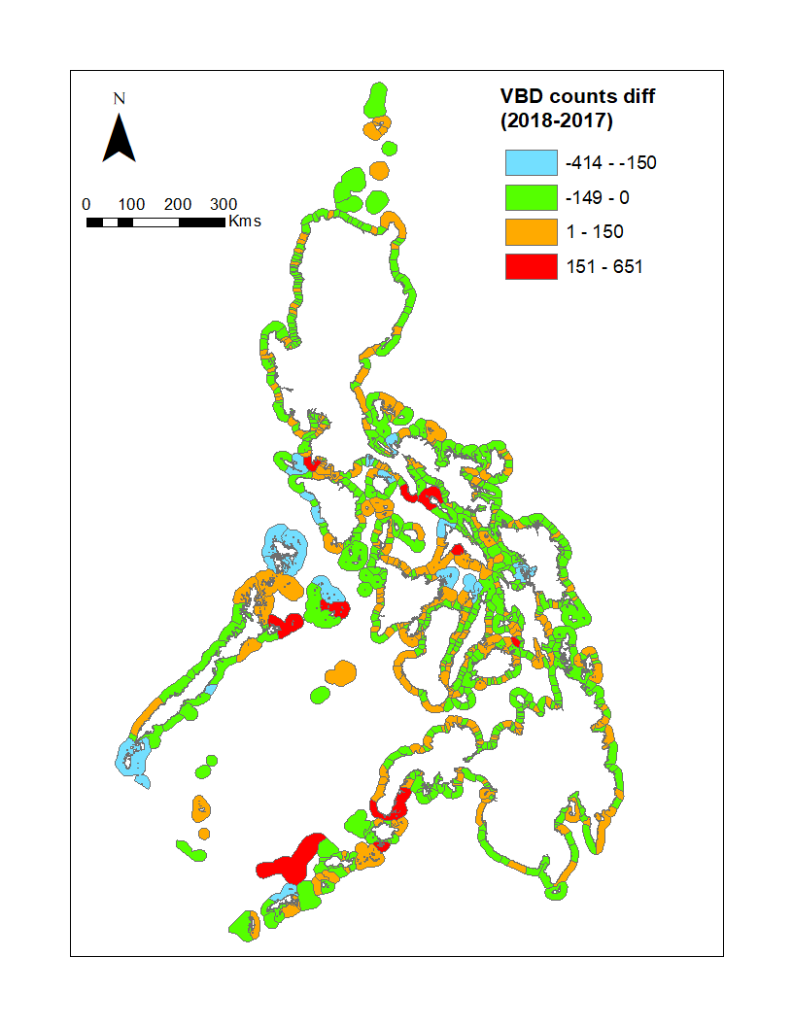
Count difference (2018 through October)
2017 - 2016
2018 - 2017

Slide 44
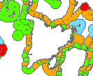
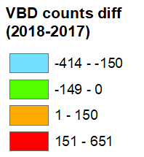
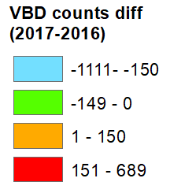
Did NOAA training have an effect? Training given in Carles and San Joaquin in June 2018
2017 - 2016
2018 - 2017

Slide 45
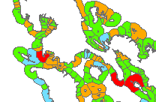
Did NOAA training have an effect? Calapan and Batangas January 2018 Lucena June 2018
2017 - 2016
2018 - 2017

Slide 46
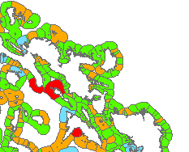
Did NOAA training have an effect? Legazpi September 2017
2017 - 2016
2018 - 2017

Slide 47
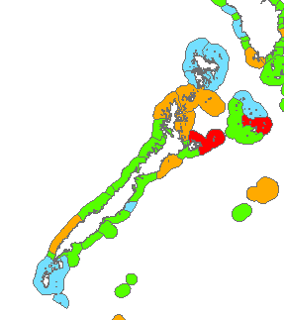
Did NOAA training have an effect? Puerto Princessa September 2017
2017 - 2016
2018 - 2017

Slide 48
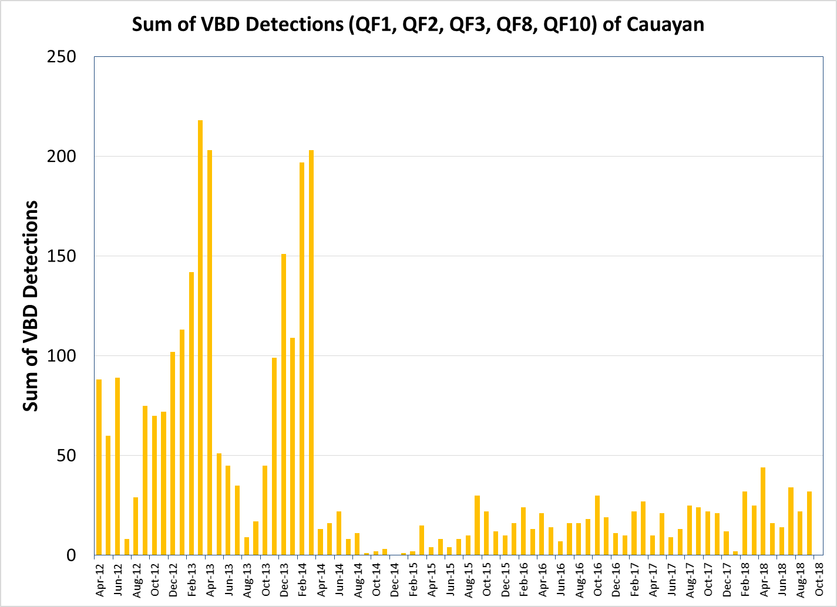
Cauayan, Negros Occidental is the “gold standard” for government success in pushing commercial boats out of municipal waters
Negros Occidental increased enforcement efforts beginning in late-March 2014

Slide 49
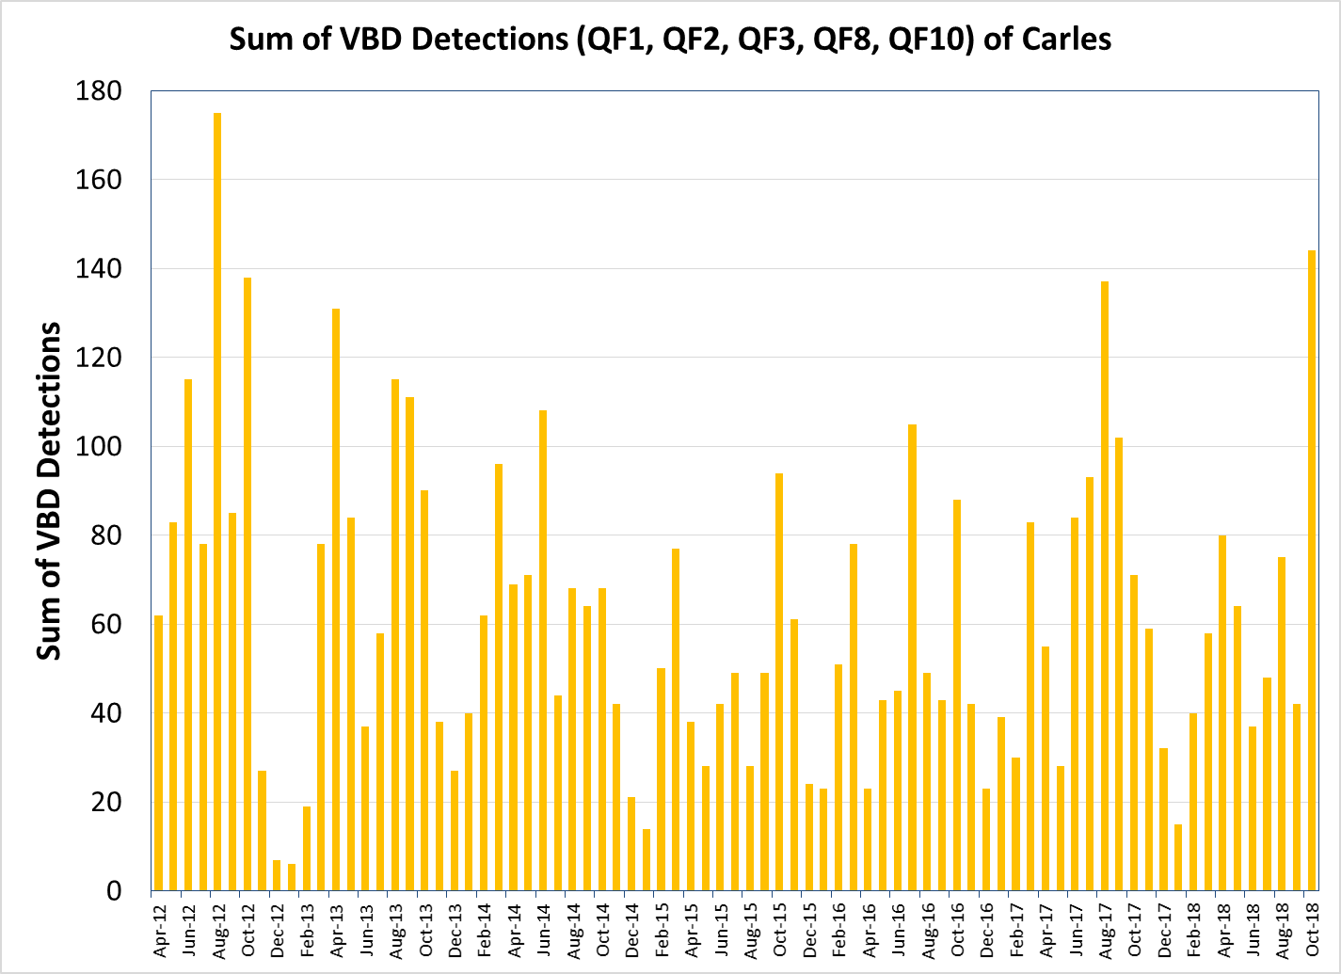
Elvidge gave training in Carles, Iloilo in June 2018
Training
June 2018

Slide 50
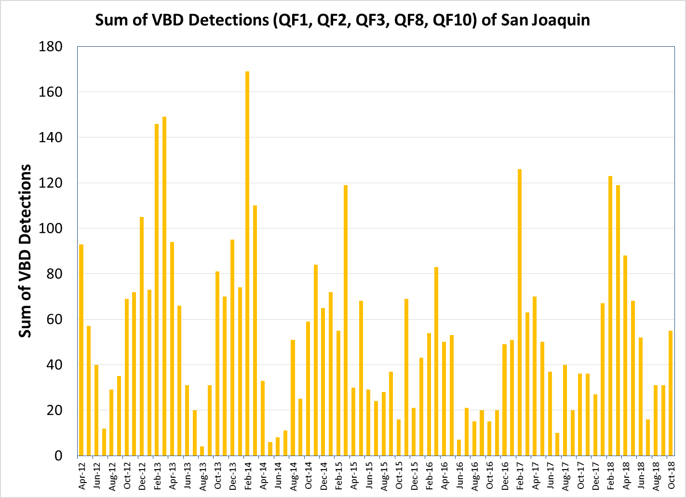
Elvidge gave training in San Joaquin, Iloilo in June 2018
Training
June 2018

Slide 51
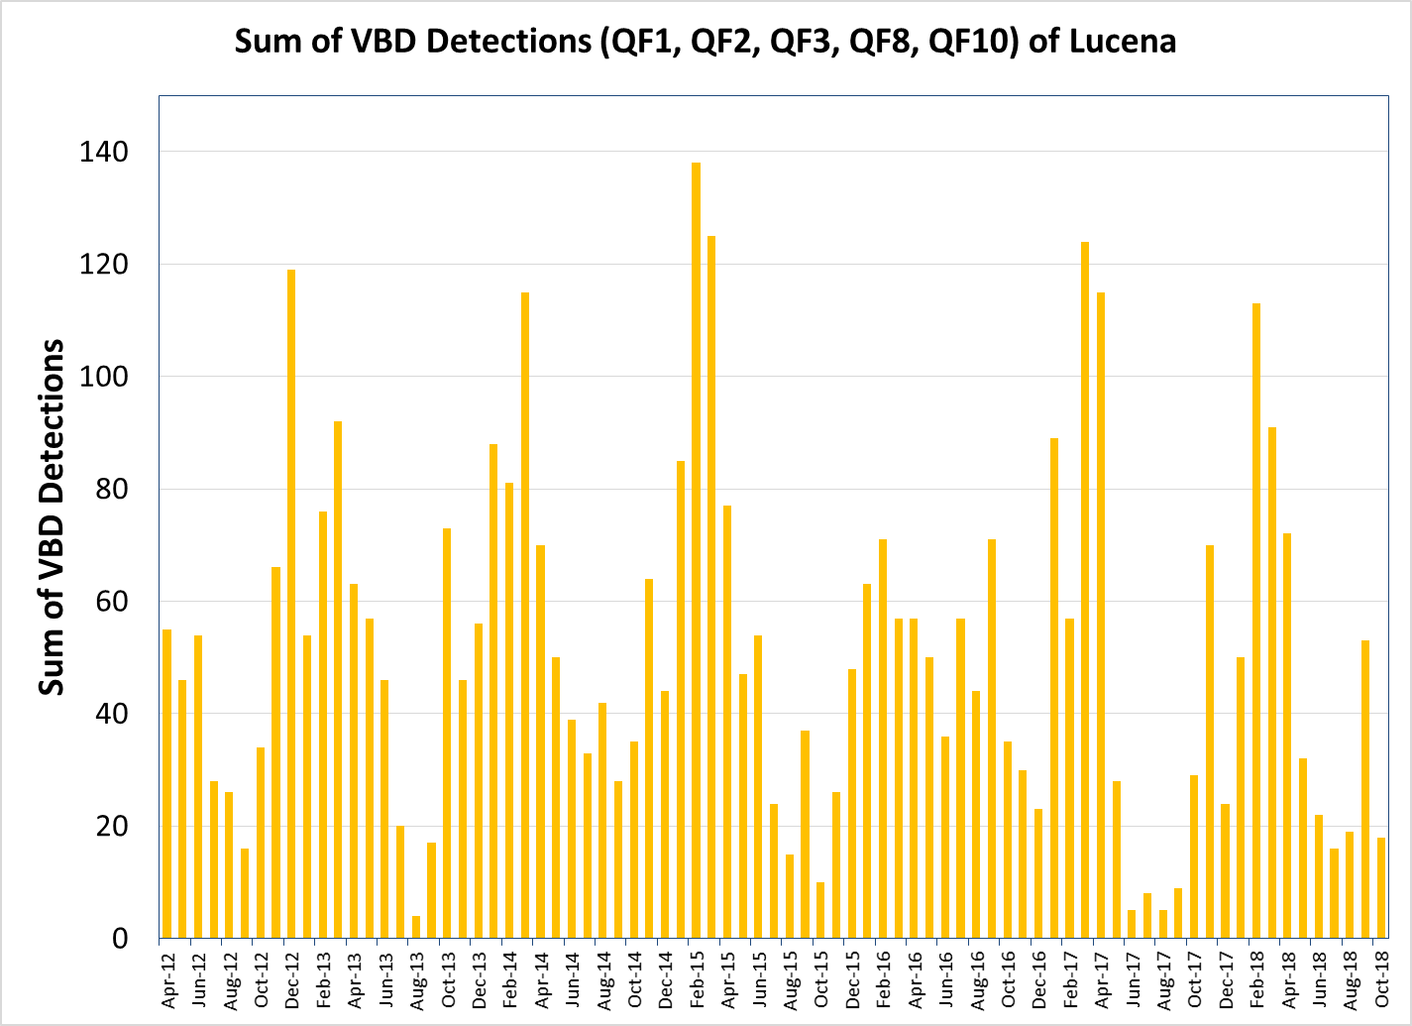
Elvidge gave training in Lucena, Quezon Province in June 2018
Training
June 2018

Slide 52
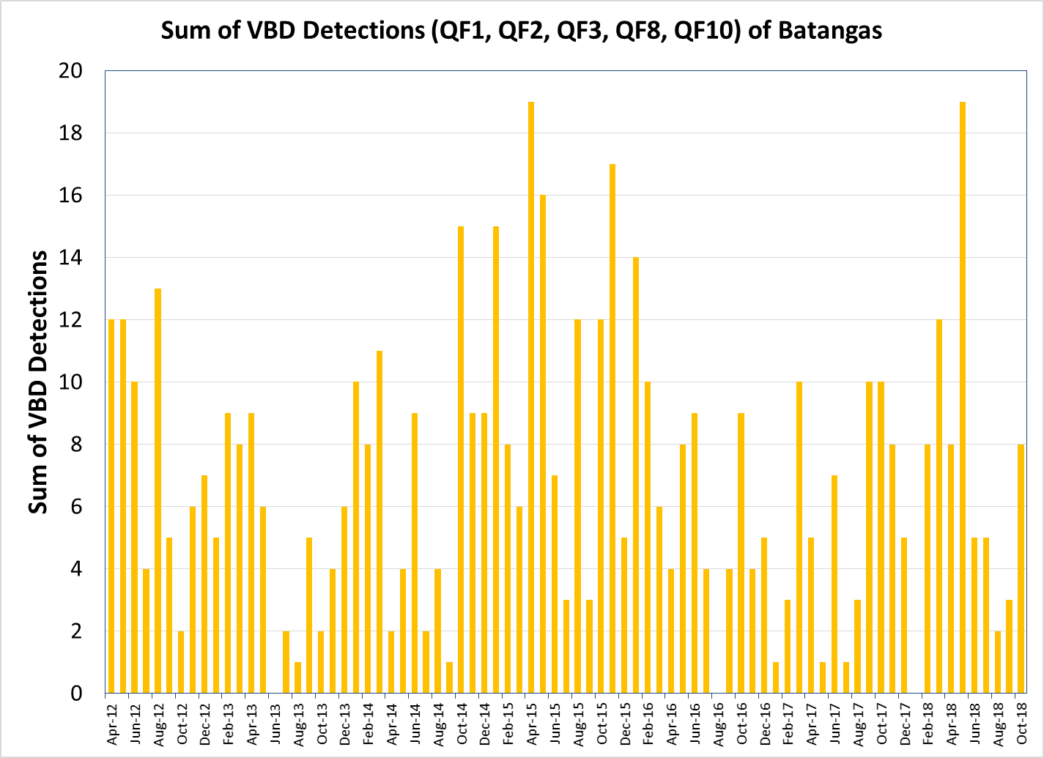
Elvidge gave training in Batangas in January 2018
Training
January 2018

Slide 53
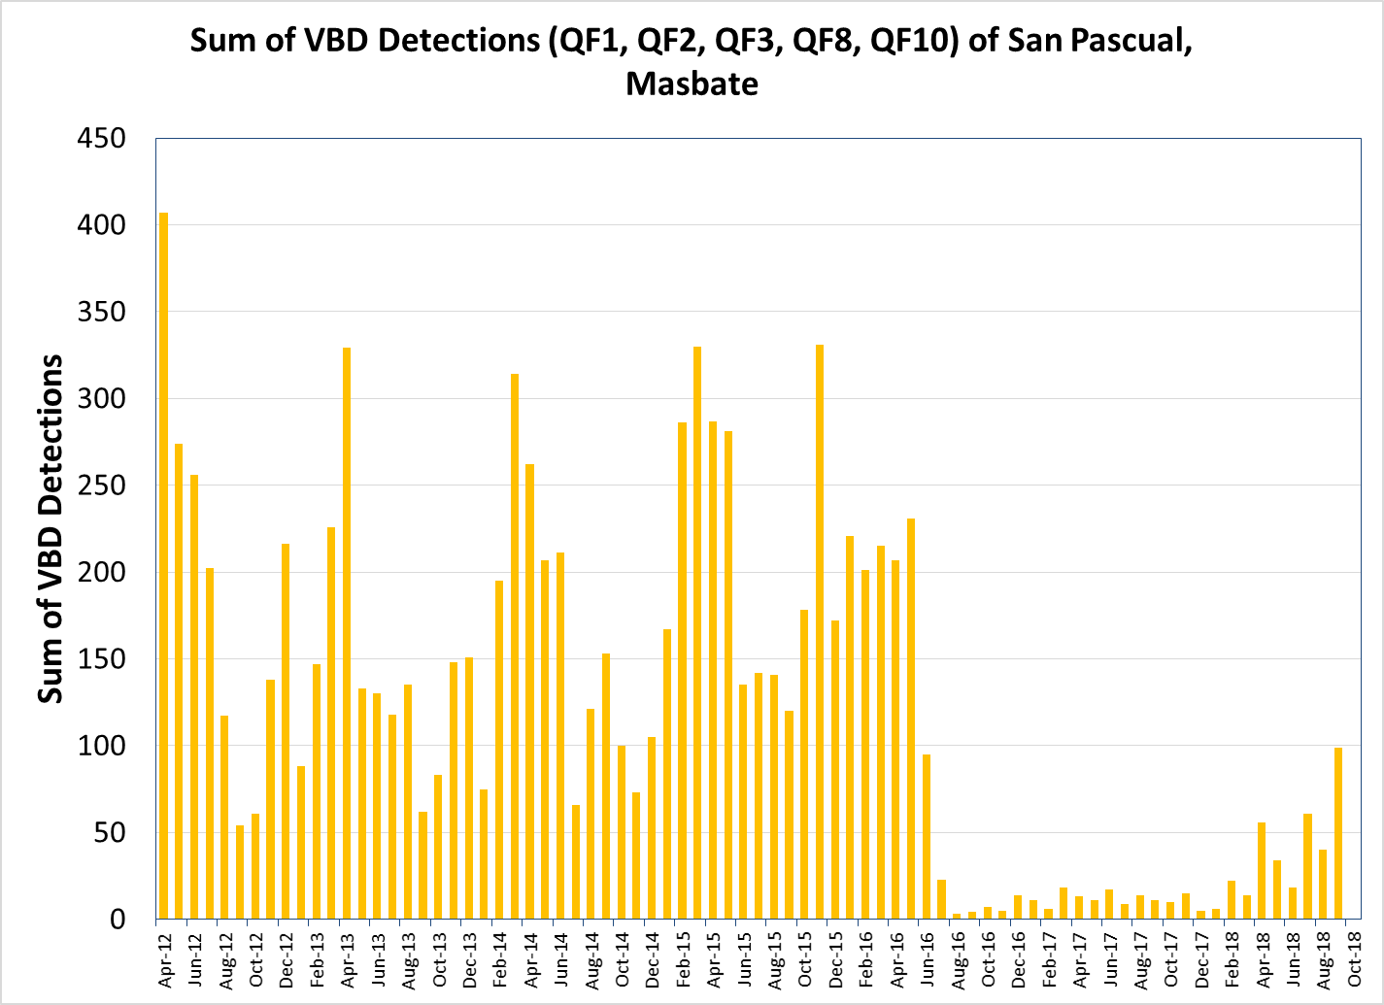
Look who cleaned up their MWs starting in July 2016!
July
2016

Slide 54
VIIRS Boat Detections for the Top Twenty LGUs in 2015
Region 5/Masbate/San Pascual | 7723
Region 4/Palawan/Cuyo | 6624
Region 4/Marinduque/Santa Cruz | 4660
Region 4/Palawan/Coron | 4151
Region 4/Palawan/Magsaysay | 4126
Region 4/Palawan/Linapacan | 3958
Region 5/Camarines Norte/Vinzons | 3540
Region 4/Palawan/Balabac | 3035
Region 4/Occidental Mindoro/Sablayan | 2966
Region 4/Palawan/Araceli | 2948
Region 4/Occidental Mindoro/Mamburao | 2935
Region 4/Palawan/Busuanga | 2852
Region 4/Occidental Mindoro/Paluan | 2808
Region 4/Quezon/Calauag | 2772
Region 4/Batangas/Calatagan | 2740
Region 3/Zambales/San Antonio | 2707
Region 5/Masbate/Milagros | 2644
Region 4/Quezon/Padre | 2616
Region 5/Masbate/Aroroy | 2600
Region 4/Palawan/Batarasa | 2280

Slide 55
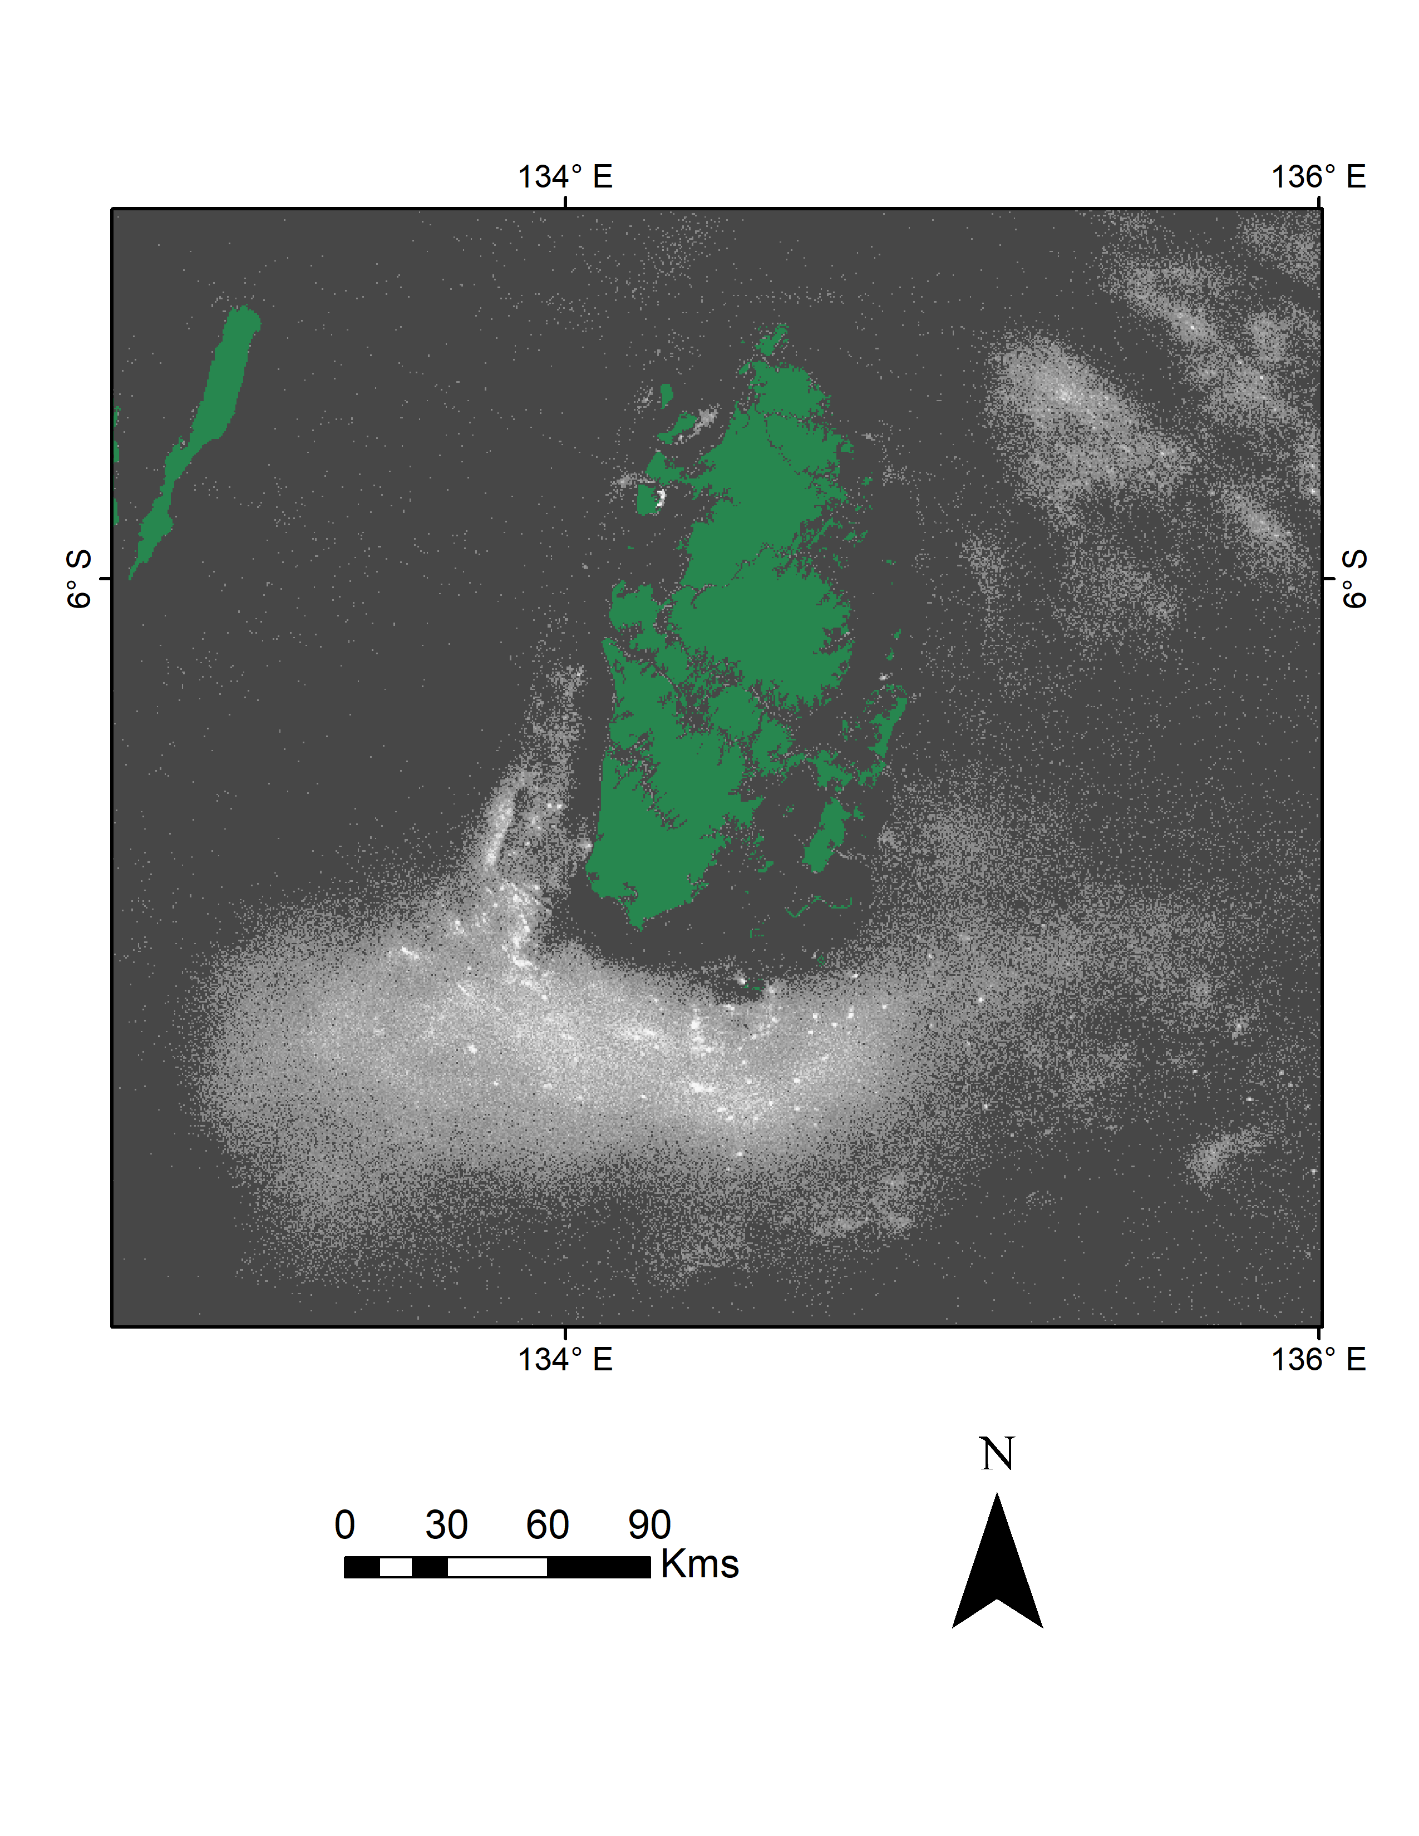
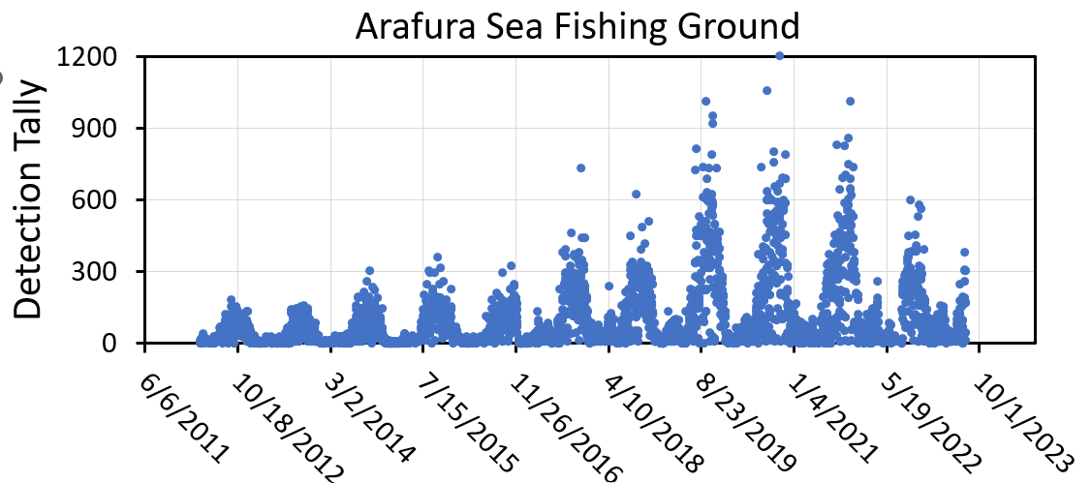
Cumulative Boat Detections (2012-2022) Arafura Sea

Slide 56
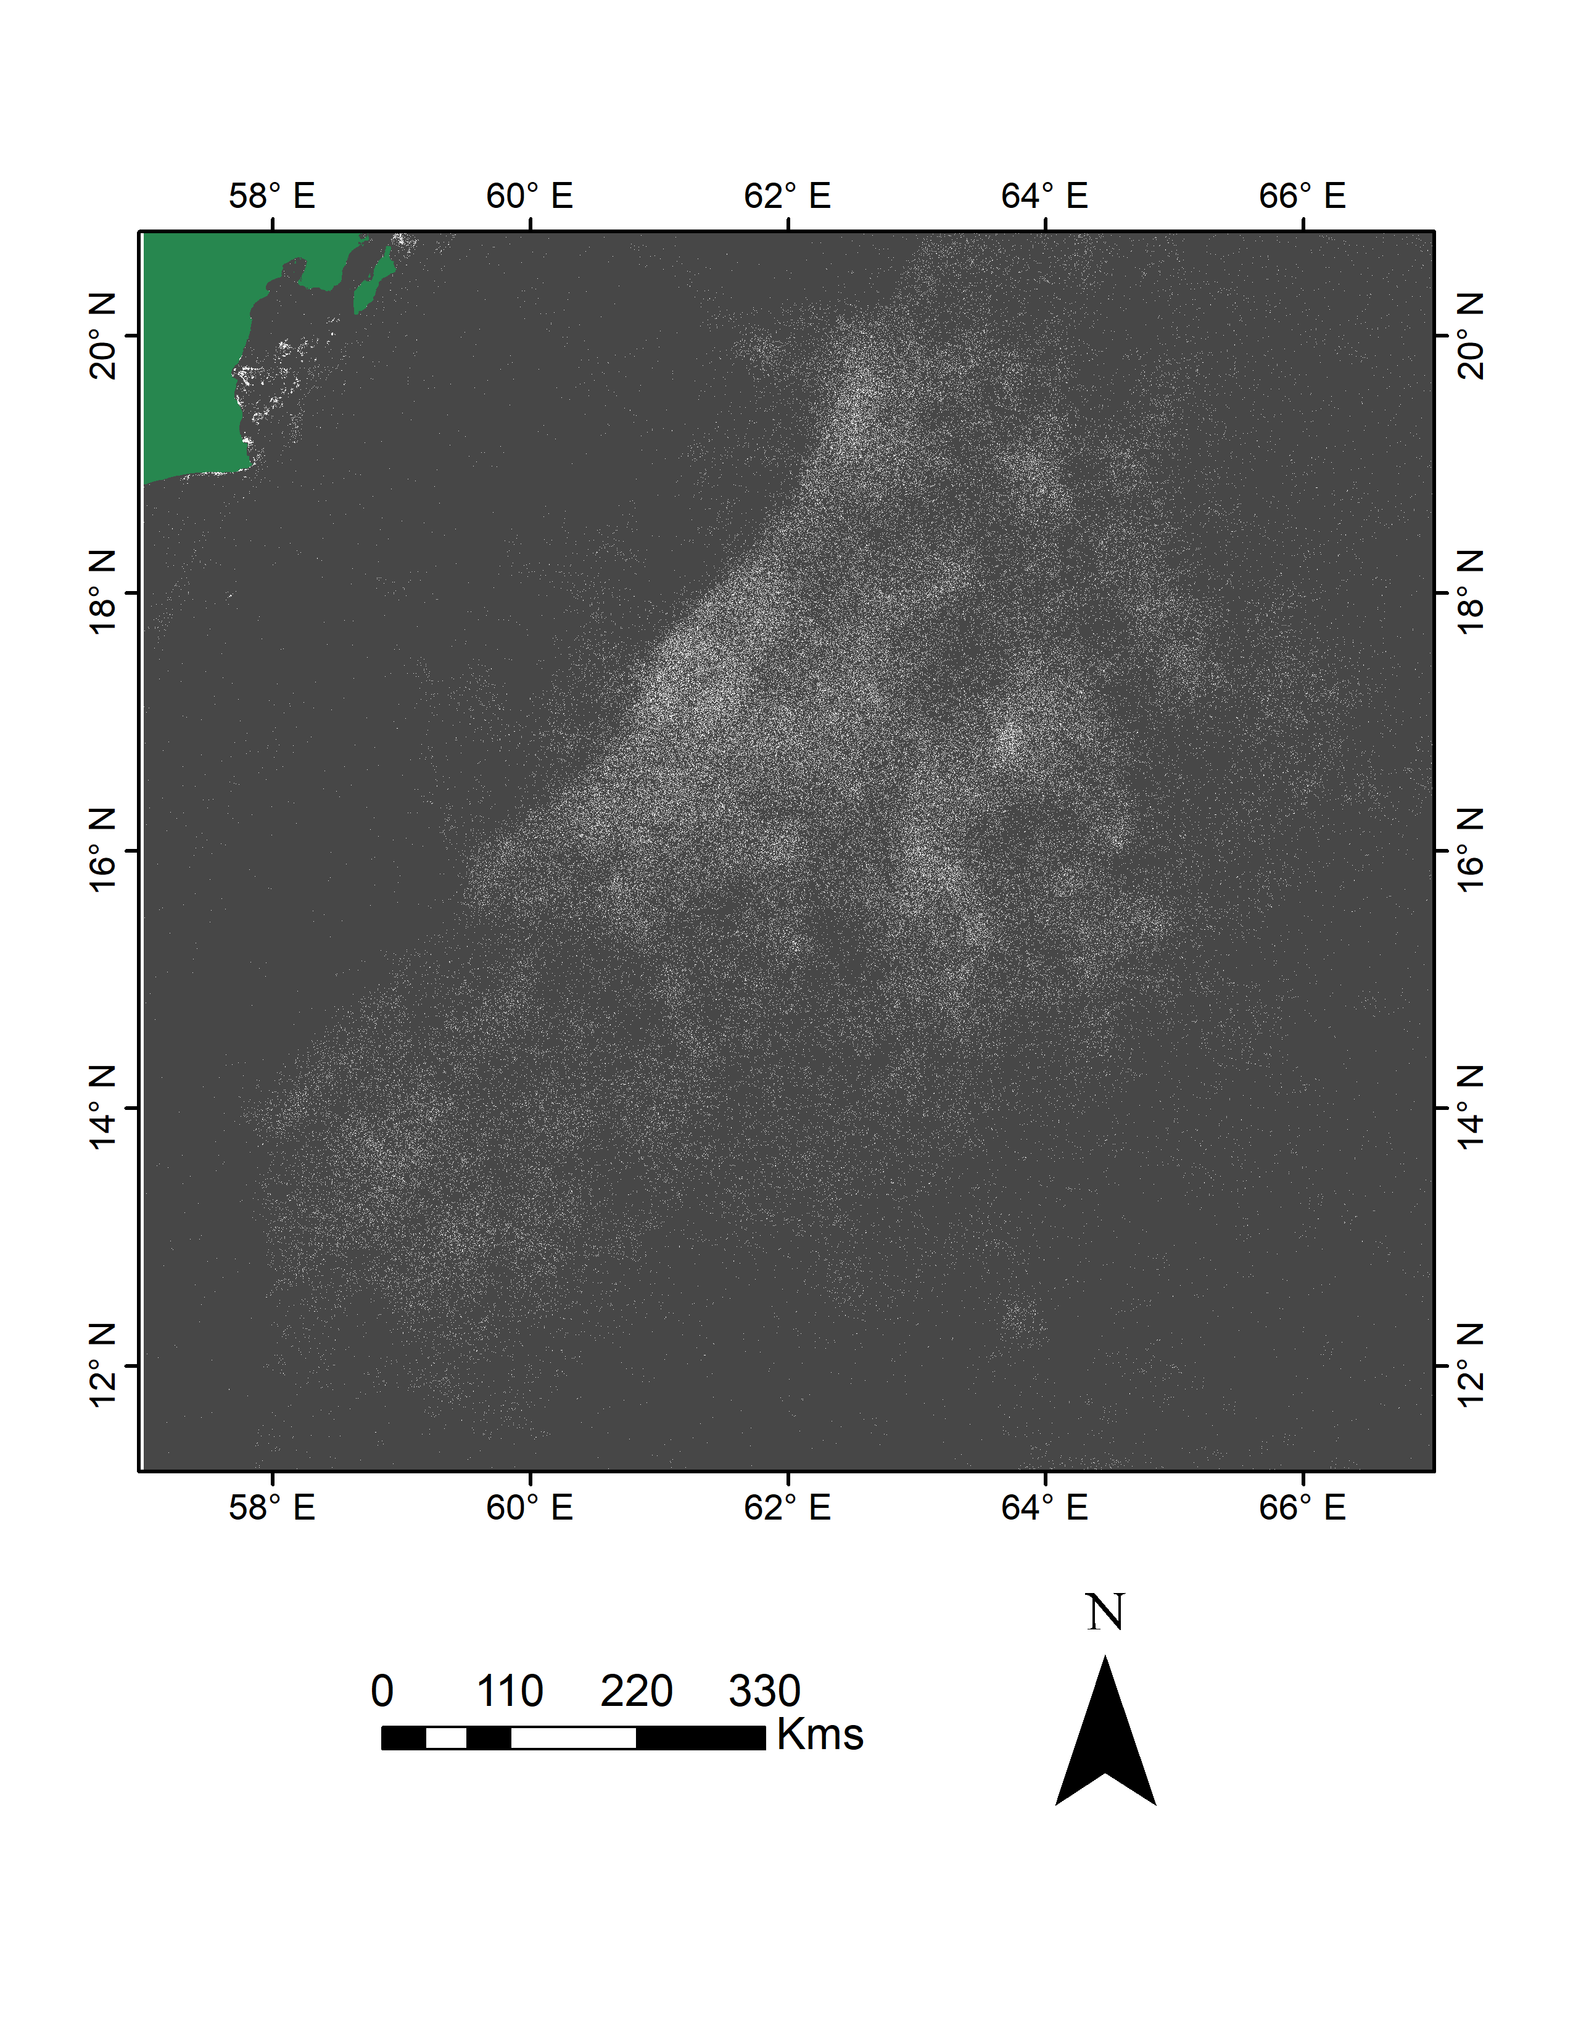
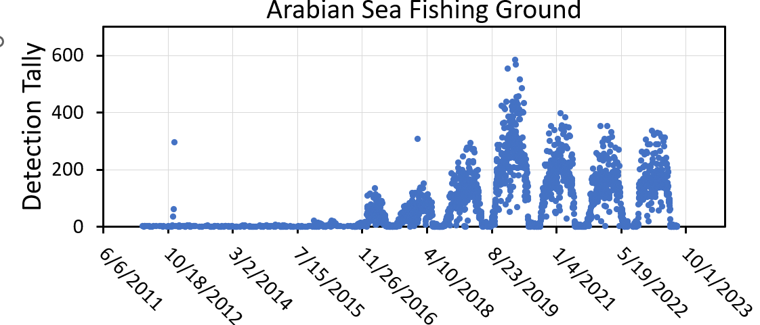
Cumulative Boat Detections (2012-2022) Arabian Sea Squid Fishery

Slide 57
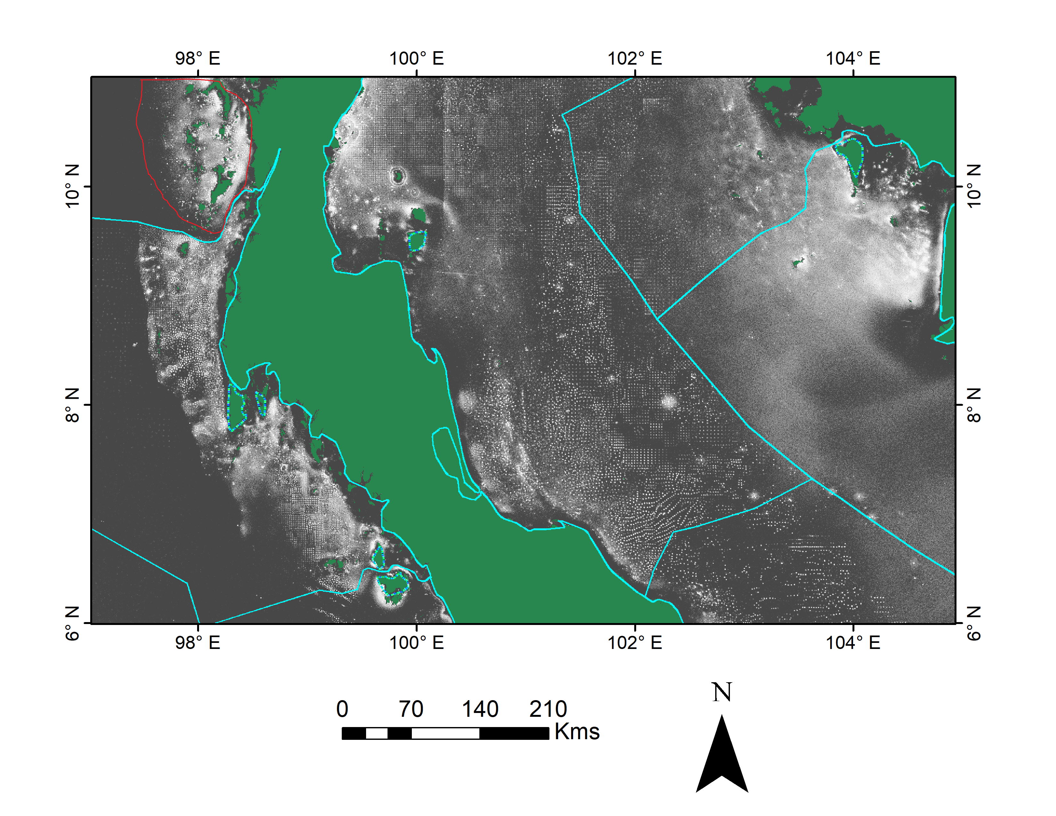
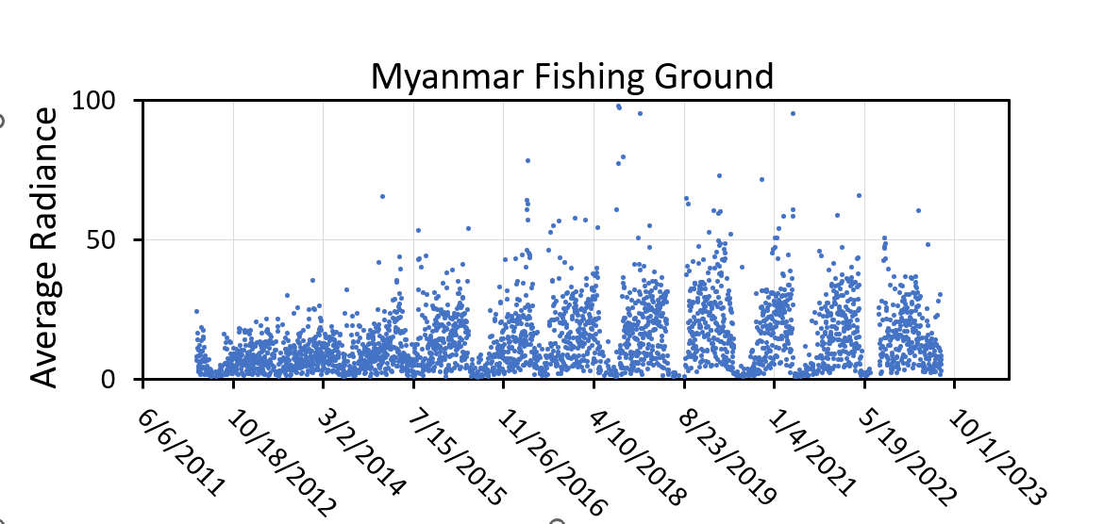
Cumulative Boat Detections (2012-2022) Myanmar Andaman Sea Fishery

Slide 58
Summary
The VBD algorithm was developed in 2015-2016 funded by the U.S. Agency for International Development and the VIIRS program office (JPSS).
The algorithm is based on the detection and characterization of offshore DNB spikes.
VBD has special modules that adaptively adjusts the detection threshold up to minimize false detections from moonlit clouds and lunar glint.
EOG currently makes daily VBD from three VIIRS sensors (SNPP, NOAA-20 and NOAA-21).
Email VBD alerts are sent out near 06:00 local time.
The archive is global from 2017 to present and 2012 to present in Asia.
The cumulative VBD shows the outline of fishing ground, anchorages, transportation routes.
Temporal profiles can track the activity levels through time.

