Slide 1
Overview of the VIIRS Instruments
Chris Elvidge
Earth Observation Group
Payne Institute for Public Policy
Colorado School of Mines
Golden, Colorado
celvidge@mines.edu
Presented at AIT
January 10, 2024

Slide 2
Currently Three VIIRS Instruments Are Collecting
SNPP (Suomi National Polar Partnership) launched 28 October 2011.
NOAA-20 launched 18 November 2017.
NOAA-21 launched 10 November 2022.
NOAA-22 being built for launch in 2027.
NOAA-23 being built for launch in 2032.
Each has an after-midnight overpass.
Orbits are staggered to have three or more overpasses per night.
We may have VIIRS data until 2040 or more.
A follow on sensor series is in the design phase.

Slide 3
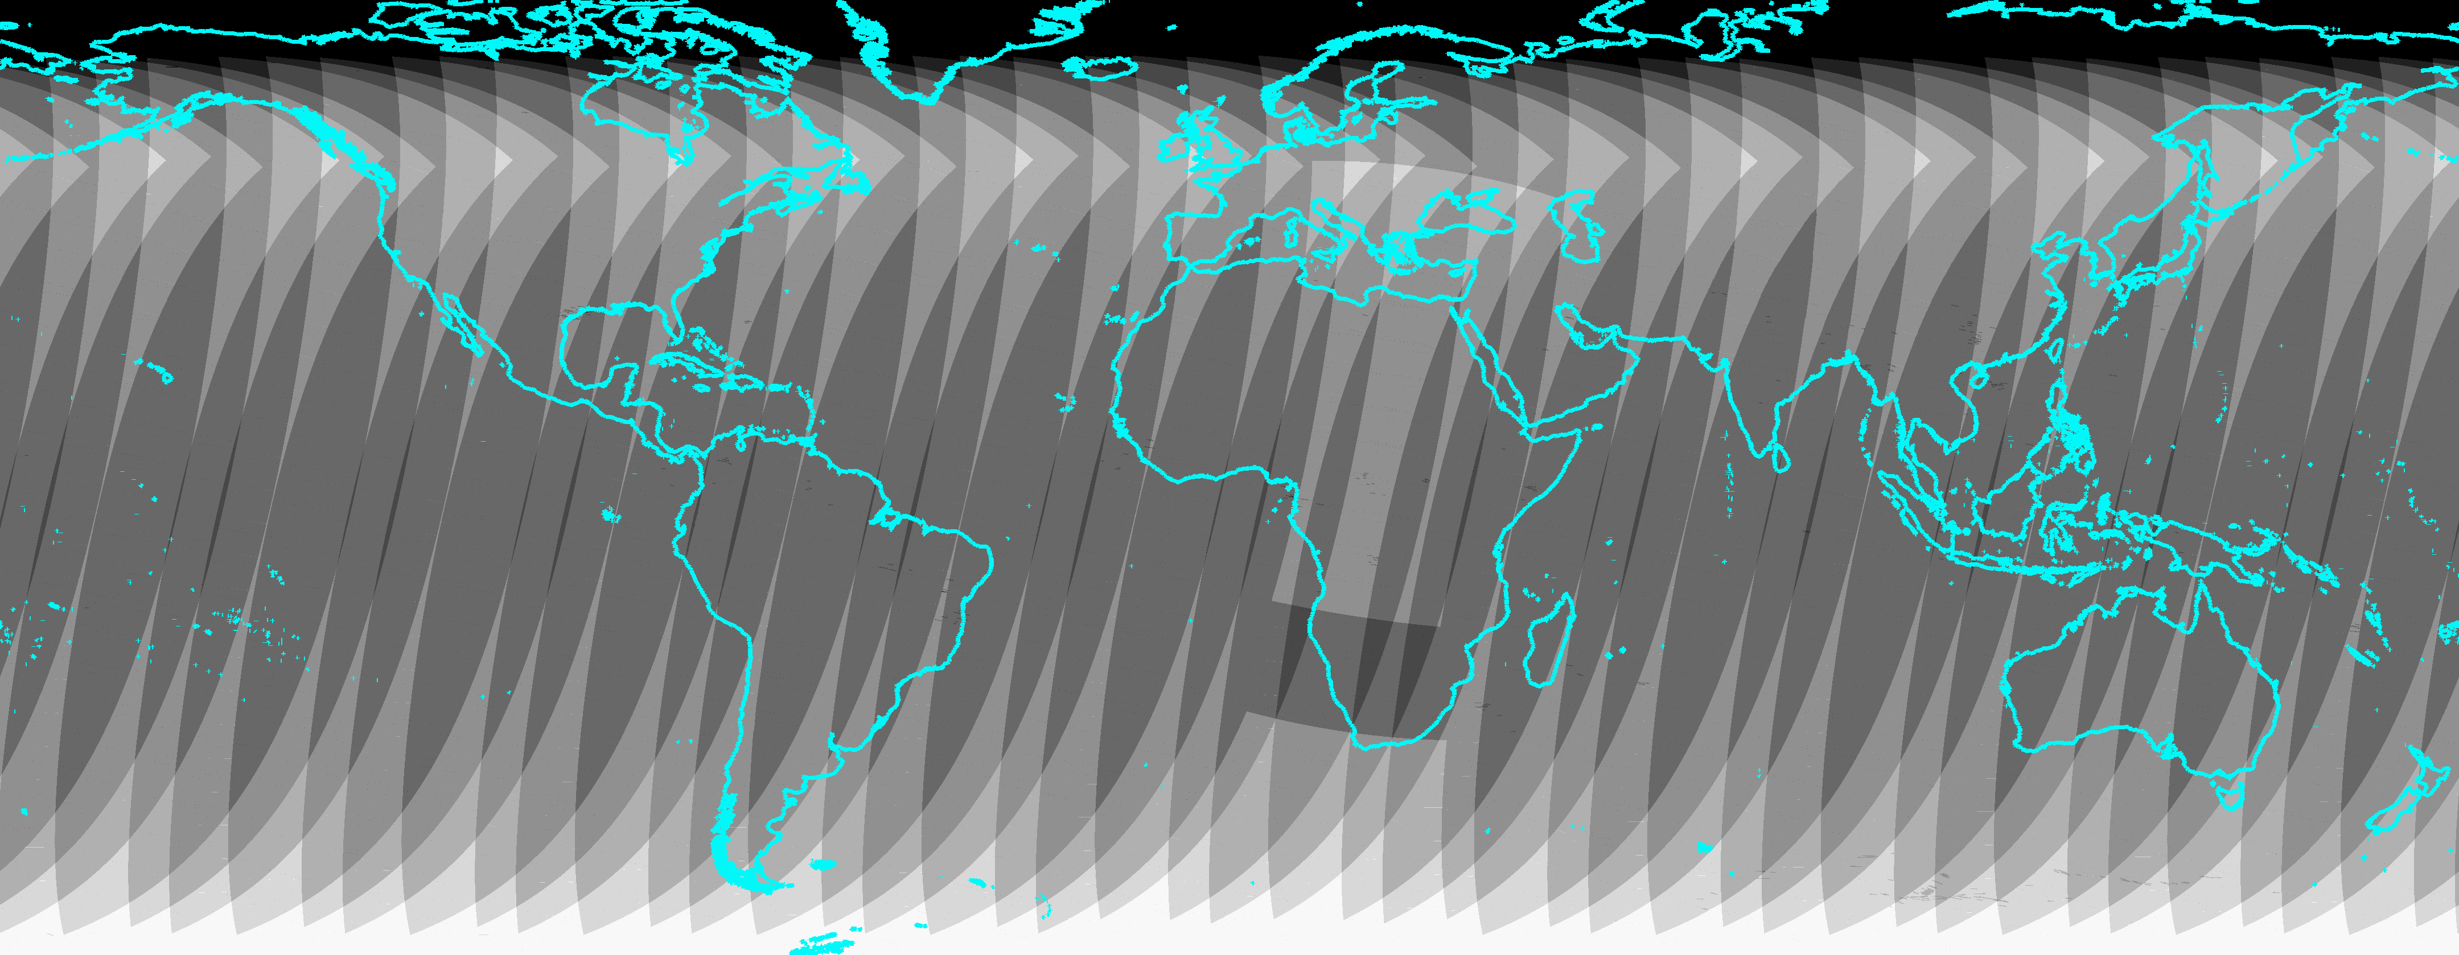
Global map of VIIRS coverages (SNPP, NOAA-20, NOAA-21) on a randomly selected night – April 21, 2023
5
4
3

Slide 4
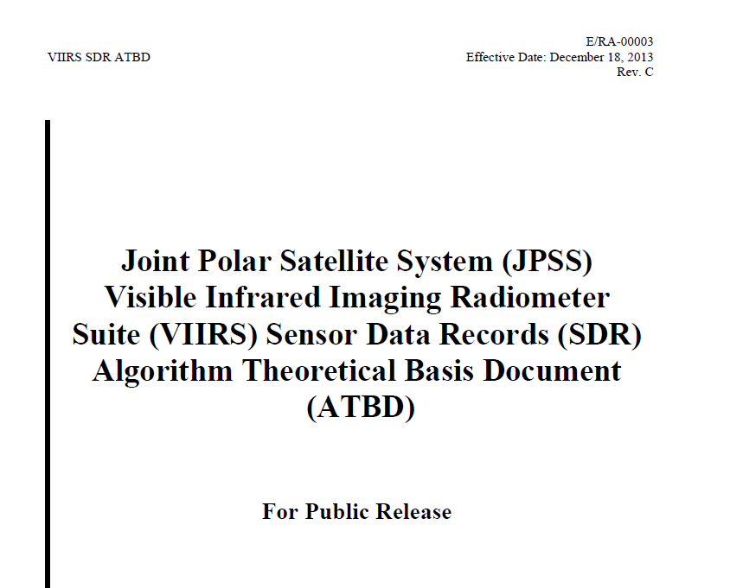
Key Reference ATBDs

Slide 5
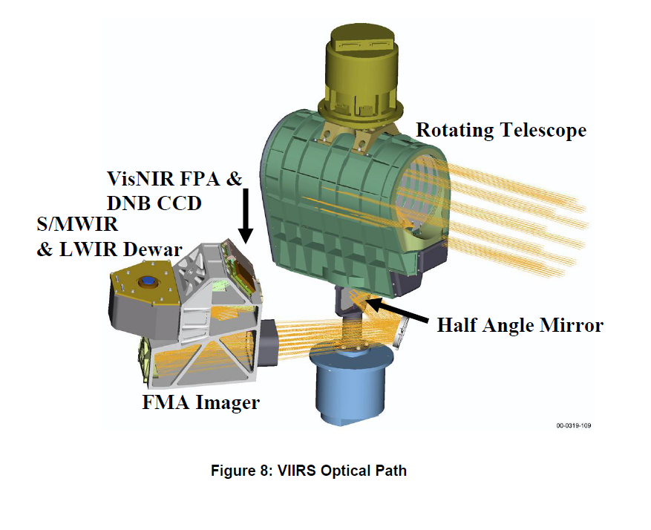
VIIRS collects through a rotating telescope

Slide 6
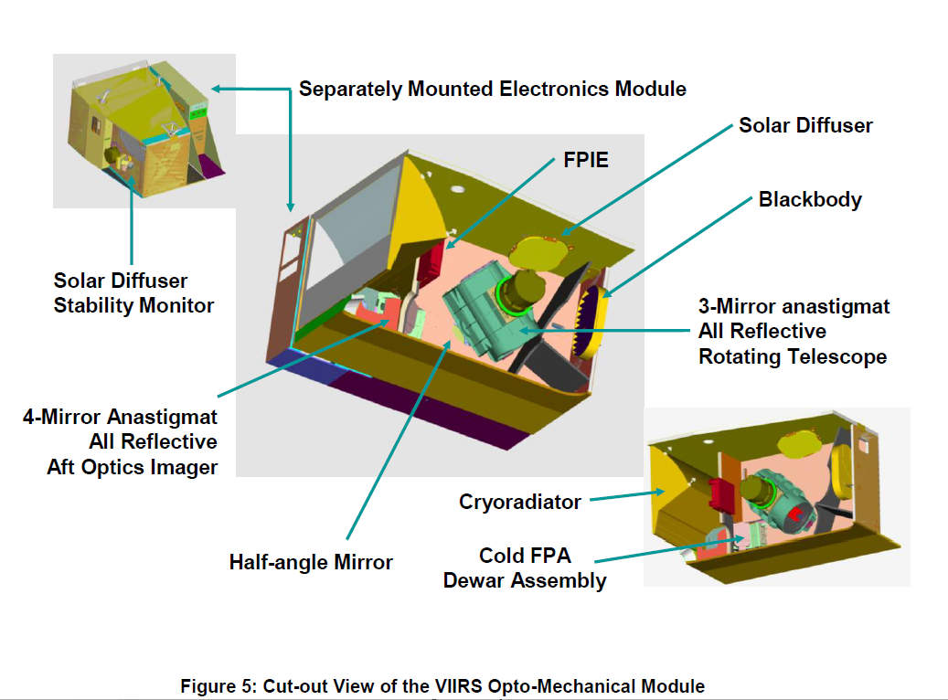
Overview Schematic

Slide 7
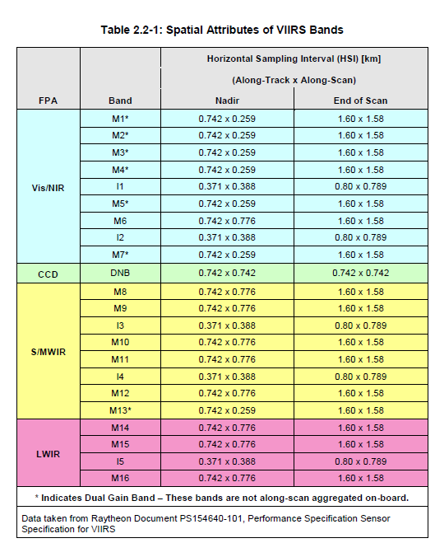
VIIRS Spectral Bands and ground footprints

Slide 8
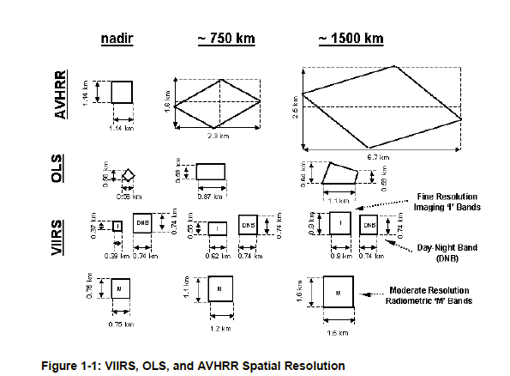
Each new generation of polar orbiting meteorological imager has improved spatial resolution

Slide 9
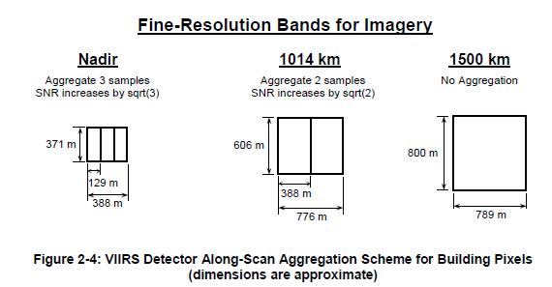
VIIRS I and M band data are aggregated on board to constrain pixel footprint
The nadir zone has smaller pixel footprints and lower noise.

Slide 10
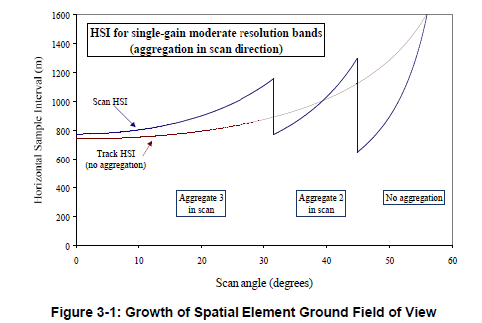
Pixel footprint have track and scan direction components

Slide 11
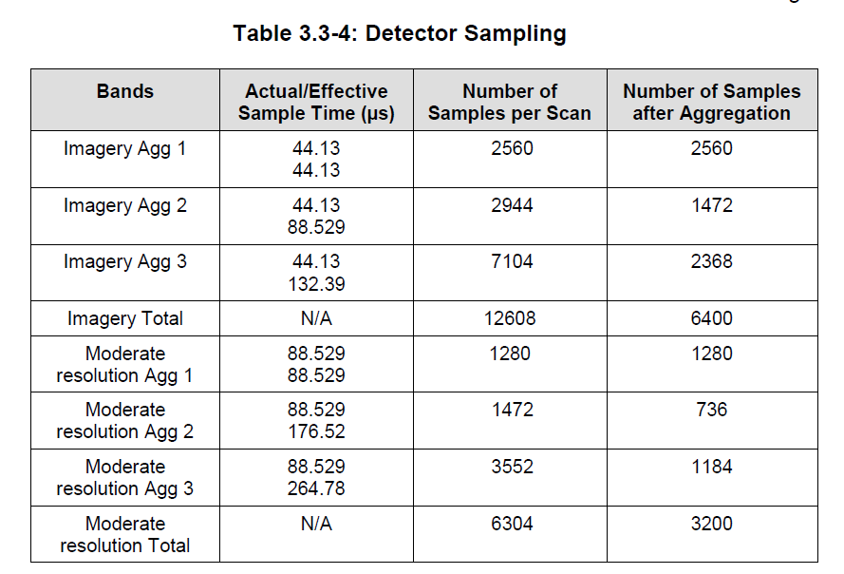
M and I band dwell times and aggregation zones

Slide 12
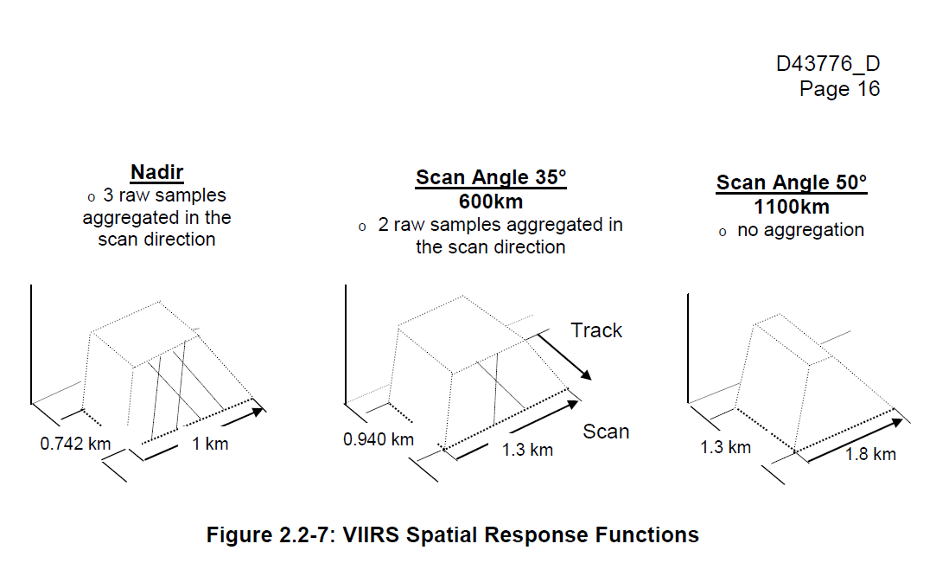
M band footprint expansion from nadir to edge-of-scan

Slide 13
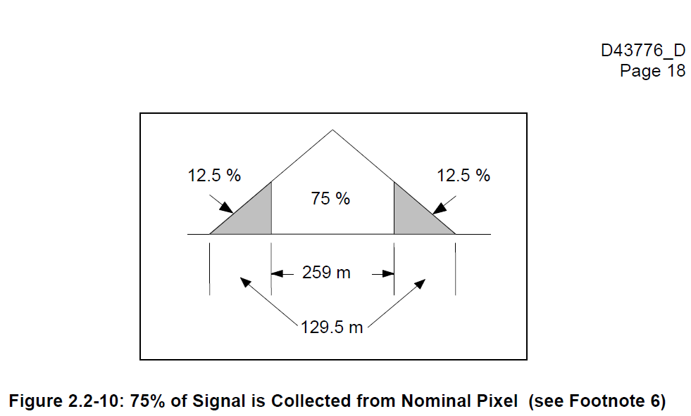
75% of the M band pixel response is from the non-overlap pixel center

Slide 14
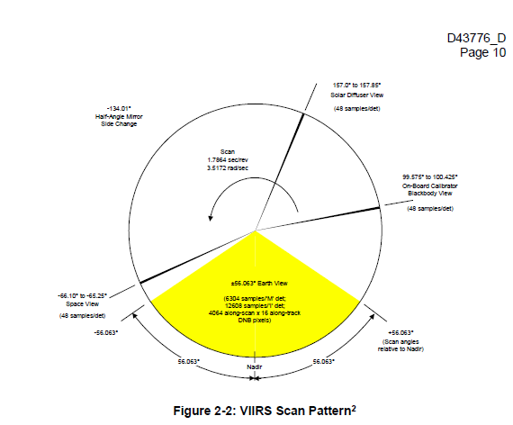
The VIIRS scans are 1.7864 seconds apart

Slide 15
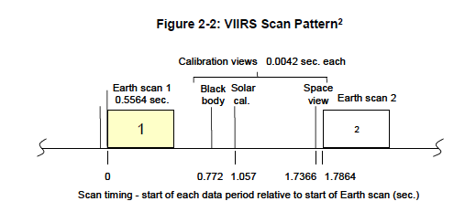
VIIRS Scan

Slide 16
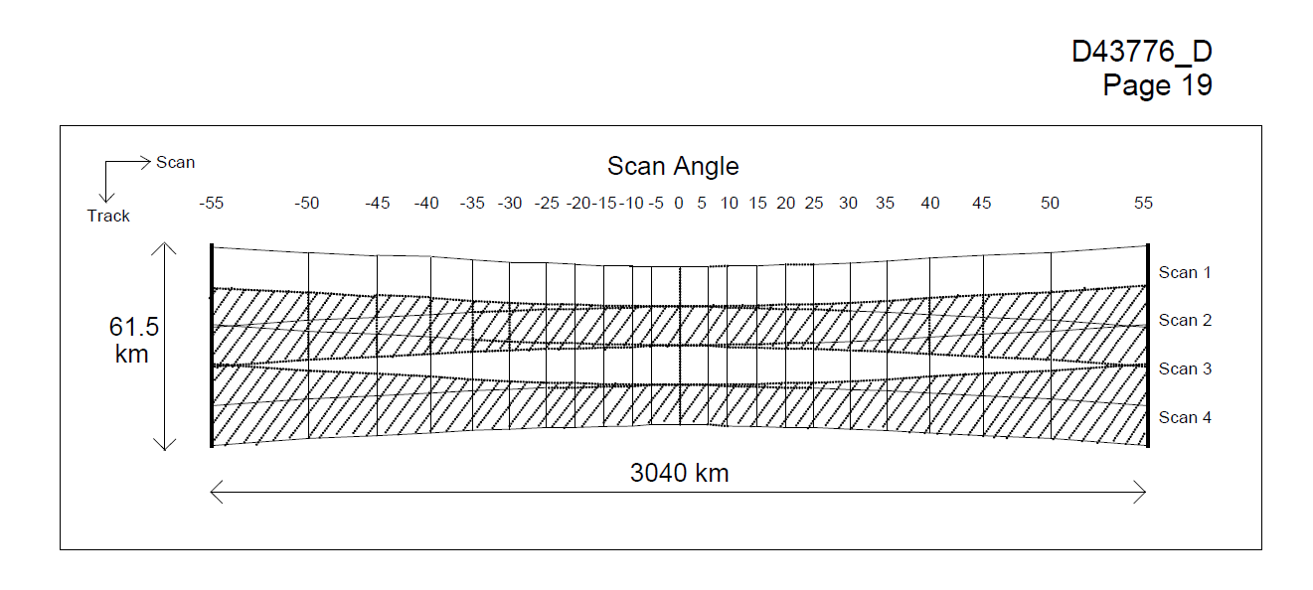
M, I, and DNB pixels are collected in “scan” from a sweep of the telescope across the earth
M band and DNB scans contain 16 scanlines
I band scans contain 32 scanlines
The ideal would be for there to be zero overlap between the scans.
Only the DNB achieves this.
The M and I band scans have negligible overlap at nadir and large overlap at the edge-of-scan

Slide 17
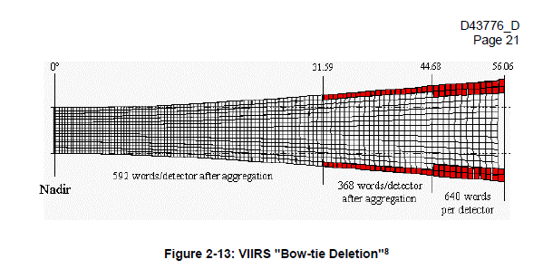
M and I band H5 data have “line deletions” – with empty grid cells of “redundant” data

Slide 18
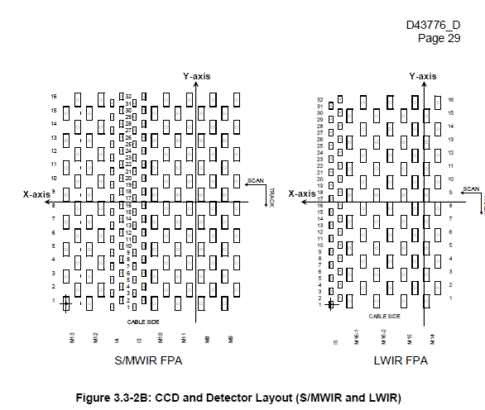
SWIR and LWIR detector arrays

Slide 19
M and I band pixels

Slide 20
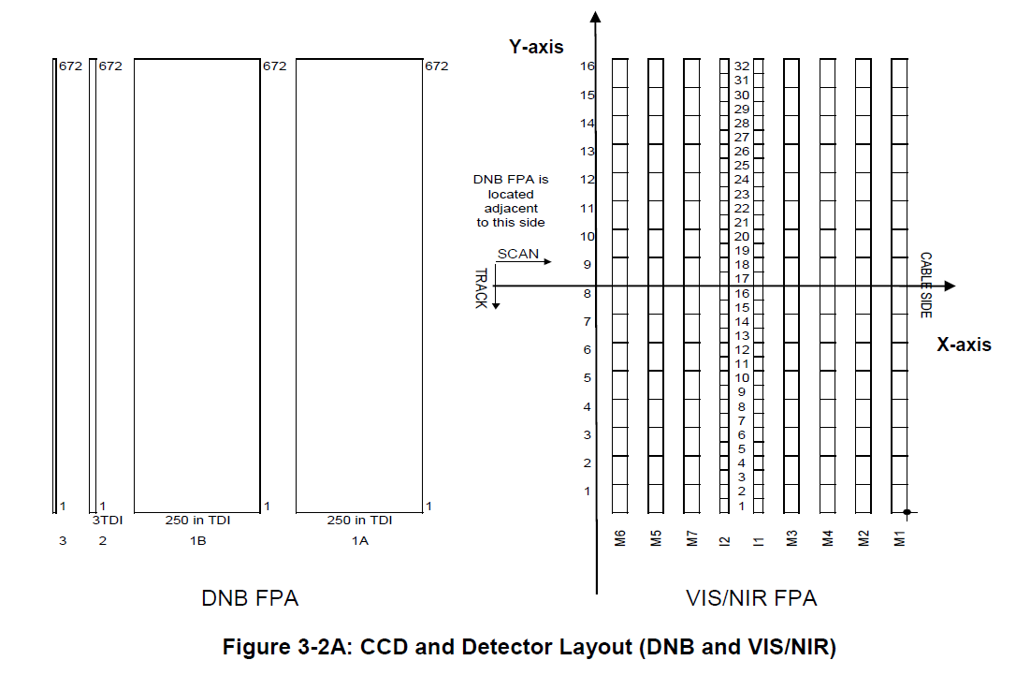
DNB and VNIR detector arrays

Slide 21
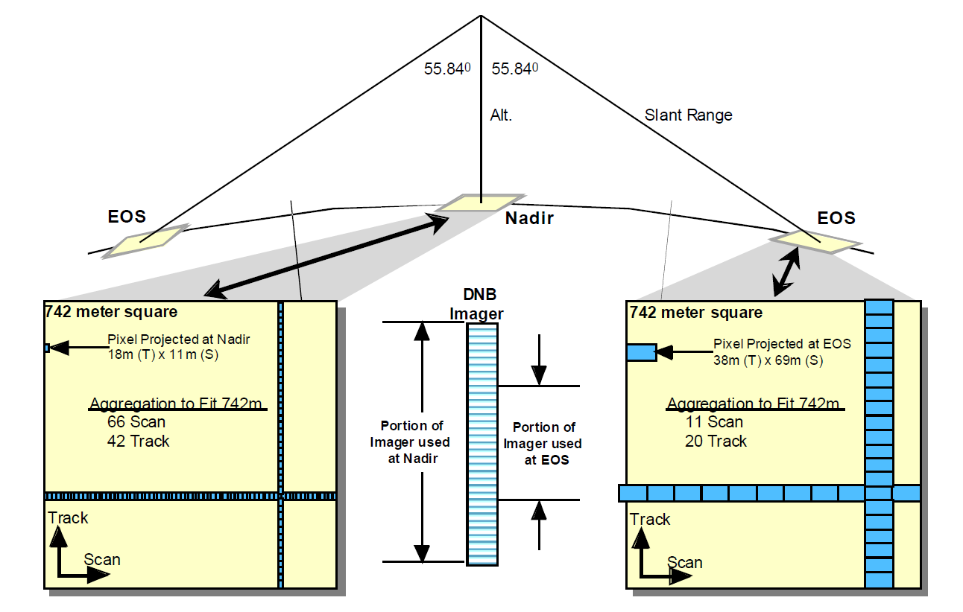
DNB maintains a near-constant footprint across the scan

Slide 22
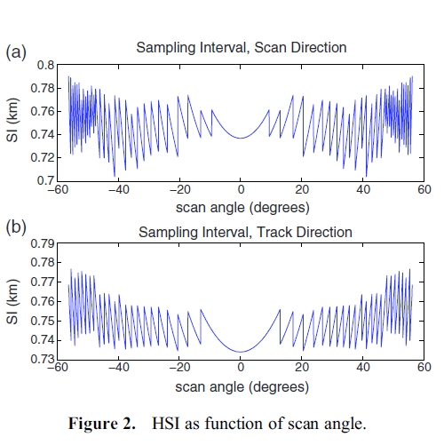
DNB track and scan direction pixel dimensions

