Slide 1
Thermal Laws Used in VIIRS Nightfire
Chris Elvidge
AIT Nighttime Remote Sensing
Lecture 4 January 15, 2024

Slide 2
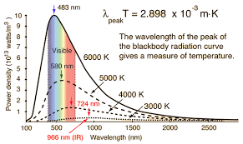
Calculation of IR emitter temperature with Wien’s Displacement Law

Slide 3
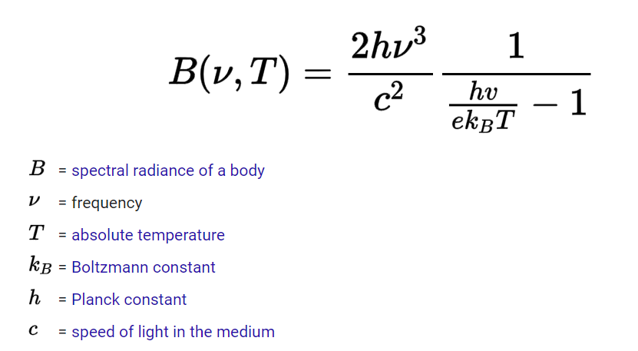
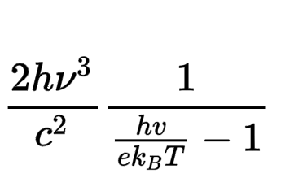
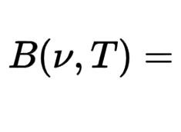
Planck’s Law – run for a series of wavelengths to generate a Planck curve
For a blackbody (emissivity = 1)
For a blackbody (emissivity = 1)
(
(
= emissivity from 0 to 1
Subpixel IR emitters are graybodies.
In VNF we use emission scaling factor (esf) as a stand-in for .

Slide 4
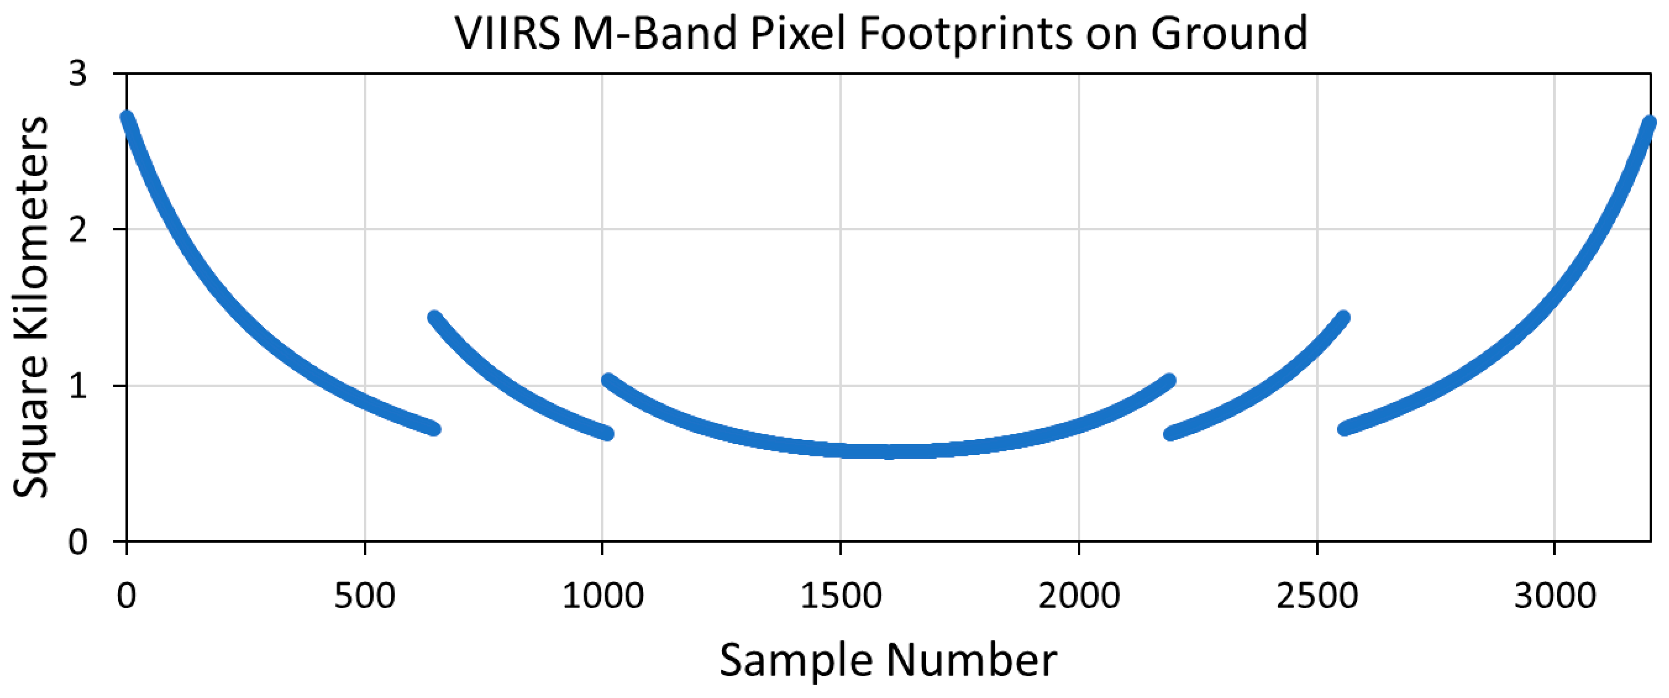
To Estimate Source Area We Need the Pixel Footprint Size

Slide 5
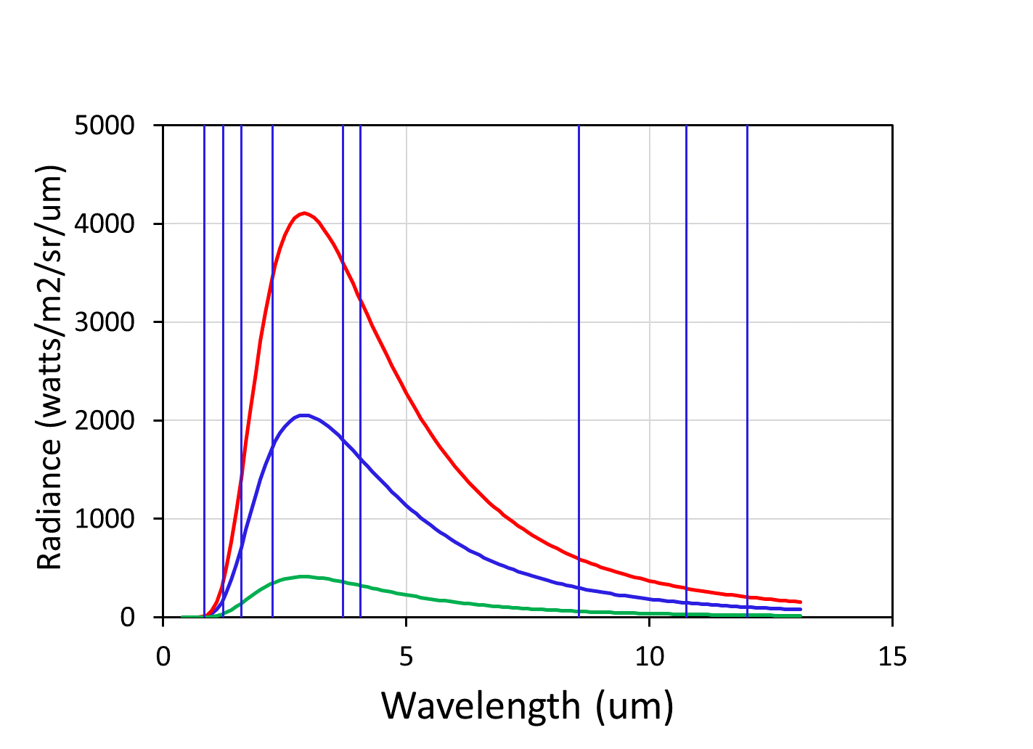
Estimating IR Emitter Source Area
1000 K esf = 1
The ratio between the full pixel (E=1) radiance and the subject detection is multiplied by the pixel footprint size to estimate source size. Any wavelength from 400 to 12000 nm can be used, but the peak is probably the best.
1000 K esf = 0.5
1000 K esf = 0.1

Slide 6
Estimating Radiant Heat With the Stefan-Boltzmann Law
RH = A esf T⁴
RH = Radiant heat in megawatts
A = Surface area of emitter
esf = Emission scaling factor
= Stefan-Boltzmann constant =
5.67 10⁻¹¹ MW/m²
T = Temperature in Kelvin

Slide 7
The T⁴ term results in an exponential increase in RH as temperature rises
This provides the radiance kick that makes satellite fire detection possible.
If a pixel contains emitters with two temperatures – the hotter emitter (primary) dominates making it harder to detect the presence of the cooler emitter.
VNF v.4 refers to the hotter emitter as primary and the cooler emitter as secondary.
VNF v.4 derives the primary emitter Planck curve from the M7-M11 radiances and subtracts the primary emitter’s radiance from all spectral band radiances

