Slide 1
Visualizing changes of lights in Ukraine
M. Zhizhin, Payne Institute, CSM

Slide 2
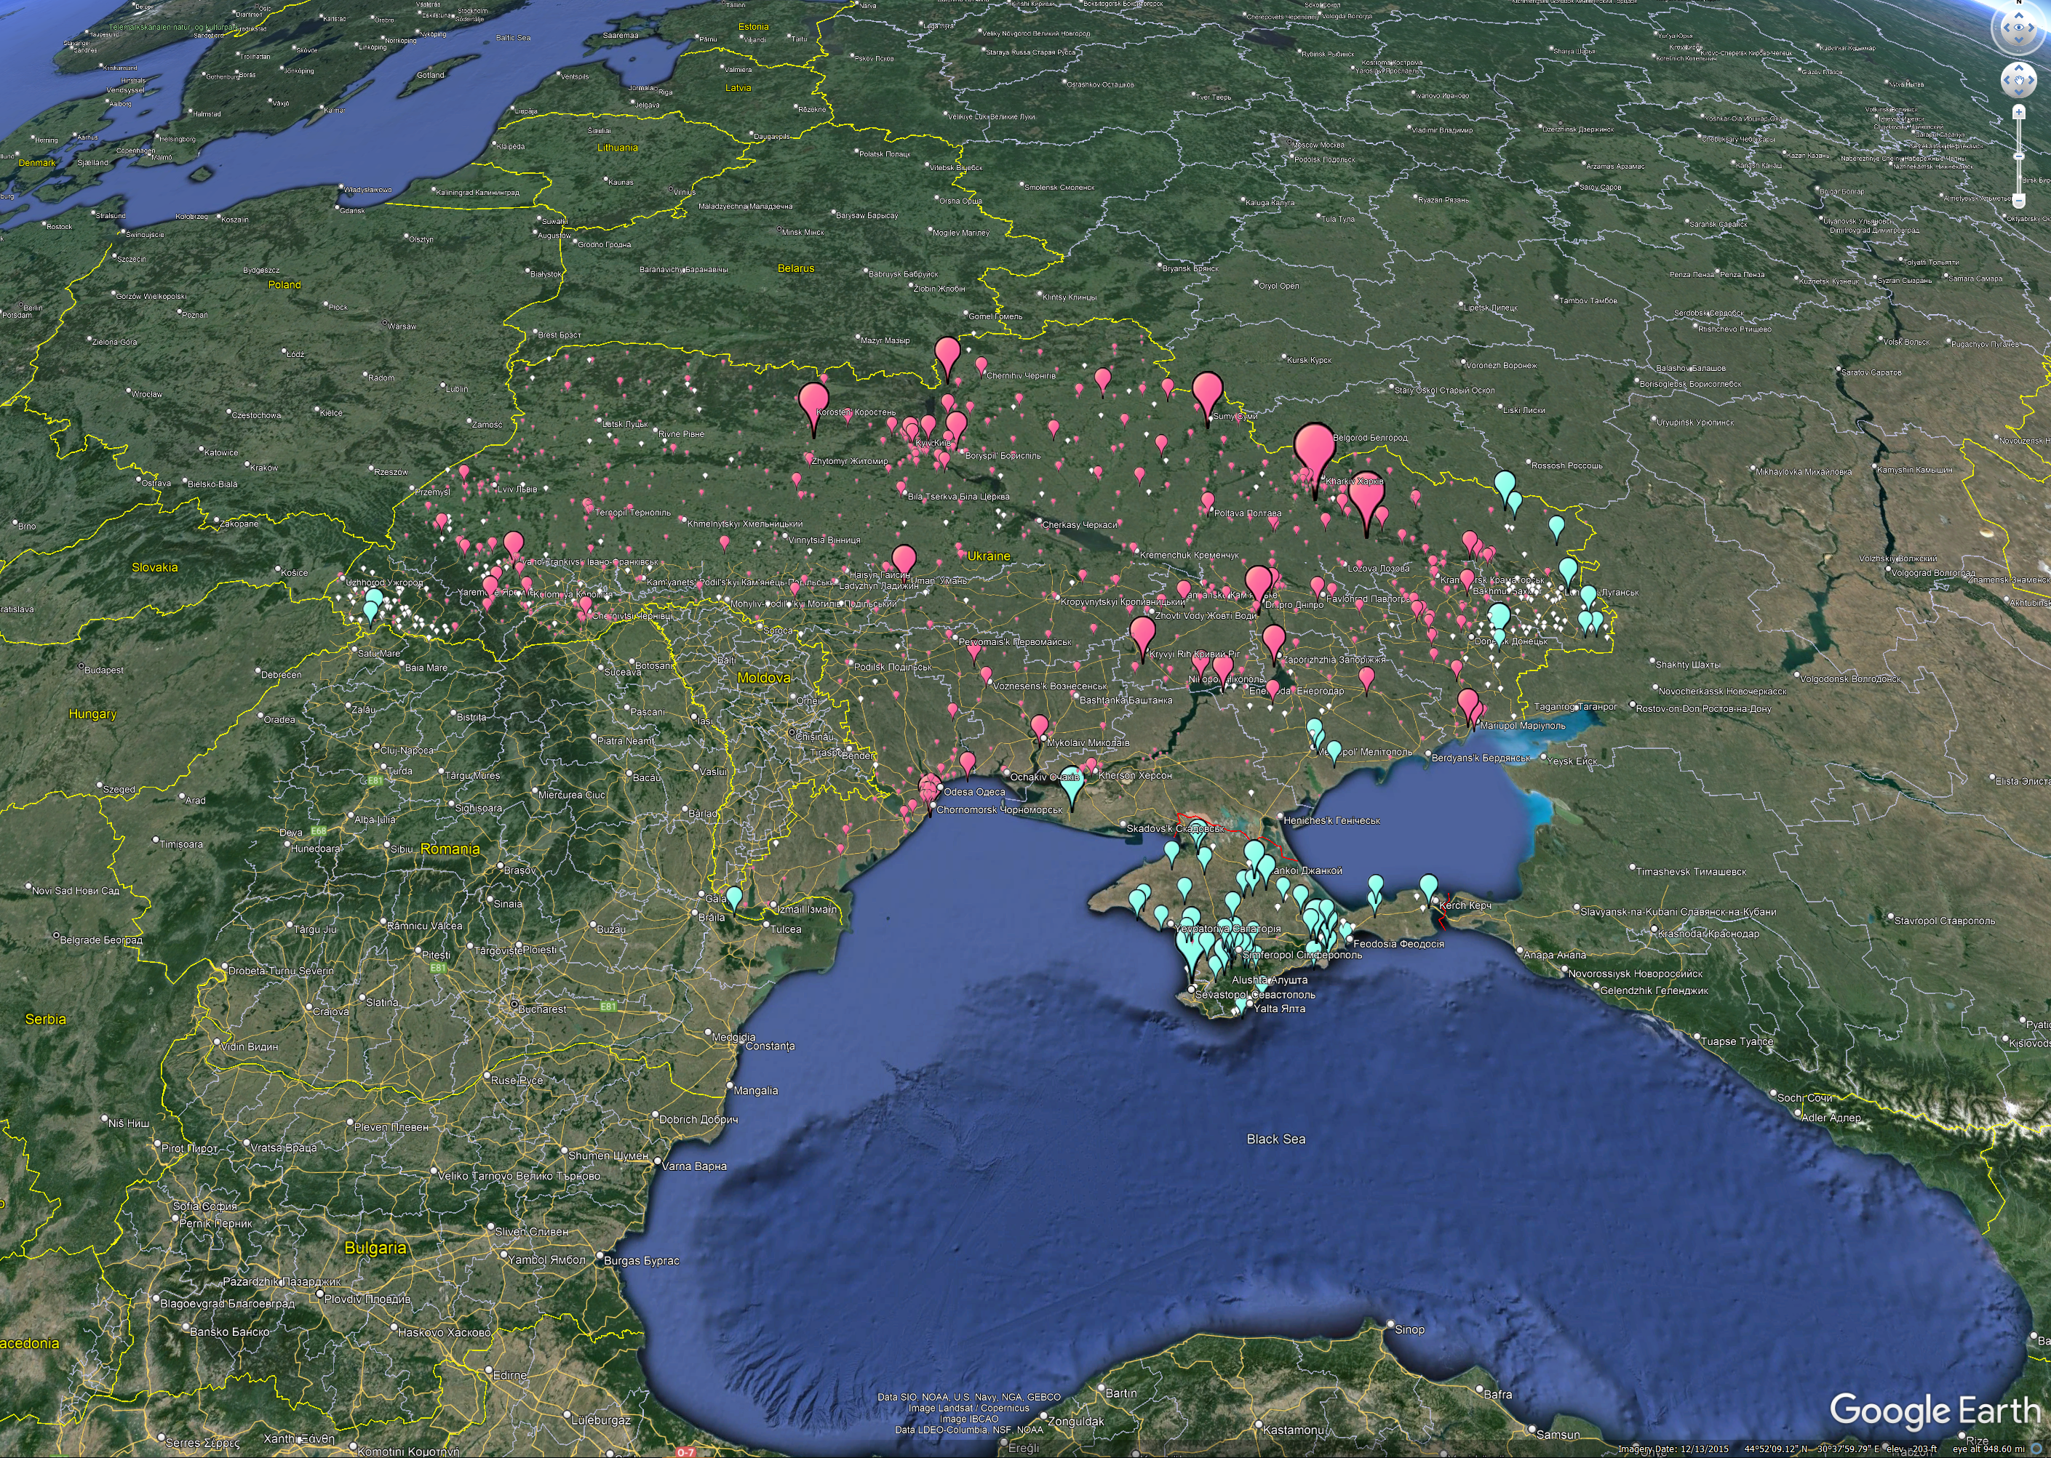
City center lights

Slide 3
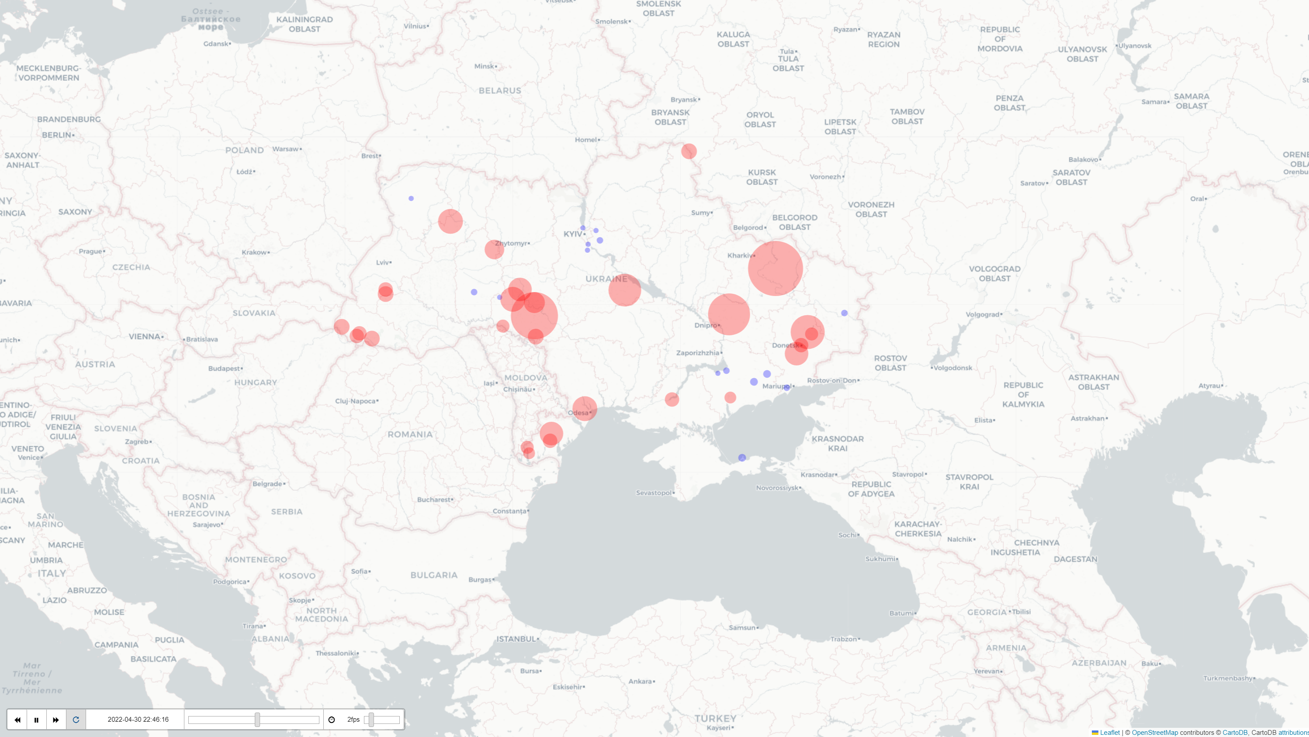
Timelapse of radiance steps in city centers

Slide 4
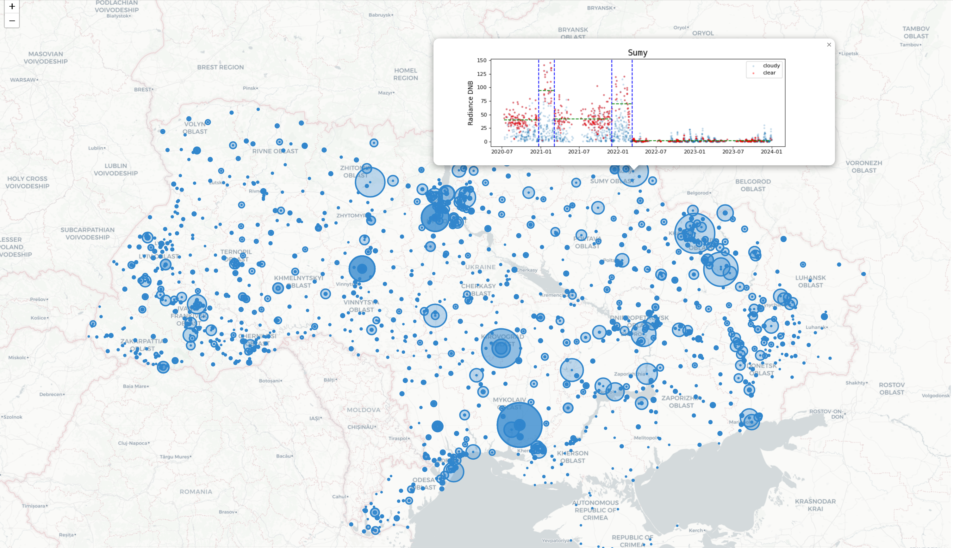
Accumulated steps in city centers

Slide 5
Changes in all lit pixels in Ukraine

Slide 6
Animated map

Slide 7
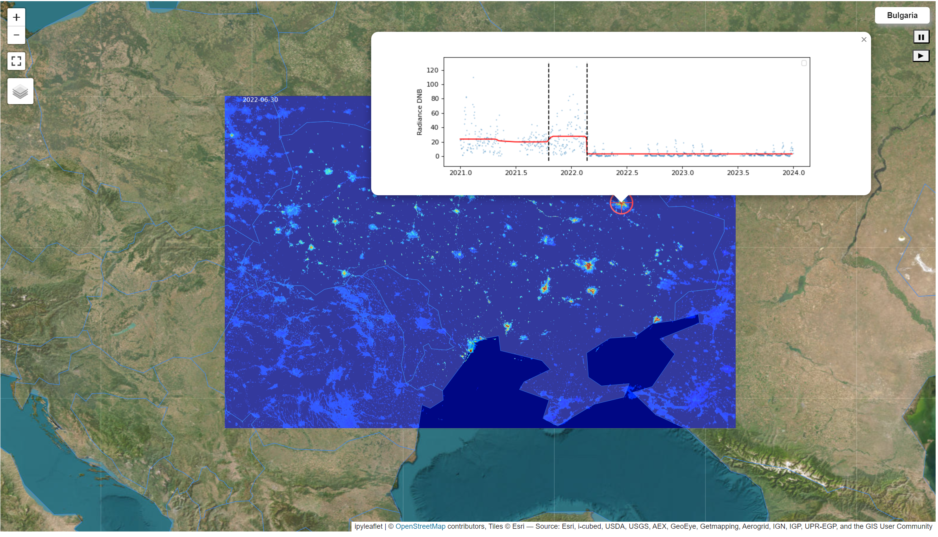
Web map with street and satellite maps, changes movie and profiles

